Slide 2
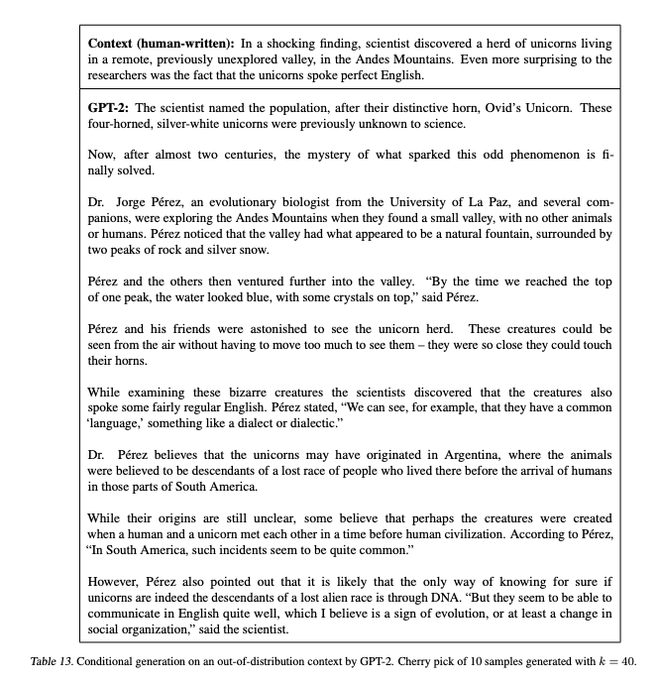

Slide 3
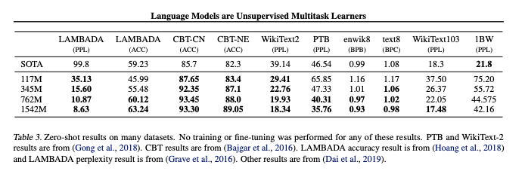
All basically perplexity except CBT = children’s book test, where task is to name the missing word (common noun or named entity)

Slide 4
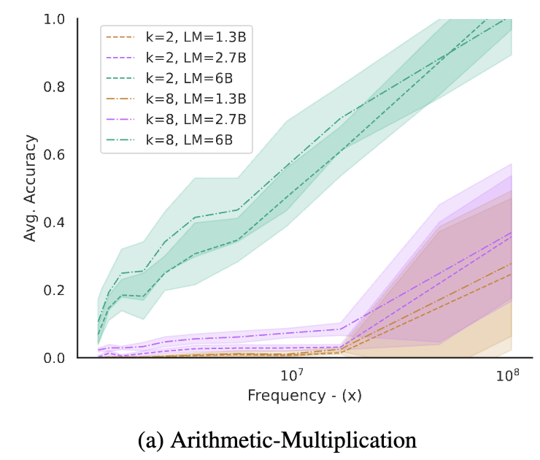
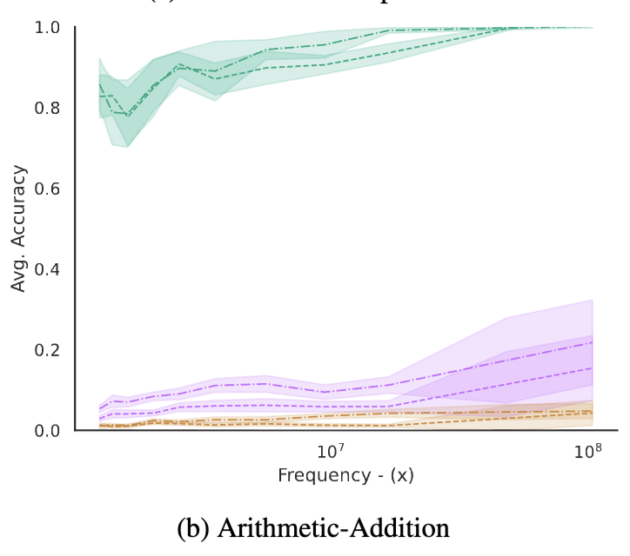
k = shots, LM = GPT-J/GPT-Neo (open reproductions of gpt-3)

Slide 5
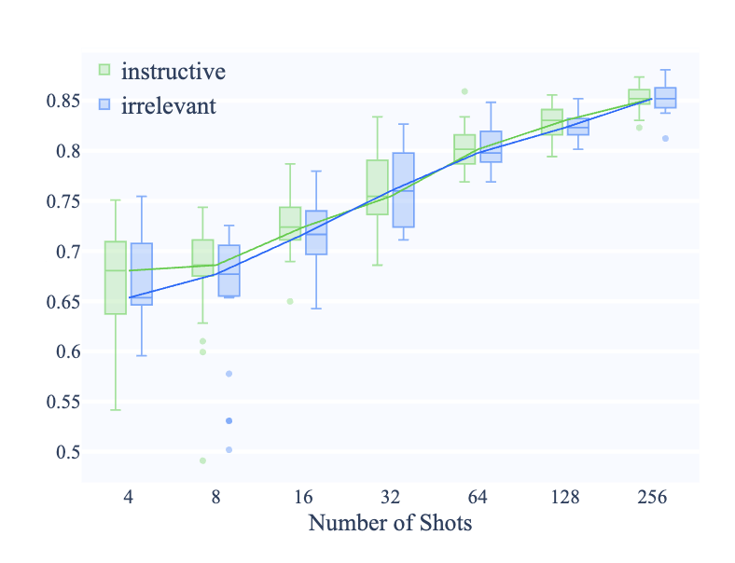
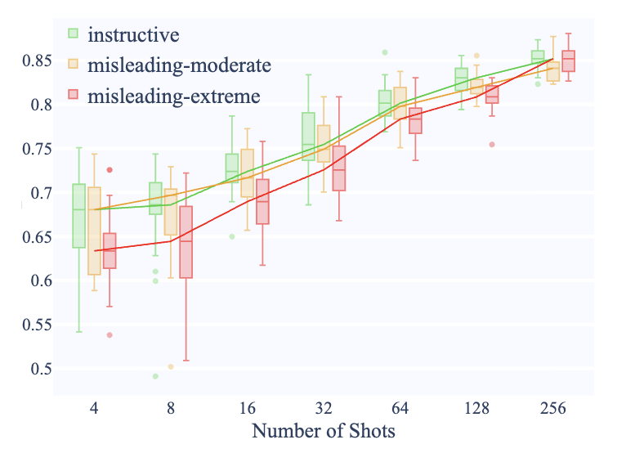
T0 3b
moderate: “<x> Can that be paraphrased as <y>?
extreme: “<x> Is this a sports news? <y>

Slide 6
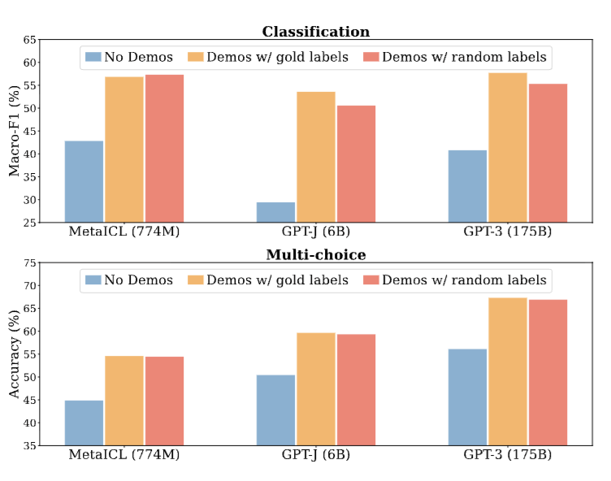
Tasks: 26 datasets, including sentiment analysis, paraphrase detection, natural language inference, hate speech detection, question answering, and sentence completion

Slide 7
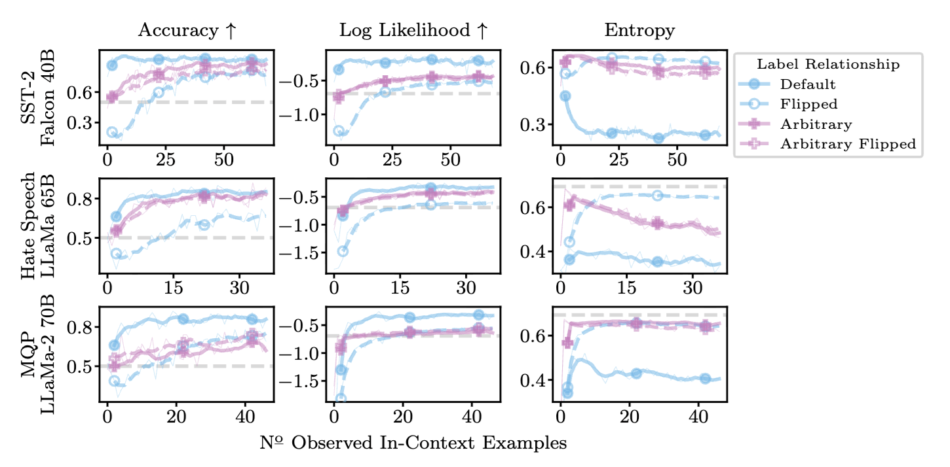
Goal here is to predict the wrong relationship, i.e. “flipped” is “correct”. Note that this is a struggle to learn but the ”wrong” relationship is easy to learn as it’s likely part of pretraining. If the semantics are removed (pos/neg->a/b) no difference seen

Slide 8
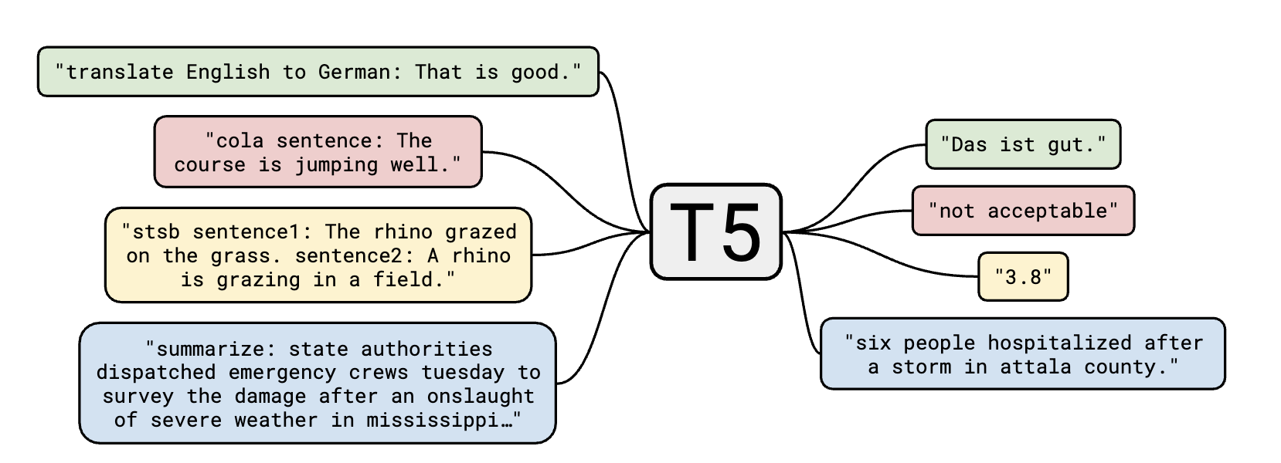

Slide 9
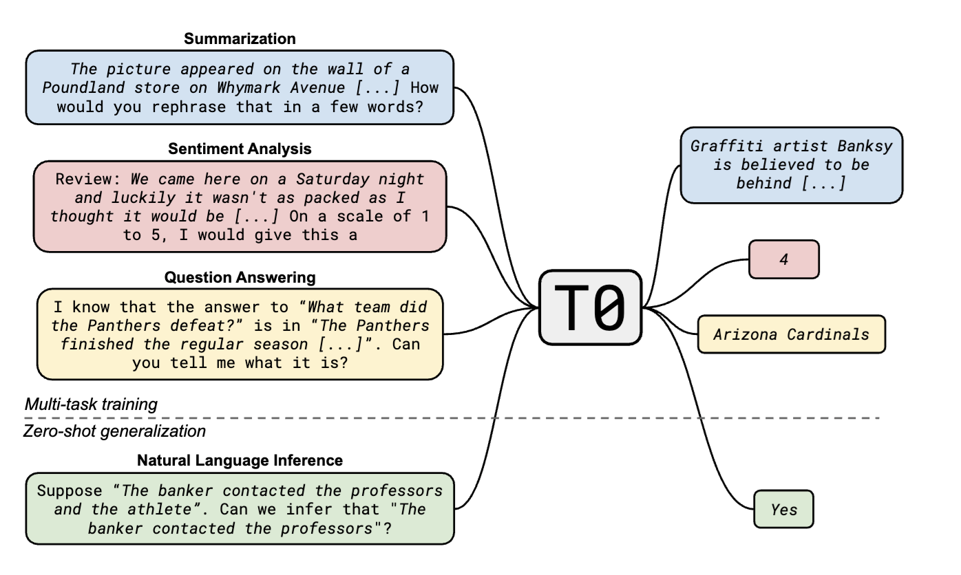
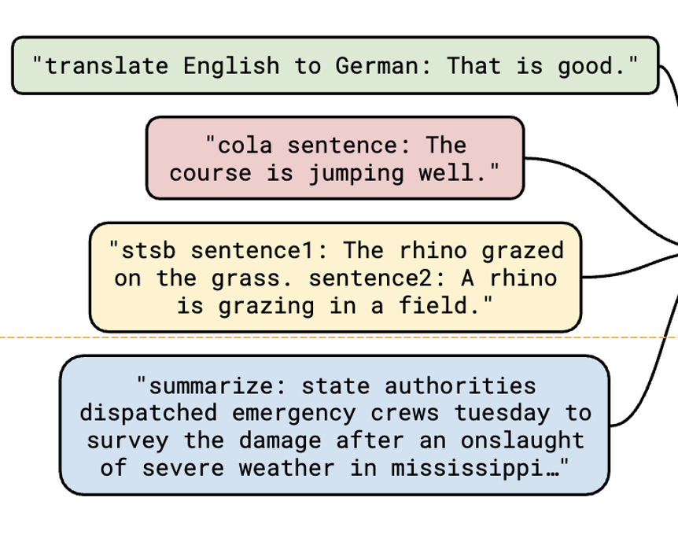
Notice also difference in phrasing

Slide 10
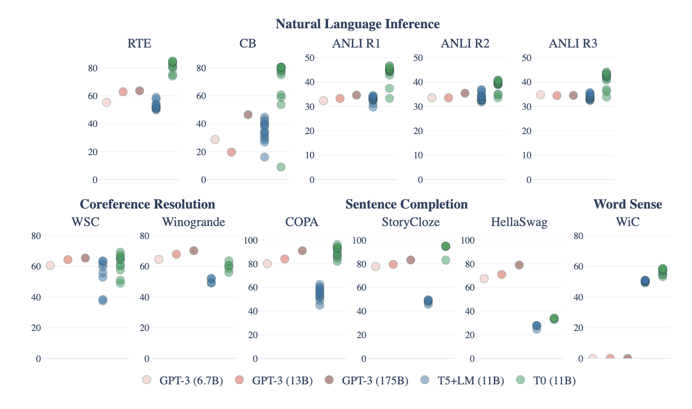
GPT3 = 1 prompt.

Slide 11
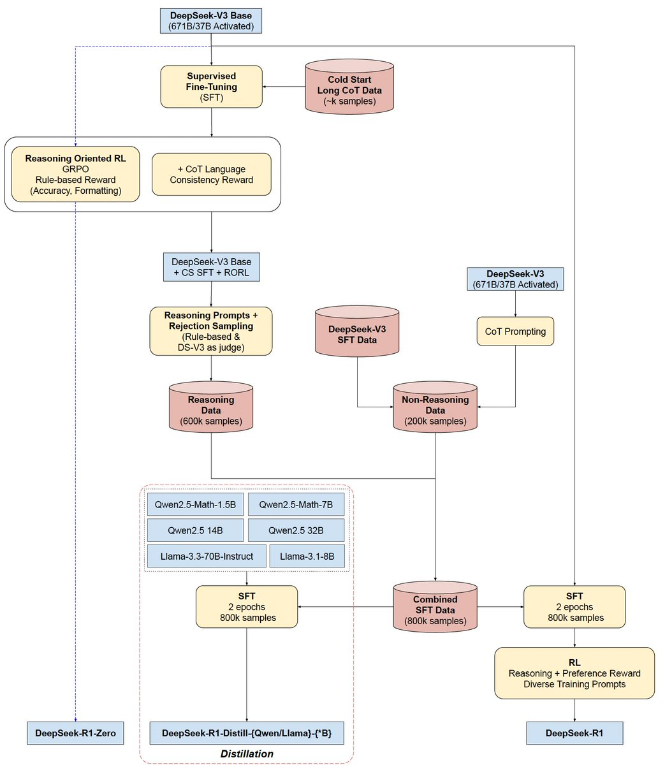
DeepSeek
https://x.com/SirrahChan/status/1881488738473357753/photo/1
https://www.youtube.com/watch?v=QdEuh2UVbu0&list=WL&index=10

Slide 12
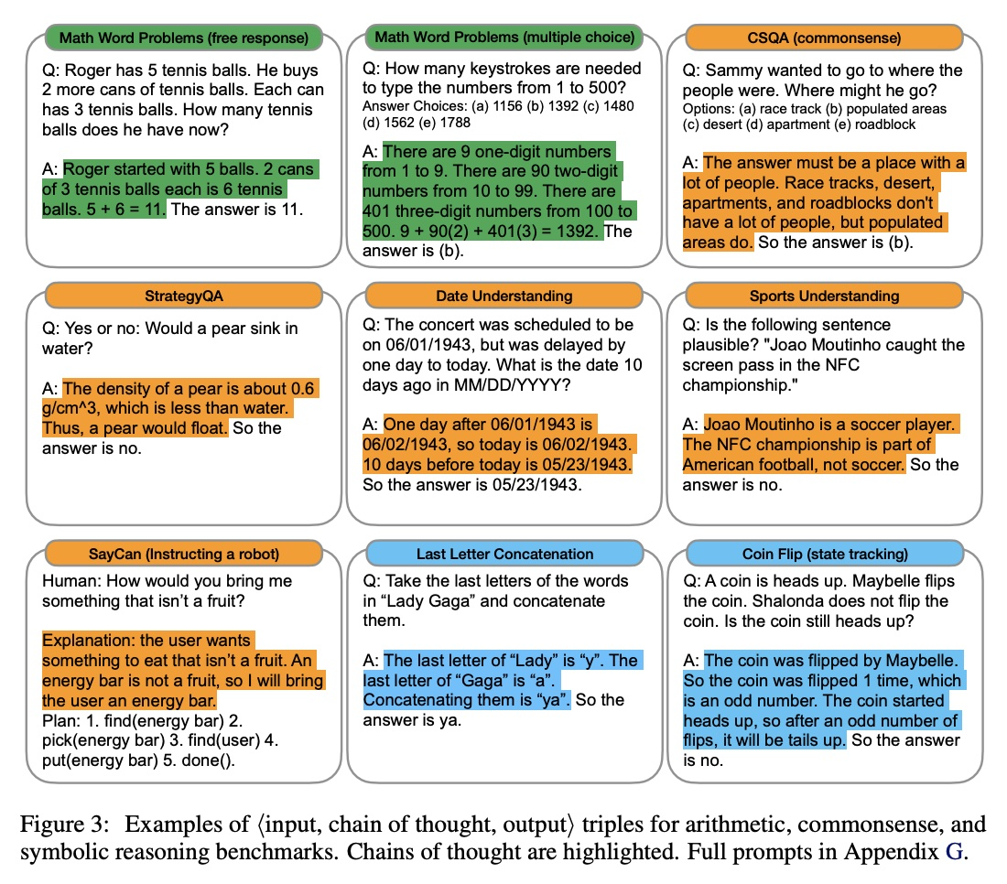
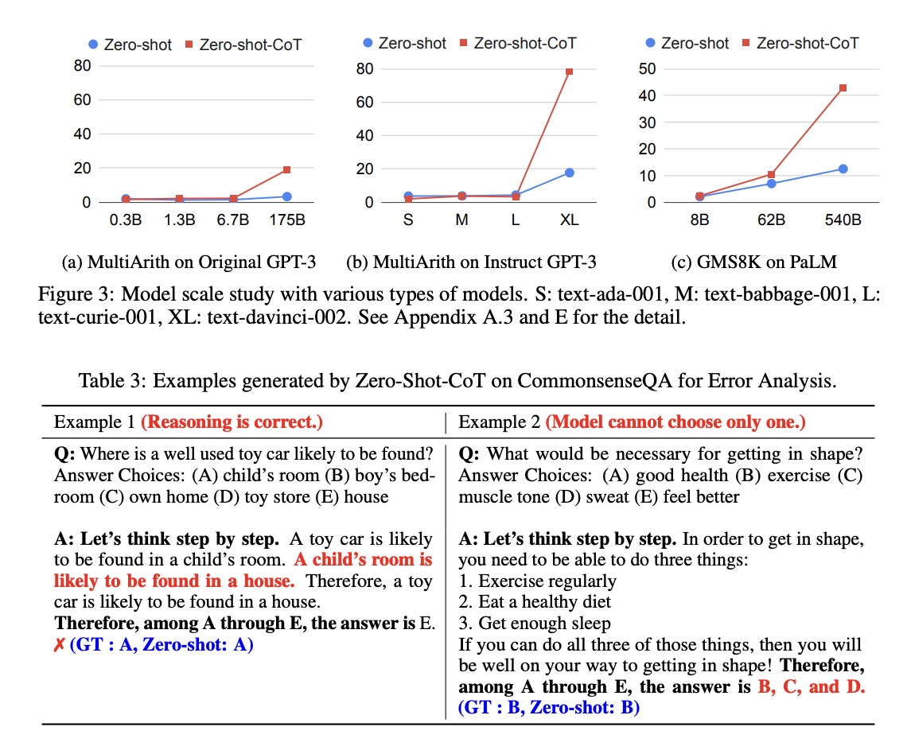

Slide 13
