Slide 1
Human Feedback and Optimization For Language Models
Jonathan May
USC CSCI 662
Oct 1, 2025
Thanks to Graham Neubig (CMU) and Archit Sharma (Stanford) for slides/inspiration
Thanks to Bill Byrne (Cambridge) for discussion and pointers

Slide 2
Reading List
Critical Papers
Ziegler et al. 2020. RLHF for LMs from OpenAI. Foundation for InstructGPT/ChatGPT
Ouyang et al. 2022. InstructGPT (mainly section 3 and relevant appendices)
Rafailov et al. 2023. DPO
Ethayarajh et al. 2024. KTO. Also gives a nice overview of RLHF/PPO/DPO
Xu et al. 2024. CPO (mainly section 3 and relevant appendices)
Other Papers
Schulman et al. 2017 PPO, not from an LM perspective
Ahmadian et al. 2024 Cohere paper on REINFORCE. Good recap of Ziegler too
Liu et al. 2024 and Liu and May 2024 . ASTRAPOP and STAMP
Yang et al. 2024. DPO and MBR (for MT)

Slide 3
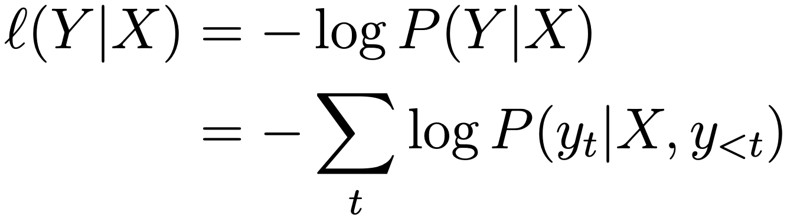
Maximum Likelihood Training
Maximum the likelihood of predicting the next word in the reference given the previous words

Slide 4



Problem 1: Some Mistakes are Worse than Others
In the end, we want good outputs
Some mistaken predictions hurt more than others, so we'd like to penalize them appropriately
e.g.:
Please send this package to Pittsburgh
Please send a package to Pittsburgh
Please send this package to Tokyo
****ing send this package to Pittsburgh
Խնդրում ենք ուղարկել այս փաթեթը Պիտսբուրգ
(Khndrum yenk’ ugharkel ays p’at’et’y Pitsburg)
Notes:
ays = this
patet ugharkel pitsburg = send a package to pgh

Slide 5
Problem 2: The “Gold-standard” in MLE can be Bad
Corpora are full of outputs that we wouldn’t want a language model reproducing!
For instance:
Toxic comments in reddit
Disinformation
Translations from old machine translation systems
Less-good auto-generated text

Slide 6



Problem 3: Exposure Bias
MLE training doesn’t consider the necessity for generation — relies on gold-standard context
encoder
I
I
I
I
classify
classify
classify
classify
classify
I
I
I
I
I
Exposure bias: The model is not exposed to mistakes during training, and cannot deal with them at test
Notes:
the context is always the *correct* y so far, and in real world you make mistakes but keep going. leads to repetition. if a word happens it’s more likely to happen

Slide 7
An Alternative: Measuring how “Good” an Output Is

Slide 8
How to Measure output “Goodness"?
Objective assessment
Human subjective annotation
Machine prediction of human preferences
Use in another system

Slide 9
Objective Assessment
Have an annotated “correct” answer and match against this
e.g. in solving math problems, answering objective questions
Beth bakes 4 batches of 2 dozen cookies in a week. If these cookies are shared amongst 16 people equally, how many cookies does each person consume?
Source: GSM8K - Cobbe et al. 2021
Notes:
24 x 4 = 96; 96/16 = 6

Slide 10



Human Evaluation
??
0.8
Hypothesis 1
Source
??
0.5
Hypothesis 2

Slide 11
Human Feedback: Direct Assessment
Խնդրում ենք ուղարկել
այս փաթեթը Պիտսբուրգ
Directly give a score
Often assign scores based on desirable traits
Fluency: how natural is the output
Adequacy: in translation, how well does the output reflect the input semantics?
Factuality: is the output factually entailed
Coherence: does the output fit coherently in a discourse?
etc. etc.
Please send this package to Tokyo
2/10
Notes:
mt example; assumes some japanese input i guess that isn’t seen? replace with something else...

Slide 12
Human Feedback: Preference Ratings
Preference rankings
+ can be easier and more intuitive than direct assessment
- can’t tell if all systems are really good or really bad
To rank multiple systems (avoid overwhelming humans), can use Elo or TrueSkill rankings (Sakaguchi et al. 2014)
Please send this package to Tokyo
worse
Please send a package to Pittsburgh
better
connection to Bradley-Terry model:
p(sys1 > sys2) = pref1/(pref1+pref2)
Notes:
REDO SLIDE

Slide 13
Human Feedback: Error Annotation
Annotate individual errors within the outputs
e.g. Multi-dimensional Quality Metrics (Freitag et al. 2021)
Can you send a package to Tokyo
minor/
linguistic
conventions
major/
accuracy
+ Gives more fine-grained feedback
+ Can be more consistent
- Can be very time-consuming
Notes:
REDO SLIDE

Slide 14

An Alternative to Humans: Automatic Evaluation
??
0.8
Hypothesis 1
Source
Reference
??
0.5
Hypothesis 2

Slide 15
Machine Prediction of Human Preferences
Predict human feedback automatically using a model
Variously called
“automatic evaluation” e.g. in machine translation
“reward model” e.g. in chatbots
Sometimes uses a “reference” output

Slide 16
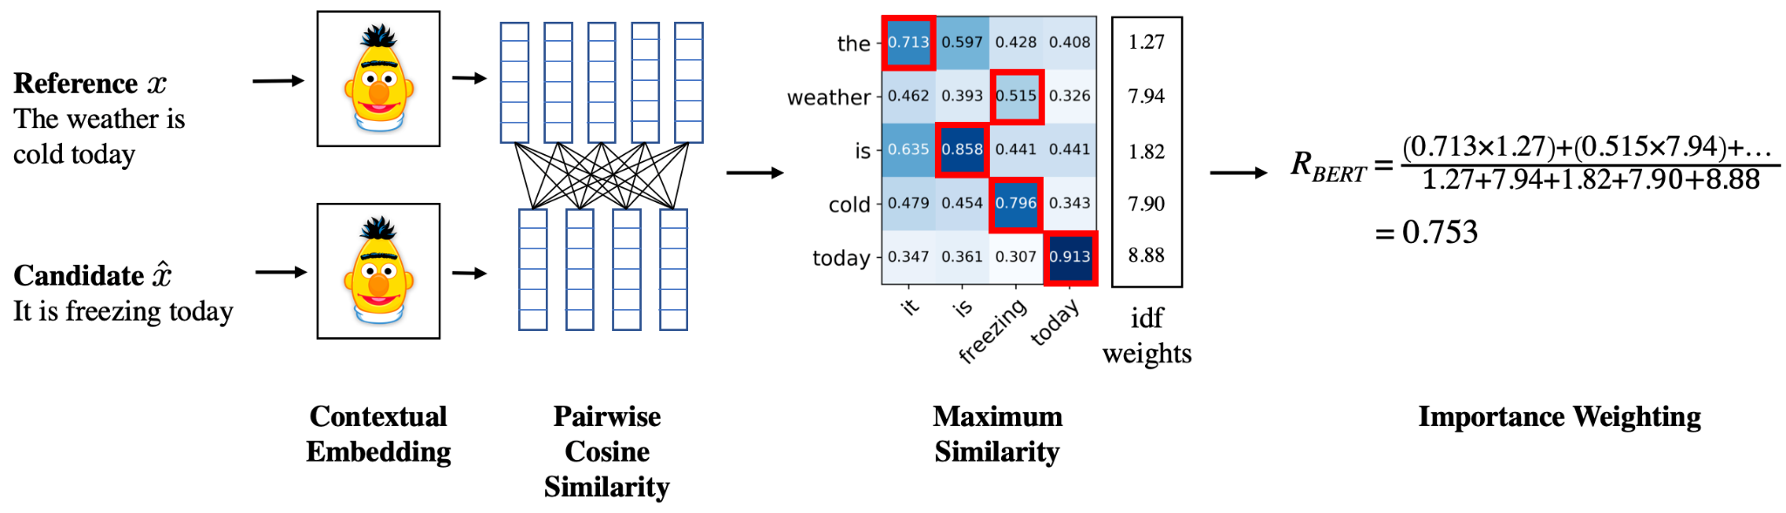
Embedding-based Evaluation
Unsupervised calculation based on embedding similarity
e.g. BERTScore (Zhang et al. 2019)
Notes:
recall along the rows, or precision along the columns. use IDF to encourage rarer more contentful terms

Slide 17

Regression-based Evaluation
Supervised training of an embedding-based regressor
e.g. COMET (Rei et al. 2020)
0.5
Source
0.4
Difference
Update
Reference
0.1
??
Hypothesis 1

Slide 18
Meta-evaluation of Metrics
Human
Automatic
??
0.8
0.7
Pearson = 0.23
Kendall = 0.33 Error = 0.28
??
0.5
0.1
??
0.1
0.5
??
0.6
0.4
Use datasets like WMT shared tasks (Fabbri et al. 2020), SumEval (Freitag et al. 2023)

Slide 19
Use in a Downstream System
Intrinsic evaluation: Evaluate the quality of the output itself
Extrinsic evaluation: Evaluate output quality by its utility
Example: evaluate LLM summaries through QA accuracy (Eyal et al. 2019)

Slide 20
Incorporating “Goodness” into Learning: Error and Risk

Slide 21
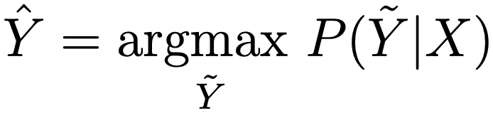
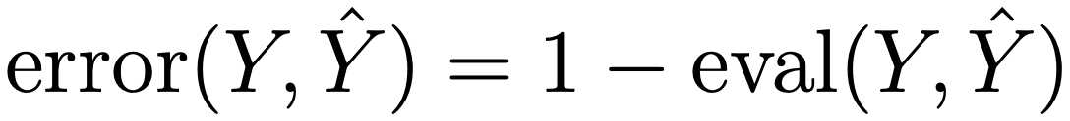
Error
Generate an output
Calculate its "badness" (e.g. 1-eval score)
We would like to minimize error

Slide 22
Problem: Eval is Non-differentiable
Evaluation function applies to a sequence, not a token
The gradient (and value!) of this function is zero almost everywhere, not-conducive to gradient-based training
Only sampling one output doesn’t give us information about the error for other outputs given the same input

Slide 23
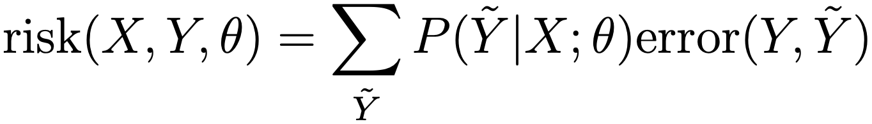
Risk
Risk is defined as the expected error
This includes the probability in the objective function!
Differentiable, but the sum is intractable (so sample over a reduced set per X; avoid duplicates and bad samples)
Very similar to RL; see REINFORCE algorithm; next section
Notes:
TODO: wait, but this is different from reward * KL div, isn’t it?

Slide 24
Reinforcment Learning Basics: Policy Gradient
(Review of Karpathy 2016)

Slide 25
What is Reinforcement Learning?
Learning where we have an
environment X
ability to make actions A
get a delayed reward R
Example of pong: X is our observed image, A is up or down, and R is the win/loss at the end of the game
What are X, A, R in an NLP task?
Notes:
ask: what are X, A, R in NLP?

Slide 26
Why Reinforcement Learning in NLP?
We may have a typical reinforcement learning scenario: e.g. a dialog where we can make responses and will get a reward at the end.
We may have latent variables (e.g. chains of thought), where we decide the latent variable, then get a reward based on their configuration.
We may have a sequence-level evaluation metric such that we cannot optimize without first generating a whole sentence.
Notes:
call center: reward if complete w/o human, mild reward if human delivered, punishment if hangup (maybe?)
chain of thought may not be good but you still might get the right answer. if you only care about answer, then this is an RL scenario. I tend to not favor this.

Slide 27
Supervised MLE
We are given the correct decisions
In the context of reinforcement learning, this is also called “imitation learning,” imitating a teacher (although imitation learning is more general)
Notes:
skippable? not sure point w/r/t RL

Slide 28



Self Training
Sample or argmax according to the current model
or
Use this sample (or samples) to maximize likelihood
No correct answer needed! But is this a good idea?
One successful alternative: co-training, only use sentences where multiple models agree (Blum and Mitchell 1998)

Slide 29
Policy Gradient/REINFORCE
Add a term that scales the loss by the reward
Outputs that get a bigger reward will get a higher weight
Quiz: Under what conditions is this equal to MLE?
Notes:
zero one reward; iimplies more flexible rewards
this is the expectation of the reward

Slide 30
Credit Assignment for Rewards
How do we know which action led to the reward?
Best scenario, immediate reward:
Worst scenario, only at end of roll-out:
Often assign decaying rewards for future events to take into account the time delay between action and reward
Most frequent approach: do nothing (just average across actions or only apply it to the final token)
a1
a2
a3
a4
a5
a6
0
+1
0
-0.5
+1
+1.5
a1
a2
a3
a4
a5
a6
+3
Notes:
mostly just amortize over the sequence

Slide 31
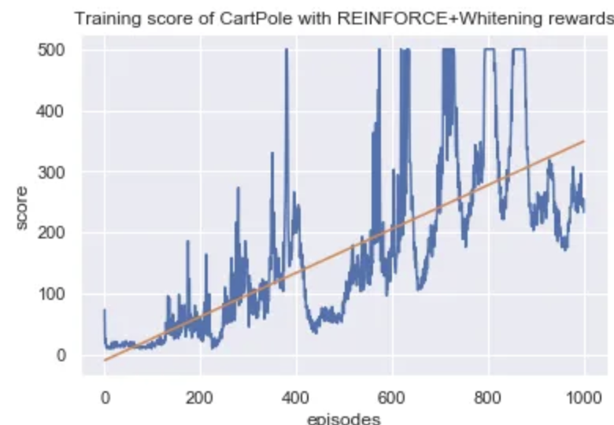
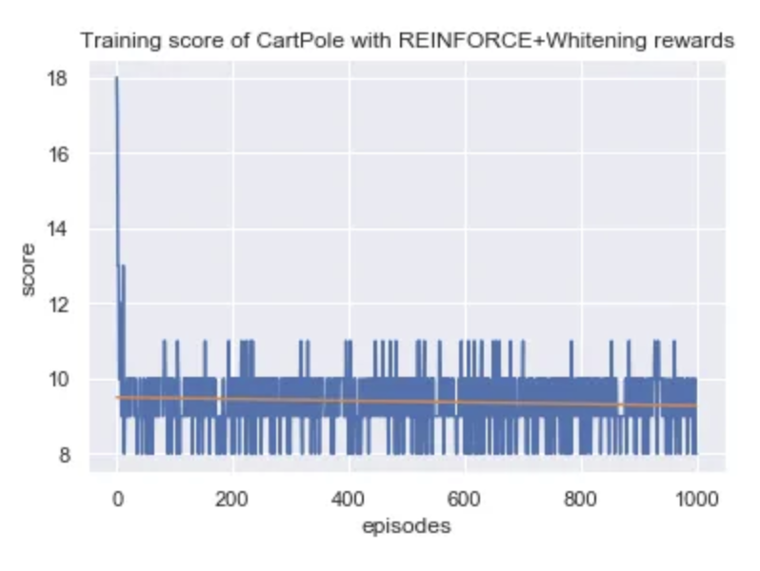
Naive Implementation
From a base model, given an (X, Y) pair [or just X], generate [or score] some [YHAT] with probability P(YHAT|X)
Calculate R(YHAT, Y) [depending on R approach]
Update model with loss per REINFORCE algorithm
Problem?
Notes:
TODO replace with actual loss curves if possible

Slide 32
Stabilizing Reinforcement Learning

Slide 33
Problems w/ Reinforcement Learning
Like other sampling-based methods, reinforcement learning is unstable
It is particularly unstable when using bigger output spaces (e.g. words of a vocabulary)
A number of strategies can be used to stabilize
Notes:
why is sampling stability not a problem with MLE? (because cross entropy and specifically eq for deriv of softmax inherently downweights all other possibilities)

Slide 34
Pre-training with MLE
(Ranzato et al. 2016)
Start training with MLE, then switch over to RL
Almost seems obvious for us!
Works only in the scenarios where we can run MLE
e.g. standard RL (cartpole)
or in NLP if no training data (but now we effectivevly always can have some kind of training data)

Slide 35
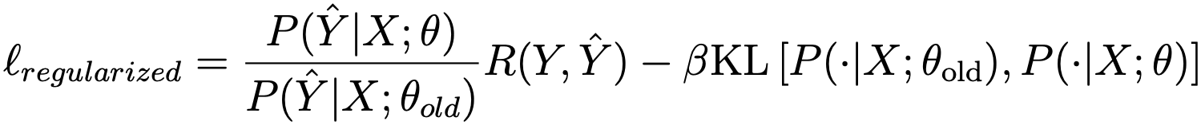
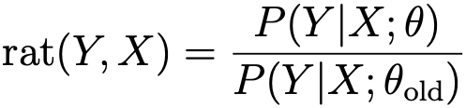
Regularization to an Existing Model
(e.g. Schulman et al. 2017)
Have an existing model, and prevent it from moving too far away
Method one: KL regularization
tough to calculate
improve reward
keep model similar
Method two: proximal policy optimization (PPO)
don’t reward large jumps
Notes:
change this to objective; higher is better but it’s represented as a loss
also point out how the kl is hard to calculate.
both are fairly popular nowadays
implemented in hf trl

Slide 36
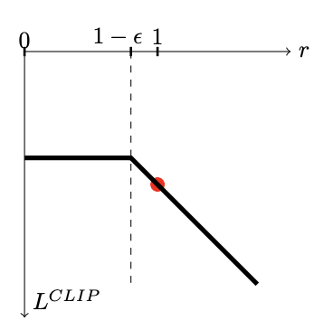
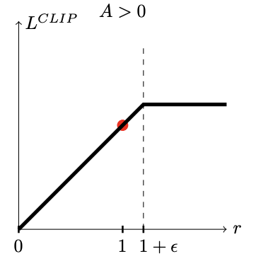
Understanding the pessimistic clipping term a little more (from Schulman et al. 2017)
R > 0, so any <1 rat (where current model is worse) will be used but the biggest rat is 1+𝛜
R < 0, so any >1 rat (where current model is better) will be used but the smallest rat is 1-𝛜
loss
rat

Slide 37
Adding a Baseline To Normalize R
Basic idea: we have expectations about our reward for a particular sentence
Reward
Baseline
B-R
“This is an easy sentence”
0.8
0.95
-0.15
“Buffalo Buffalo Buffalo”
0.3
0.1
0.2
We can instead weight our likelihood by B-R to reflect when we did better or worse than expected
(Be careful to not backprop through the baseline)

Slide 38
Calculating Baselines
Choice of a baseline is arbitrary
Option 1: predict final reward using linear from current state (e.g. Ranzato et al. 2016)
Sentence-level: one baseline per sentence
Decoder state level: one baseline per output action
Option 2: use the mean of the rewards in the batch as the baseline (e.g. Dayan 1990)
Notes:
used as motivation for normed reward

Slide 39

PPO In Action – make positive reviews (manipulated example from trl tutorial
from trl import PPOTrainer, PPOConfig, AutoModelForCausalLMWithValueHead
config = PPOConfig(
model_name="lvwerra/gpt2-imdb",
learning_rate=1.41e-5,
log_with="wandb",
)
Model starts as ref
model = AutoModelForCausalLMWithValueHead.from_pretrained(config.model_name)
ref_model = AutoModelForCausalLMWithValueHead.from_pretrained(config.model_name)
ppo_trainer = PPOTrainer(config, model, ref_model, ...)
sentiment_pipe = pipeline("sentiment-analysis", model="distilbert-imdb”, ...)
text = "this movie was really bad!!"
sentiment_pipe(text...)
[[{'label': 'NEGATIVE', 'score': 2.335048198699951},
{'label': 'POSITIVE', 'score': -2.726576566696167}]]
reward model (R) is basic sentiment classifier
Notes:
TODO: PPO/KL regularization in trl

Slide 40
PPO In Action – make positive reviews (manipulated example from trl tutorial
for batch in enumerate(ppo_trainer.dataloader):
query_t = batch["input_ids"]
#### Get response from gpt2
response_t = []
for query in queries:
response_t.append(ppo_trainer.generate(query...))
batch["response"] = [tokenizer.decode(r) for r in response_t]
#### Compute sentiment score
texts = [q + r for q, r in zip(batch["query"], batch["response"])]
outputs = sentiment_pipe(texts...)
rewards = [o[1]["score"] for o in outputs]
#### Run PPO step
stats = ppo_trainer.step(query_t, response_t, rewards)
run the model to produce output
positive signal used as reward
Notes:
TODO: PPO/KL regularization in trl

Slide 41
Reward Calculation from trl PPO code
def compute_rewards(self,
scores, # Scores from the reward model
logprobs, # Log probabilities of the model
ref_logprobs, # Log probabilities of the reference model
masks, ):
rewards, non_score_rewards, kls = [], [], []
for score, logprob, ref_logprob, mask in zip(scores, logprobs, ref_logprobs, masks):
# compute KL penalty (from difference in logprobs)
kl = self._kl_penalty(logprob, ref_logprob)
kls.append(kl)
non_score_reward = -self.kl_ctl.value * kl
non_score_rewards.append(non_score_reward)
reward = non_score_reward.clone()
last_non_masked_index = mask.nonzero()[-1]
# reward is preference model score + KL penalty
reward[last_non_masked_index] += score
rewards.append(reward)
return torch.stack(rewards), torch.stack(non_score_rewards), torch.stack(kls)
def _kl_penalty(self, logprob, ref_logprob):
if self.config.kl_penalty == "kl":
return logprob - ref_logprob
beta (can be dynamic)
pretty irregular, right? Explains instability somewhat
(Note: this is somewhat out of date PPO code)

Slide 42
RLHF → InstructGPT → ChatGPT
Start with a much better SFT model than baseline GPTx
Reward model from human feedback, adjusted carefully to prevent destabilization during RL
PPO used, to encourage stability during RL
Lots of data

Slide 43
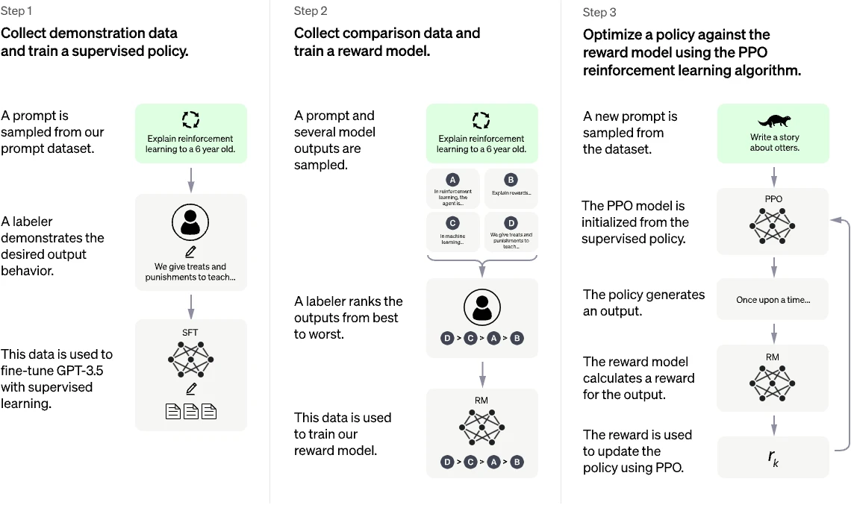
InstructGPT/ChatGPT Overview: RLHF
ChatGPT Blog Post: “ChatGPT is a sibling model to InstructGPT...”

Slide 44
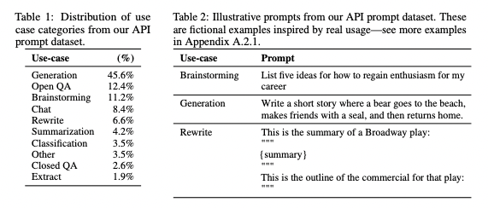
InstructGPT/ChatGPT Overview
Plain old supervised fine-tuning (“mid-training”) of GPT 3.5 (𝜌)
InstructGPT: 13k examples; mix of labeler-generated tasks and user-provided suggestions
This gets a pretty-good instruction following model (𝜋)

Slide 45

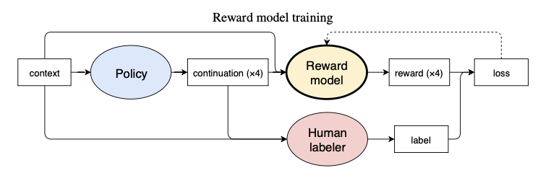
InstructGPT/ChatGPT Overview
For each prompt x, several outputs y0...y3, preferred one (b) identified (33k of these collected in InstructGPT)
Reward model (r) could be anything we discussed at the beginning
In this work, it is the SFT model with a linear classifier head, trained to optimize human selection (Plackett-Luce, which is generalized Bradley-Terry):
r is also normalized to have mean 0 variance 1

Slide 46

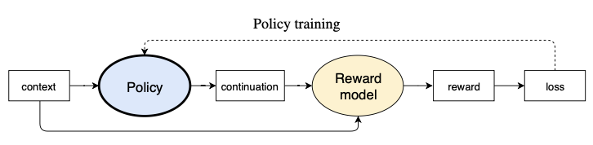
InstructGPT/ChatGPT Overview
We now repeatedly draw (a batch of) x (a prompt) and use 𝜋 to complete it (y) – recall self training (31k prompts collected)
Reward R is a modification of r that discourages variance from the SFT model (repeating theme!):
Then PPO is used to encourage outputs with good R; recall

Slide 47
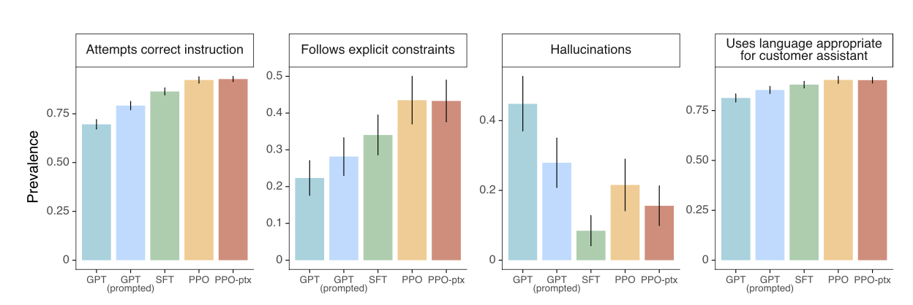
InstructGPT Results (Ouyang et al. ‘22)
Generally better at “high-level” tasks
(PPO-ptx variant includes an additional pretraining term in objective to avoid catastrophic forgetting)

Slide 48
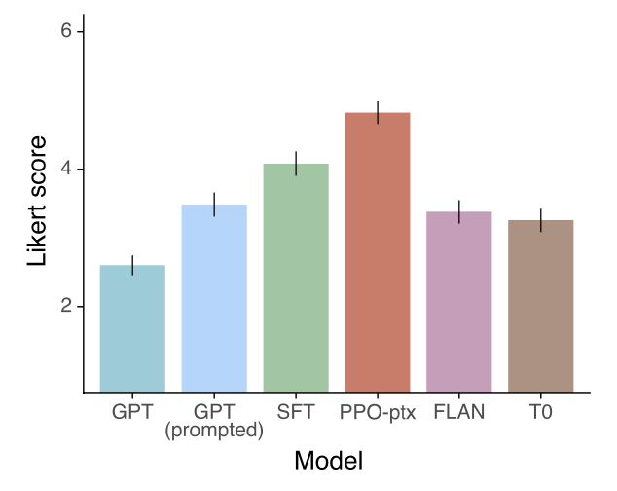
InstructGPT Prompts vs other prompts
FLAN and T0 (derived from existing benchmarks, manipulated into prompt structure) aren’t sufficiently diverse to improve performance on OpenAI’s API prompt distribution

Slide 49
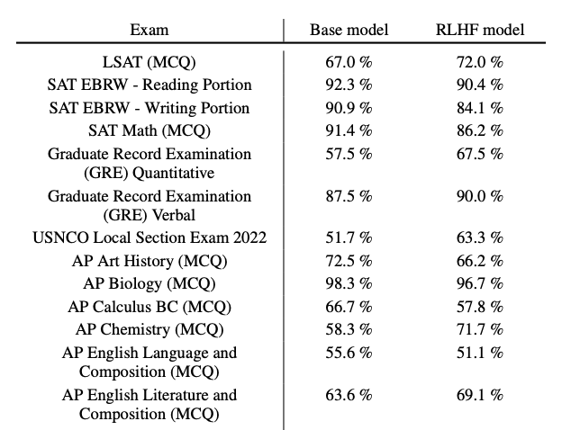
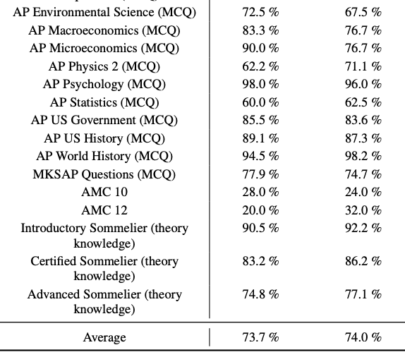
But How Important is it to ChatGPT/etc?
GPT-4 report suggests...not very? They (probably) do a lot of SFT...

Slide 50

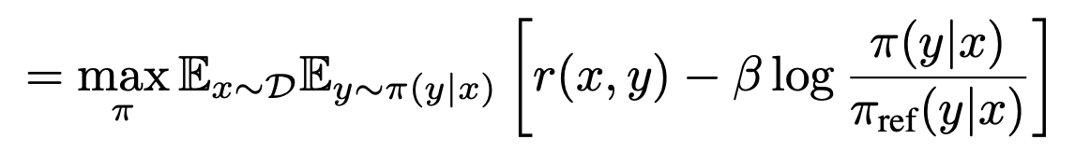
DPO: Let’s Get Rid of the Reward Model
It seems like we’re kind of scared of the reward and the instability it causes!
We normalize the value
We regularize its impact on model scores
Can we avoid it altogether by defining reward in terms of model evolution?
Consider the RL optimization (expectation of R):
R(x, y)

Slide 51


DPO
pi-ref is same thing as rho before
We can show that the best policy has this form:
(A potential problem here is Z, the partition function, which is intractable for NLP)
The reward can then be expressed in terms of a ratio of models (and Z)
Notes:
TODO: add Appendix 1 derivation

Slide 52


Bradley-Terry Model
If you have some score (r*) for choices 1 vs 2 (let’s say sports teams number of wins), the Bradley-Terry Model says the probability that 1 is better than (beats) 2 is
So let’s plug
in for r(...) when comparing a “winning” vs “losing alternative:
Sigmoid of the ratio! And no Z! Which gets us to the DPO loss:
(an explanation of this is in hidden slides)

Slide 54
Notes:
AND TO MAKE IT DIFFERENTIABLE

Slide 61
DPO in Practice
We don’t need an explicit reward model, and we don’t need to worry about its magnitude.
All we need to do is know, for two completions, which is the “winner” and which is the “loser.”
Then we evaluate each completion according to our reference model and the current model
Here’s the algorithm:
Start with SFT ”reference model”
For each prompt x, sample y1, y2 from reference, and use reward model (or human preference) to label as yw and yl
Optimize the current model based on the DPO loss
Go back to step 2 as needed

Slide 62
Holding Two Models is Kind of A Lot?
These are big models! They take up a lot of GPU RAM and they take time to run!
def get_loss(w, l, ref, model):
w_ref = ref(w) # inf 1
w_mod = model(w) # inf 2
l_ref = ref(l) # inf 3
l_mod = model(l) # inf 4
return <dpo equation>
?
What if we used a uniform model instead of 𝜌? Wouldn’t need to calculate anything!
But is it any good?
Notes:
https://arxiv.org/pdf/2401.08417
RE-RENDER

Slide 63
CPO (Xu et al. 2024)
Is this legit? TBH, not sure. Seems to work ok in practice though...

Slide 64
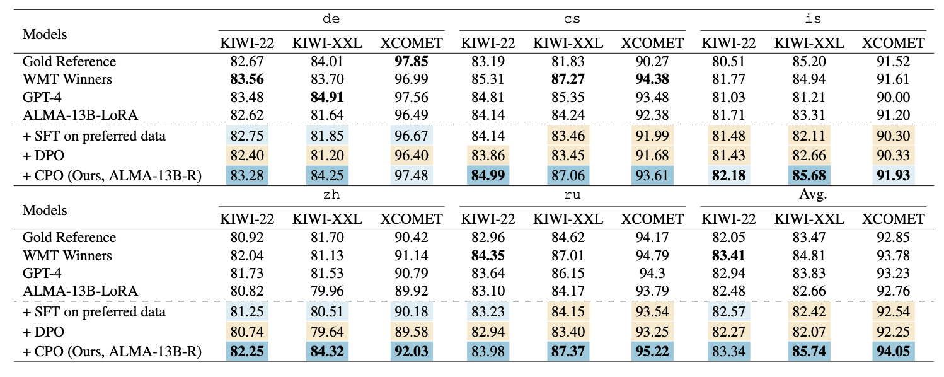
CPO Results
3 different “reference-free” eval approaches for each of 5 en->xx langs; CPO improves over an ALMA 13B model
Notes:
true also for xx->en. True also for reference-based model but not generally true for BLEU; they make an argument that it’s time to stop using BLEU.

Slide 65


Style Transfer Task
W. Shakespeare
e.e. cummings
To the market I venture, in quest of bread's embrace.
i'm going;to the store(for some bread)where silence is a shape of warm loaves
Choose a Target Author – Should Confound a Style Detector

Slide 66
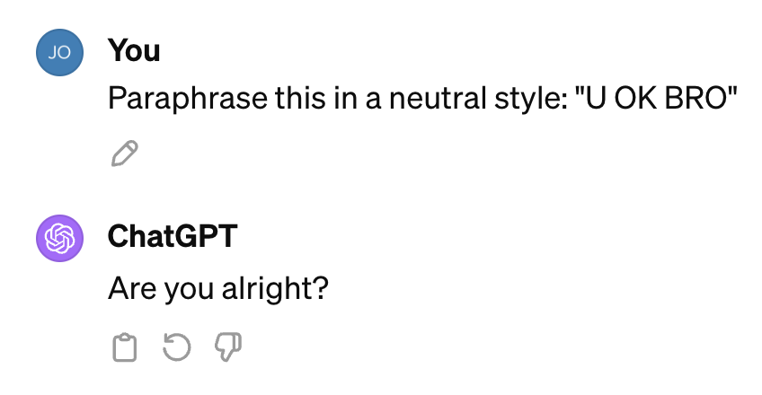
How to Generate Training Data?
There is some style-labeled data out there
Reddit Corpus – tens of thousands of users, each with a small number of examples
ETS TOEFL – Eleven native languages, each with thousands of examples
Grammarly’s Yahoo Answers Formality Corpus (GYAFC) – two styles, lots of examples
Corpus of Diverse Styles (CDS) – eleven styles, lots of examples
To form reward model, use LUAR (Rivera-Soto et al ‘21) style representation given exemplars
For transfer, there isn’t much naturally existing style->style parallel data
Online LLMs do a pretty good job!

Slide 67
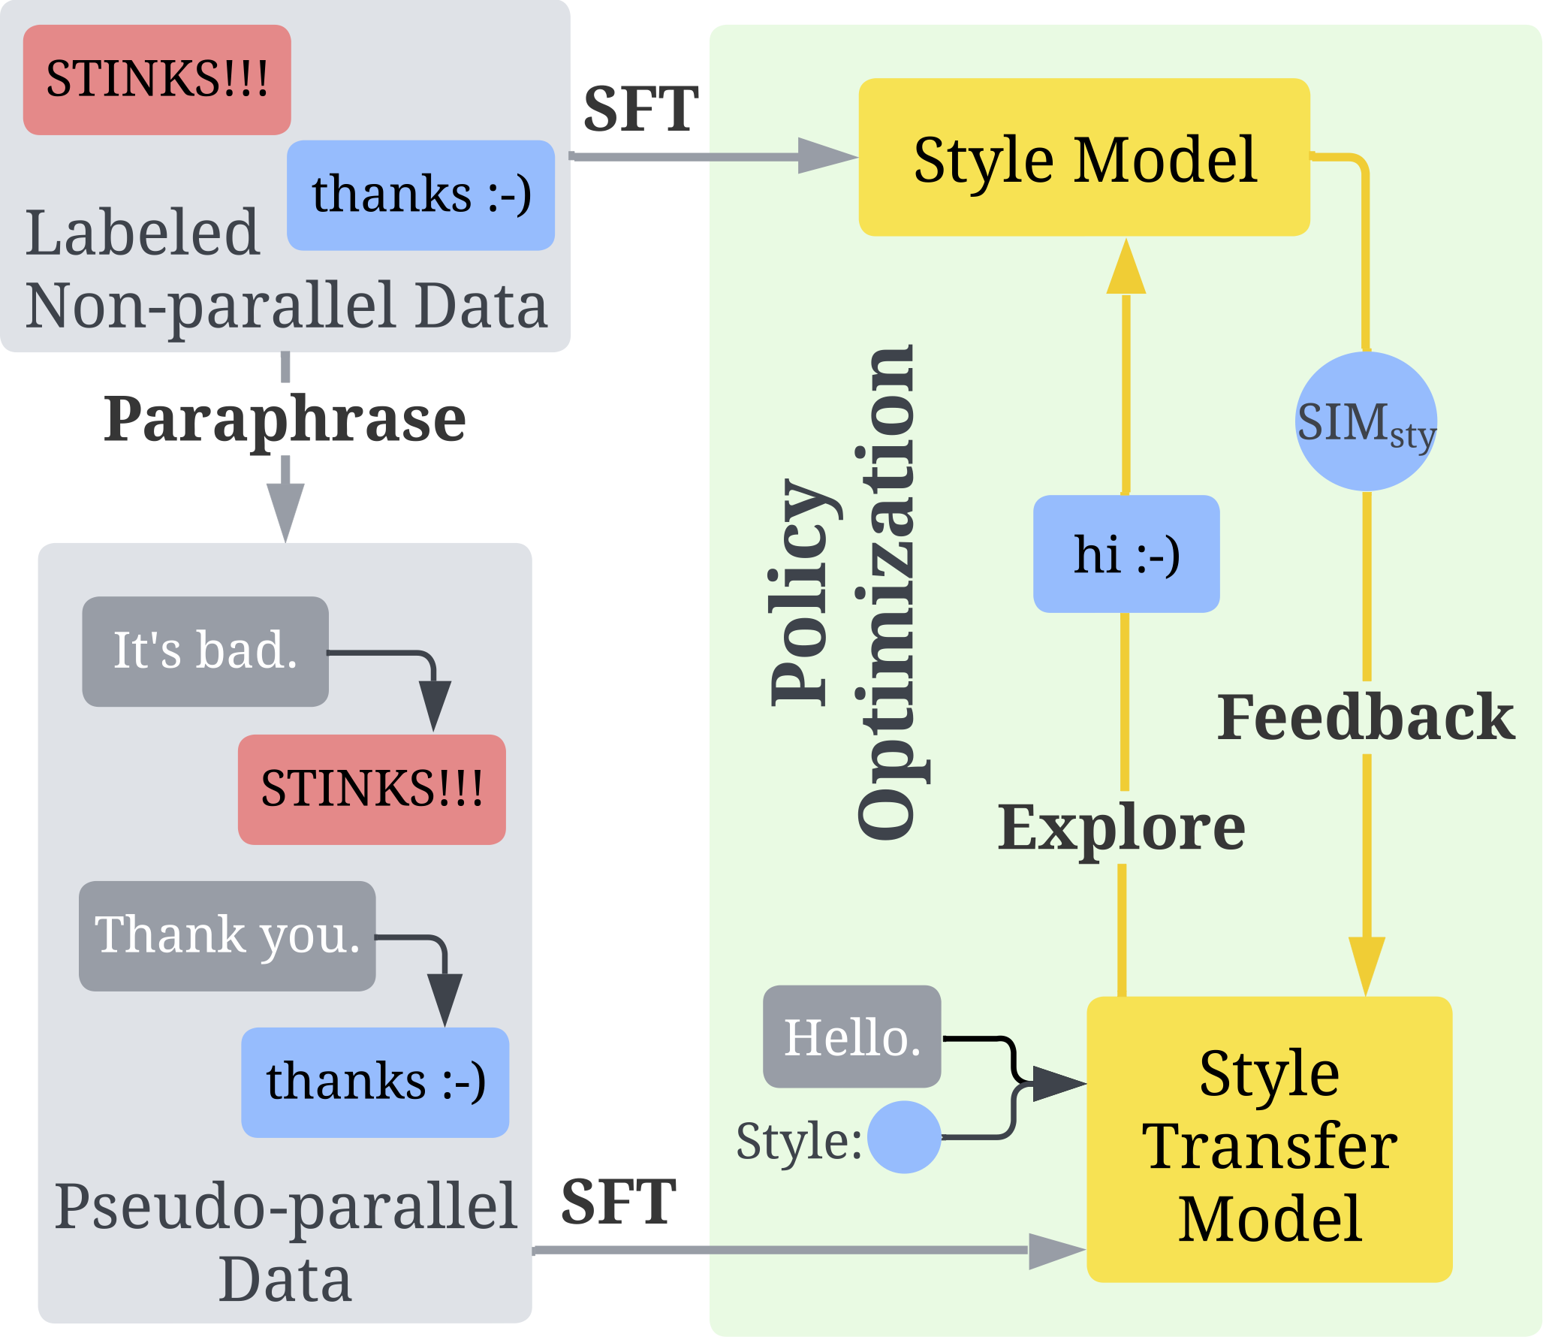
Authorship Transfer with Policy Optimization (Liu et al, CustomNLP4U wkshp ‘24)
Motivation :
Move style toward target, not just away from source
We can potentially improve the performance with SFT and PO
Method:​
Two-step PO training framework​
Supervised Fine-tuning​
Generate pseudo-parallel training data from labeled non-parallel data​
Train the model on LM cross-entropy loss on the generated data​
Policy optimization​
Train the model from the previous step directly on the authorship transfer objectives using policy optimization algorithms

Slide 68
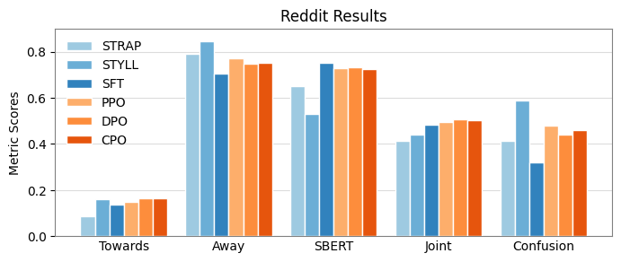
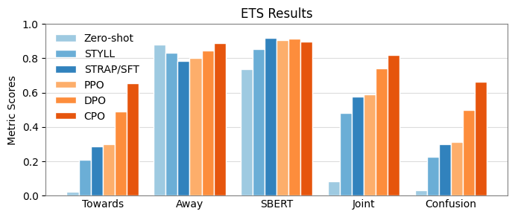
Results on Public Data (from paper)
Reddit example:​
Input ​
SRC: How do you access it?​
TGT exemplar: I DON'T KNOW WHAT I'M WATCHING EITHER, BUT I THINK I LIKE IT​
Transferred​
STRAP: Get to it!
STYLL: How do I get it? ​
SFT: How do you get to it? ​
PPO: HOW DO YOU GET THERE?
DPO: HOW DO YOU EVEN GET THERE?
CPO: HOW DO YOU EVEN GET IT?!?!
Notes:
STRAP = one model per native language/author for transfer. In ETS that was a better baseline for PPO/DPO/CPO but in Reddit combining them was better

Slide 69
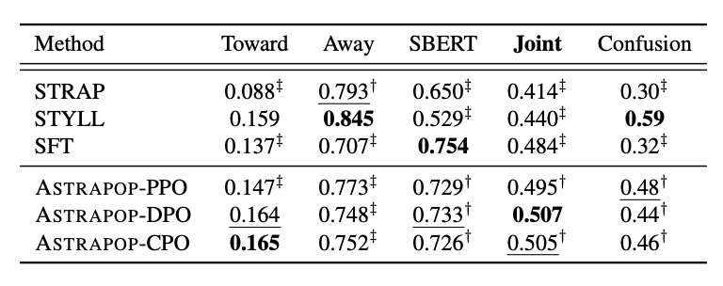
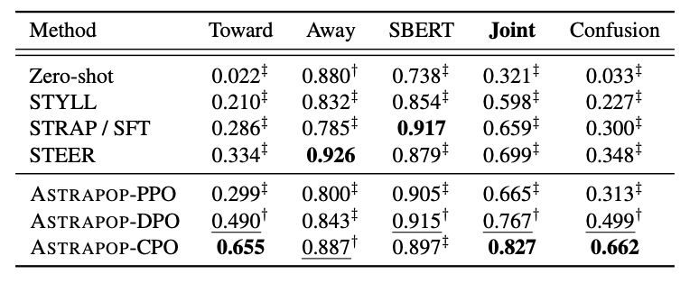
Results
Low-resource individual authorship transfer (Reddit)
Medium-resource community authorship transfer (ETS TOEFL11)

Slide 70
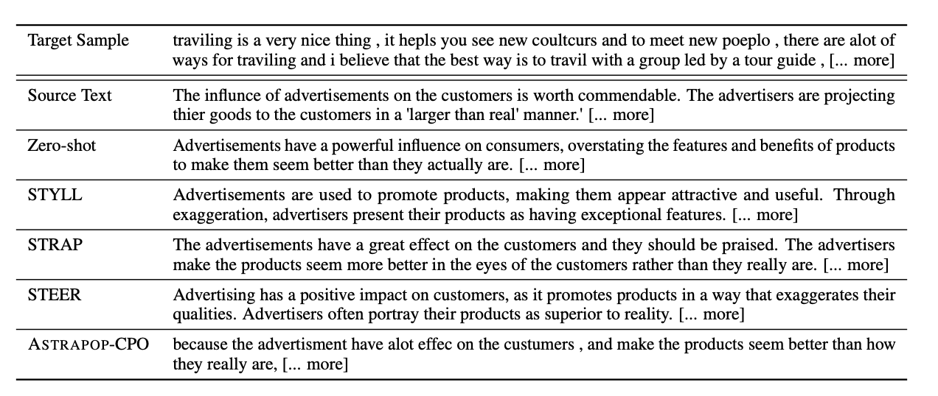
Style Transfer Example

Slide 71
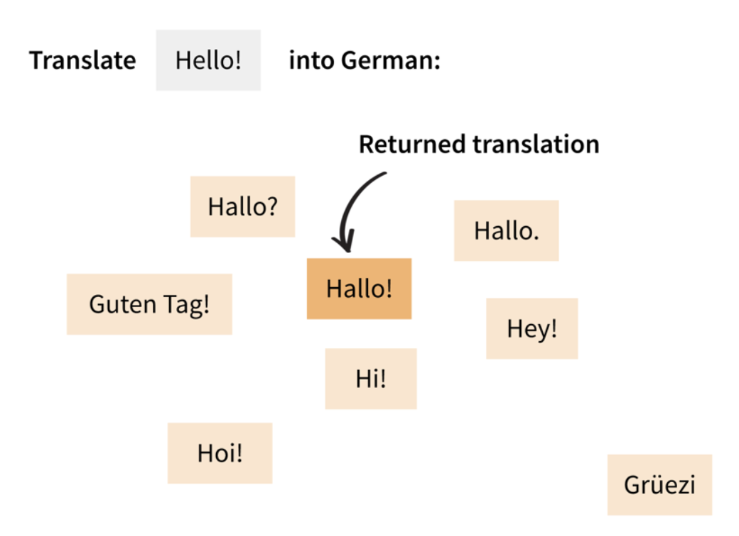
MBR+DPO (Yang et al. 2024)
Minimum Bayes Risk is a popular reference-free technique for improving generation
Key idea – generate many outputs and score them against each other – essentially find the median
Problem: This is very slow at decode-time because of quadratic comparisons

Slide 72
With DPO we can take as long as we need to create the data
Pair Data
Winner
Loser
“Hallo!”
“Grüezi”
DPO
...
...

Slide 73
We can actually select many items...
Pair Data
Winner
Loser
“Hallo!”
“Hoi!”
DPO
“Hoi!”
“Grüezi”
...
...
A few different strategies tried

Slide 74
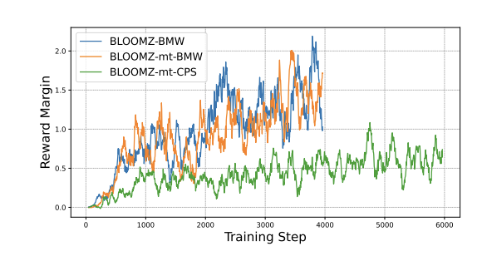
MBR+DPO Results
High Margin = model prefers winners more
BMW = “best middle worst”
CPS = strided consecutive
Moral: use big margins

Slide 75
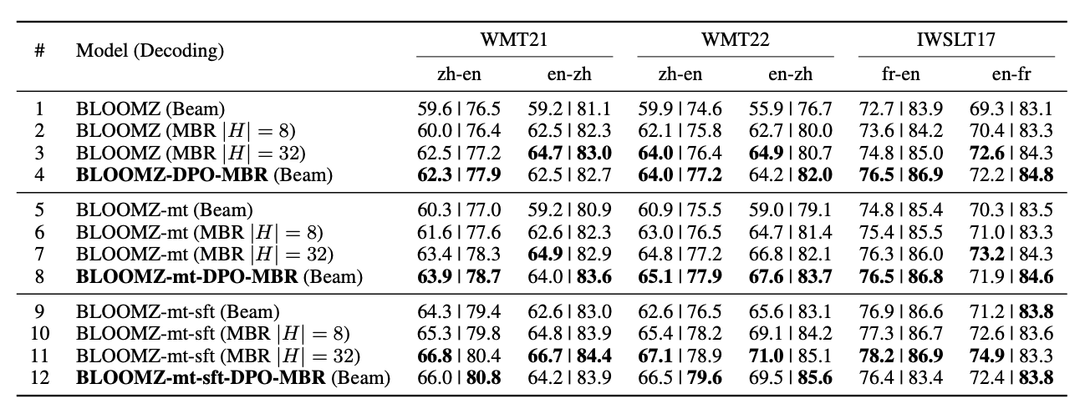
MBR+DPO Results
Eval is BLEURT | COMET
MBR is better than not
DPO-MBR at least as good as MBR (and faster)

Slide 76
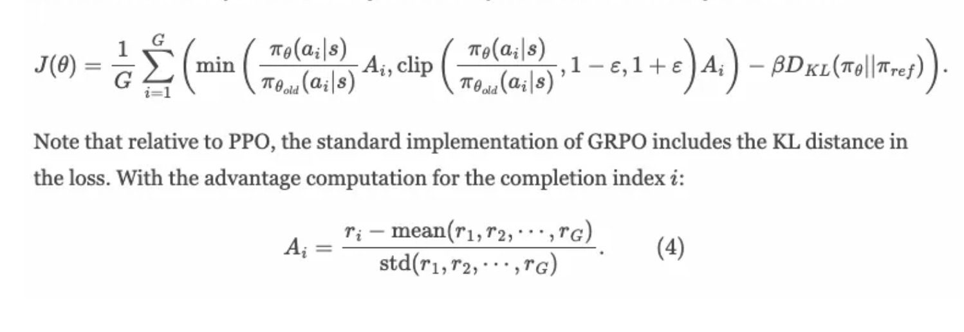
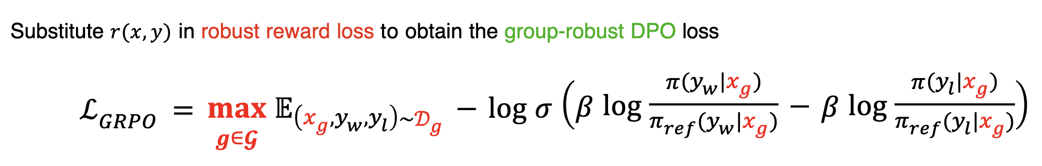
Note on GRPO/GRDPO
GRPO is PPO where the reward advantage is normed – choose a group of points (e.g. a batch), get reward of each, then subtract mean and divide by std
What if we replaced the black-box reward function with the DPO approach – calculate in terms of average model score?
That is a lot like MBR (but for training)! Doesn’t need to be done offline either
https://www.interconnects.ai/p/papers-im-reading-base-model-rl-grpo
Ramesh et al., NeurIPS ‘24, https://dl.acm.org/doi/10.5555/3737916.3739087

Slide 77
Some Inspiration
In the old days of (non-neural) MT, we would generate some translations, then optimize parameters for our evaluation metric to encourage the winners (just like DPO/CPO)
But then we would iterate, and use the new model to generate more translations, then optimize again (just like Pang et al 2024 and others)
We would also generate lots of translations, not just two, and pick the ones that had a strong reward margin (just like Yang et al)
Let’s use these lessons on a style transfer task

Slide 78
Style Transfer Task
W. Shakespeare
e.e. cummings
To the market I venture, in quest of bread's embrace.
i'm going;to the store(for some bread)where silence is a shape of warm loaves
Choose a Target Author – Should Confound a Style Detector

Slide 79
How to Generate Training Data?
There is some style-labeled data out there
Reddit Corpus – tens of thousands of users, each with a small number of examples
ETS TOEFL – Eleven native languages, each with thousands of examples
Grammarly’s Yahoo Answers Formality Corpus (GYAFC) – two styles, lots of examples
Corpus of Diverse Styles (CDS) – eleven styles, lots of examples
To form reward model, use LUAR (Rivera-Soto et al ‘21) style representation given exemplars
For transfer, there isn’t much naturally existing style->style parallel data
Online LLMs do a pretty good job!

Slide 80
Authorship Transfer with Policy Optimization (Liu et al, CustomNLP4U wkshp ‘24)
Motivation :
Move style toward target, not just away from source
We can potentially improve the performance with SFT and PO
Method:​
Two-step PO training framework​
Supervised Fine-tuning​
Generate pseudo-parallel training data from labeled non-parallel data​
Train the model on LM cross-entropy loss on the generated data​
Policy optimization​
Train the model from the previous step directly on the authorship transfer objectives using policy optimization algorithms

Slide 81
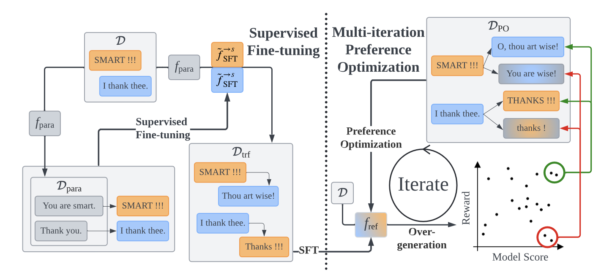
STAMP (Liu and May, ACL 25)
Notes:
key ideas:
GPT training data
iterative optimization
overgeneration

Slide 82
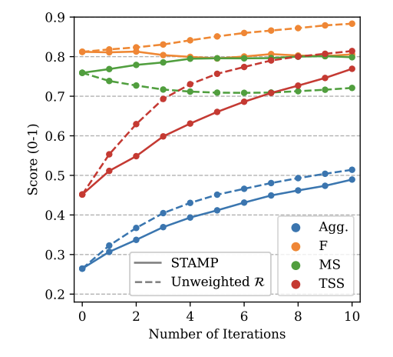
Multi-Iteration Is Really Important

Slide 83
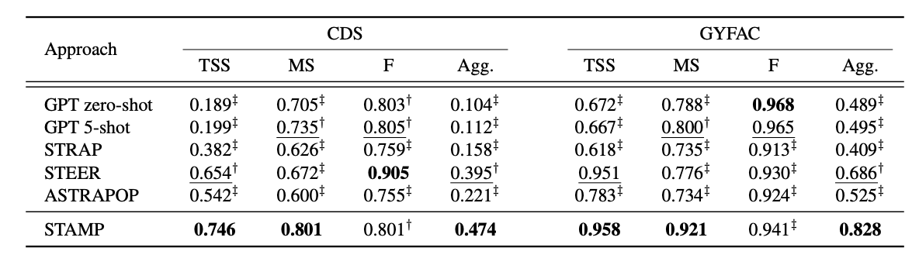
Evaluation of STAMP
CDS – corpus of diverse styles (11 styles, many examples, stronger perceptually than ETS)
GYFAC is just formal vs informal; much easier task

Slide 84
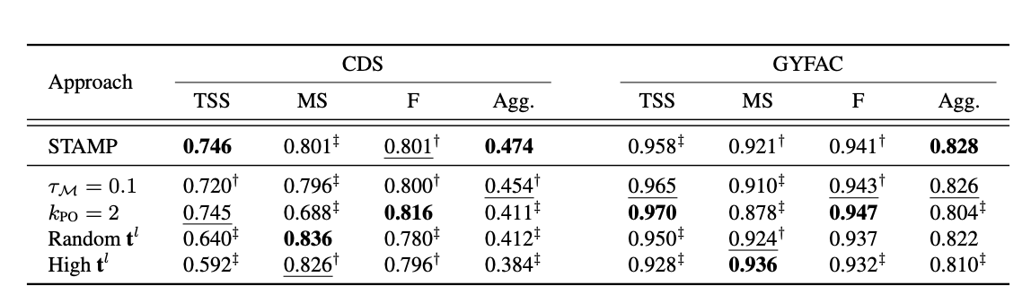
Ablation of STAMP
Not overgenerating hurts
Picking pairs that are not maximally far away hurts

Slide 85
Some Things In Backup Slides That I Skipped
KTO – don’t use pairs, just know whether you have a good or bad sample
Cohere on REINFORCE – don’t do partial completions, don’t bother with PPO, just use vanilla PG (almost)

Slide 86
Conclusions?
Once upon a time our probabilistic models didn’t behave the way we wanted so we had to use post-hoc techniques to get those scores up
For a while we luxuriated in MLE and Cross Entropy matching our metrics
RL and RL-like techniques are once again important for ensuring that our models behave they way they want to behave...
Although perhaps data will still conquer all once we go up another OOM

Slide 87
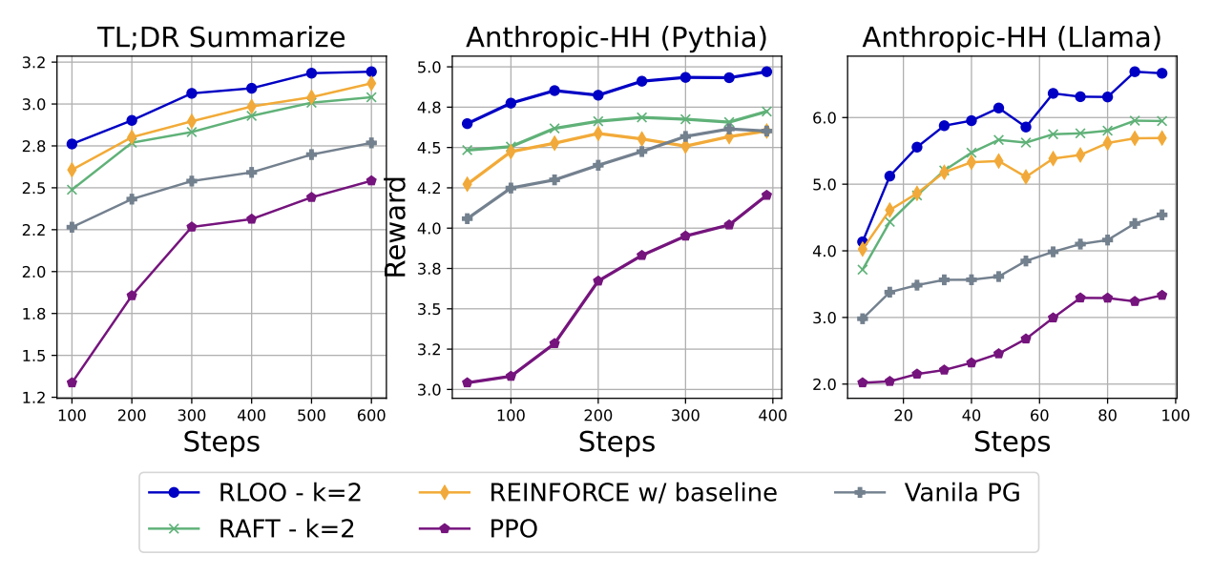
(Ahmadian et al 2024)
Could We Just Use REINFORCE after all?
Exponential decay to incorporate word over tokens (lambda return, i.e. GAE)
No partial completions...I don’t fully get how that can work so I’m reluctant to present this either...

Slide 88
KTO (Ethayarajh et al. 2024)
DPO: We don’t need to know the score of winner and loser, we just need to know which is which
Are pairs necessary? Maybe we only need to know whether an example is “good” or not
Bonus – you get double the amount of training data!

Slide 89
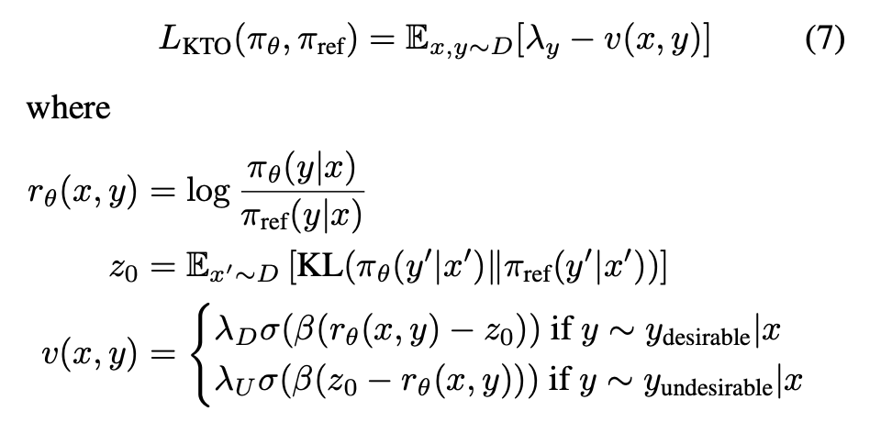
KTO Loss (Sorry for lazier setting on this one)
The keys are you treat desirables different from undesirables and you have a pool for your KL component

Slide 90
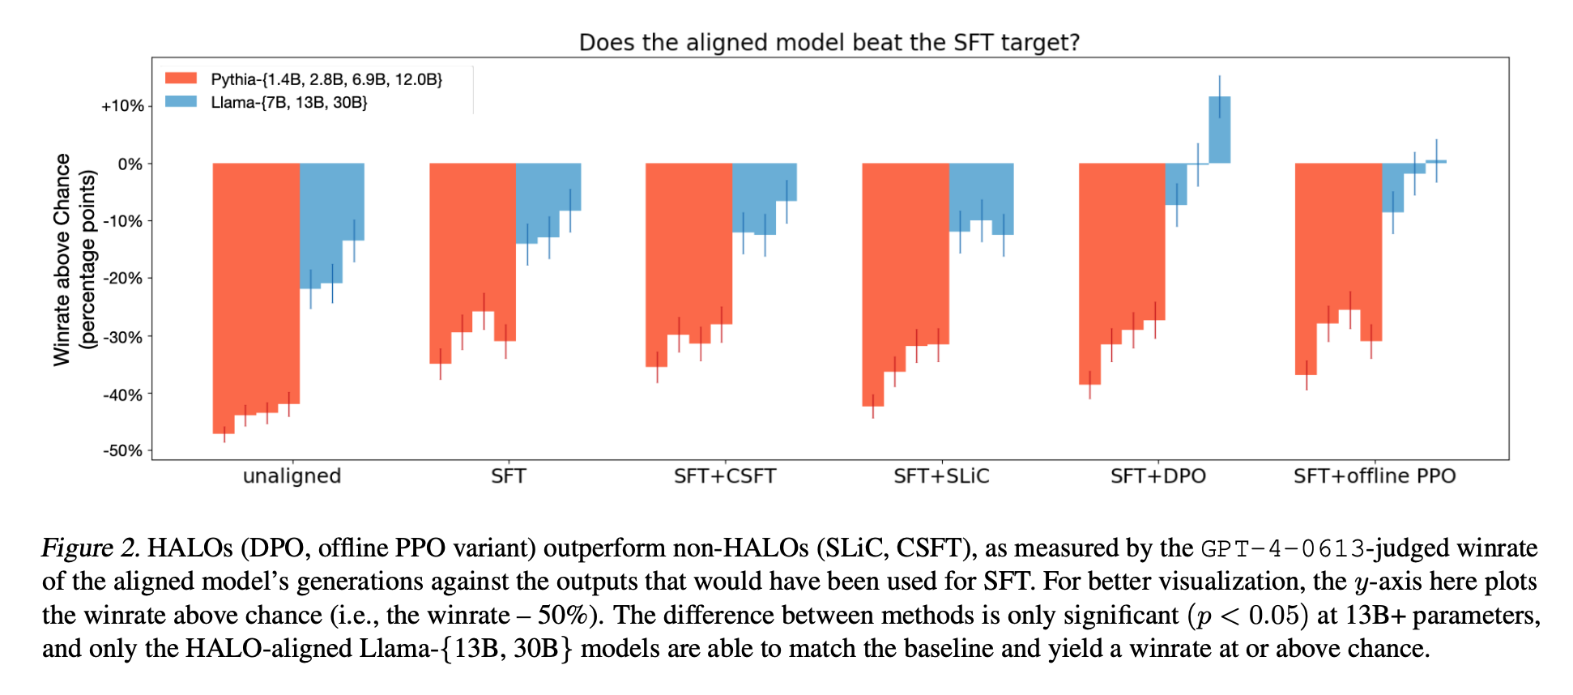
KTO Impact
I have some issues with this which is why I’m not presenting it

