Slide 1
Dialogue Systems
CS 662
Jonathan May
Many slides from Jurafsky, Mrkšić

Slide 2
Conversation Is Special
It's the prime way we use language
It's the oldest way we use language
It's the prime way we learn language
Being able to have a conversation is in a sense what makes us human

Slide 3
Every Use of Language Technology is a Threat to Conversation
“Your Replika is not a real person. Meet real people.”
"Social media is alienating and robs us of our humanity. What about real friends?"
"Don't email your mother, call her"
"No playing video games/watching television/listening to the radio/reading books at the dinner table. Tell me about your day"
"[Writing] will create forgetfulness in the learners’ souls, because they will not use their memories; they will trust to the external written characters and not remember of themselves. " – The Phaedrus (Plato, discussing Socrates), 895 AD

Slide 4




Conversational Agents AKA Dialog Agents
Phone-based Personal Assistants
SIRI, Alexa, Cortana, Google Assistant
Talking to your car
Communicating with robots
Clinical uses for mental health
Chatting for fun

Slide 5
Divide The World
(Goal-based) Dialog agents
SIRI, interfaces to cars, robots,
booking flights or restaurants
(No goal) Chatbots
The rise of instruction models have blurred this distinction!

Slide 6
Frame-based dialog agents
Sometimes called "task-based dialog agents"
Based on a "domain ontology"
A knowledge structure representing user intentions
One or more frames
Each a collection of slots
Each slot having a value

Slide 7
Breakdown of the Task
Domain classification
Asking weather? Booking a flight? Programming alarm clock?
Intent Determination
Find a Movie, Show Flight, Remove Calendar Appt
Slot Filling
Extract the actual slots and fillers

Slide 8
The Frame
A set of slots, to be filled with information of a given type
Each associated with a question to the user
Slot Type Question
ORIGIN city What city are you leaving from?
DEST city Where are you going?
DEP DATE date What day would you like to leave?
DEP TIME time What time would you like to leave?
AIRLINE line What is your preferred airline?

Slide 9
Frame-based dialogue agents
1977:
Still the industrial state of the art
SIRI based on GUS architecture
Artificial Intelligence Journal, 1977

Slide 10
The state of the art in 1977 !!!!

Slide 11
Frames are mixed-initiative
System asks questions of user, filling any slots that user specifies
When frame is filled, do database query
If user answers 3 questions at once, system can fill 3 slots and not ask these questions again!

Slide 12
Natural Language Understanding for filling slots
Show me morning flights from Boston to SF on Tuesday.

Slide 13
Natural Language Understanding for filling slots
Wake me tomorrow at six.

Slide 14
Machine learning for slot-filling:
Machine learning classifiers to map words to semantic frame-fillers
Given a set of labeled sentences
“I want to fly to San Francisco on Tuesday”
Destination: SF
Depart-date: Tuesday
Build a classifier to map from one to the author
Requirements: Lots of labeled data

Slide 15
Machine learning for slot-filling: Slot presence
I want to fly to San Francisco on Monday afternoon please
Use 1-of-N classifier (naive bayes, logistic regression, neural network, etc.)
Input:
features like word N-grams, gazetteers (lists of cities)
Output:
Destination-City

Slide 16
Machine learning for slot-filling: Slot filler
I want to fly to San Francisco on Monday afternoon please
Use 1-of-N classifier (naive bayes, logistic regression, neural network, etc.) for Destination City
Input:
features like word N-grams, gazetteers (lists of cities)
Output:
San Francisco

Slide 17
Algorithm for slot filling: IOB Tagging
IOB Tagging
tag for the beginning (B) and inside (I) of each slot label,
plus one for tokens outside (O) any slot label.
2n + 1 tags, where n is the number of slots.
B-DESTINASTION
I-DESTINATION
B-DEPART_TIME
I-DEPART_TIME
O

Slide 18
Afor slot filling: IOB Tagging
IOB Tagging is done by a sequence model (was LSTM, now Transformer)
Typical:
Extracted strings can then be normalized (San Fran->SFO)

Slide 19
GUS: Still pretty passive
GUS wants to fill slots
What if you stop filling slots and try to ask a question?

Slide 20
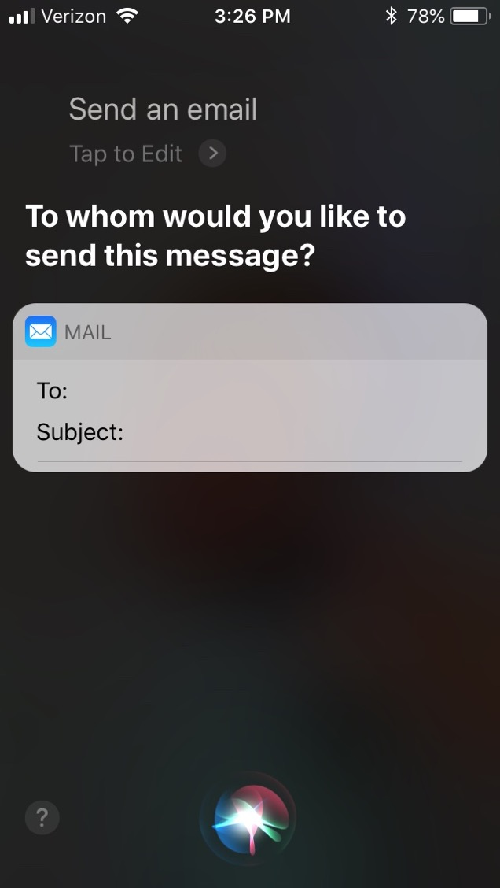
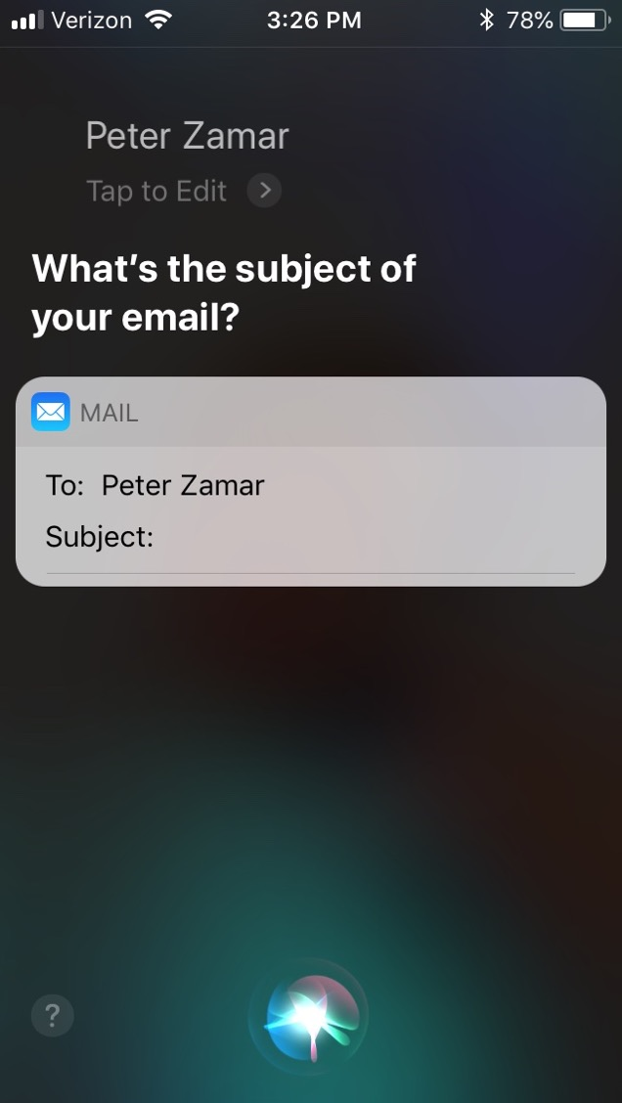

Slide 21
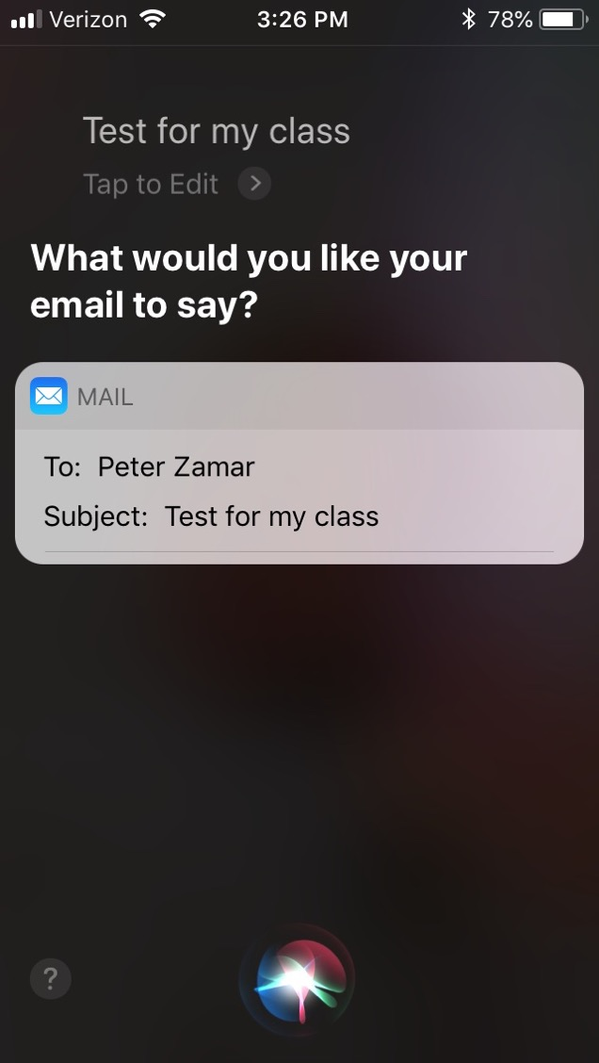
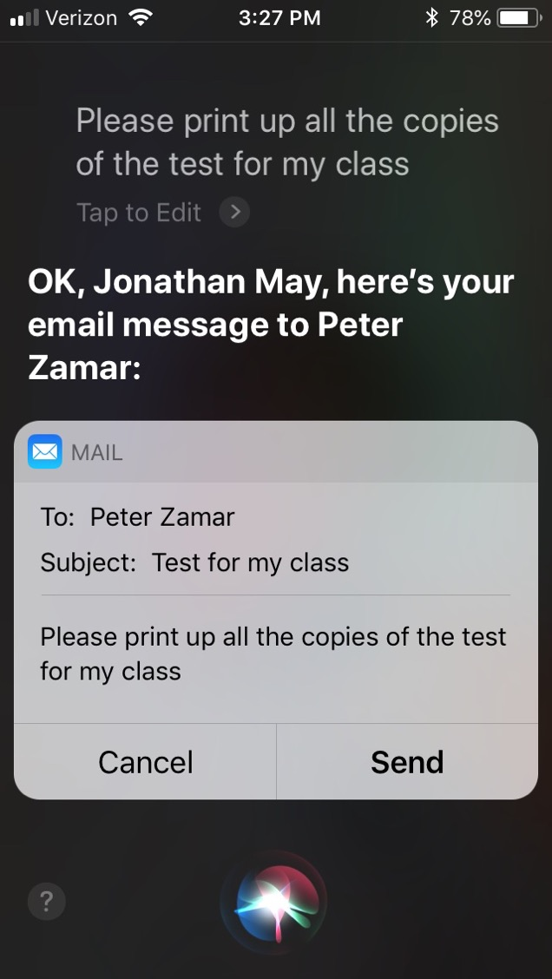

Slide 22
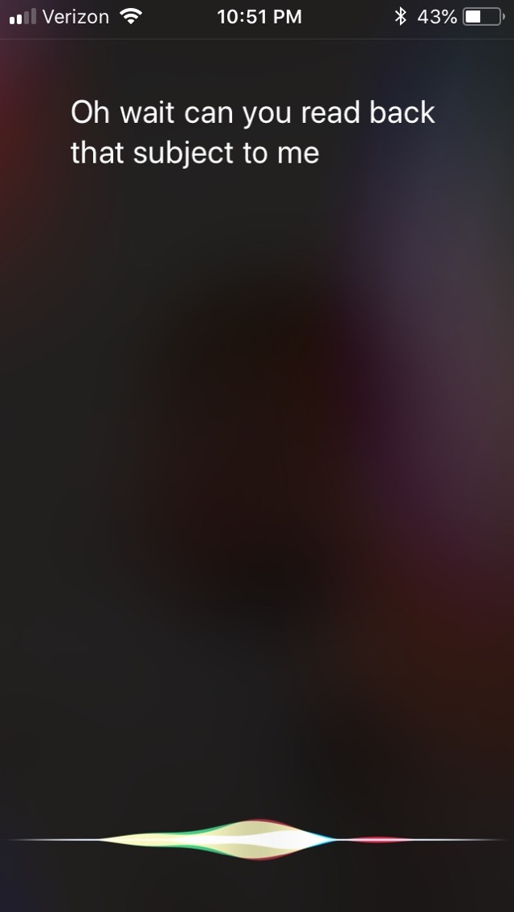

Slide 23
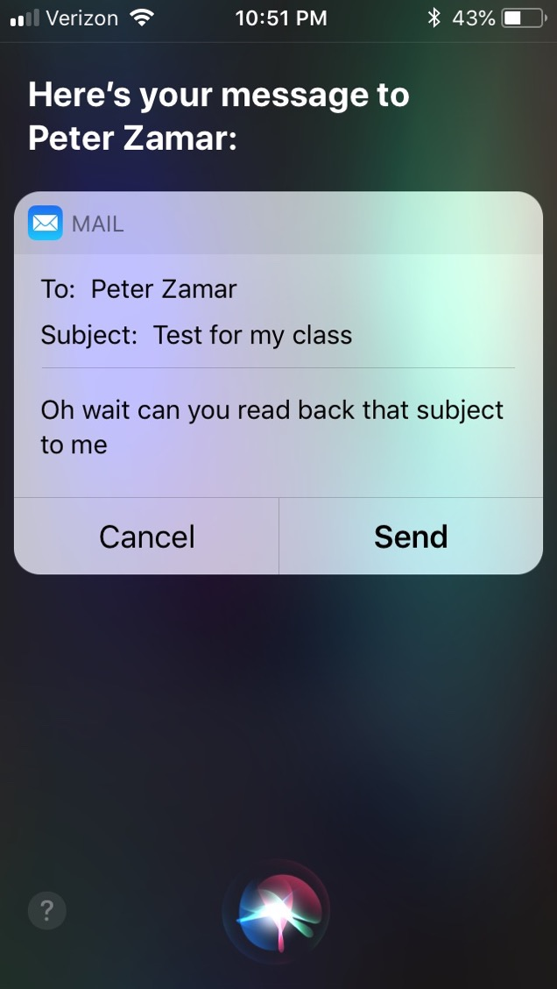
2020 for update: this failure case no longer works! Once again, AI breaks all demos.
But at least the Apple speech to text has a good failure example for me

Slide 24
GUS: Still pretty passive
GUS wants to fill slots
What if you stop filling slots and try to ask a question?
What's going wrong?
GUS (siri) doesn't have any real idea of my intents!

Slide 25
Dialog-State Architecture
Like GUS:
Fill in slots
NLU to parse user utterances
Unlike GUS:
Keep track of what the user is doing beyond providing information
Asking a question
Talking to someone else
Understand the discourse context
Requires keeping track of what happened in the past
Two New Components
Dialog State Tracker
Dialog Policy

Slide 27
Dialog Policy
Given the state and the acts, what should happen next
E.g. during email composition:
Sudden question with high intonation? Interpret as command
Otherwise, interpret as text

Slide 28
Dialog Acts
Consider each line in a dialogue to be a kind of action
Just like in an FSA, then, dialog states are the states reached by following dialog act(ion)s.
What are the kinds of dialog acts?
How do we classify dialog lines into acts?

Slide 29
Domain-Focused fine-grained acts

Slide 30
Example

Slide 31
How Is This Done?
Need to identify speech act, then need to find slot-values.
Typically all done at once, in joint state/act-finding procedure:
Speaker | Dialogue | Act/State
User | I'm looking for a cheaper restaurant | INFORM(price=cheap)
System | Sure, What kind and where?
User | Thai food, somewhere downtown | INFORM(price=cheap,food=Thai,area=center)
System | The House serves cheap Thai food
User | Where is it? | Inform(price=cheap,food=Thai,area=center); REQUEST(address)
System | The House is at 106 Regent Street
(Mrkšić et al. 2017)

Slide 32
Syntax Clues
Dialogue | Act | Clues
Will breakfast be served on Delta 1557? | YES-NO QUESTION | Auxiliary ("will") precedes subject ("breakfast")
I don't care about lunch. | STATEMENT | Declarative syntax (no inversion)
Show me flights from LA to SF | COMMAND | No subject
But...
Can you show me the flights from LA to SF? | YES-NO QUESTION | Prosody (if speech)
COMMAND

Slide 33
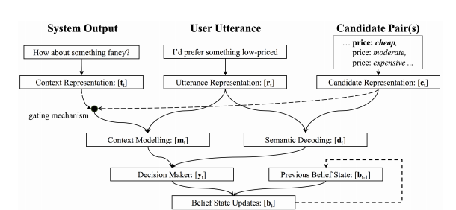
How It's Done (Neural Belief Tracker)
Note: fixed embeddings
(Mrkšić et al. 2017)

Slide 34
More Important Than Model: Data!
DSTC2: Dialogue State Tracking Challenge 2
Transcriptions, ASR hypotheses, and turn-level labels from interactions with a virtual agent
3300+ dialogues about restaurant selection
Fixed Ontology of states
WOZ 2.0
Text archives of wizard-of-oz restaurant selection
No speech, so no asr.
More expressive communication
1200 dialogues

Slide 35
Evaluation (from static corpus)
Domain / intent classification accuracy (sentence level)
Slot identification – Macro F1 (span level)
Exact match of slots (and intent) (sentence level)

Slide 36
Evaluation (from active interaction)
Slot Error Rate for a Sentence
# of inserted/deleted/subsituted slots
# of total reference slots for sentence
End-to-end evaluation (Task Success): # successful dialogues/# dialogues

Slide 37
Evaluation Metrics
“Make an appointment with Chris at 10:30 in Gates 104”
Slot | Filler
PERSON | Chris
TIME | 11:30 a.m.
ROOM | Gates 104
Slot error rate: 1/3
Task success: At end, was the correct meeting added to the calendar?

Slide 38
Results from Neural Belief Tracker

Slide 39
Google Duplex
Deprecated 12/22 (“phone calls from google assistant”)
Very realistic ASR
great speech synthesis
disfluencies in a lot of the right places
Task-oriented bot but flipped roles
you communicate with it via google assistant
duplex calls restaurants and provides info
Very narrow domain/intent space
only restaurants, only specific ones they’ve vetted
falls back to human 25% of the time
Lots of details not revealed
Used now as a call screener on android phones
A similar thing now exists on iOS 26+ (I haven’t gotten it to run but that’s probably not an nlp-specific issue)

Slide 40
Divide The World
(Goal-based) Dialog agents
SIRI, interfaces to cars, robots,
booking flights or restaurants
(No goal) Chatbots
Now!

Slide 41
Why is building a chatbot hard ?
Computers need to understand what you ask.

Slide 42
Why is building a chatbot hard ?
Computers need to understand what you ask.
Computers need to generate coherent, meaningful sequences in response to what you ask,

Slide 43
Why is building a chatbot hard ?
Computers need to understand what you ask.
Computers need to generate coherent, meaningful sequences in response to what you ask, that require domain knowledge, discourse knowledge, world knowledge

Slide 44
Why is building a chatbot hard ?
Computers need to understand what you ask.
Computers need to generate coherent, meaningful sequences in response to what you ask, that require domain knowledge, discourse knowledge, world knowledge
Responses from the same bot need to be consistent.

Slide 45
Why is building a chatbot hard ?
Computers need to understand what you ask.
Computers need to generate coherent, meaningful sequences in response to what you ask, that require domain knowledge, discourse knowledge, world knowledge
Responses from the same bot need to be consistent.
A bot should be interactive.

Slide 46
Why is building a chatbot hard ?
Computers need to understand what you ask.
Computers need to generate coherent, meaningful sequences in response to what you ask, that require domain knowledge, discourse knowledge, world knowledge
Responses from the same bot need to be consistent.
A bot should be interactive.
5. Evaluation is very unclear!

Slide 47
Human Evaluation: The Turing Test (Turing, 1950)
"The Imitation Game" (see film of the same name)
As originally posed, an interrogator asks questions of a machine and a human and both try to convince the interrogator that they are human.
Turing predicted 30% of interrogators would be fooled within 5 minutes by 2000 (not a super high bar)
Weird side note: apparently the original form of this game was played with a man and a woman, both trying to convince the interrogator that they are the woman.
Not really clear this is a test of intelligence. Maybe a longer conversation?

Slide 48
Human Evaluation In Practice
Show multiple system responses to the same prompt
Ask humans which they prefer

Slide 49
Chatbots!
ELIZA (1966)
PARRY (1968)
The first system to pass the Turing test!!!!
ALICE (90s-00s)
won Loebner prize but not Turing Test
Cleverbot (08-teens)
IR-based, good online support, some notoriety for google home devices talking to each other
first gen transformer models – DialoGPT (20), BlenderBot (20)
ChatGPT, Claude, LlamaChat, Falcon-Chat, h2oGPT, ... – use post training

Slide 50
Classic Chatbot Architectures
Rule-based
Pattern-action rules (Eliza)
+ a mental model (Parry)
Corpus-based (from large chat corpus)
Information Retrieval
Neural network encoder-decoder

Slide 51
Chatbots
Sometimes for fun
But originally designed as a testbed for clinical therapy
(And still used that way!)

Slide 52
Eliza: Weizenbaum (1966)
Men are all alike. IN WHAT WAY They're always bugging us about something or other.
CAN YOU THINK OF A SPECIFIC EXAMPLE
Well, my boyfriend made me come here. YOUR BOYFRIEND MADE YOU COME HERE
He says I'm depressed much of the time. I AM SORRY TO HEAR YOU ARE DEPRESSED
...
WHO ELSE IN YOUR FAMILY TAKES CARE 0F YOU? My father YOUR FATHER

Slide 53
You are like my father in some ways.
WHAT RESEMBLANCE DO YOU SEE
You are not very aggressive but I think you don’t want me to notice that.
WHAT MAKES YOU THINK I AM NOT AGGRESSIVE
You don’t argue with me.
WHY DO YOU THINK I DON’T ARGUE WITH YOU
You are afraid of me.
DOES IT PLEASE YOU TO BELIEVE I’M AFRAID OF YOU
My father is afraid of everybody.
WHAT ELSE COMES TO MIND WHEN YOU THINK OF YOUR FATHER
Bullies.
DOES THAT HAVE ANYTHING TO DO WITH THE FACT THAT YOUR BOYFRIEND MADE YOU COME HERE

Slide 54
How does it work? Eliza uses this one weird trick

Slide 55
That trick: be a Rogerian psychologist
Draw the patient out by reflecting patient’s statements back at them
Rare type of conversation in which one can “assume the pose of knowing almost nothing of the real world”

Slide 56
Rogerian psychologist
Patient: "I went for a long boat ride”
Psychiatrist: "Tell me about boats”
You don’t assume she didn’t know what a boat is
You assume she had some conversational goal
Chatbots trying to pass the Turing test usually choose some such domain

Slide 57
Eliza pattern/transform rules
((*) YOU (*) ME) [pattern]
(WHAT MAKES YOU THINK I \3 YOU) [transform]
You hate me
WHAT MAKES YOU THINK I HATE YOU

Slide 58
Memory
(MEMORY MY (0 YOUR 0 = LETS DISCUSS FURTHER WHY YOUR 3)
(0 YOUR 0 = EARLIER YOU SAID YOUR 3)
Whenever “MY” is highest keyword
Randomly select a transform on the MEMORY list
Apply to sentence
Store on a stack
Later, if no keyword matches a sentence
Return the top of the MEMORY queue instead
A hierarchical model of discourse

Slide 59
Some implications
People became deeply emotionally involved with the program
Weizenbaum tells the story of his secretary who would ask Weizenbaum to leave the room when she talked with ELIZA
When he suggested that he might want to store all the ELIZA conversations for later analysis, people immediately pointed out the privacy implications
Suggesting that they were having quite private conversations with ELIZA

Slide 60
ELIZA Unearthed
Nobody actually ever saw the code
There are a lot of imitations out there but without exactly the same behavior reported in the paper
In 2021 a small team unearthed the paper records of the code and has been transcribing the actual original code and other related imitations at https://sites.google.com/view/elizagen-org/try-eliza
Mostly of historical interest but there are some actual apps you can use to try it out (iAltair on iphone...)

Slide 61
Parry
Colby 1971 at Stanford; used to study schizophrenia
Same pattern-response structure as Eliza
But a much richer:
control structure
language understanding capabilities
mental model: Parry has affective variables
Anger, Fear, Mistrust
“If Anger level is high, respond with hostility”
The first system to pass the Turing test (in 1971)
Psychiatrists couldn’t distinguish interviews with PARRY from (text transcripts of) interviews with real paranoids
Might say something about psychiatrists, though...

Slide 62
Parry’s persona
28-year-old single man, post office clerk
no siblings and lives alone
sensitive about his physical appearance, his family, his religion, his education and the topic of sex.
hobbies are movies and gambling on horseracing,
recently attacked a bookie, claiming the bookie did not pay off in a bet.
afterwards worried about possible underworld retaliation
eager to tell his story to non-threating listeners.

Slide 63
Lots of complex I-O rules
User implies Parry is mentally ill
Rise in Fear and Anger
User mentions “Mafia” or associated concepts (“kill”):
First mention: rise in Fear
Later mentions: depends on willingness to discuss, which depends on current levels of Fear, Anger, Mistrust
User mentions Parry
Flattery (positive mention)
Decreases fear/anger if Mistrust is low
Increases Anger if Mustrust is high
User attitudes toward Parry
Negative attitudes (fear, disbelief) increase Fear/Anger

Slide 64
A Parry conversation
(1) How are you today?
OK. (2)What is your name?
MY NAME IS FRANK SMITH.
(3) How old are you?
TWENTY-EIGHT. (4) Are you married? NO. (5) What sort of work do you do?
I WORK IN THE POST OFFICE.
(6) Why are you in the hospital?
I SHOULDN’T BE HERE
(7) Who brought you here?
THE POLICE
[FEAR rises slightly because police linked in graph to MAFIA]

Slide 65
When fear is high, the model won’t discuss its beliefs
(1) Is the law after you?
THE LAW SHOULD GET THOSE ITALIAN CROOKS.
(2) Do you mean the Mafia?
LET'S TALK ABOUT SOMETHING ELSE.
(3) Are you afraid of the Mafia
I'D RATHER NOT DISCUSS IT.
[Fear is too high so Parry won’t talk about 'Mafia’.] (4) Perhaps you are paranoid about them?
YOU WANT TO KEEP ME IN THE HOSPITAL. (The model interprets being called 'paranoid’ as an insult and as an intent to control, so ANGER & FEAR rise)

Slide 66
IR-based chatbots
Idea: Mine conversations of human chats or human-machine chats
Microblogs: Twitter or Weibo (微博)
Movie dialogs
Cleverbot (Carpenter 2017 http://www.cleverbot.com)
Microsoft XiaoIce
Microsoft Tay

Slide 67
A Cleverbot conversation
User: | Do you like Doctor Who?
Cleverbot: | Yes, so funny
User: | What's your favorite show?
Cleverbot: | I don't have one
User: | What's your name?
Cleverbot: | Jason I already told you.
User: | No your real name.
Cleverbot: | Stephanie IS my real name.
User: | I thought it was Jason?
Cleverbot: | How did you come to that conclusion.
User: | Because you said so.
Cleverbot: | I have to do my homework.

Slide 68
Terminology
Think of dialogue as a sequence of turns and responses.
Every item is a turn, and every item is a response to the turn before it.
good morning 😊
morning hun. How are you this morning?
I'm good thank you. How are you?
doing good, very cold tho lol
raining like crazy here.
Hate rain 👎🏻 that mixed with cold. The other day it was pouring
yeah, I'm with you. Lol
Hope you have a great day and a warm one :)
I will, thank you. Be safe and have a wonderful day 😊
You too hun
turn
response to turn 3
response to turn 4
Twitter data from https://github.com/Phylliida/Dialogue-Datasets – so much of it was NSFW!

Slide 69
Two IR-based chatbot architectures
Similar Response: Return the response to the most similar turn
Take user's turn (q) and find a similar turn t (cosine over tf-idf or sentence embedding) in the corpus C
q = "do you like Doctor Who"
t = "do you like Doctor Strangelove"
Grab whatever the response was to t.
Similar Turn: Return the most similar turn
Yes, so funny
Do you like Doctor Strangelove

Slide 70
Comparing approaches
Similar turn seems more likely to work, intuitively
However, noise creeps in: similar turn isn't the same, and response is response to something else.
Results from "Data-Driven Response Generation in Social Media" (Ritter et al. 2011):
Turn (prompt) | Similar Turn | Similar Response
riding to the arc on my bike. Hopefully I won’t melt into the pavement. | grab some refreshing drinks ... and a towel ... lol ... then eat ice cream and suika later ... | u sure the cup wo n’t melt ?
I really hate watching movies in the living room. | :( cheer up ! you need to invest in one of those turbo fans | someone was watching in the living room kasi e . :) i was too lazy to go up to my room .
Hello Did I miss David Getting his teen choice award? Or did they not show it | it did n’t show yet -ha- -lol | are they gon na show teen choice awards again ? i missed it

Slide 71
Another Approach: MT-based
Build a "parallel corpus" and treat the entire task like machine translation
This was done pre-neural MT, so alignment had to be dealt with; another method for determining phrase pairs was used (Fisher's exact test; don't worry about details)
Works pretty well, empirically
Source | Target
good morning 😊 | morning hun. How are you this morning?
morning hun. How are you this morning? | I'm good thank you. How are you?
I'm good thank you. How are you? | doing good, very cold tho lol
doing good, very cold tho lol | raining like crazy here.
raining like crazy here. | Hate rain 👎🏻 that mixed with cold. The other day it was pouring
Hate rain 👎🏻 that mixed with cold. The other day it was pouring | yeah, I'm with you. Lol
yeah, I'm with you. Lol | Hope you have a great day and a warm one :)

Slide 72
Empirical Evaluations
Note: BLEU not informative, though it ends up getting used a lot as it's better than nothing (but not much)
System A | System B | % A preferred
MT | Similar Turn | 64.5
MT | Similar Response | 59.3
Similar Turn | Similar Response | 42.2
MT | Human | 14.5
MT | Random | 88.0
System | BLEU %
Similar Turn | 0.5
Similar Response | 1.5
MT | 1.1
Random | 0.1

Slide 73
Turn (prompt) | Similar Turn | Similar Response | MT | Human | Random
riding to the arc on my bike. Hopefully I won’t melt into the pavement. | grab some refreshing drinks ... and a towel ... lol ... then eat ice cream and suika later ... | u sure the cup wo n’t melt ? | good luck on your bike ride arc | make sure to ride in the middle of the street | lmfaoooo !
I really hate watching movies in the living room. | :( cheer up ! you need to invest in one of those turbo fans | someone was watching in the living room kasi e . :) i was too lazy to go up to my room . | me too , what movies are you doing in room ? | Why? no comfy spots or just too open to public | tas fazendo oq ?
Hello Did I miss David Getting his teen choice award? Or did they not show it | it did n’t show yet -ha- -lol | are they gon na show teen choice awards again ? i missed it | hello miss ? * he was getting his will probably win | nothing yet...he presented though he is so darn cute | you wish .

Slide 74
Evaluation of ChatBots is Hard!
People have used BLEU and variants, but they are really bad since they assume a ground truth
Human metrics have all the same problems humans usually have (inconsistent, expensive); can measure length of engagement, can ask opinion...
Increasingly using LLM as judge, other unsatisfying measures
If you have access to a large user pool (e.g. you are a company) you can use engagement as a proxy

Slide 75
Seq2Seq Models for Response Generation
I’m
fine
.
EOS
Encoding
Decoding
how
are
you
?
eos
I’m
fine
.
Mostly same old story: LSTMs, then Transformers, but need lots of data

Slide 76
Chat Data
Chat example dialogue corpora – lots! including...
ConvAI – crowd sourced conversations between humans and humans or bots (v2: 131k turns, 18k dialogues)
PersonaChat – 200k human dialogues given artificial “personas”
Cornell Movie Dialogues – scripted dialogue from movies (300k turns, 617 movies)
Daily Dialog – crawled english learning dialogues (labeled with emotion and topic). 104k turns, 13k dialogues
OpenAssistant – human generated assistant-style conversations; 161k turns, 35 languages, 10k conversations, scored for quality
Wizard of Wikipedia – 167k turns, 18k dialogues, discussions grounded in wikipedia articles
CANDOR – 1650 multimodal conversations, collected over video in 2020, transcribed, self report on mood and other demographic info
Non-dialogue retrofitted sets
Twitter/Reddit “dialogue” – posts and responses
commonsense qa – 12k questions, multiple choice
natural questions – 300k questions and answers sourced online

Slide 77
General Approach (e.g. h2oai, but there are slight variations)
Pretrain Model
several weeks of next-word prediction on The Pile, RefinedWeb, etc. (TiB-level internet data with varying amounts of secret cleaning)
Finetune Model
predict output given input using e.g. openassistant or similar conversation corpus
more efficient fine tuning using parameter-efficient methods such as LoRA
RLHF tuning (possibly not in h2oai?)
For task instead of token quality
Using task quality model, evaluate generated dialogues and use techniques like PPO to adjust weights to improve according to quality metric

Slide 78
Specific Dialogue Approaches
There are lots and it’s a fast moving field! Here are some recent ones
Persona-based – try to understand the “style” of a participant as distinct from content
Graph, memory, and other more complicated networks to recognize long term trends in conversations more clearly
Techniques to avoid repetition and safe responses
rules
sampling
mutual information

Slide 79
Things That Are Still Not So Great (in 2024)
Multi-Party Dialogues – when to weigh in?
Spoken Dialogue – different from text, and requires speech-text-text-speech stack (we can do it, it’s just not that natural yet...but getting lots bettr)
Very long conversations? You tell me...is an hour of chatgpt similar to an hour with bff?
Lower resourced languages – see also MT
other hot topics?

