Slide 1
Discourse
slides by Alexander Spangher

Slide 2
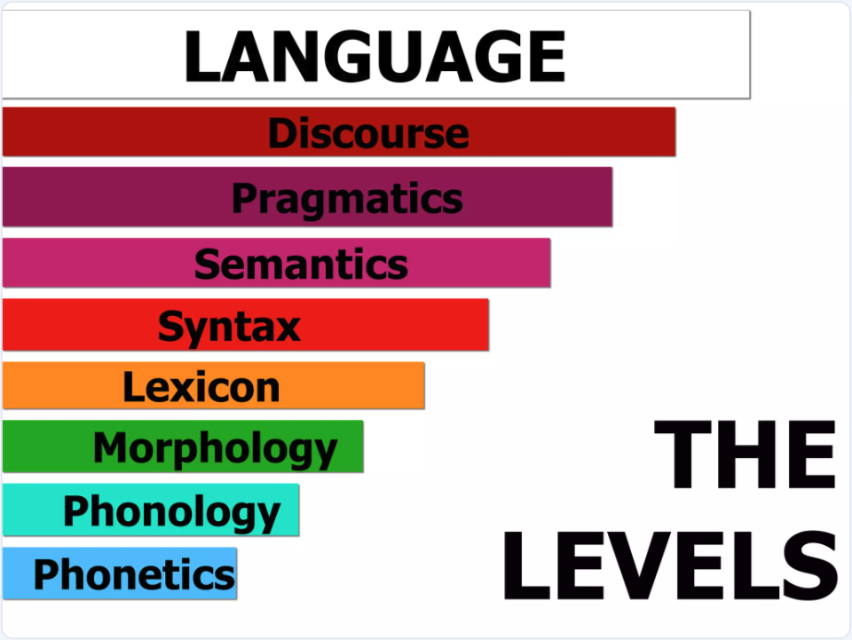

Slide 3
What is discourse?
Syntax: The study of the structure and rules governing the arrangement of words and phrases in sentences.
Semantics: The study of the meaning of words, phrases, sentences, and texts.
Pragmatics: The study of how context influences the interpretation of meaning in communication.
Discourse: The study of the structure and use of language in communication beyond individual sentences. It involves analyzing how sentences connect to form cohesive and coherent texts or spoken interactions, considering context, purpose, and social dynamics.

Slide 4
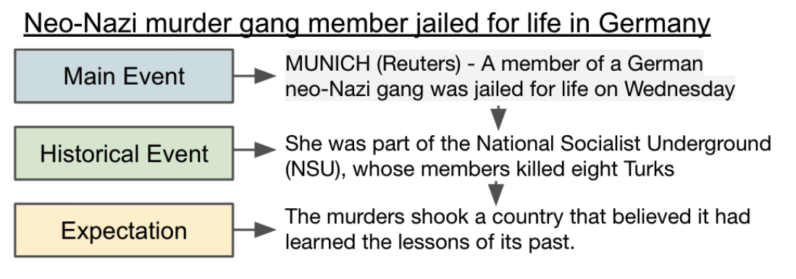
You have seen discourse already this semester!
Discourse: Refers to the structure and use of language in communication beyond individual sentences. It involves analyzing how sentences connect to form cohesive and coherent texts or spoken interactions, considering context, purpose, and social dynamics.
News Discourse!

Slide 5
Classical Discourse

Slide 6
Penn Discourse Treebank
Simplest definition of discourse
connective
Text block 1
Text block 2
Draws from grammatical cohesion theory (Halliday and Hasan, 1976), coherence relations (Hobbs, 1979), connectives (Schiffrin, 1986)

Slide 7
Penn Discourse Treebank
Explicit Relations
connective
Text block 1
Text block 2
Causal: She left early because she was tired.
Contrast: He wanted to go out but it was raining.
Temporal: We arrived late. So, we missed the show.
Expansion: He loves outdoors. For example, he goes hiking like a king.

Slide 8
Penn Discourse Treebank
Implicit Relations
connective
Text block 1
Text block 2
Causal: She left early. She was tired.
Comparison: She left home. He went out.
Temporal: We arrived late. They arrived later.
Expansion: He loves outdoors; the outdoors are where mushrooms grow.

Slide 9
From PDTB to Rhetorical Structure Theory
Causal (PDTB): She left early because she was tired.
Cause (RST):
Cause
She left early
(nucleus)
She was tired
(satellite)
The nucleus contains the primary information or central argument.
The satellite provides supplementary information, such as evidence, context, or explanation.

Slide 10
Rhetorical Structure Theory
Provides a way of analysing longer chains of thought:
"John missed the meeting. He was stuck in traffic. He should have left earlier."
John missed meeting
(nucleus)
Cause
Counterfactual
He should have left earlier.
(satellite)
He was stuck in traffic
(satellite)

Slide 11
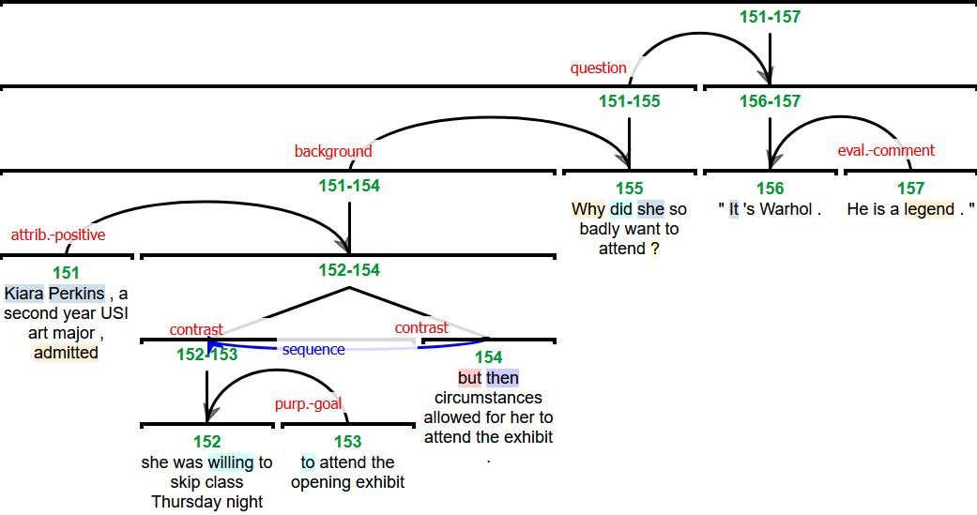
Rhetorical Structure Theory

Slide 12

Rhetorical Structure Theory – developed at ISI! (late 80s, then work in early 00s)

Slide 13
Modern Discourse Theory

Slide 14
Discourse as structural markers
Discourse: The structure and use of language in communication beyond individual sentences. It involves analyzing how sentences connect to form cohesive and coherent texts or spoken interactions, considering context, purpose, and social dynamics.
News Discourse (Van Dijk, 1989)

Slide 15
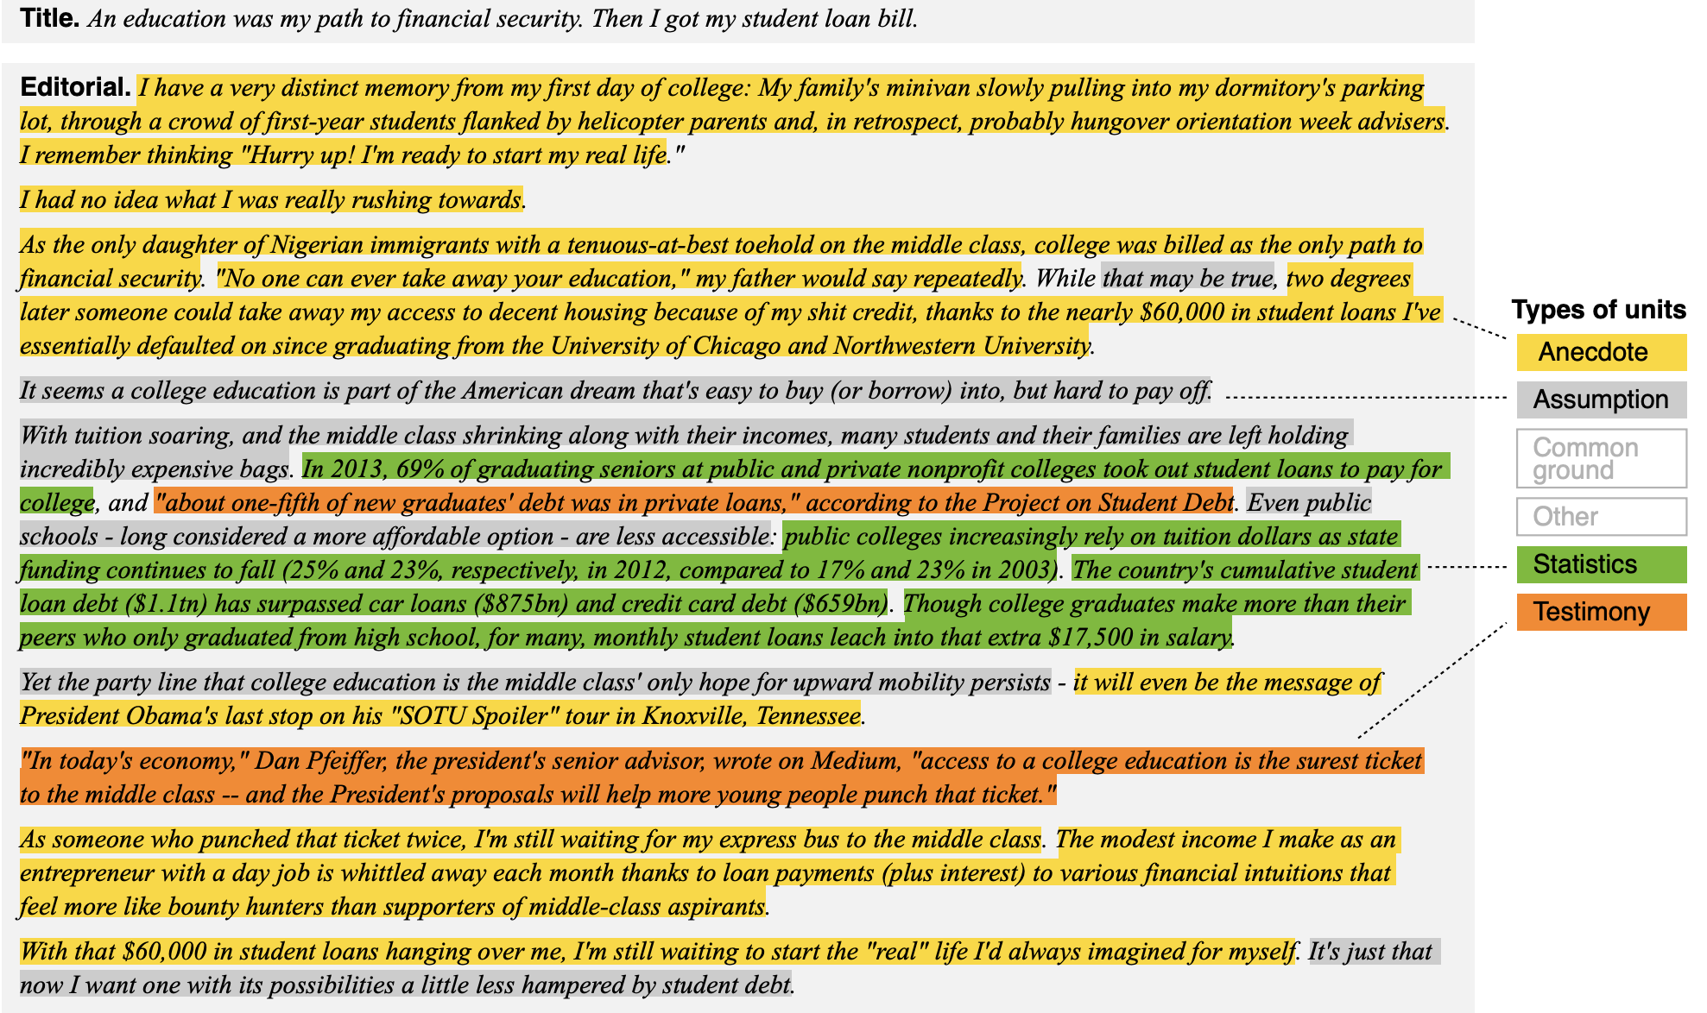
Argumentation Discourse (Khatib, 2016)

Slide 16
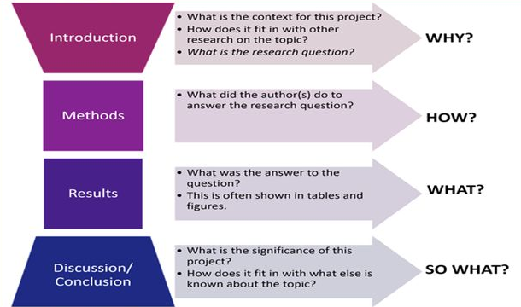
Science Discourse

Slide 17
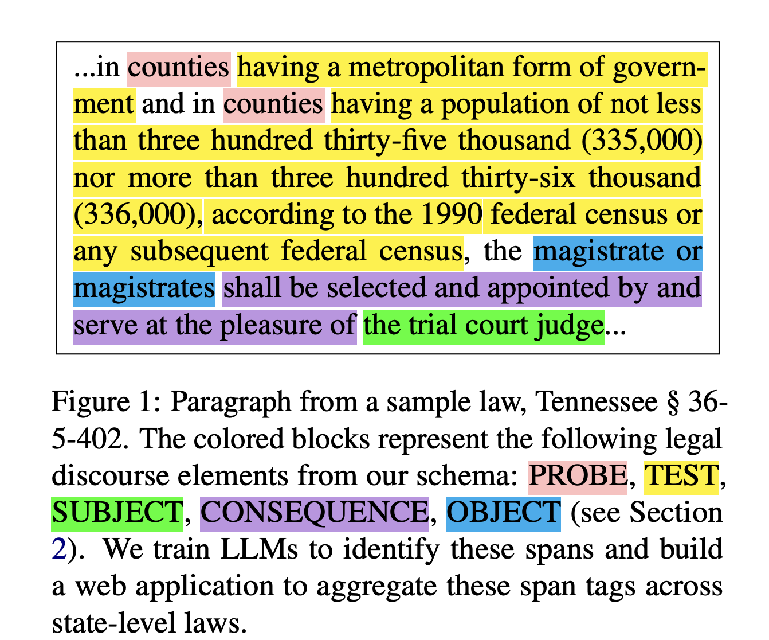
Legal Discourse
Spangher, A., Wu, T.-L., Xue, Z., Hansen, M., & May, J. (2024). LegalDiscourse: Interpreting when laws apply and who they affect.
NAACL 2024

Slide 18
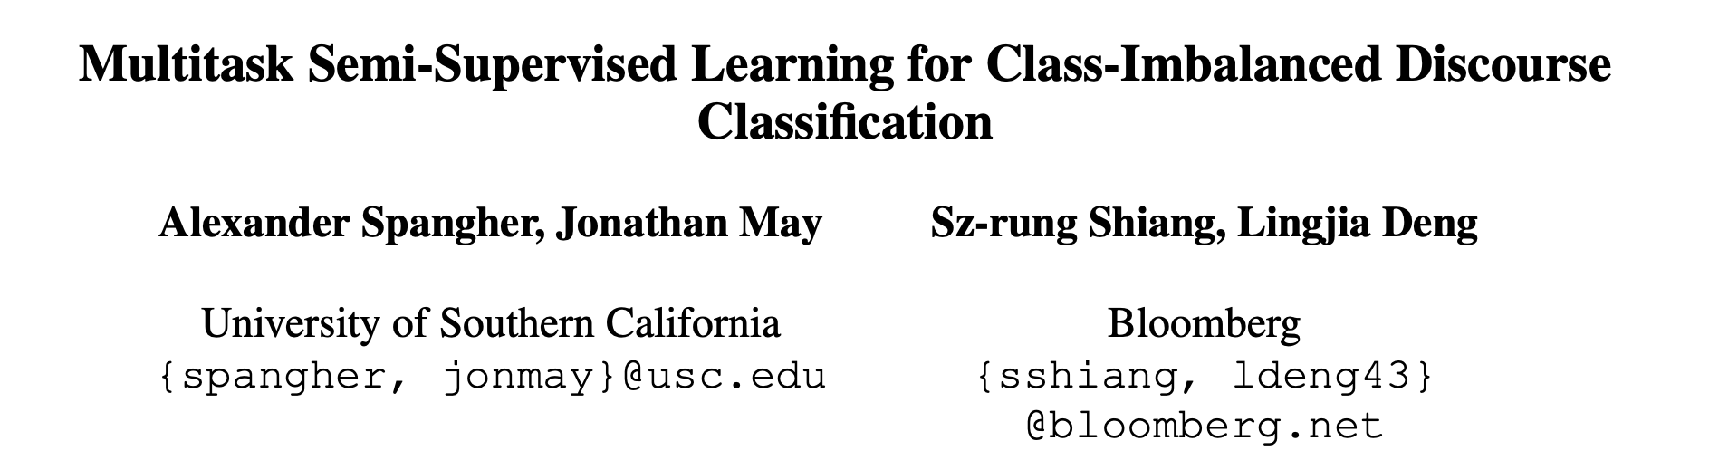
What can discourse tell us?
Insight #1: Different discourse-types complement each other.

Slide 19
Task: Classify News Discourse
Type
Label
Many different discourse datasets are annotated on news!
Yarlott, 2018: Van Dijk Schema
Choubey, 2020: Van Dijk Schema + Anecdote
Spangher, 2021: Van Dijk Schema + Explanation
Al Khatib, 2016: Argumentation Schema
Prasad, 2008: Penn Discourse Treebank (PDTB)
Carlson, 2003: Rhetorical Structure Theory Treebank (RST)
Main Event
Main Content
Consequence
Previous Event
Contextualizing
Content
Current Context
Historical Event
Additional
Supporting
Content
Anecdotal Event
Evaluation
Expectation

Slide 20
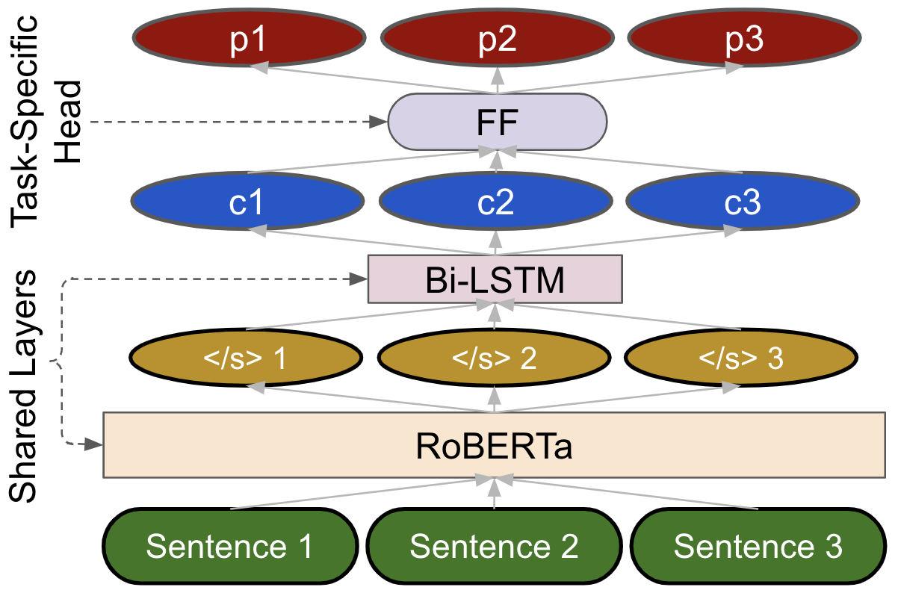
Multitask Architecture

Slide 21
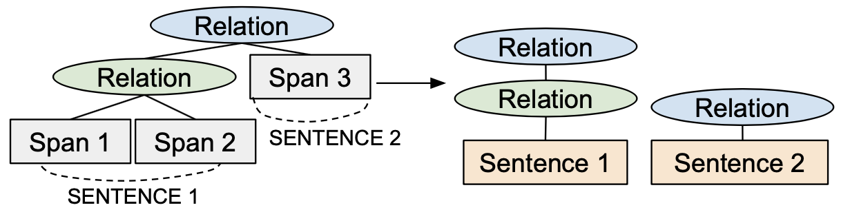
Additional Details on Data Processing
PDTB and RST are relational datasets. We need to process them to model them as multilabel datasets.
Additionally, we filter tags in PDTB to only include tags on temporal relations.
We experiment with Event Nuggets Dataset from Knowledge Base Population (KBP) 2014/2015. [6]

Slide 22
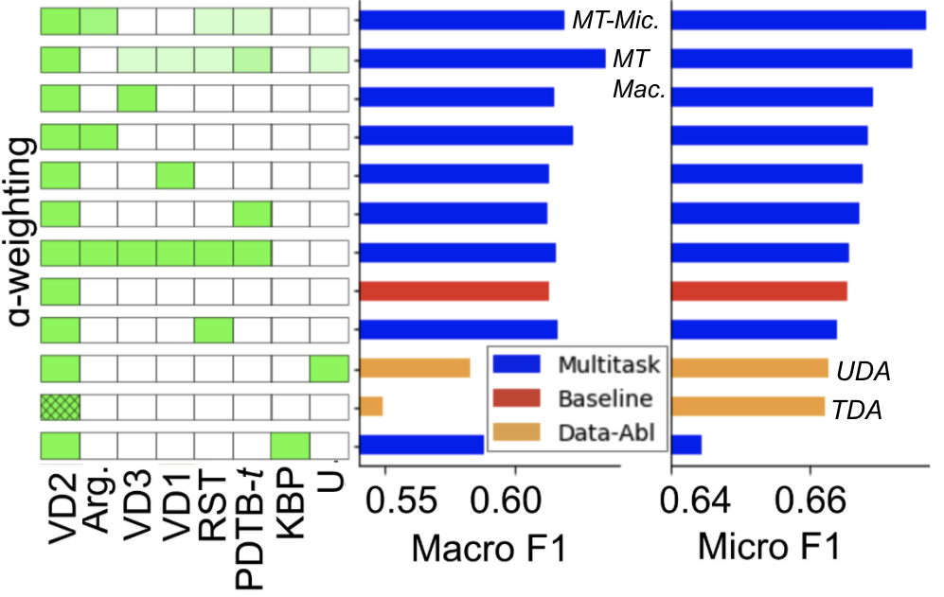
Multitask Outperforms Baseline and Data Ablations
Notes:
Say that semi-supervised learning is still a field we’d like to explore more
Look at the dataset sizes for semi-supervised task
Hyperparameter tuning -- performance improvements after the
We will still explore semi-sup as the TODO work
This is confusing -- what is data augmentation, how do you get this, what is the semi-supervised setting?
Needs some introduction here -- include another slide about what we’re about to see before this slide.
Be aware of the label-set size for each multitask

Slide 23
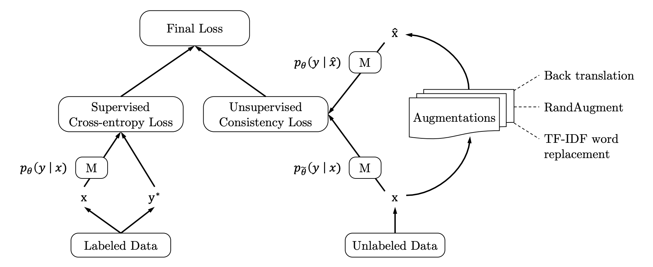
Two Data Ablations:
Training Data Augmentation (TDA) [6]
For each labeled pair (X, Y) in training set:
Generate k augmentations (X’, Y)
Add these to the dataset
Augmentation method: Back-translation (ex. English -> German -> English)
Unsupervised Data Augmentation (UDA) [7]

Slide 24
Multitask Outperforms Baseline and Data Ablations
Notes:
Say that semi-supervised learning is still a field we’d like to explore more
Look at the dataset sizes for semi-supervised task
Hyperparameter tuning -- performance improvements after the
We will still explore semi-sup as the TODO work
This is confusing -- what is data augmentation, how do you get this, what is the semi-supervised setting?
Needs some introduction here -- include another slide about what we’re about to see before this slide.
Be aware of the label-set size for each multitask

Slide 25
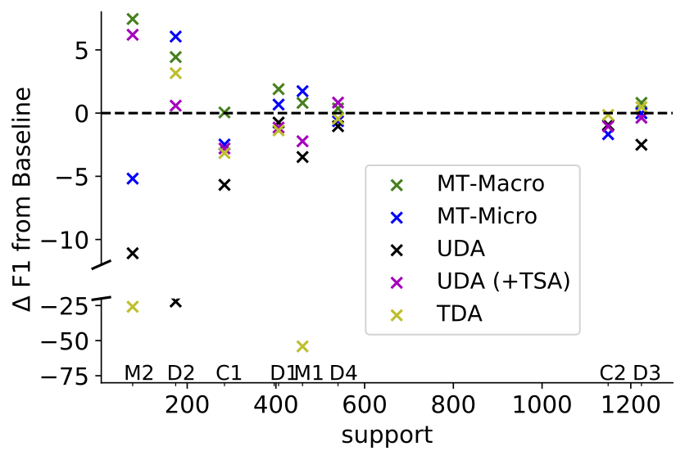
Multitask Learning Boosts Performance of Low-Support Classes

Slide 26
What can discourse tell us?
Insight #1: Different discourse-types complement each other.

Slide 27
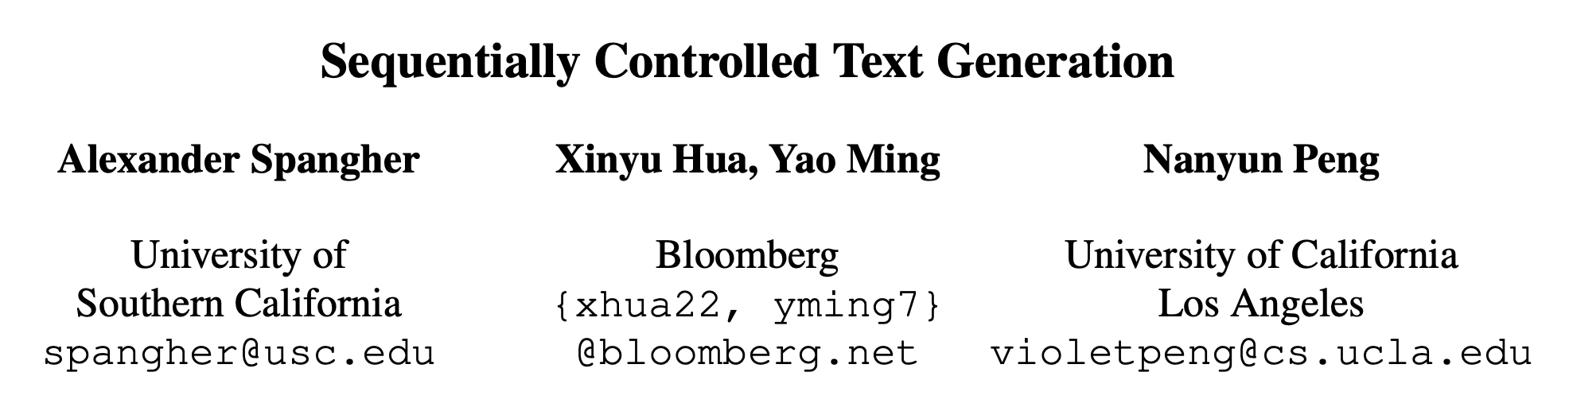
What can discourse tell us?
Insight #2: Discourse Helps Us Structure Text

Slide 28
{ “company”: “Apple Inc.”,
“datetime”: “01/01/2020”,
“eps”: “$5” … }
Step 1:
Given data,
propose article
structure
HEADLINE
Graf 1: Main Event
Graf 2: Context
Step 2:
Generate background
paragraphs
Step 3:
Model for recommending
sources
Graf 3: Expectation, Quote
Graf 4: History

Slide 29
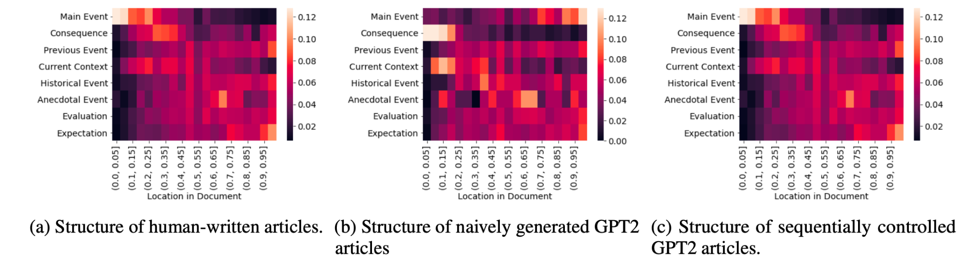
Right now, there’s no good way to control the structure of text generated by language models:

Slide 30
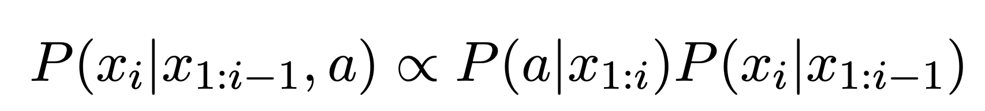
Controlled Text Generation
X_{i} is the current word you want to generate
X_{1… i-1} are the previous words you’ve generated
a is the control code

Slide 31
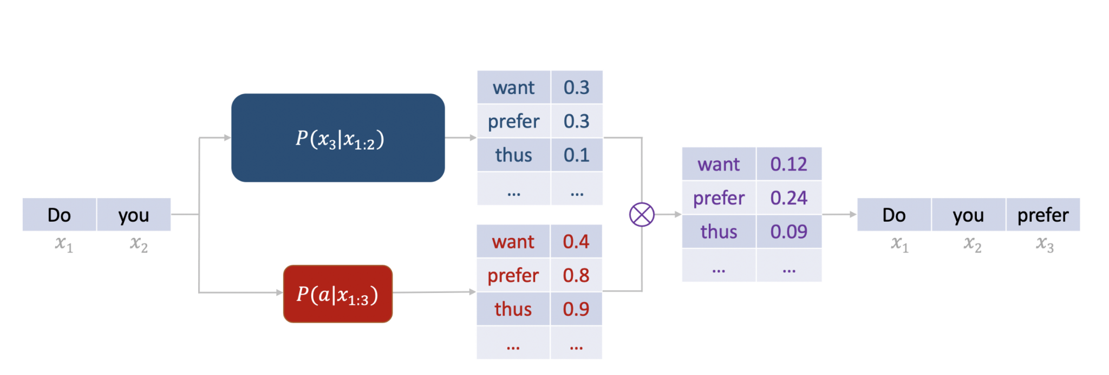
Controlled Text Generation

Slide 32
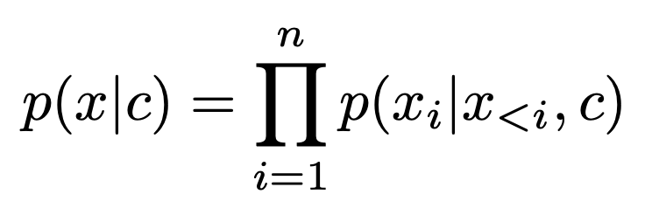
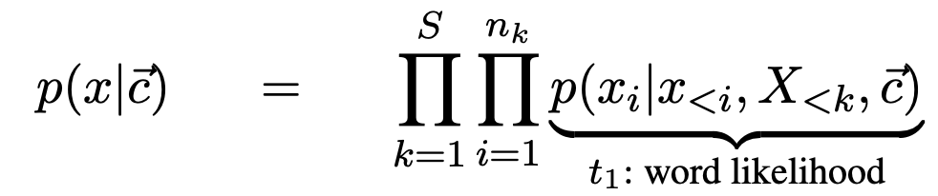
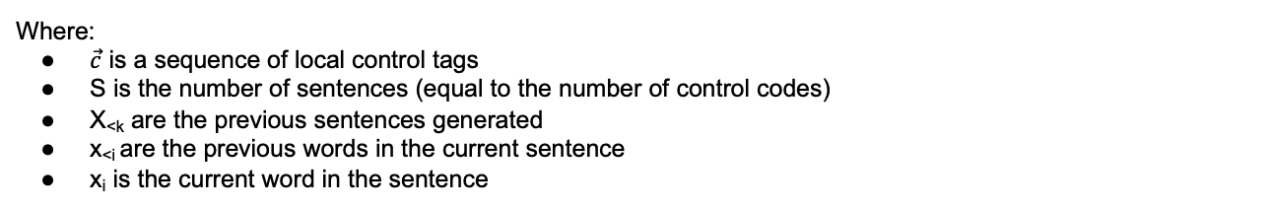
Sequentially Controlled Sequence Generation
Can we control the structure of text using a sequence of tags?
Instead of:
We have:
Where:
$\vec{c}$ is a sequence of local control tags
S is the number of sentences (equal to the number of control codes)
X_{<k} are the previous sentences generated
x_{<i} are the previous words in the current sentence
x_{i} is the current word in the sentence

Slide 33
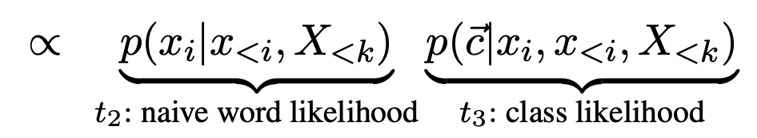
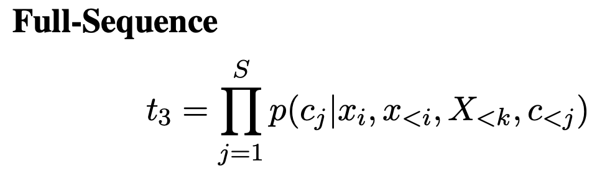
Factorization:
Naive language model (GPT2)
(except it needs to be able to generate enough words for a full news article ~2048 word pieces)
Discriminator…
How do we train a discriminator to predict a vector???

Slide 34
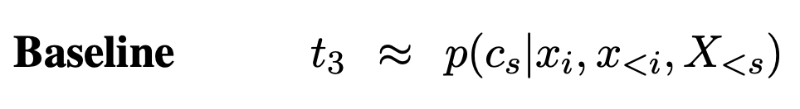
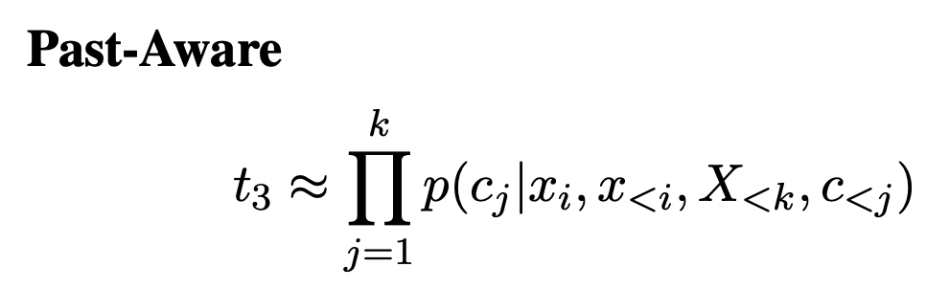

Slide 35
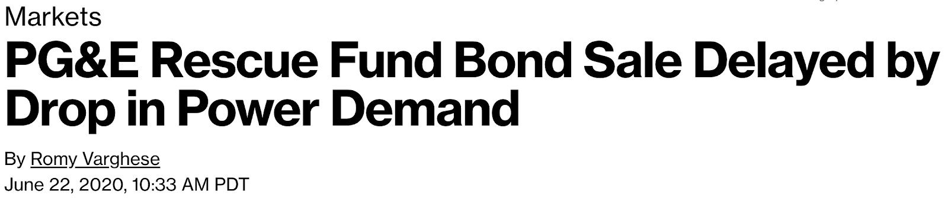
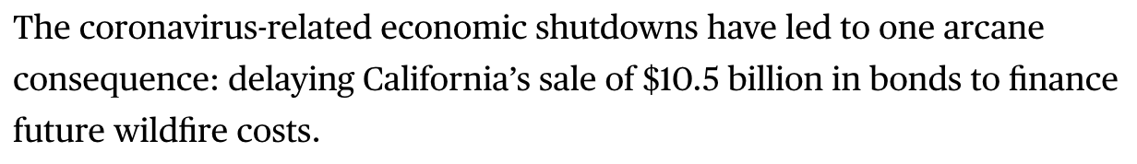
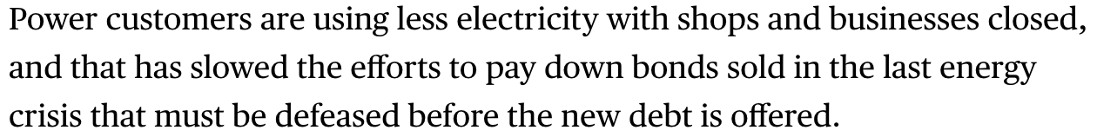
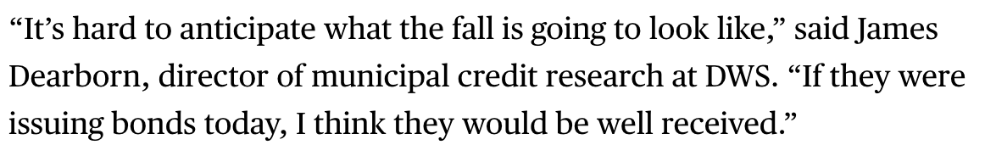
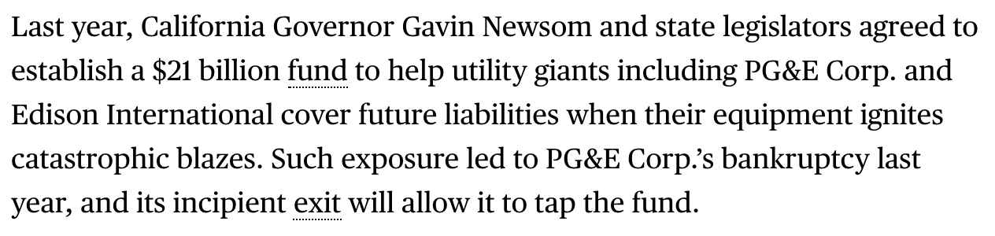
Dataset
Van Dijk News Discourse
Choubey, Prafulla K., et al. "Discourse as a function of event: Profiling discourse structure in news articles around the main event." ACL. 2020.
https://aclanthology.org/2020.acl-main.478/
Main
Event
Spangher, A., May, J., Shiang, S. R., & Deng, L.
Multitask learning for class-imbalanced discourse
classification. https://arxiv.org/abs/2101.00389
Context
NewsDiscourse: 800 articles
9 discourse labels:
Main Event
Background
Context
Evaluation
Sentence-level annotation
Verbal
Reaction
History

Slide 36
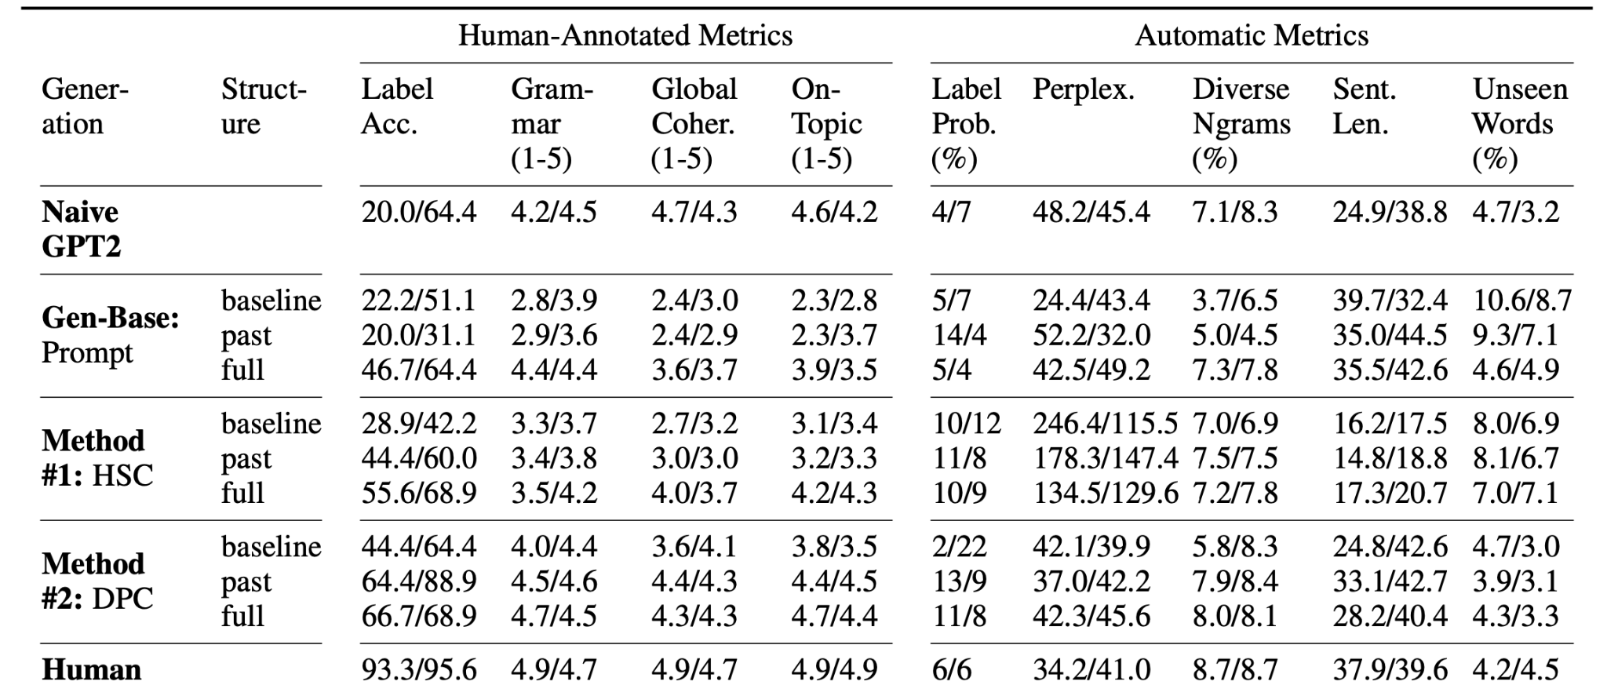
Results
https://aclanthology.org/2022.findings-emnlp.509
Notes:
baseline = local only, no awareness of other control codes
past-aware =
HSC = hidden state control; at inference time state is perturbed to take

Slide 37
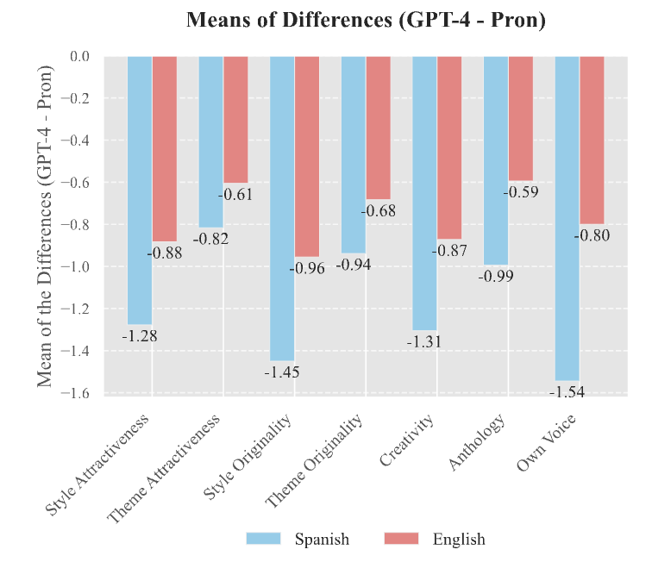
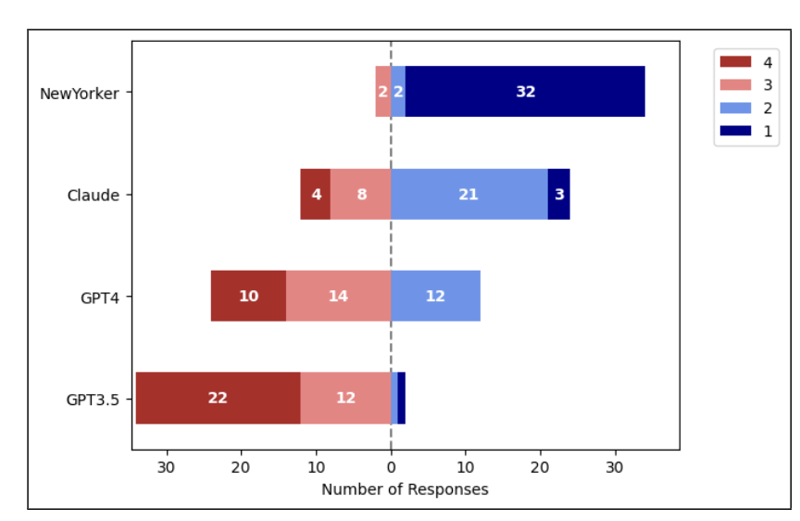
Humans don’t like model “creative” output
Likert rank
Pron vs. Prompt Marco et al. EMNLP ‘24
Art or Artifice? Chakrabarty et al. CHI ‘24
Why? Can we break down creativity more finely?

Slide 38
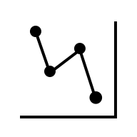

Discourse-Level Framework
How do stories generated by differ in narrative complexity and diversity from human storytelling?
Three aspects of plot progression
1. Macro-Level | Story Arcs
2. Meso-Level | Turning Points
3. Micro-Level | Arousal & Valence
Are Large Language Models Capable of Generating Human-Level Narratives?
Tian, ... May, ... et al. EMNLP ’24. Outstanding Paper Award
Notes:
1'30 To answer the question: do stories generated by LLMs exhibit the same narrative complexity and diversity as human storytelling?
We developed a quantitative assessment framework of narratives at three different discourse levels. From the coarse grained to fine grained, they are //1) story arcs 2) turning points, and 3) arousal & valence.
Don’t worry if these terms sound unfamiliar! Let's dive in and break them down together.

Slide 39
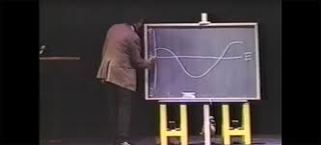
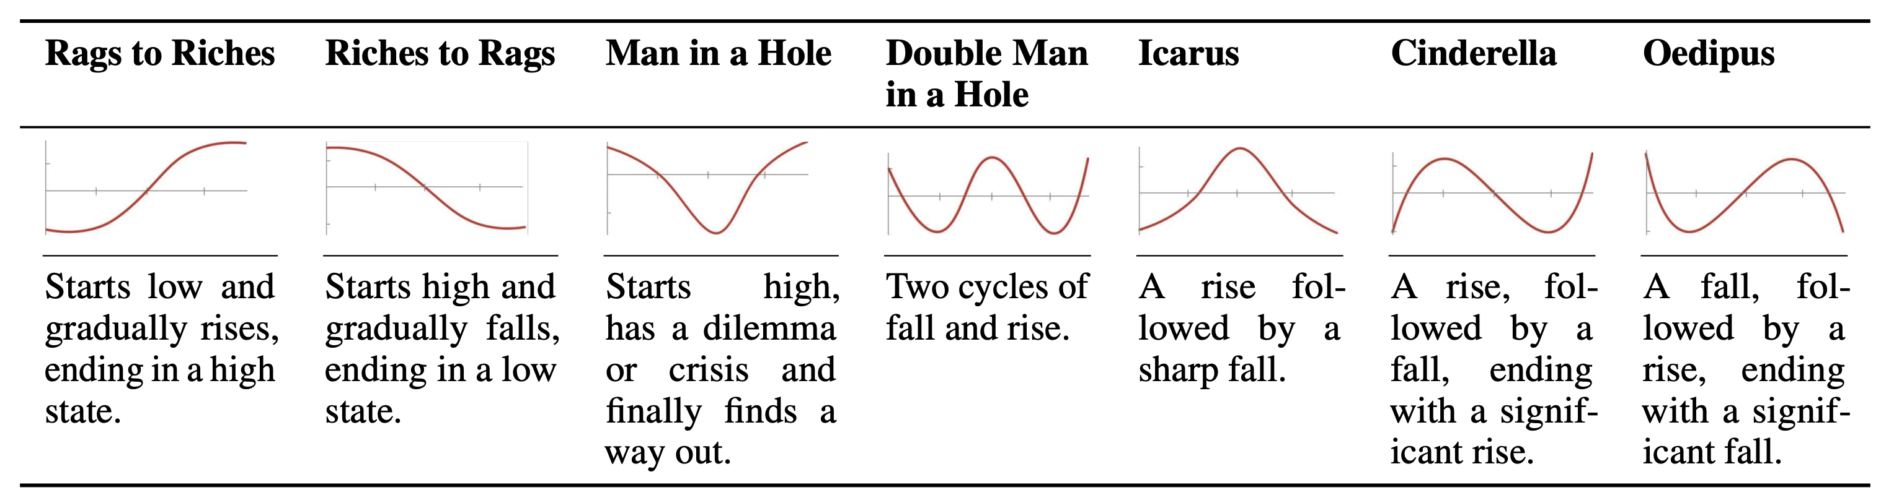
1 – Story Arc (Macro-Level)
“shapes of stories”
(worth a watch on youtube!)
Story arc types that are derived from Vonnegut (1995) and are characterized by transformations of the story’s protagonist(s) across the plot progression.
Notes:
2'10 First, story arcs represent the high-level plot development, such as rises and falls encountered by the main characters. We derived 7 common story arcs from literature, as listed in this table. They include rags to riches, riches to rags, man in a hole, and cinderella. //For example, in the Cinderella schema, the main character starts off in a low position, rises from adversity, faces a setback in the middle, and ultimately rises again, ending with a higher status. pause for 3 seconds

Slide 40

2 – Turning Point (Meso-Level)
Panic Room (Fincher, Foster, Whitaker ‘02)
Turning Point (TP) | Description
TP1 - Opportunity | The introductory event that sets the stage for the narrative.
TP2 - Change of Plans | A pivotal moment where the main goal of the narrative is defined or altered.
TP3 - Point of No Return | The commitment point beyond which the protagonists are invested in goals
TP4 - Major Setback | A critical juncture where the protagonists face significant challenges or failures.
TP5 - Climax | The peak of the narrative arc, encompassing the resolution of the central conflict.
Burnham and Raoul break into a house
Meg and Sarah run into their panic room
Sarah has a seizure
Meg lies to the police to save Sarah’s life
Burnham shoots Raoul before Raoul can shoot Meg
Turning Point (TP) Types: a turning point is an event that significantly influences a plot progression.
(Adapted from Papalampidi et al. ‘19)
Notes:
2'50 Next, we look at meso-level turning points—these are major events that shape how the plot unfolds, like transitions between rising and falling actions. We identify five key turning points: Opportunity, Change of Plans, Point of No Return, Major Setback, and Climax. The first three focus on setting up the story or building tension, the fourth deepens the conflict, and the final one, the Climax, brings resolution.

Slide 41
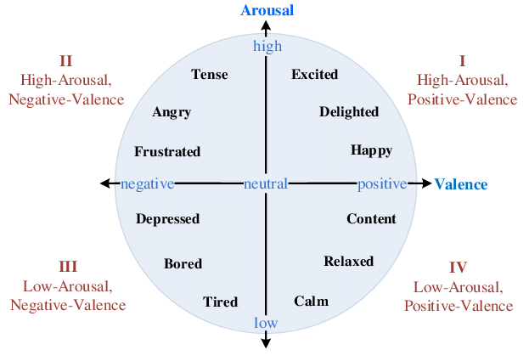
3 – Affective Dimensions (Micro-Level)
For each sentence …
Arousal:
intensity of emotions conveyed
Valence:
positivity or negativity of the emotions expressed
Labeled with NRC VAD lexicon (Mohammad, ‘18)
from Yu et al. NAACL ‘16
Notes:
3’30 Lastly, we use affective dimensions to get a finer look at sentence-level dynamics. We focus on two key aspects: Arousal, which measures the intensity of emotions, and Valence, which captures the positivity or negativity of the emotions. Both can be quantified on a 0 to 1 scale using an existing lexicon

Slide 42
Study Procedure
“Films are our culture’s Gesamtkunstwerk”
-- Annette Michelson, October, 1991
Create/Obtain Human & Model Narratives From Movies
Condensed movie synopses (not super popular ones)
Model and human share the initial setups
Model generates plans for outline and characters as intermediate steps, then generates whole (new) story
Annotation
1. Story Arcs | Human Expert (with/after TP)
2. Turning Points | Human Expert
3. Arousal & Valence | Smoothed lexicon analysis over generated relevant adjectives
Notes:
819 synopses total, then doubled to get 1638
Arc/TP: train 16 annotators thoroughly, have them annotate for turning points, then consider what arcs that fit well into. .9 spearman’s (there’s a bit of a numerical relationship in arc), .6 cohen’s
Arousal/Valence: identify main character, for each sentence infer 3 adjectives about the main, then use VAD lexicon to find arousal/valence for each adj. take average. interpolated and averaged to form 100%
3‘55 we take the condensed version of films, as a basis for our study, because they are arguably the most intriguing stories in our culture.
We ran controlled experiments to compare human and ai stories across the three dimensions I mentioned. Here, the LLMs don’t just take one shot to write the stories, but instead, plans for the outline before expanding to the full narratives.
// To analyze the results, we combined human expert annotations with automated scoring. So, what did we find out?

Slide 43
Human vs. AI Turning Point Positions
Models incorrectly pace their storytelling relative to human writers.
Learned correct pacing
Struggle to unfold adequately
e.g. “deus ex machina” turns that are not adequately justified or “earned.”
Too early in machine outputs!
Notes:
4’35 The first difference we observe between human and AI is that LLMs incorrectly pace their stories compared to human writers.
In this violin plot, we show the position of five turning points in orange and blue, which contrasts human and machine. The Y axis means the relative position of these turning points, starting from 0, the start of the narrative to 1, the end. we observe a substantial early occurrence of TP4- major setup, and TP5 – climax, in AI outputs,
This suggests that while LLMs // grasp the correct pacing to establish the initial setup, they still struggle to unfold the most //crucial junctures adequately. For example//, AI tend to write easy miracle turns that are not sufficiently justified.

Slide 44
Arousal & Valence
Arousal: intensity of emotions
Valence: positivity or negativity of the emotions
Poor pacing, low intensity leads to flat narratives without suspense!
Bias toward positive endings!
Notes:
5’45 Second, based on the sentence-level dynamics, we find that AI generate flat narratives without enough suspense. As is shown in this curve of arousal, human consistently write with higher emotion intensity. //The gap between human and LLMs enlarges from the midpoint to the end.// They are also biased towards much more positive endings compared to humans, as is shown in the valence curve on the right hand side!// pause for 3 seconds

Slide 45
LLMs lack narrative diversity!
Simpler plots (↑29%) and fewer negative plots (↓ 22%)
Notes:
6’20 Last but not least, we find that the share of story types, between human and LLM show significant differences. //AI is much more likely to generate story with less inflections or complexity, such as rags to riches and man in the hole,// and are unlikely to generate negative plot progression such as riches to rags, and Oedipus, which accounted for 25% of human narratives, but only 3% of LLM-generated narratives.

Slide 46

If we include discourse, will that make for a better storyteller?
Notes:
8’05 Finally, Towards more captivating and Diverse AI Story-Telling, we investigate whether incorporating the discourse aspects into the planning stage enhances machine’s storytelling ability. --- And the answer is Yes!

Slide 47

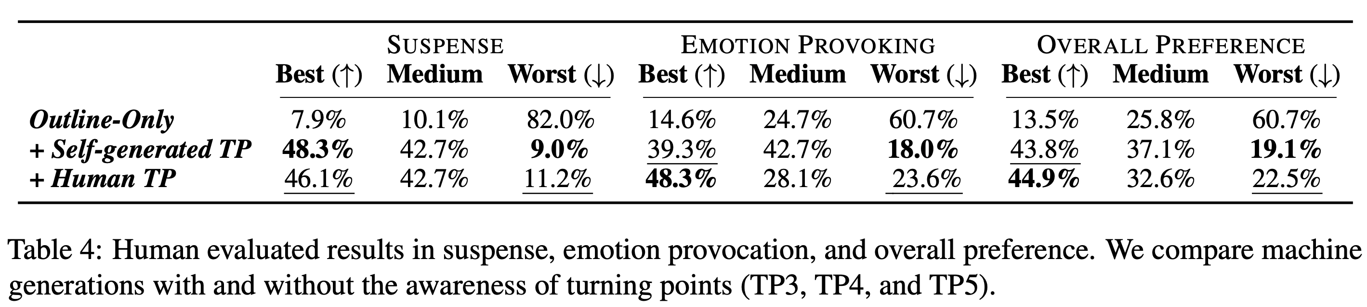

More captivating AI Story-Telling
Planning and reasoning about TP in the story outline
improves overall narrative construction
reduce plot holes
enhance suspense and emotion provocation
Notes:
8’20 Compared to simply instructing the model to generate an outline, then expand it to a full story.
We find that explicitly asking the model to mark these turning points during the planning stage// improves the overall narrative construction including reduced plot holes, enhanced suspense level, and greater emotion provocation.
Interestingly, enforcing the gold turning points that human wrote didn’t further improve the quality. We realize that this is because that such enforcement could disrupt the machine’s generative flow, and make the whole plot illogical

Slide 48
Ongoing Work
Facebook Post
Tweet
Jialiang, Tenghao, Alex, Muhao
Using genetic algorithms and GPT4 to generate summaries with specific kinds of structure
News article
LinkedIn

Slide 49
What can discourse tell us?
Insight #2: Discourse Helps Us Structure Text

Slide 50
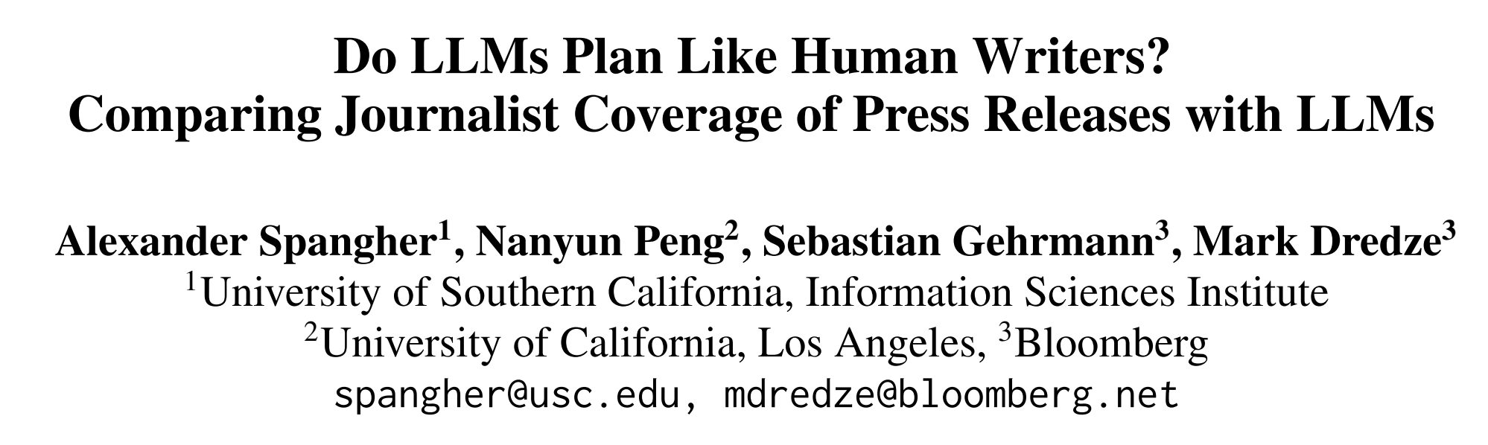
What can discourse tell us?
Insight #3: Discourse Can Help Us Plan
EMNLP 24

Slide 51
News Coverage
Finding background
Calling a source
Calling another source
a₁
a₂
a₃
a₄
actions:
…
d₁
d₂
discourse:
…
words:
…
w₁
w₂
w₃
w₄

Slide 52
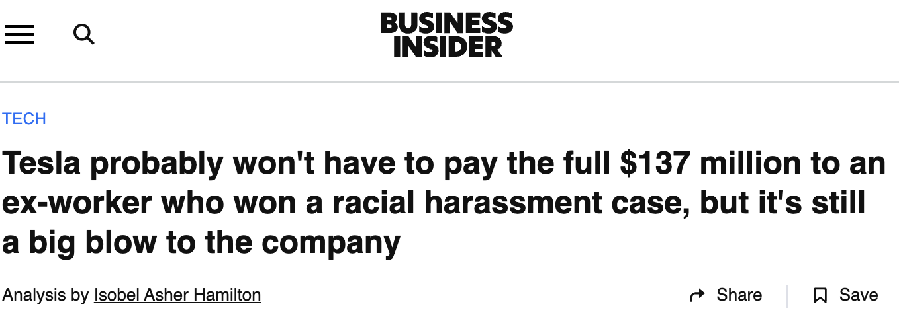
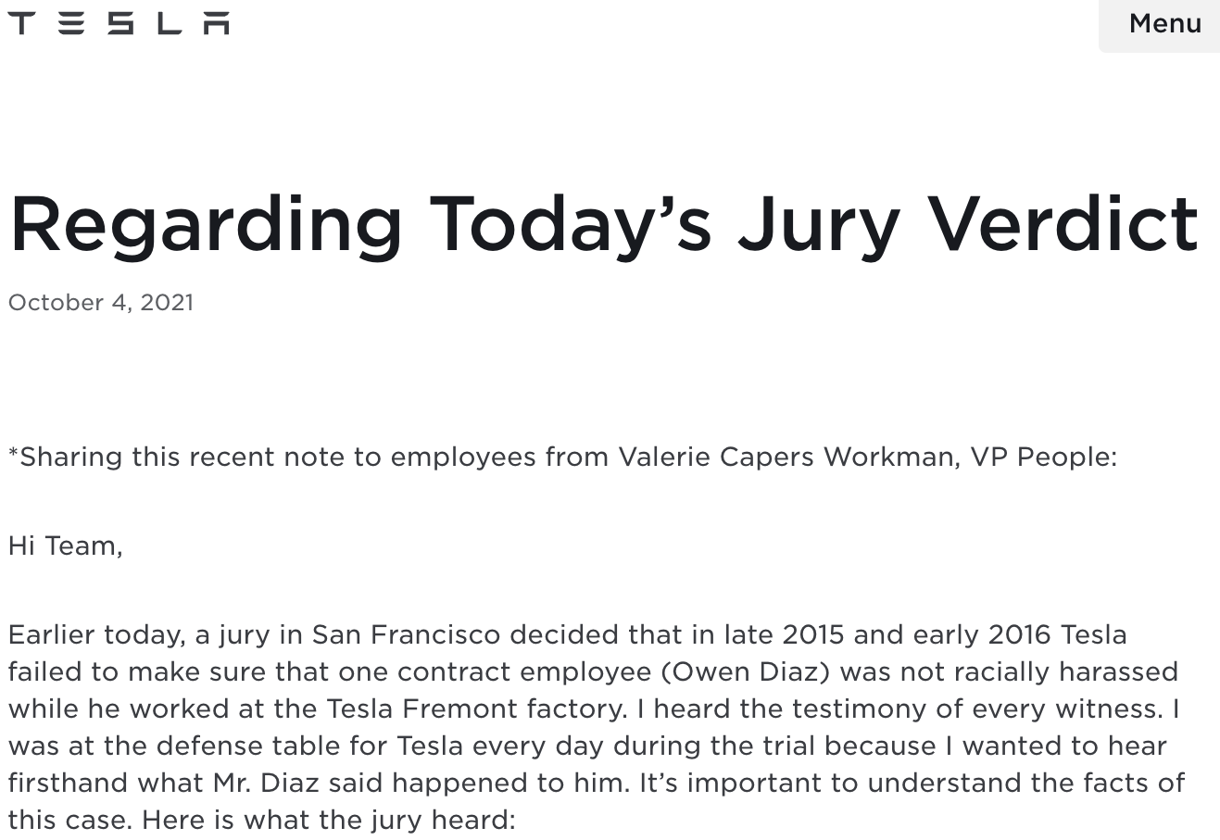
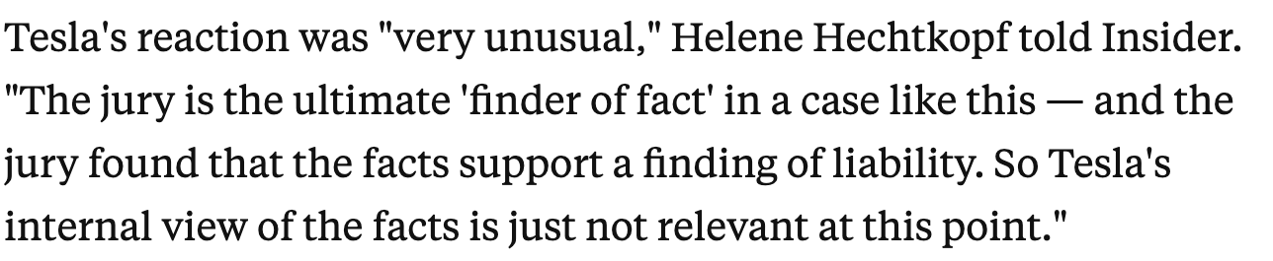
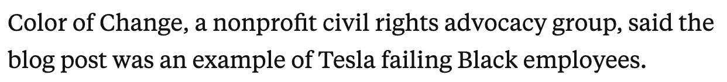
News Coverage of Press Releases
Angle: de-spin
Source: contextualization
spin
Source: broadening

Slide 53
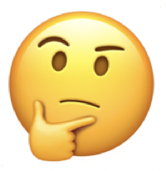

Goal
LLMs are being used increasingly as aids in human workflows.
We need to understand how their decisions differ from those humans would have made.
How well do LLM planning suggestions align with the decisions humans make?
How creative are LLM planning decisions?
Is this part of a larger, negative pattern?
Let’s describe the event in detail…
Angle
Source #1
Employment
lawyer
Spokesperson
Source #2
Advocacy
group
Business professor
Source #3
Legal professor
Insider

Slide 54
Inferring Human Plans
Human plan:
LLM
Is this part of a larger, negative pattern?
Here is a press release: {{Press_Release}}
Here is a news article: {{News_Article }}
Angle
Press
Release
(Angle) What specific focus does the journalist take? How does they challenge "spin", or positive portrayals?
(Sources) Which kinds of sources does the human use in their reporting?
Source #1
Employment
lawyer
News
article
Source #2
Advocacy
group
Source #3
Insider

Slide 55
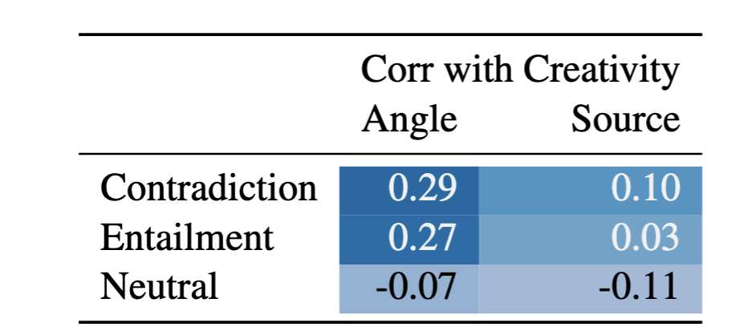
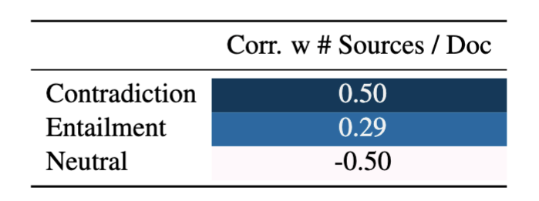
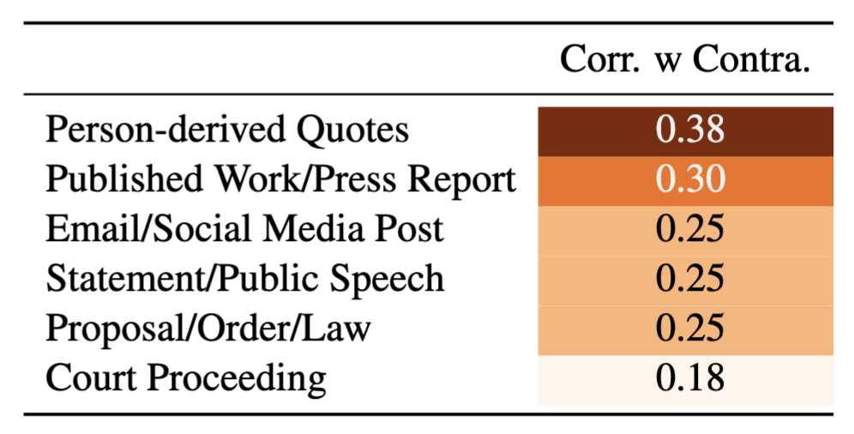
Insights
Insight #1: Effective coverage has significantly more creative angles, slightly more creative sources.
Insight #2: Effective Coverage uses more sources
Insight #3: Effective coverage uses more labor intensive sources.

Slide 56
Main Experiment: Comparing LLM Planning to Human
Press release
Press release
News article
LLM
LLM
(Angle) What are potential directions to investigate? How would a news article de-spin this?
(Sources) What are some kinds of sources I should use to pursue these angles?
(Angle) What specific focus does the journalist take? How does they challenge "spin", or positive portrayals?
(Sources) Which kinds of sources does the human use in their reporting?
Let’s describe the event in detail…
Is this part of a larger, negative pattern?
Angle
❌
❌
Source #1
Spokesperson
✅
❌
Employment lawyer
Source #2
Business professor
❌
Advocacy group
❌
Source #3
Legal professor
Insider
❌

Slide 57
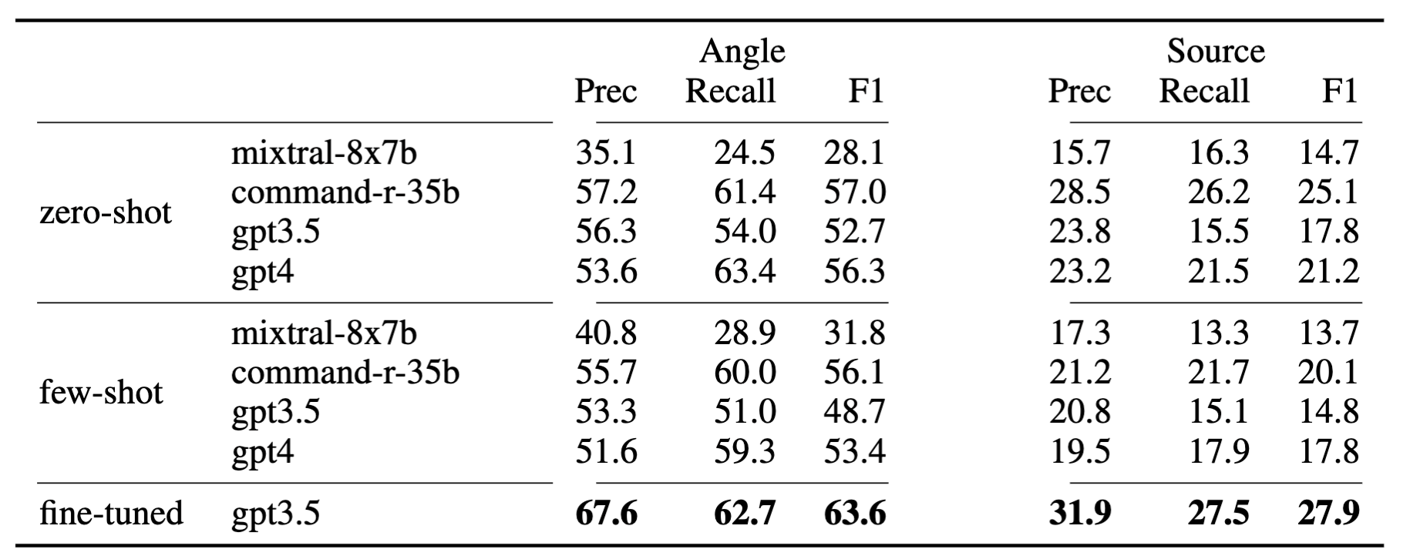
Result #1: LLMs do well at suggesting angles that humans use, but are less likely to suggest the right kinds of sources

Slide 58
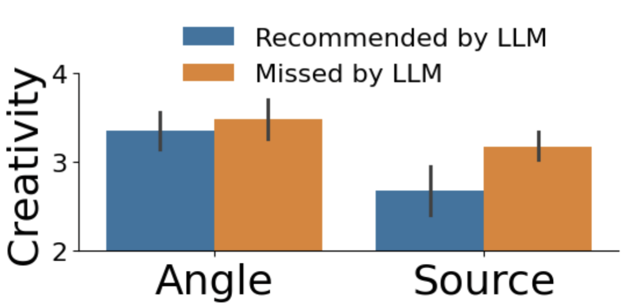
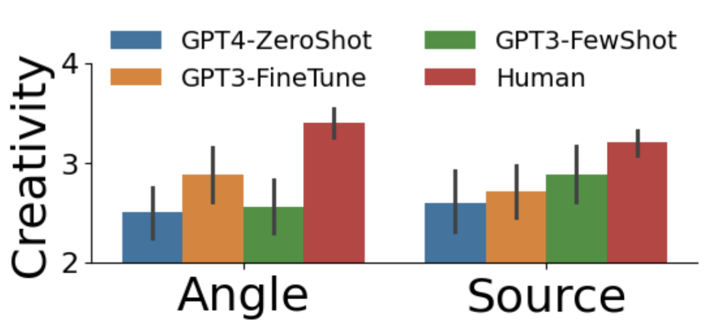
Result #2: LLMs are significantly less creative than humans

Slide 59
What can discourse tell us?
Insight #3: Discourse Can Help Us Plan

Slide 60
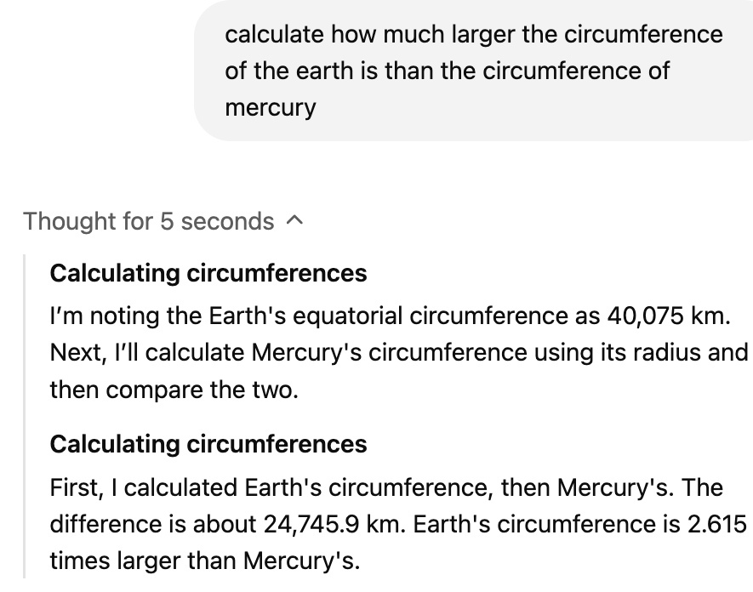
Takeaways
We are seeing over, and over, and over again that naive language modeling doesn’t capture:
Human-like discourse structure
Although this is very learnable with some supervision!
Human-like plans (or action-sequences) are not like LLM plans.
Is this learnable?

Slide 61
Post-Modern Discourse:
Learning our own discourse schemas

Slide 62
TopicGPT

Slide 63
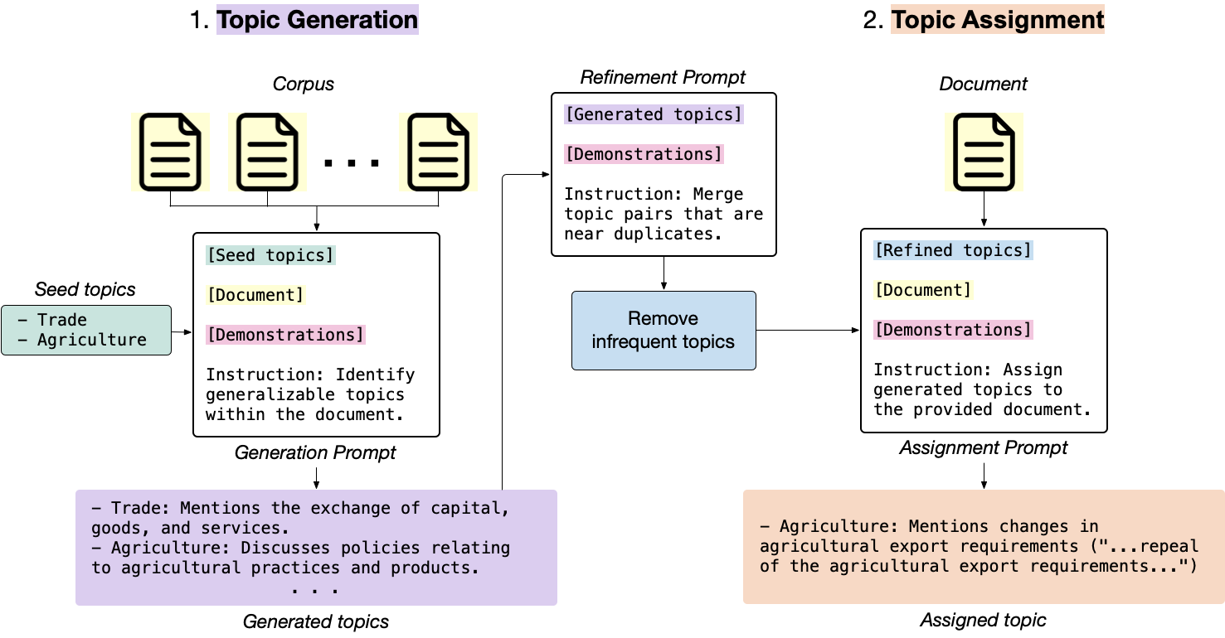
TopicGPT

Slide 64

TopicGPT

Slide 65
Observation: the initial prompt can change
>>> What narrative role does this source play?
{source}
'"Authority": This source is used to provide information about the Framingham Heart Study and its findings.'
"Illustrator": This source is used to provide information about the artwork
"Expert": This source is used to provide information about the development…

Slide 66
Observation: removing seeds increases the creativity
Existing lists/seeds can constrain the creativity of LLM.
We found that the LLM does better without any existing seeds.

Slide 67
Observation: Improvement needed on refinement step
Original Approach: Uses SBERT to embed each topic. Calculates cosine similarity and clusters topics based on >.5 (Note: BERTopic does this too.)
This often fails with more complicated discourse tags!
Error Example:
"Insight": This source provides insight into Huawei's strategy for licensing its 5G technology to US companies.
"More Context": This source provides more context for events happening at the time so we can better understand the impacts.
"Example": This source is used as an example to illustrate the mobile payment solution.”

Slide 68
Observation: Improvement needed on refinement step
Our approach:
Use LLM to label 400,000 pairs of labels as “same” and “not same”
Train SBERT bi-encoder using this supervised data.
Naive SBERT:
F1 = .35
Trained SBERT:
F1 = .65
Avg. cosine distance
no 0.280045
yes 0.365856
Avg. cosine distance
No 0.348549
Yes 0.517865

Slide 69

Observation: We can hierarchically cluster
Approach: like BERTopic, we can use hierarchical clustering methods to cluster groups.
Then, we can use GPT to generate cluster labels for each group

Slide 70
Observation: We can hierarchically cluster
'"Disclaimer": This source is used to provide legal disclaimers…
>
'"Legal and Disclosure": This collection of sources is used to provide legal disclaimers, copyright information, data protection notices
>
'"Transparency and Compliance": This collection of sources is used to provide critical legal disclaimers, copyright information, data protection notices, transparency statements, funding details, affiliations, conflicts of interest, and practices and policies
>
'"Source Credibility": This label provides comprehensive information regarding the financial, professional, and biographical context, including affiliations, legal compliance, conflicts of interest
>
'"Enhanced Narrative Integrity": These sources collectively provide extensive background information, credible insights, data, context, and authoritative perspectives, ensuring the accuracy, reliability, and engagement of various articles and topics.',

Slide 71
Thanks!
Questions?
alexander.spangher@gmail.com

