Slide 1
A Better N-Best List: Practical Determinization of Weighted Finite Tree Automata
Jonathan May and Kevin Knight
University of Southern California/Information Sciences Institute
June 7, 2006
Notes:
CAN YOU HEAR ME?

Slide 2
Acknowledgments
Summer 2005 ISI Treeworld workshop
  Steve DeNeefe, Jonathan Graehl, Mark Hopkins, Liang Huang, Quamrul Tipu
Draft reviewers
  Daniel Marcu, David Chiang
Special Thanks
  Magnus Steinby

Slide 3
Motivation
NLP applications such as translation, speech recognition, and parsing rely on ranked lists of weighted results
These lists frequently contain many instances of the same result with different weight
A list with repeated results can be harmful
  Lack of useful information hampers diagnostics
  Prevents potential alternatives from being reranked
  Actual score of results is misrepresented
23.18
23.24
23.24
23.26
23.30
23.31
23.44
23.47
23.49
23.52
Scores are negative log weights, thus a lower score is better
Notes:
In evaluation mode only the one-best is needed, but in intermediate steps or while debugging we are quite concerned with a list of results. We want to reshuffle (rerank) or figure out how to tweak feature weights to get the “correct” answer to the top of the list, or if the correct answer isn’t in the list, figure out why not. If there’s repetition in the lists, these tasks become more difficult, if not impossible.

Slide 4
Motivation
﻿34.73: this cases had caused the american protests .
34.74: this cases had aroused the american protests .
34.83: this cases had caused the american protests .
34.83: this cases had aroused the american protests .
34.84: this cases had caused the american protests .
34.85: this cases had caused the american protests .
34.85: this cases had aroused the american protests .
34.85: this cases had aroused the american protests .
34.87: this cases had arouse the american protests .
34.92: this cases had aroused the american protests .
Notes:
An mt system. Most important point is that there are only three distinct sentences in this top-10 list

Slide 5
Motivation
﻿34.73: S(NP-C(NPB(DT(this) NNS(cases))) VP(VBD(had) VP-C(VBN(caused) NP-C(NPB(DT(the) JJ(american) NNS(protests))))) .(.))
34.74: S(NP-C(NPB(DT(this) NNS(cases))) VP(VBD(had) VP-C(VBN(aroused) NP-C(NPB(DT(the) JJ(american) NNS(protests))))) .(.))
34.83: S(NP-C(NPB(DT(this) NNS(cases))) VP(VBD(had) VP-C(VBN(caused) NP-C(NPB(DT(the) JJ(american) NNS(protests))))) .(.))
34.83: S(NP-C(NPB(DT(this) NNS(cases))) VP(VBD(had) VP-C(VBN(aroused) NP-C(NPB(DT(the) JJ(american) NNS(protests))))) .(.))
34.84: S(NP-C(NPB(DT(this) NNS(cases))) VP(VBD(had) VP-C(VBN(caused) NP-C(NPB(DT(the) JJ(american) NNS(protests))))) .(.))
34.85: S(NP-C(NPB(DT(this) NNS(cases))) VP(VBD(had) VP-C(VBN(caused) NP-C(NPB(DT(the) JJ(american) NNS(protests))))) .(.))
34.85: S(NP-C(NPB(DT(this) NNS(cases))) VP(VBD(had) VP-C(VBN(aroused) NP-C(NPB(DT(the) JJ(american) NNS(protests))))) .(.))
34.85: S(NP-C(NPB(DT(this) NNS(cases))) VP(VBD(had) VP-C(VBN(aroused) NP-C(NPB(DT(the) JJ(american) NNS(protests))))) .(.))
34.87: S(NP-C(NPB(DT(this) NNS(cases))) VP(VBD(had) VP-C(VB(arouse) NP-C(NPB(DT(the) JJ(american) NNS(protests))))) .(.))
34.92: S(NP-C(NPB(DT(this) NNS(cases))) VP(VBD(had) VP-C(VBN(aroused) NP-C(NPB(DT(the) JJ(american) NNS(protests))))) .(.))
Notes:
It’s really a syntax-based mt system, so the output is English trees that are a translation of a chinese string. But the point remains - three unique trees.

Slide 6
Motivation
These are the best 10 English translation parse trees from a syntax-based translation model based on (Galley, et. al. 2004)
Multiply repeated trees in a ranked list is a common occurrence, and is due to combinations of weighted partial results of various sizes
There is not much information in that highly repetitive list
Notes:
The problem here is a typical problem in any system where results are built piece by piece from pieces of different sizes. By allowing the same tree result to be constructed, we reduce the amount of information provided by our system.

Slide 7
Motivation
﻿31.87: this cases had aroused the american protests .
32.11: this cases had caused the american protests .
32.15: this cases had arouse the american protests .
32.55: this cases had cause the american protests .
32.60: this cases had attracted the american protests .
33.16: this cases had provoke the american protests .
33.27: this cases causing the american protests .
33.29: this case had aroused the american protests .
33.31: this cases had aroused the protest of the united_states .
33.33: this cases had incurred the american protests .
This list has much more information!
Notes:
Imagine if the mt system output for its top-10 list 10 unique sentences! There is much more info, allowing us to see, for example, that the singular “case” is actually in the list, though not as high as we would like, and that there aren’t many agreements with the verb and the subject.

Slide 8
What This Talk Is About
FSA
To obtain string output NLP systems produce finite-state (string) automata
To obtain tree output NLP systems produce finite-state tree automata
FTA
Notes:
Source: http://www.kidcrosswords.com/kidoutdoors/where%20to%20go/forest.htm

Slide 9
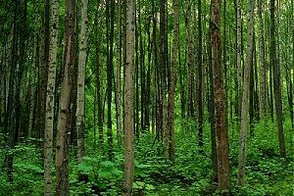
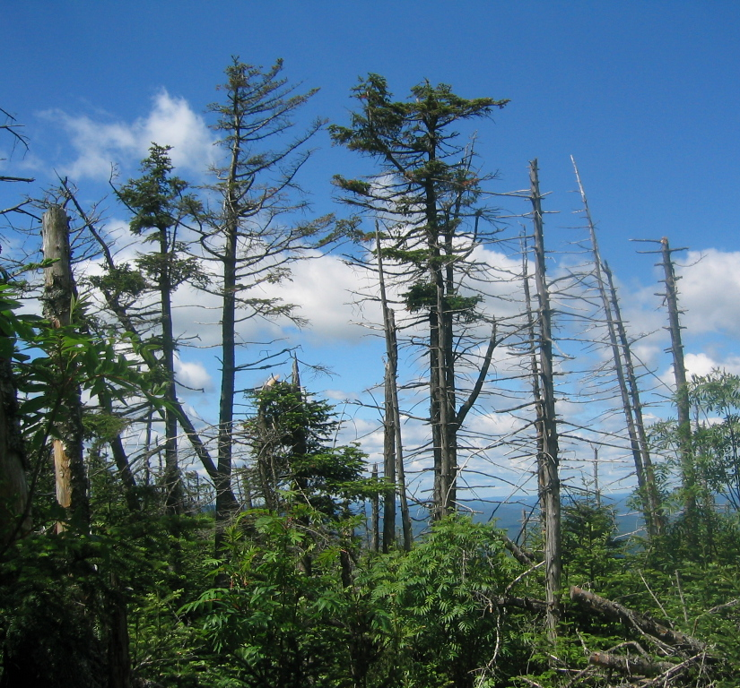
What This Talk Is About
NLP systems produce FTAs that generate the same tree in many ways
Notice the duplicates!
We introduce a determinization algorithm that transforms these FTAs such that each tree is unique and empirically evaluate the impact of determinization
Determinize
Each tree is unique!
Notes:
Source: http://www.adirondackphotos.info

Slide 10
What This Talk Is About
Applications such as syntax-based machine translation, parsing, sentence compression, etc. have tree output
The mechanisms that produce this output are constructed such that repetition is common
We present an algorithm that takes as input a tree automaton that can produce repetitive lists and returns as output an equivalent automaton that produces no repetition
An algorithm such as the one proposed in (Huang and Chiang, 2005) is used to acquire n-best lists
Notes:
We’d like to in general be able to obtain lists like the last one when working with nlg systems that produce lists like the first one. NLG systems producing trees by assembling various weighted parts can be envisioned as tree automata, and the algorithm we present returns equivalent automata with no repetition. By using an algorithm to return n-best lists of trees given a weighted tree automaton, we can acquire the lists we want.

Slide 11
Motivation
S
NP
=
0.05
R3:
=
0.01
R1:
NP
VP
S
fish
R2:
=
0.3
fish
VP
VP
NP
R4:
=
0.01
swim
P(tree using R1, R4) = 0.005
P(tree using R2, R3, R4) = 0.003
We would prefer to say P(tree) = 0.008
Notes:
Make this a backup slide

Slide 12
Previous Work
In (Mohri, 1997), this problem was addressed for wFSAs. This work extends that algorithm to wFTAs
(Gécseg and Steinby, 1984) summarize the formalisms of tree automata
(Borchardt and Vogler, 2003) present a solution to the determinization of wFTAs but their solution generates impractically large automata
Notes:
The algorithm by mohri is our inspiration for this work. We have applied his innovative method of bookkeeping to tree automata in order to achieve these results. GS is useful for a foundation of tree automata. BV attacked the determinization problem from the theoretical perspective, but their method is impractical, as the automata resulting from determinization can be as large as the size of the recognized language.

Slide 13
Finite State Automata
A/0.7
B/1
C/0.4
ABC = 0.7•1•0.4 = 0.28
ABD = 0.7•1•0.6 = 0.42
ABC = 0.3•1•1 = 0.3
q
s
p
D/0.6
u
r
B/1
t
C/1
A/0.3
determinize
A/1
B/1
C/0.58
p
qr
u
ABC = 1•1•0.58 = 0.58
ABD = 1•1•0.42 = 0.42
st
D/0.42
(Mohri, 1997)
Notes:
Tree automata may be unfamiliar but you’ve probably seen finite state string automata. By following a path from the start state to an end state and multiplying weights along the way you can see the strings accepted by this automaton and the weight associated with it. Notice there are two paths that recognize the string ABC. This undeterminized automaton is converted by Mohri’s determinization algorithm, that converts to…
This automaton, which recognizes the same language, but has a single path for ABC, with a weight equal to the sum of the two paths in the undeterminized automaton.

Slide 14
Finite State Tree Automata
Finite State (String) Automata (FSA) represent potentially infinite sets of strings
Similarly, Finite State Tree Automata (FTA) represent potentially infinite sets of trees
FTA are the automata dual of Regular Tree Grammars (RTG)
RTGs are similar to CFGs, though they have greater expressive power
Notes:
We’re concerned with FTA, not FSA. FTA represent the class of regular trees. They are generally represented with a regular tree grammar, which is similar to the more familiar CFGs but has greater expressive power due to the notion of state.

Slide 15
Finite State Tree Automata
A/0.3
q
1
This is a wFTA that accepts three trees, two of which are duplicates
D/0.2
D
B/0.2
=
0.054
p
2
t
0.18
r
1
B/0.6
D/0.3
A
B
2
C/0.4
s
Notes:
1) wfsa represents potentially infinite set of weighted strings. By analogy fta represents potentially infinite set of trees.
2) FTA are visualized like FSAs but notice that this is a directed hypergraph - it has hyperedges with multiple tails. We read a hyperpath through the hypergraph, starting with the start state,
3) Then following multiple paths…
4) So that a hyperedge may be followed.
This determines an accepted tree and the relevant weight.
Say ftas are similar to cfgs (except for state if ppl ask).

Slide 16
Finite State Tree Automata
A/0.3
q
1
D/0.2
p
B/0.2
2
t
r
1
B/0.6
D/0.3
2
C/0.4
s
D
D
D
=
0.054
=
0.036
=
0.012
A
B
A
C
A
B
Notes:
Like I said, there are three represented trees, two of which are duplicates
We saw this hyperpath before
We can also do D(A C)
And there’s an alternate way to get D(A B)

Slide 17
Determinization Algorithm
A/0.3
q
1
D/0.2
p
B/0.2
2
t
r
1
B/0.6
2
D/0.3
C/0.4
s
The residual affects the contribution of each edge to the total
Two edges apply to this pair of states
A/0.3
If more than one outgoing edge in an old automaton state has the same symbol…
D/0.275
(q, 1)
Set the cost of the single edge as the sum of the edges of the old automaton…
New automaton
is initialized to a
start state
1
(p, 1)
B/0.8
2
(t, 1)
…but “remember” the contribution of each edge
…create a state in the new automaton that represents all the states that could be reached
(r, ) (s, )
(r, .25) (s, .75)
1
2
D/0.3
C/0.4
(s, 1)
0.2•1 • 0.25 + 0.3 • 1 • 0.75 = 0.275
Notes:
I’m going to demonstrate the algorithm via example, rather than displaying the actual algorithm, which is in the paper. To construct the new automaton, we start by copying the start state of the old automaton. We mostly want to simply copy the old automaton, but when we reach a point of nondeterminism…
We instead create a state representing all the states that could be reached
And add an arc with the sum of all the nondeterministic edges
However, we remember the contribution of each state in the old automaton
The other two arcs are copied as normal (the “contribution” in this case is 1)
Since the lower state represents 2 different “old” states two edges apply here
The remembered bit, or residual, is multiplied into the rule in which it is used

Slide 18
Determinization Algorithm
D
=
0.054
A/0.3
(0.3•0.6•0.3)
q
1
A
B
D/0.2
D
p
B/0.2
2
t
=
0.012
r
1
(0.3•0.2•0.2)
B/0.6
D/0.3
A
B
2
D
C/0.4
s
=
0.036
(0.3•0.4•0.3)
A
C
determinize
A/0.3
D
=
0.066
D/0.275
(0.3•0.8•0.275)
(q, 1)
A
B
1
(p, 1)
B/0.8
2
(t, 1)
D
(r, ) (s, )
=
0.036
(r, .25) (s, .75)
1
D/0.3
(0.3•0.4•0.3)
2
A
C
C/0.4
(s, 1)
Notes:
We can see that the original automaton is nondeterministic
While the determinized automaton produces the same language as its predecessor but with a single hyperpath for each recognized tree.

Slide 19
Determinization Algorithm
Goal: produce new automaton with only one path per unique tree
New automaton is initialized to a start state
If more than one outgoing edge in an old automaton state or set of states has the same symbol, create a state in the new automaton that represents all the states that could be reached by the old automaton
Set the cost of the single edge as the sum of the edges of the old automaton, but “remember” the contribution of each edge
Notes:
To recap, we, for the most part, copy the previous automaton, but when we hit a point of non-determinism, we create a state that represents all reachable states, remembering the contribution, and push that proportional remembering forward.

Slide 20
Empirical Tests
The determinization algorithm was applied to packed-forest English outputs of both a string-to-tree MT system and a data oriented parsing (DOP) system
In each case the main result is the reduction of the number of trees in each forest and the degree to which this affects the top-scoring tree
If the models that produced these results are good, and the evaluation metrics are good, this should also result in higher task evaluation scores
Notes:
We explored the impact of applying this determinization to actual outputs with two real-world applications, mt and data oriented parsing. We hoped to demonstrate that there was a great amount of nondeterminism in the automata that represented the results. Since determinized automata have the “proper” weight for each tree, if the model we’re using is good, this should result in better scores, however it is not the primary goal of the algorithm.

Slide 21
Empirical Tests
Machine Translation
Data-Oriented Parsing
(Bod, 1992)
Lists from (Huang and Chiang, 2005)

Slide 22
Empirical Results
How many trees?
How often does the top-scoring tree change?
How do the results change?

Slide 23
Machine Translation
Decoded 116 short Chinese sentences using the string-to-tree MT model based on (Galley, et. al. 2004)
  No language model
  No reranking
Counted number of trees in each forest before and after determinization
Notes:
We used our syntax mt system from about a year ago to decode a short batch of sentences, and considered the automata representing the result set. We counted how many trees were in each forest, comparing the results before determinization to after determinization as a way of seeing how many multiple paths for the same tree are removed via determinization. We also compare our results to a common way of approximating these results, by taking the top 500 trees from the undeterminized automaton and summing the probabilities of all repeated trees.

Slide 24
Machine Translation
3 lists for comparison:
  Before determinization
  After determinization
  “Crunching” - a simulation of determinization using the top 500 trees

Slide 25
Machine Translation
On average, 86.3% of the trees in a forest are duplicates
  Before determinization the forests contained a median of 1.4 x 10¹² parse trees each
  After determinization the forests contained a median of 2.0 x 10¹¹ parse trees each
77.6% of forests had a different top-scoring sentence after determinization
The “crunching” approximation has the same top-scoring sentence as the determinized forest for 50.6% of cases, i.e. it is “correct” only half of the time
Notes:
On average, an order of magnitude of paths was removed by doing determinization, from x to y, showing that on average 86.3% trees in the mt forests

Slide 26
Machine Translation
Method | Bleu
Undeterminized | 21.87
Top-500 “crunching” | 23.33
Determinized | 24.17

Slide 27
Data Oriented Parsing
Created a DOP-like (Bod, 1992) parser by training our machine translation system on sections 02-21 of the Penn Treebank aligned to their string yield.
Decoded the 2416 sentences of Treebank section 23
Output comparison sets the same as for MT

Slide 28
Data Oriented Parsing
On average there are 900,000 times more duplicates than unique trees in a forest
  Before determinization the forests contained a median of 2.5 x 10¹⁵ trees each
  After determinization the forests contained a median of 2.3 x 10¹⁰ trees each
49.1% of forests had a different top-scoring parse after determinization
The “crunching” approximation has the same top-scoring sentence as the determinized forest for 55.9% of cases

Slide 29
Data Oriented Parsing
Method | Recall | Precision | F-measure
undeterminized | 80.23 | 80.18 | 80.20
Top-500 “crunching” | 80.48 | 80.29 | 80.39
Determinized | 81.09 | 79.72 | 80.40

Slide 30
Incomplete Determinization
In all the cases presented we determinized an automata for a maximum of 1 hour
If the determinization algorithm did not complete in sufficient time, we did not report that sentence in statistics
To perform evaluations, we used the top-500 approximation for sentences where determinization did not complete
26.7% of machine translation cases, and 16.9% of parsing cases did not complete

Slide 31
Future Work
Determinization is in general exponential in its runtime
Using the inside-outside algorithm to prune “relatively useless” transitions from automata allows determinization of larger forests in reasonable time
Determinization of string yield of trees – a viable algorithm is currently unknown
We’d like to show empirical results on more advanced problems
Notes:
Backup slide on tiburon
Add more references along the way
Related work - cite the paper and why we’re different
Either add kevin’s name or say joint work

Slide 32
Current Work
Tiburon - the weighted tree automata toolkit
  Sequel to Carmel, the weighted string automata toolkit
  Intersection, determinization, pruning of recognizers
  N-best and stochastic generation
  Tree-to-tree and tree-to-string transducers with EM training
  http://www.isi.edu/licensed-sw/tiburon

Slide 33
The End
http://www.isi.edu/licensed-sw/tiburon

