Slide 1



Leitner-Guided Memory Replay for Cross-lingual Continual Learning
Meryem M’hamdi
Jonathan May
Department of Computer Science
University of Southern California
Microsoft
NAACL, Mexico City
June 2024

Slide 2
Human-Inspired Cross-lingual Continual Learning
Cross-lingual continual learning trains on newly emerging languages without having to train from scratch or training jointly. [1]
Experience replay is one of the most successful approaches at taming the plasticity stability dilemma.
Experience replay is a memory-based approach inspired by the process of memory consolidation in humans.
How can we dynamically determine informative memory examples for each language? Does repeating well-learned examples or focusing on more challenging ones help reduce forgetting while maintaining transfer?
[M’hamdi & May NAACL’24] MOTIVATION ➡️ APPROACH ➡️ EXPERIMENTS ➡️ TAKEAWAYS
2

Slide 3


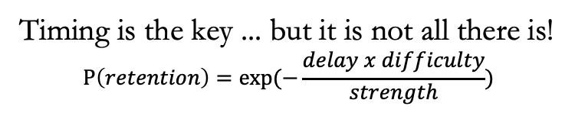
Forgetting in Humans & Machines
Forgetting Curve
Leitner Queues
[3]
Learn some
concept
Towards
long-term
retention
Less familiar
More familiar
1
1
1
2
4
2
…
Queue 1
3
4
Retention
2
4
3
…
Queue 2
3
1
Time
Queue 3
…
2
3
4
[2]
Epoch 1
Epoch 2
Epoch 3
Convergence
[M’hamdi & May NAACL’24] MOTIVATION ➡️ APPROACH ➡️ EXPERIMENTS ➡️ TAKEAWAYS
3

Slide 4
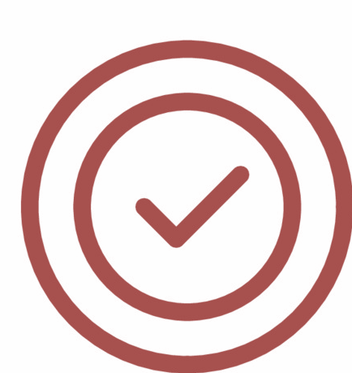
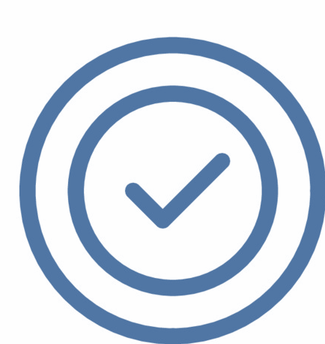


Leitner-Queues in Machine Learning
Prior Work
Our Contributions
Focus on spaced repetition techniques.
Repurpose it as a method of memory prioritization.
Focus on main non-continual data scheduling.
Focus on memory replay in continual learning.
Focus on monolingual setup.
Focus on cross-lingual setup.
[M’hamdi & May NAACL’24] MOTIVATION ➡️ APPROACH ➡️ EXPERIMENTS ➡️ TAKEAWAYS
4

Slide 5
Leitner-based Cross-lingual Skill Rating System
Phase 1: English
Phase 2: German
Phase 3: Hindi
Phase 4: Thai
[1]
1
1
1
2
3
3
4
1
1
1
1
2
2
3
1
1
1
1
2
3
3
5
5
5
5
5
5
5
4
4
4
4
5
5
5
4
4
4
4
5
5
5
Memory
Storage
Memory
Storage
Memory
Storage
1
1
1
1
1
1
2
2
3
3
1
1
1
1
1
1
1
2
2
3
3
3
1
1
2
2
3
3
[M’hamdi & May NAACL’24] MOTIVATION ➡️ APPROACH ➡️ EXPERIMENTS ➡️ TAKEAWAYS
5

Slide 6
Downstream Tasks
Slot: Date
Slot: Time
MTOP[4] and MultiATIS++[5]: goal-oriented dialogue system focused on NLU.
Utterance: Set an alarm for tomorrow at 7 am.
tomorrow
7 am
Intent: Alarm/Set_Alarm
TyDiQA[6] : extracts the answer to a question given a specific context.
Question: Who is the mayor of Toronto?
The 65th and current mayor of Toronto is John Tory, in office since December 1, 2014.
Context:
John Tory
Start
End
[M’hamdi & May NAACL’24] MOTIVATION ➡️ APPROACH ➡️ EXPERIMENTS ➡️ TAKEAWAYS
6

Slide 7

Leitner Queues Results
Evaluation metric: Forgetting averaged over language orders ( ).
Dataset: MTOP [4].
Dataset: MultiATIS++ [6].
Dataset: TyDiQA [5].
Leitner strategies
LER (Easy) > Random > LER (Hard), especially for challenging tasks.
[M’hamdi & May NAACL’24] MOTIVATION ➡️ APPROACH ➡️ EXPERIMENTS ➡️ TAKEAWAYS
7

Slide 8
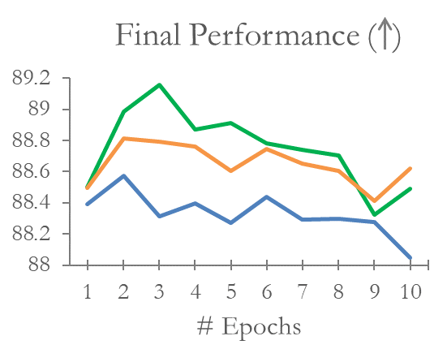
Fine-Grained Analysis
Task (metric): MTOP’s Slot Filling (F1 Score).
1 English -> German -> Hindi -> Thai (high -> low)
2 German -> English -> Thai-> Turkish
3 Hindi -> Thai -> English -> German
4 Thai -> Hindi -> German -> English ( low -> high)
LER (Easy) reduces forgetting while improving final performance => taming the plasticity-stability dilemma.
LER (Easy) > Random > LER (Hard) consistently over language orders and languages.
[M’hamdi & May NAACL’24] MOTIVATION ➡️ APPROACH ➡️ EXPERIMENTS ➡️ TAKEAWAYS
8

Slide 9
Qualitative Analysis
What makes repeating well-learned data more beneficial than harder examples?
Self-annotated hard categories:
Low-resource: the number of training instances is low.
Difficult to disambiguate: predicted label most similar to true label. E.g.: get_info_recipes vs get_recipes.
Poorly defined: label mismatch in the ontology. E.g.: “Increase my timer to 30 minutes.” whose true label is create_timer.
Hard Examples Distribution
Leitner strategy can detect such hard categories that can mislead the learner.
[M’hamdi & May NAACL’24] MOTIVATION ➡️ APPROACH ➡️ EXPERIMENTS ➡️ TAKEAWAYS
9

Slide 10
Conclusions & Future Work
Our Leitner-guided memory sampling policy is a dynamic language-agnostic skill rating system.
Alternating learning new items and replaying well-learned examples helps further reduce forgetting while maintaining transfer compared to other baselines.
Reinforcing the learning using intractable examples can be noisy and difficult to disambiguate, which can only confuse the learner.
More ablation studies:
Other variants of Leitner Queues.
Other scenarios of cross-lingual continual learning.
Other language orders.
Memory scale.
[M’hamdi & May NAACL’24] MOTIVATION ➡️ APPROACH ➡️ EXPERIMENTS ➡️ TAKEAWAYS
10

Slide 11
References
[1] Meryem M’hamdi, Xiang Ren, and Jonathan May. 2023. Cross-lingual Continual Learning. In Proceedings of the 61st Annual Meeting of the Association for Computational Linguistics (Volume 1: Long Papers), pages 3908–3943, Toronto, Canada. Association for Computational Linguistics.
[2] The Student Doctor Network. How Spaced Repetition Enhances Learning. https://www.studentdoctor.net/2018/07/31/spaced-repetition/. 2018.
[3] S. Leitner. 1974. So lernt man lernen. Herder. URL: https://books.google.com/books?id=opWFRAAACAAJ.
[4] Haoran Li, Abhinav Arora, Shuohui Chen, Anchit Gupta, Sonal Gupta, and Yashar Mehdad. 2021. MTOP: A comprehensive multilingual task-oriented semantic parsing benchmark. In Proceedings of the 16th Conference of the European Chapter of the Association for Computational Linguistics: Main Volume, EACL 2021, Online, April 19 - 23, 2021, pages 2950–2962. Association for Computational Linguistics.
[5] Weijia Xu, Batool Haider, and Saab Mansour. 2020. End-to-end slot alignment and recognition for cross-lingual NLU. In Proceedings of the 2020 Conference on Empirical Methods in Natural Language Processing (EMNLP), pages 5052–5063, Online. Association for Computational Linguistics.
[6] Jon Clark, Eunsol Choi, Michael Collins, Dan Garrette, Tom Kwiatkowski, Vitaly Nikolaev, and Jennimaria Palomaki. 2020. Tydi QA: A benchmark for information-seeking question answering in typologically diverse languages. Transactions of the Association for Computational Linguistics.
11

Slide 12

Questions? Comments?
mmhamdi@usc.edu
jonmay@isi.edu
12

