Slide 1
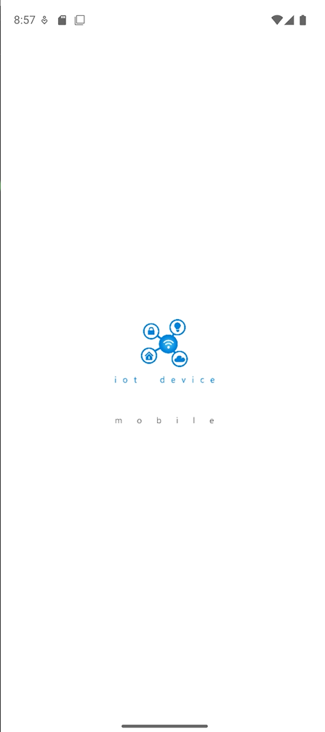
IoT Solutions
Development – Simulators
Jon Mikel Inza

Slide 2
Agenda
IoT flows and solutions (reminder)
Azure IoT main services
Why a device simulator tool ?
Mobile IoT device simulator
Q/A

Slide 3
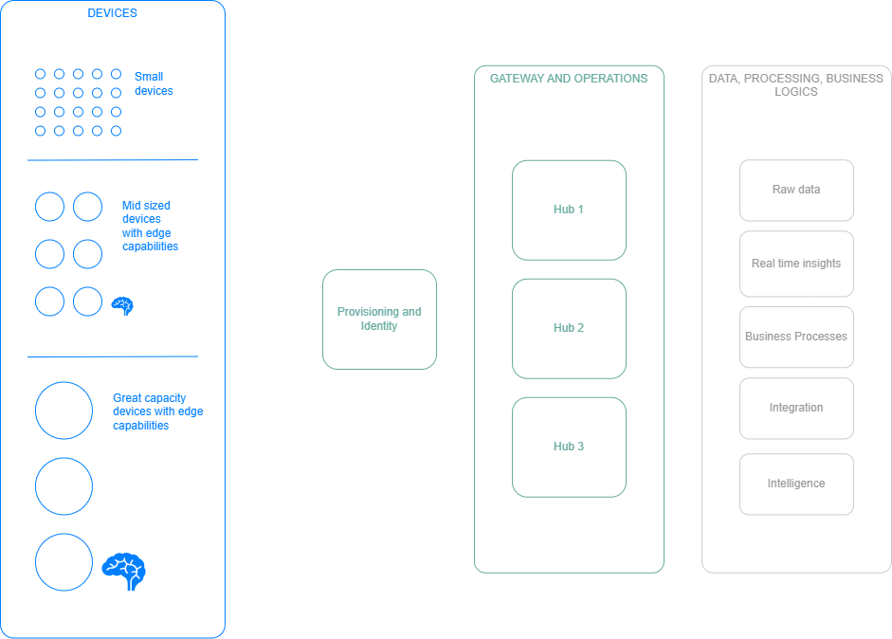
IoT Solutions – Global view

Slide 4
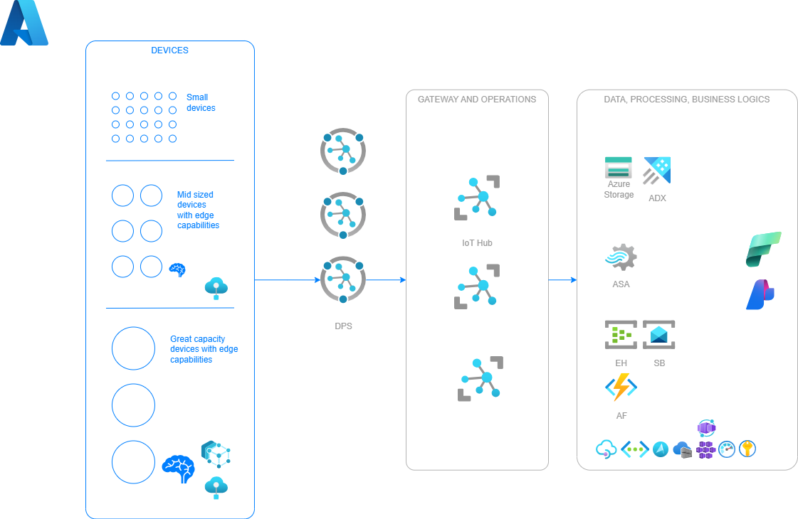
IoT Solutions – Azure IoT

Slide 5
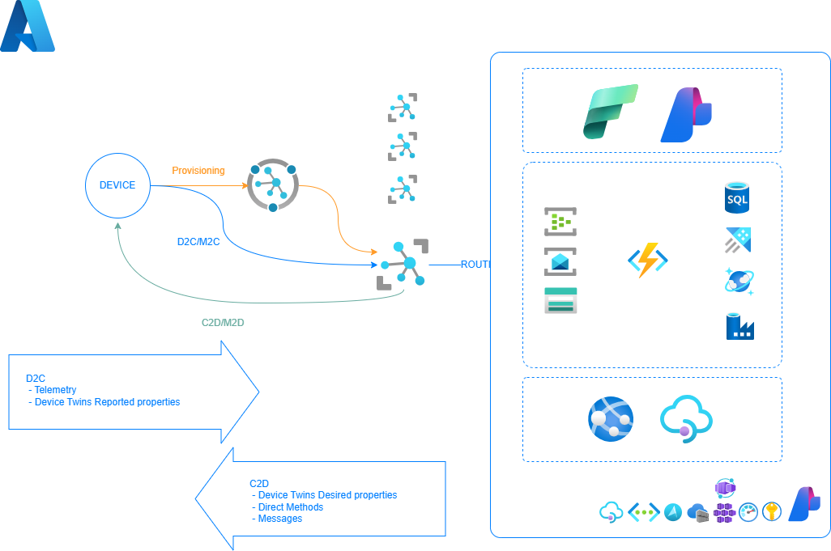
IoT Solutions – Device view

Slide 6
IoT Flows reminder
D2C, Device To Cloud
Telemetry or other (warnings, alerts, etc)
Twin reported properties
C2D, Cloud To Device
Direct Methods
Messages
Twin Desired Properties

Slide 7
Azure IoT – main services (not exhaustive)
Azure IoT Hub
Azure IoT Hub Device Provisioning Service
Azure Device Registry (New)
Azure IoT Hub Update Service
Azure IoT Operations
Azure IoT Edge
Azure Event Hub, Azure Service Bus, Azure Event Grid
Azure Stream Analytics
Microsoft Fabric (Data Factory, Analytics Databases, Real-Time Intelligence, IQ, Power BI)
Azure Data Explorer, Azure Storage, Azure Database, Azure ComosDB
Azure Maps

Slide 8
IoT Device Simulator – The “Why”?
IoT Solutions developers’ “needs”:
Have a way to have different devices with different DPSs
Have a way to validate different types of provisioning, DPS configurations (default Twin properties) and all the flows (desired/reported properties)
Have a way to send different types of telemetry (schemas)
Have a way to validate different types of interactions through the different solutions and according to specific settings in each solution

Slide 9
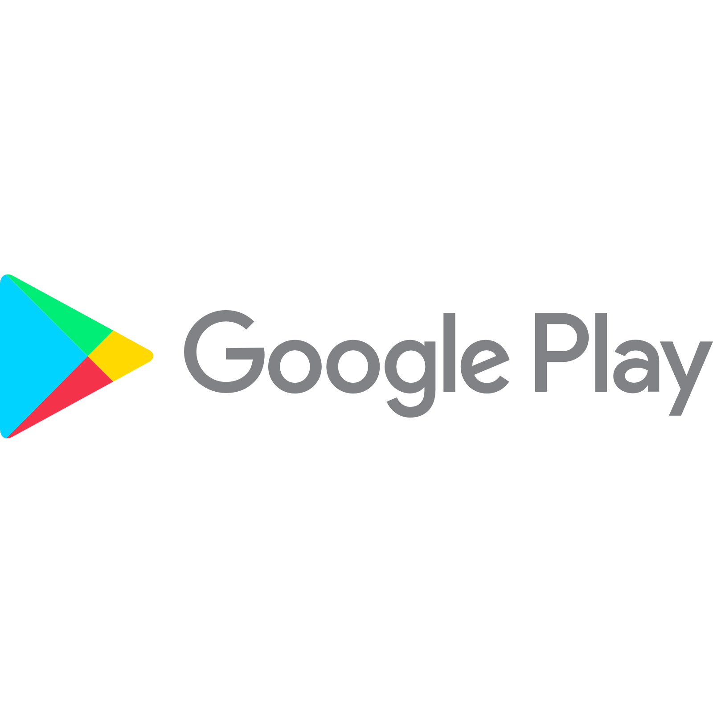
The App

Slide 10
Simulators-Android-Main Features
Add as many DPSs as you want
Provision as many devices as you want
Each device has its own simulation settings
Most of the D2C/C2D features in the IoT C# SDK are implemented
Provisioning (SAS and X509)
Telemetry (with random content based on a configurable JSON Schema, and configurable rate)
Device Twin Reported properties
Device Twin Desired properties
Direct Methods (generic and some specific like SetTelemetryInterval)
https://github.com/jonmikeli/docs/blob/main/iot/tools/mobile-app/iot-simulator-mobileapp.md#telemetry-interval
C2D Messages

Slide 11
Technical aspects
MAUI - Android
.NET 10
Integrates a “light” version of a richer implementation of the simulator

Slide 12
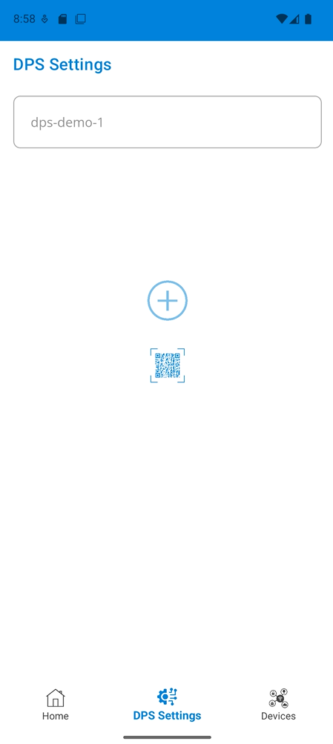
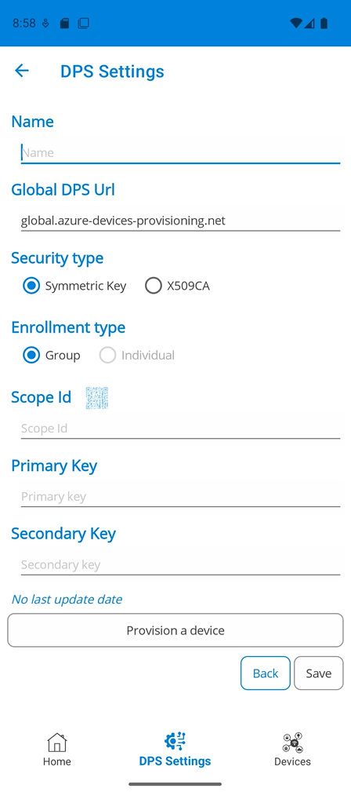
Add a DPS

Slide 13
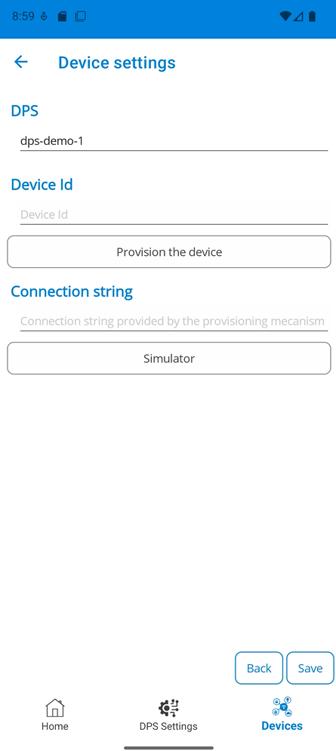
Provision a device

Slide 14
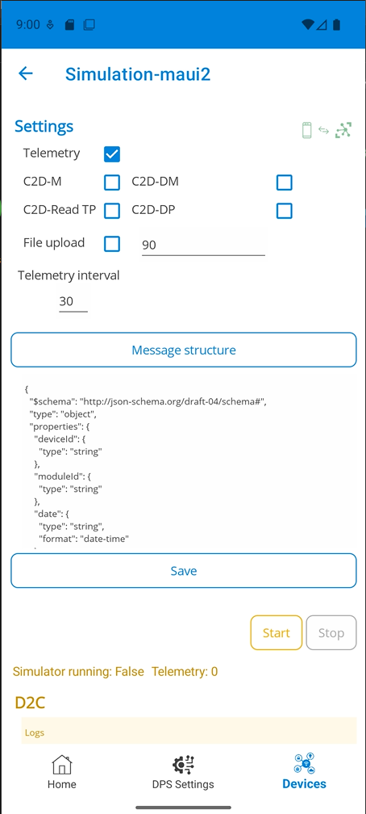
Configure simulation settings

Slide 15
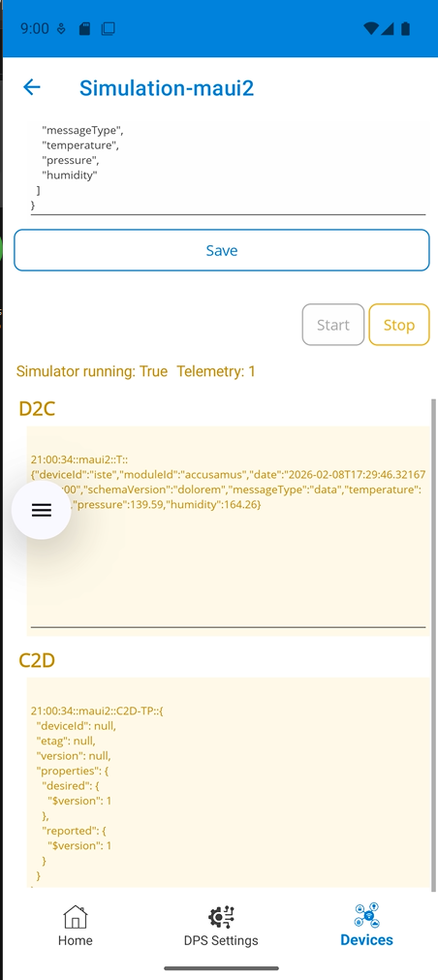
Start simulation

Slide 16
Demo1
Mobile App

Slide 17
Simulators – All the different types
Mobile
Regular
Teltonika version
Containerized
Single device (Docker Hub)
Multidevice (Docker Hub)
IoT Aspire solution
Others in progress (ex: MCP Server for the simulators)

Slide 18
Demo2
Container
Notes:
docker run -ti --rm --name multithreadTeltoDevice2SymJMI -e DPS_SECURITY_TYPE="SymmetricKey" -e TRANSPORT_TYPE="Mqtt" -e DPS_IDSCOPE=“XXXXX" -e DPS_PRIMARY_SYMMETRIC_KEY=“XXXXXXXXXXXXXXXXXXXXXXXXXXXXXXXXXXXXXXXXXXXX" -e MULTIDEVICE_DEVICE_COUNT="5" -e MULTIDEVICE_DEVICE_PREFIX="sim-e-" -e MULTIDEVICE_DEVICE_ID_FORMAT="test-d{0}" -e "simulationSettings__telemetrySchemaRelativePath=https://YOUR_JSON_SCHEMA.json" --network="host" jonmikeli/iot-simulator-dps-multi:10.2.867

Slide 19
Demo3
Aspire

Slide 20
Q/A

Slide 21
Thank you

Slide 22
Additional resources

Slide 23
Resources
Google Play link
https://play.google.com/store/apps/details?id=jmi.iot.device.mobile2
Detailed documentation
https://github.com/jonmikeli/docs/blob/main/iot/tools/mobile-app/iot-simulator-mobileapp.md
GitHub
https://github.com/jonmikeli/mobile-iot-client-net10-shared
Azure IoT Hub
https://azure.microsoft.com/fr-fr/products/iot-hub
IoT Hub SDK C#
https://github.com/Azure/azure-iot-sdk-csharp

Slide 24
Container-Single device
Same features as mobile app
Plus:
cli approach (making it industrializable)
More robust X509 integration
Container:
docker pull jonmikeli/iot-simulator-dps:10.0.892
Documentation: https://github.com/jonmikeli/docs/blob/main/iot/tools/simulators/iot-simulator-single-device-container.md

Slide 25
Container-Multi device
Same features as mobile app
Plus:
cli approach (making it industrializable)
No X509 features
Container:
docker pull jonmikeli/iot-simulator-dps-multi:10.2.867
Documentation:
https://github.com/jonmikeli/docs/blob/main/iot/tools/simulators/iot-simulator-multi-device-container.md

Slide 26
Aspire-Multi device
.NET CLI and Visual Studio Extension (VSIX) to create such solutions
NuGet
https://www.nuget.org/packages/JMI.Aspire.IoTSimulator.DPS.SingleDevice.Template/
https://www.nuget.org/packages/JMI.Aspire.IoTSimulator.DPS.MultiDevice.Template/
VSIX
https://marketplace.visualstudio.com/items?itemName=JonMikelInza.AspireIoTSimulatorDPSSingleDeviceTemplate
https://marketplace.visualstudio.com/items?itemName=JonMikelInza.AspireIoTSimulatorDPSMultiDeviceTemplate

Slide 27
Device Simulator Git Hub
https://github.com/jonmikeli/mobile-iot-client-net10-shared

