Slide 1
IoT Solutions with Azure IoT

Slide 2
IoT solutions
IoT is not only about devices/hardware
IoT solutions:
Device Management (provisioning, security, updates, configurations, etc)
Bidirectional device integration (D2C, C2D)
Data collection
Data controls, transformation, projections, pre-processing/processing, enrichment, mappings
Storage (multi-format and multi-system)
Data usage, analysis, AI, integration/exposition, monetization, etc
Intelligence or value extraction
Notes:
Un projet d’entreprise cherche globalement à couvrir différents aspects…..
….ces besoin donnent lieu à des architectures un peu plus complexes qu’un device connecté à une appli.

Slide 3
Architectures
No generic “perfect” answer
Depend always on requirements:
Functional
Technical
Business
Key factors (no specific order):
Latency
Flows (bidirectional, long/short, reactive, etc)
Value (data, intelligence, processing, AI, etc)
Security
Scalability
Reliability
Cost
Business model(s)
Evolutivity
Technical debt level

Slide 4
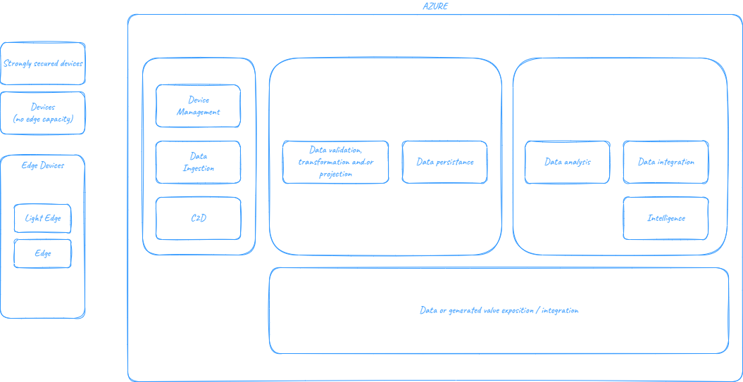
Architectures – satellite view
Notes:
Il n’y a pas UNE seule architecture.
Il faut bien comprendre le besoin et construire une solution adaptée.

Slide 5
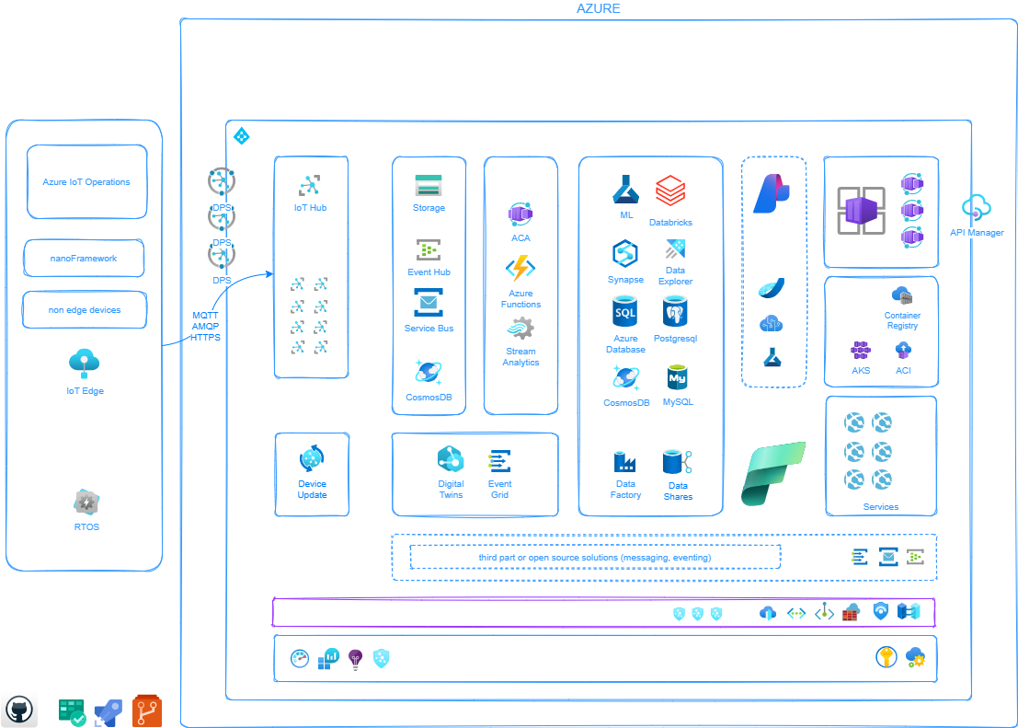
Notes:
Il n’y a pas UNE seule architecture.
Il faut bien comprendre le besoin et construire une solution adaptée.

Slide 6
IoT Solutions with Azure IoT
Azure IoT Hub
Azure IoT Hub DPS
Azure Device Update for IoT Hub
Azure Digital Twins*
Azure Plug and Play
Azure IoT Edge
Azure IoT Operations
Azure Defender for IoT
Azure Event Hub
Azure Event Grid
Azure Service Bus Topic
Azure Service Bus Queue
Azure Stream Analytics
Azure Functions
Azure App Services
Azure Kubernetes Services
Azure Container Application
Azure API Management
Microsoft Fabric, global offer
(special mention to Real Time Intelligence)
Azure Data Explorer
Azure SQL Database Family (including MySQL and PostgreSQL)
Azure Cosmos DB (including PostgreSQL)
Azure Databricks
Azure Synapse
Azure Storage
Microsoft Foundry
Azure Monitor
Azure Advisor
Azure Arc
Azure App Configuration
Azure Key Vault
Azure Defender for IoT
Azure Defender for API
Azure Defender
Azure Sentinel
Azure Purview
Azure Vnet
Azure Private Endpoints / Service Endpoints
Azure Frontdoor
Azure Application Gateway
Azure Firewall
Azure Private DNS
Azure Sentinel

Slide 7
IoT Solutions with AI assisted development
Agents
Skills
Instructions
Prompts
Extensions
Plugins
Hooks
Special mention to:
Azure Skills
GitHub Copilot

Slide 8
DPS and IoT Hub
DPS
Provisioning / reprovisioning
Configurations by default
Security (SAS, X509 | unique, group enrollments)
IoT Hub
Device identity (or module)
D2C/C2D (ou M2C/C2M) with Device Twin (tags, desired properties and reported properties), messages and commands
Routes / Endpoints + Enrichments
Updates
Jobs

Slide 9
Digital Twins
Digital representation of a logic or physical entity.
Generic concept.
Not a Device Twin. Common mistake.
Azure Digital Twins relies on DTDL, which describes:
Properties
Telemetries
Commands
Relations
MS Fabric with Ontologies

Slide 10
Questions

