Slide 1
Arduino biscuit tin Theremin
… an educational failure
Jon Mills
@fat_freddie
github.com/jonmills/biscuit_tin_theremin
Spotify theremin playlist: http://bit.ly/9vDzq4

Slide 2
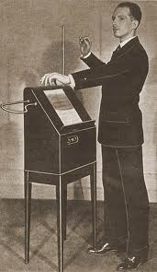
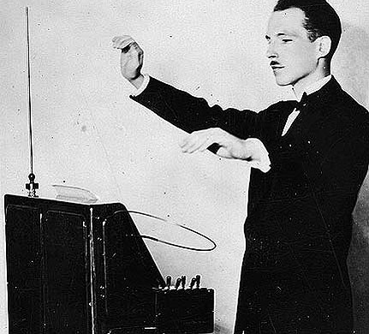
Theremin
Developed 1920 by Leon Theremin

Slide 3
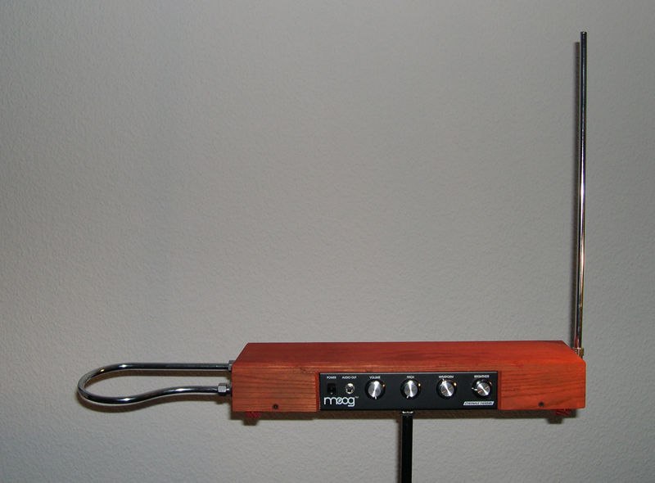

Slide 4
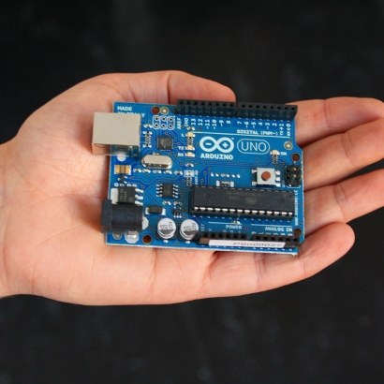
Arduino
“Arduino is an open-source
electronics prototyping
platform based on flexible,
easy-to-use hardware and
software. It's intended for
artists, designers, hobbyists,
and anyone interested in
creating interactive
objects or environments.”
… and its cheap :)

Slide 5
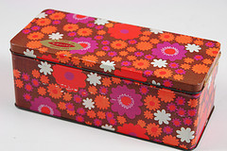
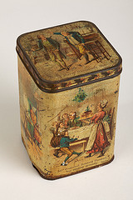
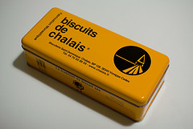
Biscuit Tin

Slide 6
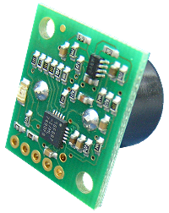
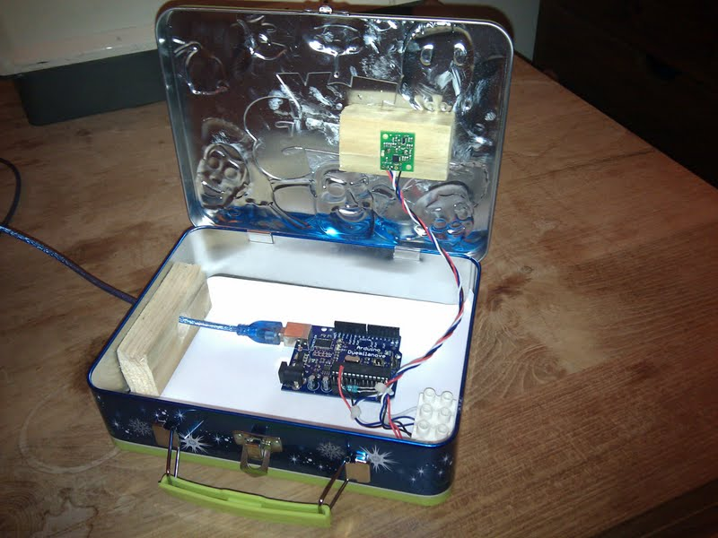
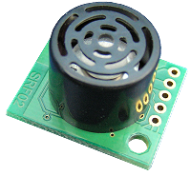
SRF02 ultrasonic range finder

Slide 7
Refs
www.flickr.com/photos/h_is_for_home/
www.flickr.com/photos/blackcountrymuseums/
www.flickr.com/photos/getdown/

