Slide 1
Bellabeat Case Study: How can a wellness company play it smart?
Jonathan Moffa
12/04/2022

Slide 2
The Business Task
Determine trends with smart device usage
Use insights gained to improve user experience
Highlight opportunities for company growth

Slide 3
About The Data
Data collected from about thirty consenting FitBit users (sources in appendix)
Wellness data can be applied by proxy to Bellabeat users
Data collected can also improve Bellabeat membership service
Membership includes personalized recommendations to subscribers
Includes metrics for:
Physical activity
Weight
Sleep
Heart rate

Slide 4
Data Limitations
Small participant sample size
Amount of data collected helps to draw useful conclusions
Some datasets do not include all participants
Most notable with weight log, including less than one third of total participants
Data was collected in 2016

Slide 5
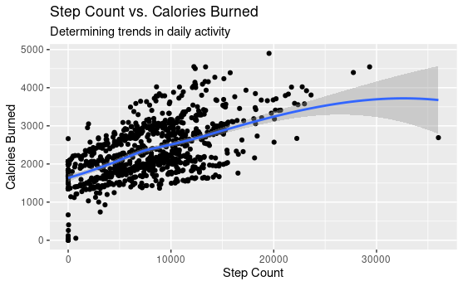
Slight correlation between step count and calories burned
Can we break it down further?

Slide 6
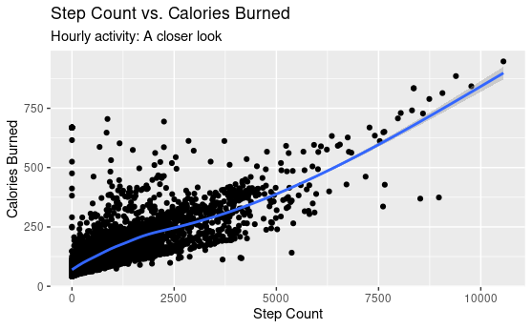
Stronger evidence of correlation highlighted in this plot
Can encourage Bellabeat users to walk more to burn more calories

Slide 7
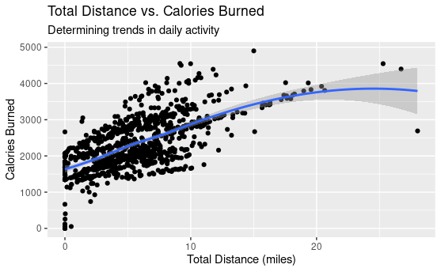
Slight correlation between total distance and calories burned
Confirm expected relationship between step count and total distance

Slide 8
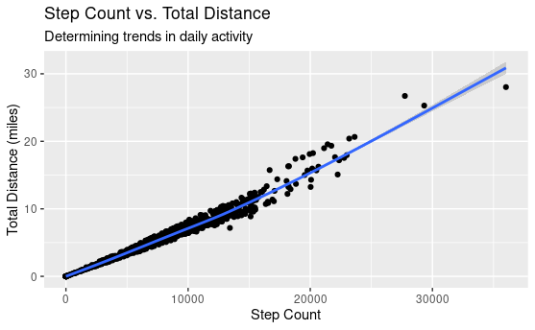
Strong correlation between step count and total distance
Above 15k steps, many points are above the average line
Hypothesis: These points correlate more strongly with very active distance

Slide 9
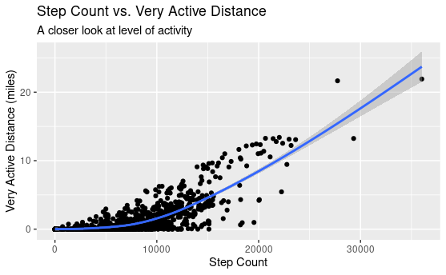
As step count increases, the correlation between step count and very active distance increases significantly
Does being very active impact calories burned?

Slide 10
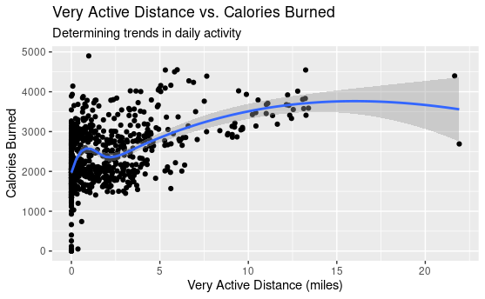
Slight correlation between very active distance and calories burned
Decrease in calories burned observed around one mile
Can encourage Bellabeat users to increase activity levels to burn more calories

Slide 11
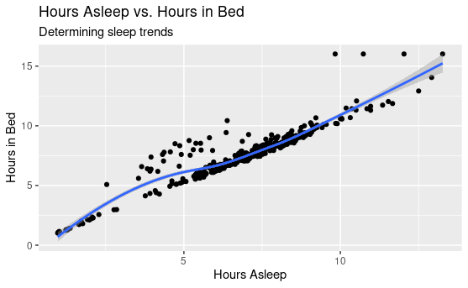
Plot describes trends related to sleep and time in bed
Strong correlation between hours asleep and hours in bed
In some cases, hours in bed are significantly higher than hours asleep
Does this impact calories burned?

Slide 12
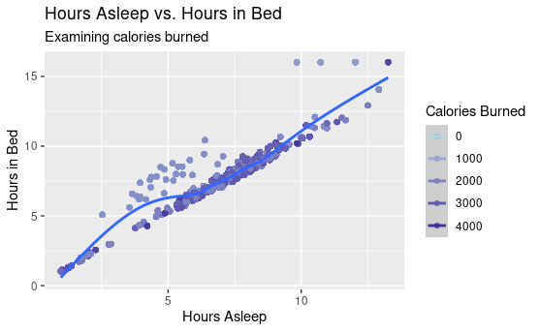
Plot further investigates sleep trends by examining calories burned
Getting less sleep and spending extra time in bed is related to burning fewer calories
Can encourage smart device users to spend less time in bed when not asleep

Slide 13
Recommended Action
Enable Bellabeat users to set goals for physical activity
This can encourage walking more, or increasing high-intensity exercise, to burn more calories
Use findings to optimize Bellabeat membership service
Can recommend to subscribers to spend less time in bed when not sleeping

Slide 14
Appendix
Dataset download: https://www.kaggle.com/datasets/arashnic/fitbit
Original data source: https://zenodo.org/record/53894#.X9oeh3Uzaao
Data collected by Furberg, Robert; Brinton, Julia; Keating, Michael; and Ortiz, Alexa
Refer to case study report for documentation of analysis

