Slide 1
Generative AI For Builder Workflows
Jon Montgomery
Notes:
In this presentation, I’ll demo a generative-AI-powered microservice that I designed to integrate into assay builder workflows with a natural language interface.
I’ll also show off my plan to manage the service outside of the AQUA/Ascent release cycle so it can iterate quickly and follow user demand.
I’m hoping to get feedback on the value of this idea and how it fits into our product’s design and plan moving forward.

Slide 2
GenAI Application Considerations
Three steps to identify business use cases for GenAI
Break workflows and jobs into tasks
Assess tasks using the GenAI cost equation
Build, launch, and evaluate pilots
Some things are easy with an LLM
Other things are really hard
Development time
License and API fees
Error mitigation
Monitor, iterate, and adapt
Notes:
I think we all have a healthy skepticism of generative AI and the AI industry. We’ve all made ChatGPT hallucinate and make basic logical errors. You’ve probably encountered situations where the model doesn’t have the domain-specific knowledge required to answer a question. There’s a lot of hype around GenAI and it can be tough to separate the wheat from the chaff, but I found this three-step process from MIT useful.
Error mitigation:
Apply guardrails and validation to user prompts. Only respond to valid queries.
Provide context. We can reduce hallucinations by filling in knowledge gaps and giving directions.
We also have an expert overseer in ComOps validating each response.
Early on, I found that LLMs are very effective at diffing text blobs and categorization tasks. LLMs can infer information from a block of text to produce a result, so if we can pull in a lot of contextual information, we can make a powerful inference tool.

Slide 3
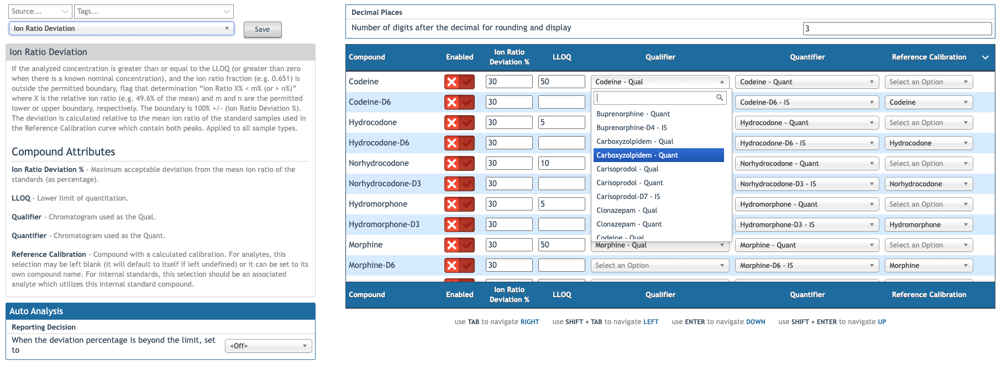
Rule configuration
Notes:
Let’s take a look at rule configuration.
This is FastGen4. It has 130 compounds and 214 chromatograms.
In June, I heard ComOps complain that most rules are designed for either analytes or internal standards. Not both. To enable a rule for all analytes requires 84 precise clicks, then more clicks and typing for each rule setting.
Look at the chromatogram dropdown menus. To select a Quant, the user must search for it among all the chromatograms in the assay (214).
Looking at this UI, we have a ton of context. We have a rule definition, parameters, and compounds and chromatograms with defined relationships.
We have:
A simple task space with clearly definable goals.
Lots of context
An expert practitioner overseeing any changes that occur
And a clearly structured data model that is easy for an LLM to understand
I tried to time myself setting the Quantifier for each compound in the assay. It took me two and a half minutes to set thirty of them and then I gave up. ComOps configure and maintain hundreds of these assays.

Slide 4
Microservice Components
Lambda
Serverless
Short-lived: < 15-minute runtime
Cold start latency: ~0.1- 2 seconds
Warm start latency: < 0.01 seconds
Can be invoked directly with no public endpoint
Bedrock
Amazon’s serverless GenAI platform
One API for many text and multi-model models
Offers services for fine-tuning, RAG documents, and agents
Data is secured and is not used to train the models
Notes:
So now we have a use case, I’ll define the components of the tool.
---
All of the components are serverless, so there isn’t much maintenance overhead.

Slide 5
Architecture
Contract
Ascent Provides:
User prompt
Assay ID
UI Context
Lambda Returns:
Status
Success:
Structured updates
Failure:
Error message
Notes:
Here is how it all fits together.
Start in the top left.
User inputs a natural language request.
Ascent web invokes lambda, sending the user’s prompt, the current UI context (for now, the current rule), and the assay id.
The lambda function parses the UI context and redirects to the appropriate tool. Currently, I only have the rule setting tool, but this can be extended in the future. If the context is not supported, we return an explanatory message to the user.
Collect and parse the ruleset schema from S3. We use an LLM to map display names to internal language and fix any spelling mistakes from the user, to clean up the prompt.
Validate the prompt to ensure that the user’s prompt is on topic, and it follows the intended use for the rule. I currently ensure that the user’s prompt is requesting an update to a rule enabling or a rule setting.
Pull in the assay json from S3, break it down into bite sized pieces, and query the LLM in parallel for each piece. I break the assay into compound methods, and ask bedrock if and how the compound should be modified. The LLM is smart enough to recognize that analytes have enabled calibrations and internal standards have disabled calibrations, and it can make inferences about each compound from the assay JSON. The LLM returns a JSON object containing its reasoning, whether the compound should be updated, and how the assay should be updated.
We present the update proposal to the user, who can accept or reject the changes.
----
For each query, we collect the user’s prompt, the success or failure state, and, if successful, the desired updates. This data will be useful for fine-tuning the model and driving new features. It is a powerful method for discovery.

Slide 6
Key findings
Bigger, more complex models have better performance
Model performance improves when models are allowed to reason
Context limits are a factor
We have 594 live assays
Average 25 compounds
Average 27 enabled rules
246,423 rule configurations
For a 25-compound assay:
One query saves minutes of work
Costs about $0.10
Price could decrease with fine-tuning
Model | Price (1k input tokens) | Price (1k output tokens)
Nova Micro | 0.000035 | 0.00014
Nova Lite | 0.00006 | 0.00024
Nova Pro | 0.0008 | 0.0032
Claude Opus 4 | 0.015 | 0.075
DeepSeek-R1 | 0.00135 | 0.0054
Notes:
I started with Nova Micro, and moved up to Nova Pro, finding that larger reasoning models were more consistent and more capable of inferring information from the assay JSON without explicit instructions.
The industry expectation is that the API costs will fall by 10 times per year.

Slide 7
CI/CD for Microservices
Notes:
The advantages:
It increases agility and adaptability
I anticipate that users will use and abuse this tool in more ways than I can imagine. I’d like to respond to feedback and iterate quickly. Since this is initially targeted at efficiency for internal expert workers, we have some leniency to move fast and break things, even though that is usually not our ethos.
When users interact with the tool, it will collect data that will directly guide development and improve it.
The basics:
The microservice is managed in its repo and uses Github Actions to automatically deploy the infrastructure
Expose the microservice entry point with an environment-based alias.
There is no need to make changes to AQUA unless the contract breaks or we want to update the UI.
Ascent’s environments will need to be mapped to the lambda environments

Slide 8
How does it evolve?
Start small and build out
Iterate quickly
Monitor usage and incorporate failures
Fine-tune expert models
Expand domain knowledge
Notes:
Start small and build out.
- I’ve started with rule configuration, and there is a lot of meat on that bone. However, this can eventually be extended to compound and chromatogram definitions. It is a powerful tool to perform bulk manipulation of assays.
Iterate quickly
- We will collect a lot of data about usage and how the tool is used and abused.
We will have the data required to drive new features and fine-tune the model over time.
As we monitor failures, we can easily incorporate those failures into the test corpus.
If user’s start using terminology that is outside of the knowledge of the LLM, we can give that domain knowledge to the model.
Fine-tune expert models
One of the most exciting parts of this project for me is that as users interact with the tool, they are building a database to fine-tune expert models which we can use to improve accuracy and reduce costs.

