Slide 1
Generative AI
For Builder Workflows

Slide 2
GenAI Application Considerations
GenAI is not deterministic
Keep tasks simple and targeted
Apply guardrails
Provide context
Monitor and iterate
When is it effective?
Errors are tolerable
Goals are clearly defined
Knowledge gaps are supplemented
Notes:
I have found that LLMs are very effective at diffing text blobs and categorization tasks.

Slide 3
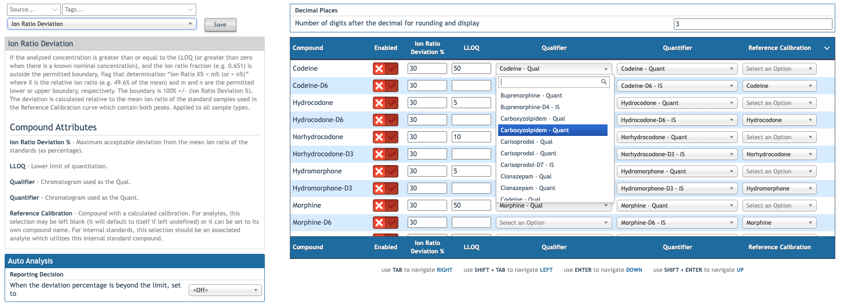
Rule configuration
Notes:
This is FastGen4. It has 130 compounds and 214 chromatograms.
The main complaint I hear from ComOps is that some rules should be enabled for only analytes or internal standards. To enable a rule for all analytes requires 84 precise clicks, then clicks and typing for each rule setting.
Look at the chromatogram dropdown menus. To select a Quant, the user must search for it among all the chromatograms in the assay (214).
Looking at this UI, we have a ton of context. We have a rule definition, parameters, and compounds and chromatograms with defined relationships.
We have:
A simple task space with clearly definable goals.
Lots of context
An expert practitioner overseeing any changes that occur
And a clearly structured data model that is easy for an LLM to understand

Slide 4
Microservice Components
Lambda
Serverless
Short-lived (< 15-minute runtime)
Cold start latency: ~0.1- 2 seconds
Warm start latency: < 0.01 seconds
Low latency for Python scripts
Bedrock
Amazon’s serverless GenAI platform
One API for many text and multi-model models
Offers services for fine-tuning, RAG documents, and agents
Data is secured and is not used to train the models

Slide 5
Architecture
Contract
Ascent Provides:
User prompt
Assay ID
UI Context
Lambda Returns:
Status
Success:
Structured updates
Failure:
Error message

Slide 6
Key findings
Bigger, more complex models have better performance
Model performance improves when models are allowed to reason
Context limits are a factor
For a 25-compound assay:
One query saves minutes of work
Costs about $0.10
Price could decrease with fine-tuning
We have 594 live assays
Average 25 compounds
Average 27 enabled rules
246,423 rule configurations
Model | Price (1k input tokens) | Price (1k output tokens)
Nova Micro | 0.000035 | 0.00014
Nova Lite | 0.00006 | 0.00024
Nova Pro | 0.0008 | 0.0032
Claude Opus 4 | 0.015 | 0.075
DeepSeek-R1 | 0.00135 | 0.0054

Slide 7
CI/CD for Microservices
Notes:
TODO: Read https://chatgpt.com/c/688d18ac-88cc-8321-9f37-6c801b3f73ce to better understand microservice architecture
The basics:
The microservice is managed in its repo and uses Github Actions to automatically deploy the infrastructure
Expose the microservice entry point with an environment-based alias.
There is no need to make changes to AQUA unless the contract breaks or we want to update the UI.
Ascent’s environments will need to be mapped to the lambda environments

Slide 8
How does it evolve?
Start small and build out
Iterate quickly
Monitor usage and incorporate failures
Fine-tune expert models
Expand domain knowledge

