Slide 1
Generative AI
For Builder Workflows

Slide 2
GenAI Application Considerations
GenAI is fundamentally unreliable
Keep tasks simple and targeted
Apply guardrails
Provide context
Monitor and iterate
When is it effective?
Errors are tolerable
Goals are clearly defined
Knowledge gaps are filled in
Notes:
I have found that LLMs are very effective at diffing text blobs and categorization tasks.

Slide 3
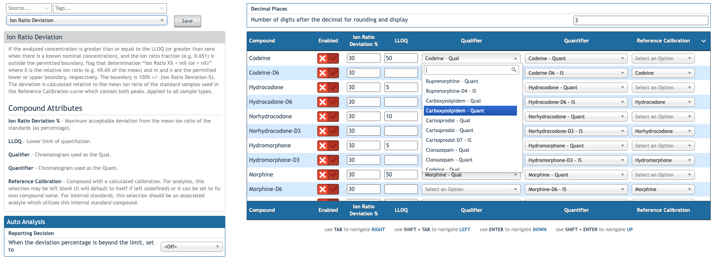
Rule configuration
Notes:
This is FastGen4. It has 130 compounds and 214 chromatograms.
The main complaint I hear from ComOps is that some rules should be enabled for only analytes or internal standards. To enable a rule for all analytes requires 84 precise clicks, then clicks and typing for each rule setting.
Look at the chromatogram dropdown menus. To select a Quant, the user must search for it among all the chromatograms in the assay (214).
Looking at this UI, we have a ton of context. We have a rule definition, parameters, and compounds and chromatograms with defined relationships.
We have:
A simple task space with clearly definable goals.
Lots of context
An expert practitioner overseeing any changes that occur
And a clearly structured data model that is easy for an LLM to understand

Slide 4
Microservice Architecture
Contract
Ascent Provides:
User prompt
Assay ID
UI Context
Lambda Returns:
Status
Success:
Structured updates
Failure:
Error message

Slide 5
CI/CD for Microservices
We want to monitor and iterate on the service quickly
Use a one-way dependency with a stable contract (no need to redeploy AQUA for changes)
Need to integrate with AQUA staging/prod environments
The microservice infrastructure is managed in its own repo
The microservice outputs the lambda function name
Ascent’s Terraform reads the function name
Terraform injects the function as an environment variable

Slide 6
The Contract

Slide 7
Lambda
Serverless script
Cold start latency: ~0.1- seconds
Warm start latency: < 0.01 seconds
Lowest latency for python scripts
Version Control:
Version aliases
Code stored in S3 as zip
Integrates with terraform
Invocation via HTTP or AWS SDK

Slide 8
Amazon Bedrock
Fully managed (serverless) service for building gen AI applications
Access to many FMs including Claude, Llama, and Nova
Utilities for fine-tuning, pre-training, testing, and RAG
Supports Caching at ¼ normal price
Model | Price (1k input tokens) | Price (1k output tokens)
Nova Micro | 0.000035 | 0.00014
Nova Lite | 0.00006 | 0.00024
Nova Pro | 0.0008 | 0.0032
Claude Opus 4 | 0.015 | 0.075
DeepSeek-R1 | 0.00135 | 0.0054

