Slide 1


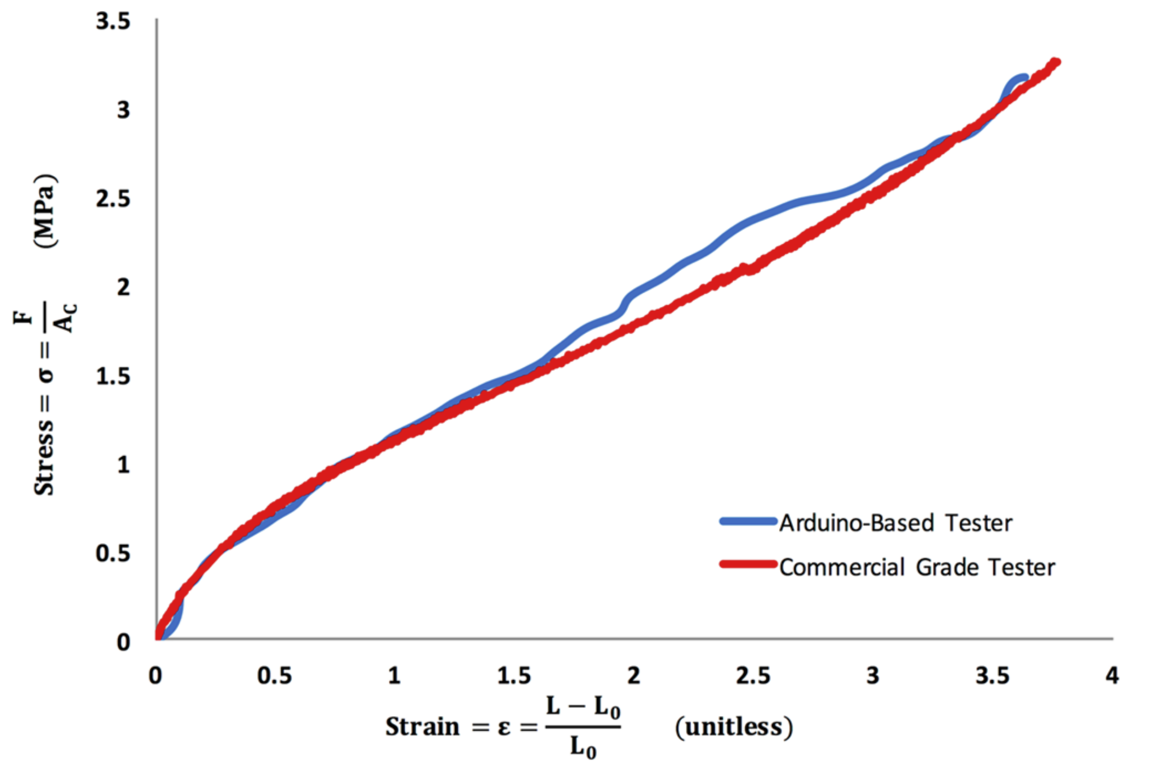
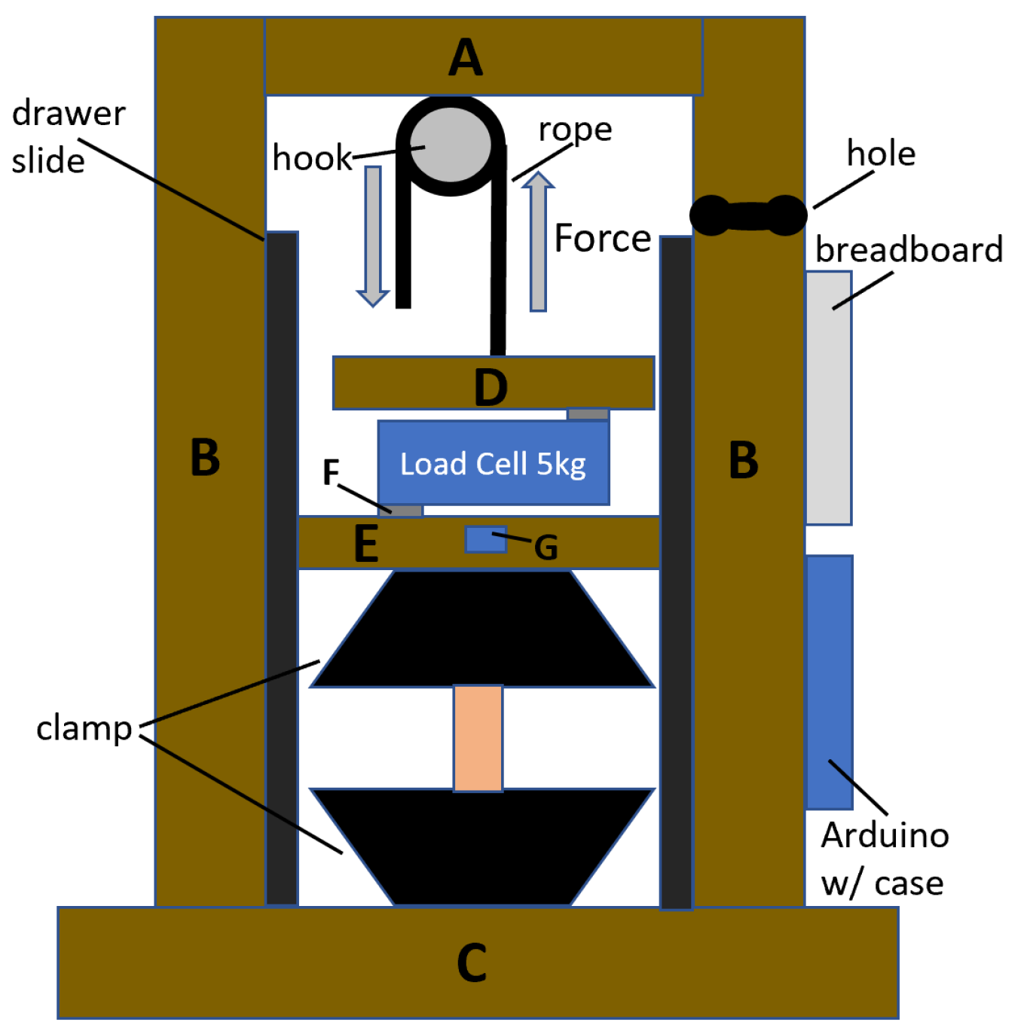
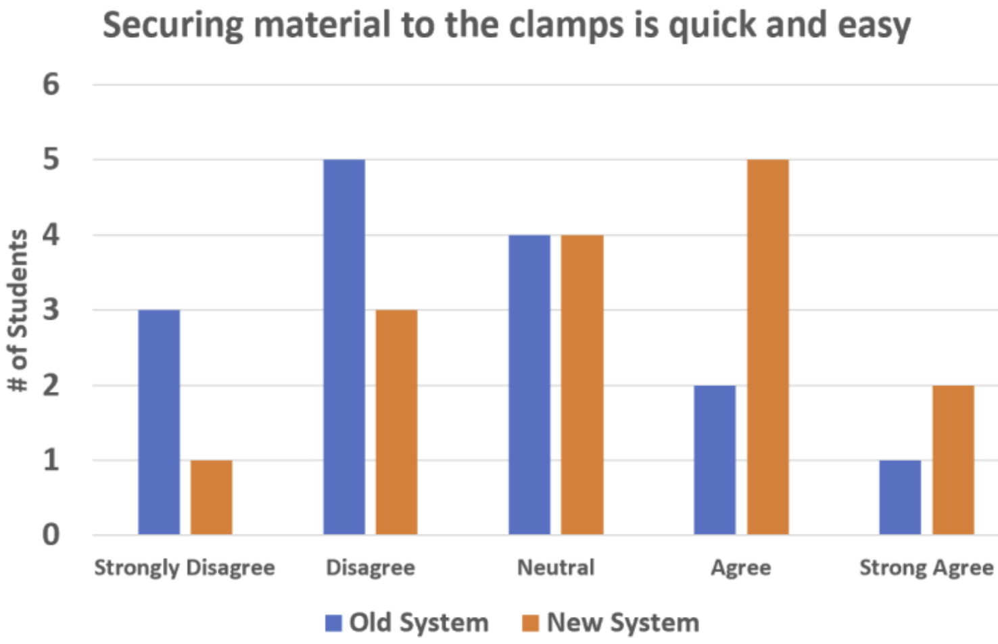
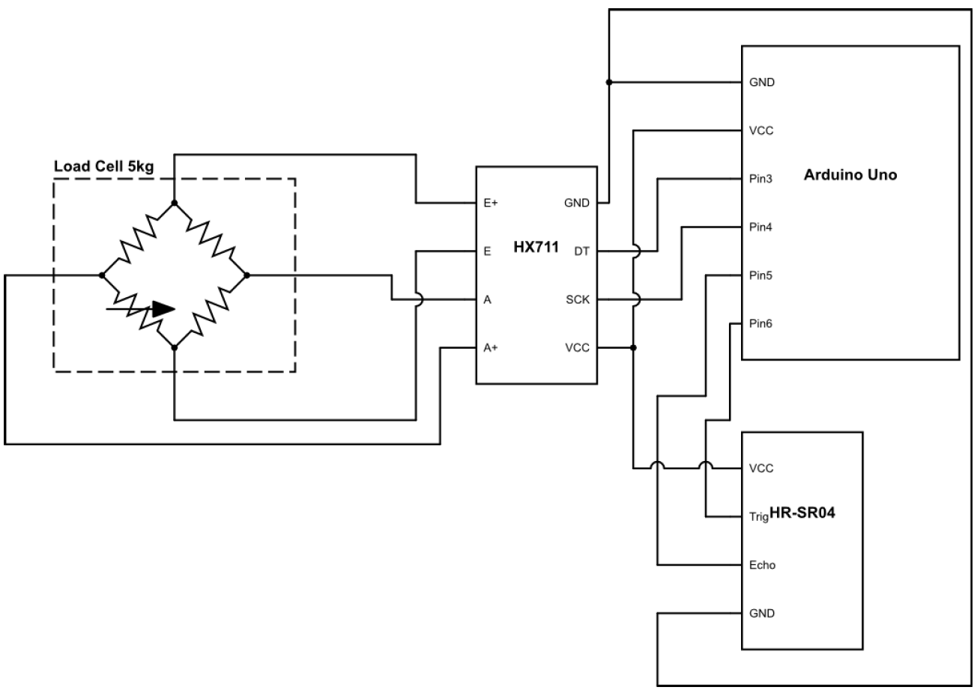
Title of Your Poster Author Names Department of Electrical & Computer Engineering, University at Albany
Problem Statement
Experimental Results
System Design
The University at Albany’s chemistry department, as part of their educational mission, intends to build a laboratory for undergraduate students where they can gain hands on experience testing various material properties (including tensile strength). However, due to the extremely high cost of commercial products they have been unable to equip such a laboratory.
The goal of this project is to build an accurate, low cost, easy to use uniaxial tensile strength tester to support this educational mission.
System Accuracy
Key System Features
Metric | Sample | Our System | Known Value | Error
Young’s Modulus | Latex | ? | 740 ± 10 kPa | ?
… | Nitrile | ? | 2.4 ± 0.2 MPa | ?
Ult. Tensile Strength | Latex | ? | 3.3 ± 0.1 MPa | ?
… | Nitrile | ? | 4.4 ± 0.1 MPa | ?
To satisfy system requirements, we incorporated the following design modifications:
Item #1: Very brief description
Item #2: Very brief description
Item #3: Very brief description
Item #4: Very brief description
Item #5: Very brief description
Modify the table above based on your experimental results.
Include a descriptive caption.
List your system features above
Physical Model
System Requirements
Stress-Strain Curve
System Accuracy: The system should be able to accurately measure the stress-strain curve, such that Young’s Modulus and Ultimate Tensile Strength can be calculated to within two significant figures.
System Ease-of-Use: The system should be easy to calibrate and operate by undergraduate students without requiring knowledge of electronics or software programming.
System Components & Budget
Include your design model with a descriptive caption that highlights key aspects of your design.
Part | Purpose | Cost
Ultrasonic Range Sensor | Measures Distance | $4
Load Cell 5kg | Measures Force | $12
Amplifier Board | Amplifies and Digitizes Signal | $10
Microcontroller | Controls System | $15
TOTAL | TOTAL | $41
Include an example stress-strain curve for either Latex or Nitrile w/ descriptive caption.
Circuit Schematic
Update this Table
Project Partners
Special thanks for Professor Chen, Feldblyun, Yeung, and the University at Albany’s Chemistry Department for sponsoring this project.
This project was developed in ECE442: Systems Analysis & Design in the Electrical & Computer Engineering Department.
Consider including a circuit schematic or other design artifact with a descriptive caption.
If you are making claims about the systems “ease-of-use” show some relevant data here with caption. Otherwise, include something else you wish to highlight.

