Slide 1
Data Spark: Illuminating Insights for Global Electronics
Retail Analytics in the Electronics Industry using Power BI
Leveraging data to drive business decisions
Presented by- Jonna Agnes J

Slide 2
Project Overview
This project provides deep insights into Global Electronics' sales, customer demographics, product performance, and more, using Power BI to drive actionable recommendations.
Helping Global Electronics make informed decisions that enhance customer satisfaction, optimize operations, and drive overall business growth. By solving critical analysis and recommendations in guiding the company's strategic initiatives.
Analyzed global electronics retail data to uncover actionable insights
Focused on customer demographics, sales trends, and product performance
Utilized data-driven approaches to support strategic planning

Slide 3
Execution Flow
Data Collection: Gathered raw data from multiple sources (CSV files)
Data Cleaning & Preprocessing: Handled missing values, standardized formats
Database Management: Structured data in MySQL for efficient querying
Exploratory Data Analysis (EDA): Identified patterns and anomalies
Visualization: Used Power BI/Tableau for dashboards and reports

Slide 4
Technologies Used
Python: Data cleaning, preprocessing, and automation
MySQL: Data storage and management, complex SQL queries
Pandas & NumPy: Data manipulation and analysis
Power BI/Tableau: Data visualization and dashboard creation

Slide 5
Skills Gained
Data Cleaning and Preprocessing
Exploratory Data Analysis (EDA)
SQL for Data Management and Analytics
Python Programming
Data Visualization with Power BI/Tableau
Domain knowledge in Retail Analytics

Slide 6
SQL Queries & Output
Sample SQL Queries:
Customer segmentation by country and gender
Brand-wise and country-wise sales analysis
Month-wise and year-wise sales trends
Sample Output Page:
Tables and charts showing top-selling brands, sales by region, and customer demographics

Slide 7
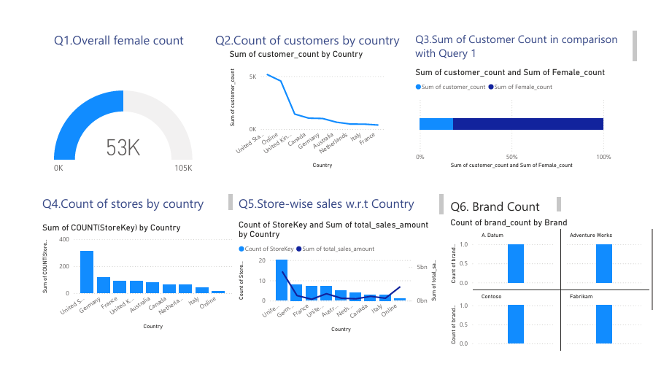
Power bi Report

Slide 8
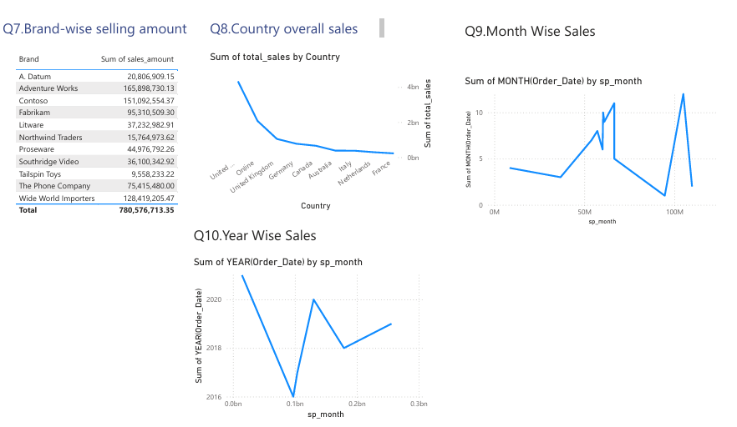
Power bi Report

Slide 9
Conclusion
Successfully transformed raw data into actionable insights.
Enhanced understanding of global electronics retail trends.
Developed technical and analytical skills applicable to real-world business problems.
Ready to apply these skills in future data-driven projects.

Slide 10
Future Enhancements
Integration with Real-Time Data: Incorporate live sales and inventory feeds for up-to-date analytics.
Advanced Analytics: Implement machine learning models for demand forecasting and customer segmentation.
Automated Reporting: Schedule regular dashboard updates and automated email reports.
Cloud Deployment: Migrate data and analytics workflows to cloud platforms for scalability and collaboration.

