Slide 1
YouTube Data Harvesting and Warehousing
Using SQL and Streamlit Presented by: Jonna Agnes

Slide 2
Project Overview
Purpose: To automate the extraction, storage, and analysis of YouTube channel and video data for insights and reporting.
Scope:
Harvest data from multiple YouTube channels
Store structured data in a SQL database
Visualize and analyze data using Streamlit dashboards
Technologies Used:
Python for scripting and automation
YouTube Data API for data collection
MySQL/SQLite for data warehousing
Streamlit for interactive web app

Slide 3
Data Harvesting Process
API Integration:
Connects to YouTube Data API using secure credentials
Fetches channel, playlist, and video metadata
Data Extraction:
Retrieves video statistics (views, likes, comments, etc.)
Collects channel information (subscribers, uploads, etc.)
Data Cleaning & Transformation:
Handles missing or inconsistent data
Converts data into structured formats for storage

Slide 4
Data Warehousing & Analysis
Database Design:
Normalized tables for channels, playlists, and videos
Ensures data integrity and efficient storage
Data Loading:
Automated scripts insert and update records
Supports incremental data updates
Analysis & Visualization:
Streamlit app provides interactive charts and tables
Enables filtering, searching, and trend analysis
Example insights: Top performing videos, subscriber growth, engagement rates

Slide 5
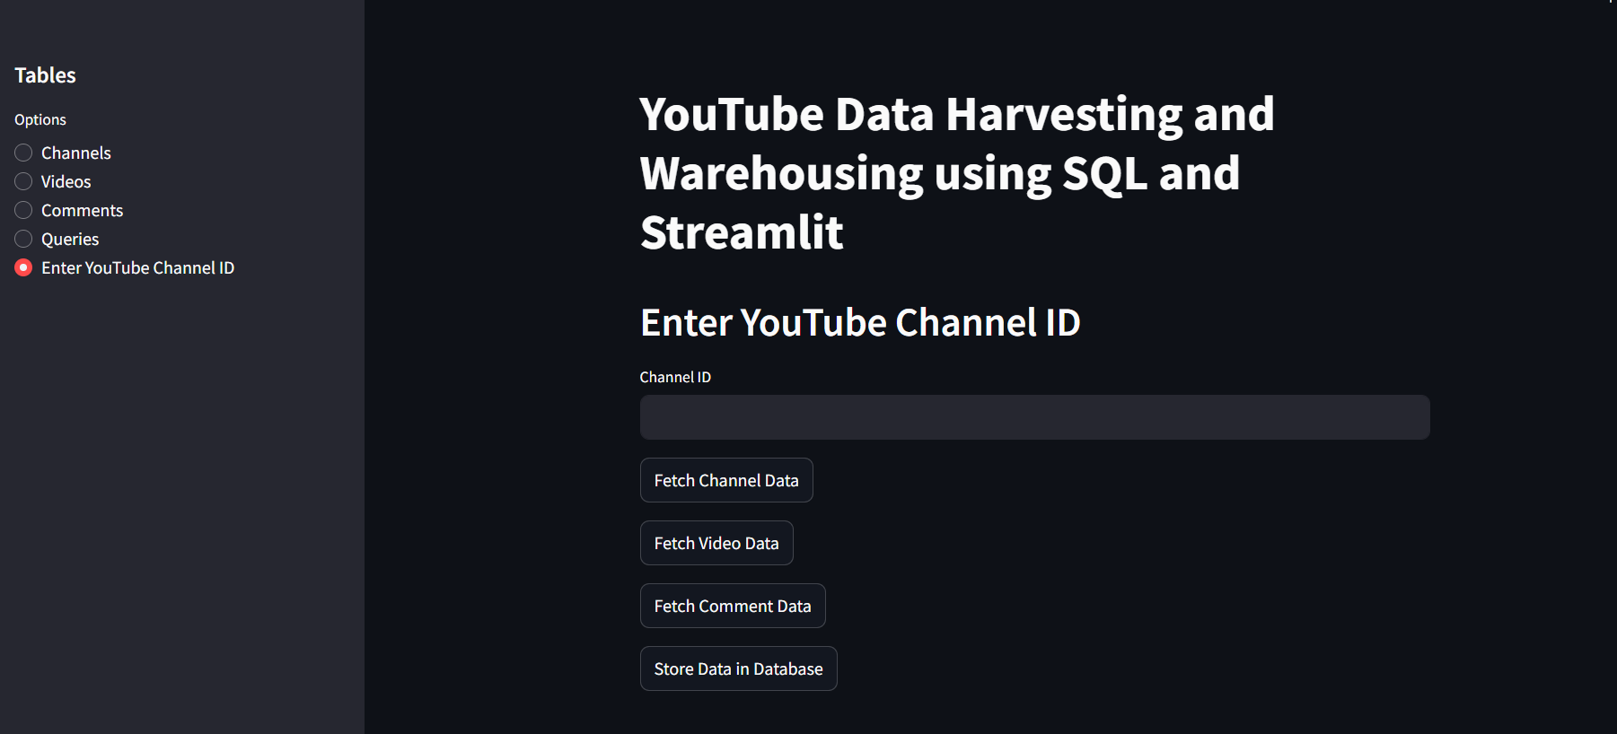
Results

Slide 6
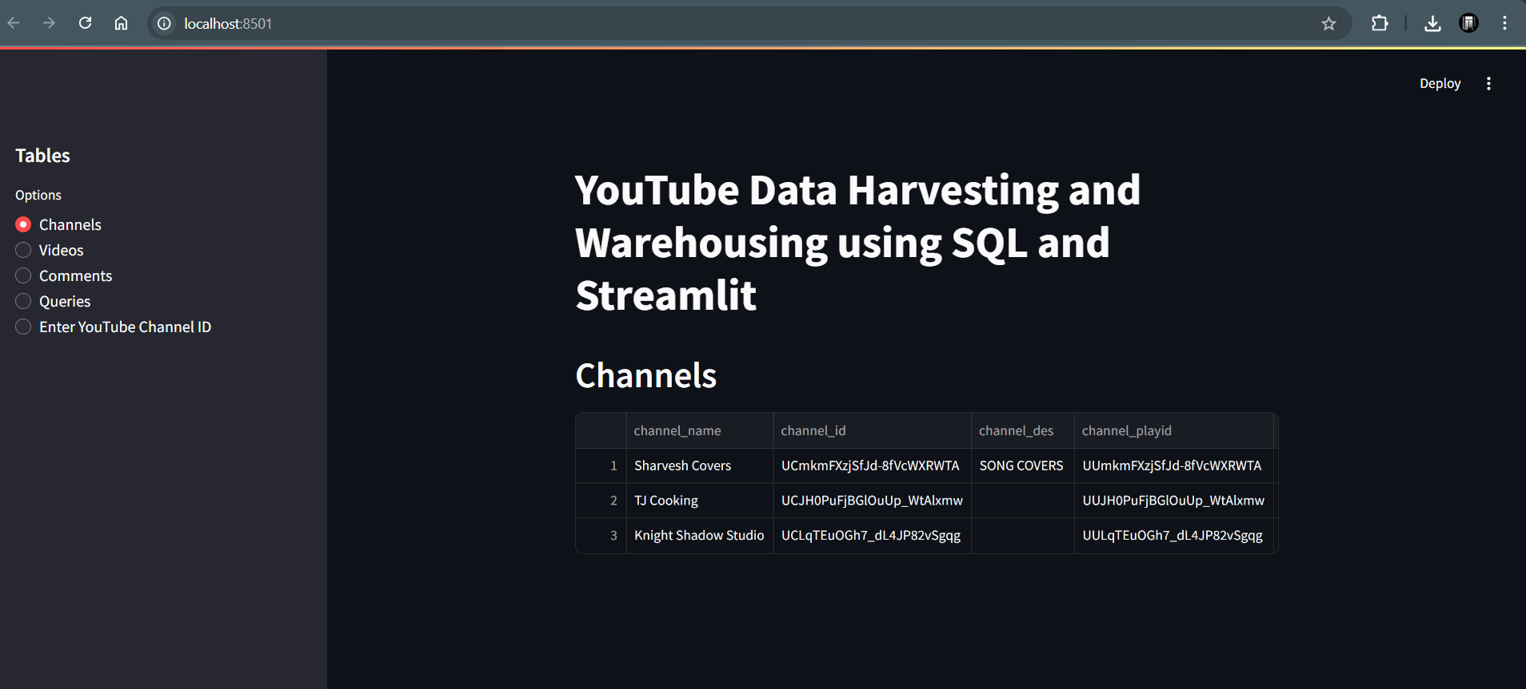

Slide 7
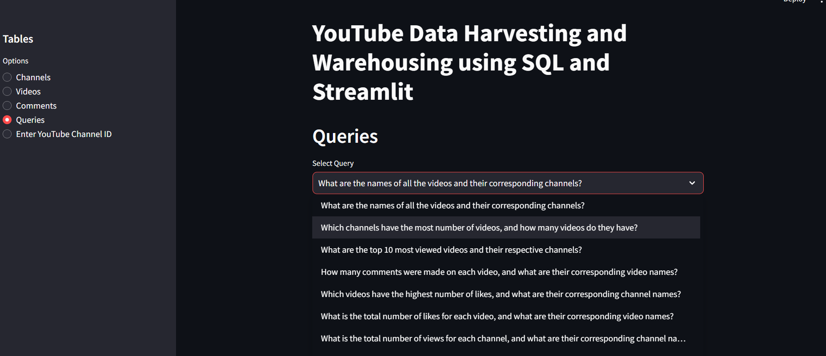

Slide 8
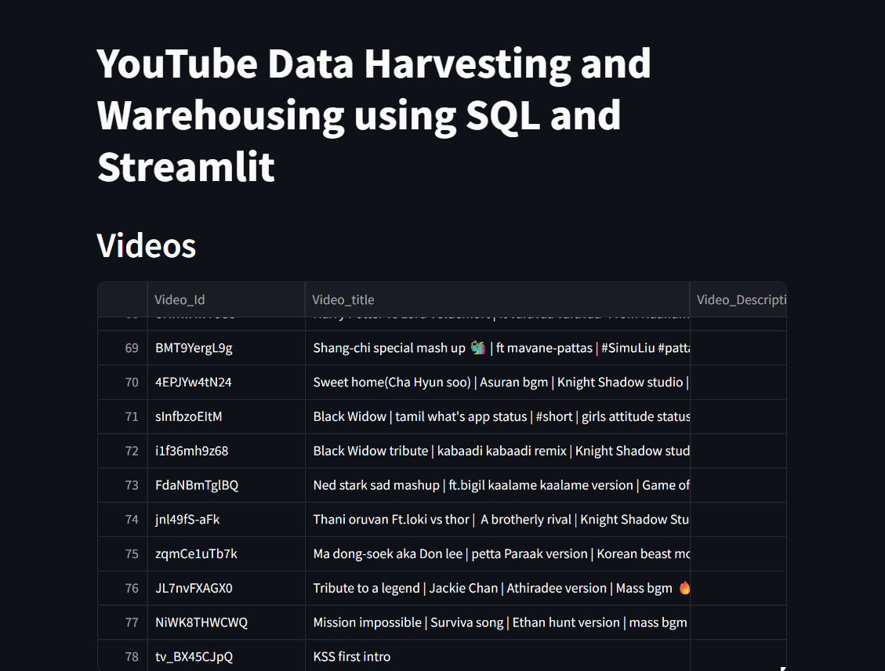

Slide 9
