Slide 1



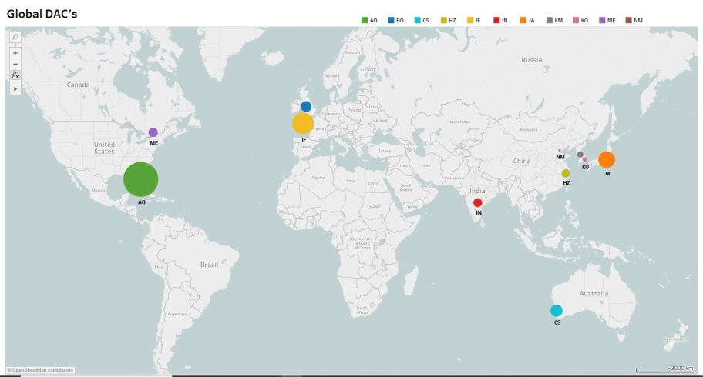
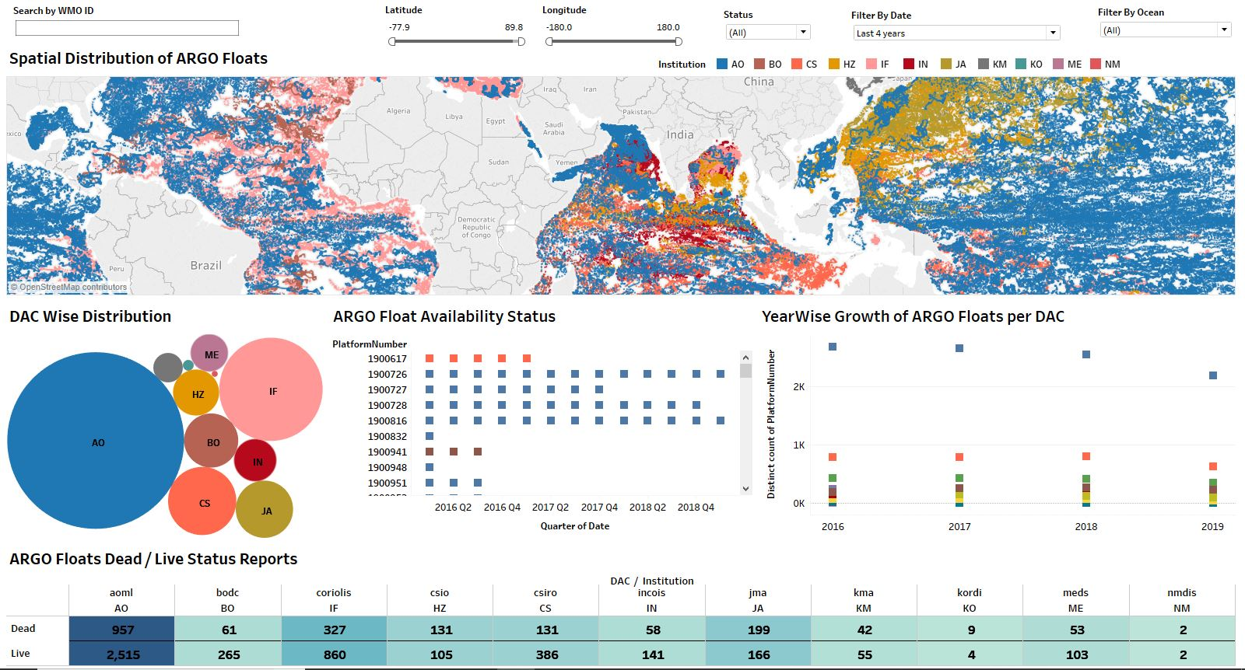
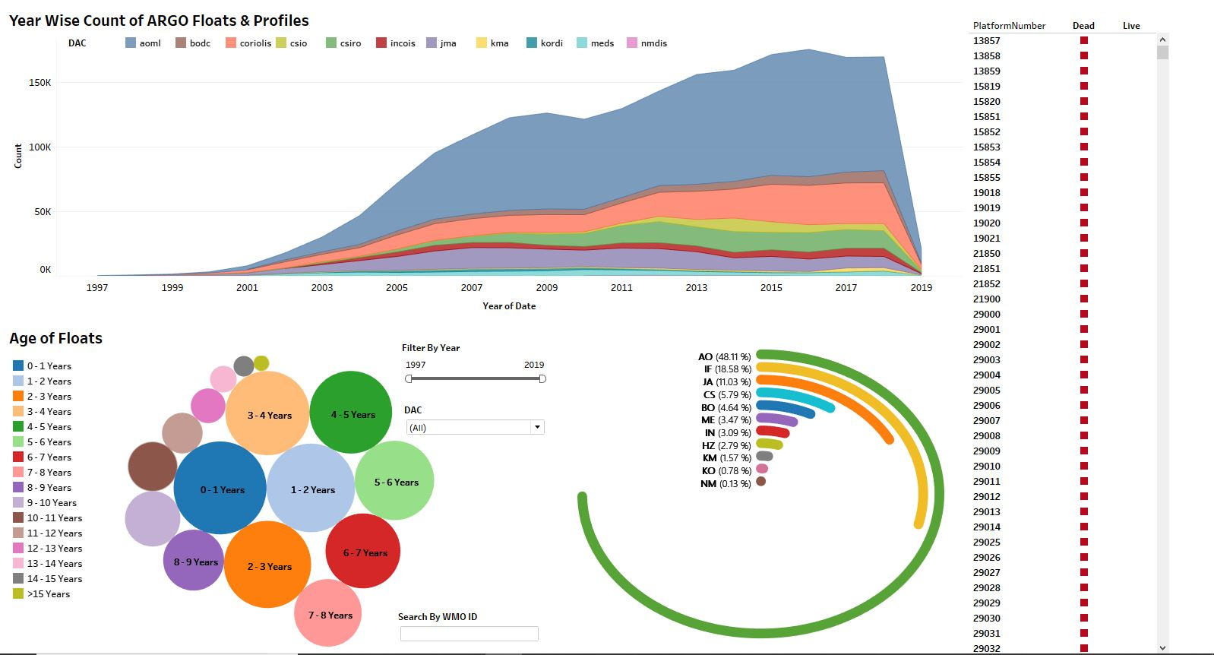
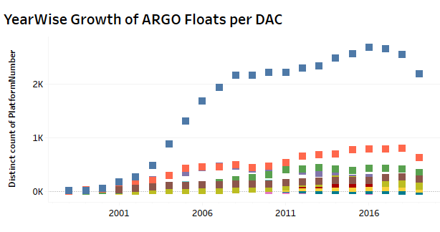
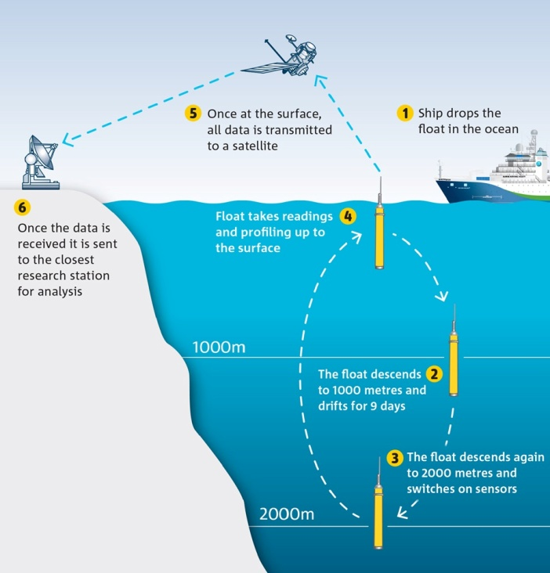
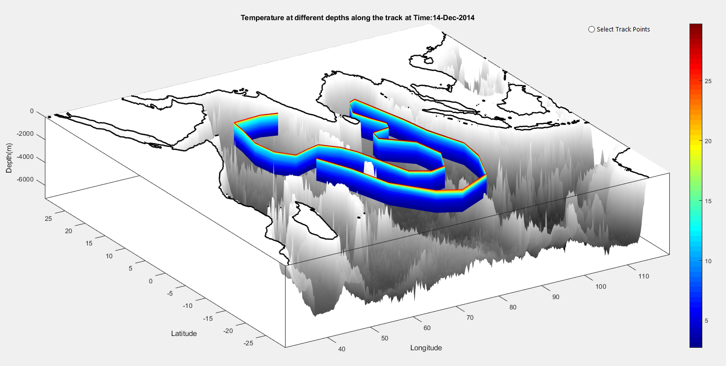
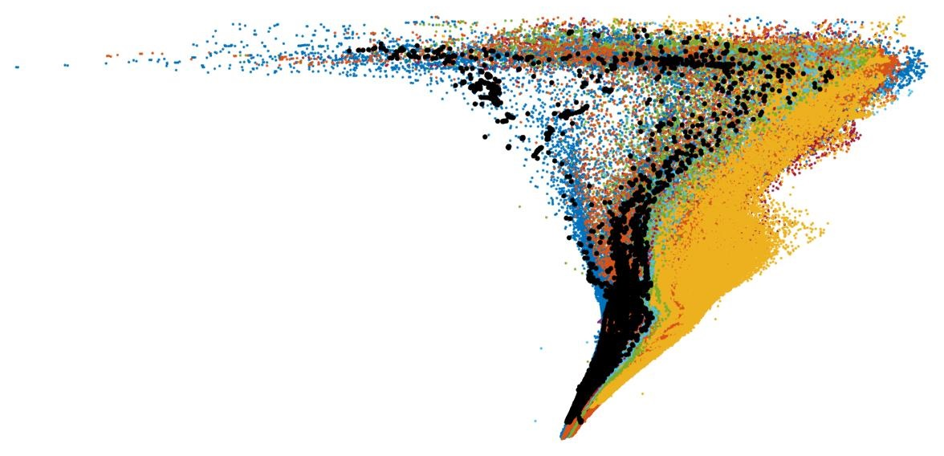

Visualization of Global Argo Metadata:
A comprehensive view of contributions by Data Assembly Centers.
Pavan Kumar Jonnakuti¹ & Udaya Bhaskar TVS¹
Abstract
Methods and Materials
Results
Argo is an internationally coordinated program in which 3000 ﬂoats are seeded into the global ocean. Ever since its inception, the Argo program is complementing the ocean observations which are otherwise taken by ship-based CTD’s and XBT/XCTDs. With the achievement of the target in November 2007, Argo is contributing 1,00,000 proﬁles per year to the oceanographic community. The data from these platforms have grown enormously and the state of the art techniques like big data and data analytics are needed to effectively handle them. In this work a comprehensive visualization of global metadata of the ﬂoats deployed and maintained by various countries, Data Assembly Centers are shown. The metadata is effectively managed to visualize plots like bubble plots of DACs contributions, yearly growth of ﬂoats contribution by each DACs, data availability from each of the ﬂoats with different colour codes are visually shown. A user can play with the range of data by choosing the time periods of choice, which will result in on the ﬂy generation of a wide range of plots from which user can make valid decisions. This system also gives feasibility of downloading chosen ARGO data as per user requirements. Spatial distribution of the ﬂoats locations in all major oceans is shown and queries application results in the automatic regeneration of plots. A comprehensive visualization system of this nature saves the time and efforts in a repeated generation of the plots for demonstration to administrators and cruise planners. As this system is built on the index ﬁles provided by Global Data Assembly Center changes in the data at the global levels will allow automatic enhancements of the data and plots resulting in optimization of the efforts.
Figure 1: Global ARGO Data Assembly Centres
Introduction
Figure 2: Dashboard shows Age of Floats ,Year wise growth of
ARGO profiles and DAC wise data distribution.
The broad-scale global array of temperature/salinity profiling floats, known as Argo, has already grown to be a major component of the ocean observing system. Argo builds on other upper-ocean observing networks, extending their coverage in space and time, their depth
Discussion
Figure 3: Global ARGO Data Analytics dashboard representing Spatial and Temporal distribution .
Building good data visualizations of 2M ARGO records often involves balancing the need to show a comprehensive view of the data, while giving scientific data users the ability to easily find and facilitate them a real-time conversation with the data elements they are looking for. With the help of big data visualization tool Tableau one can easily integrate and analyze to create valuable hidden insights that can be shared for high-quality global ocean analyses and use in all ocean data assimilation models.
range and accuracy, and enhancing them through the addition of salinity and velocity measurements. The global array of 3,000 floats will be distributed roughly every 3 degrees (300km). Argo is the sole source of global subsurface datasets used in all ocean data assimilation models and reanalysis. It will provide a quantitative description of the changing state of the upper ocean and the patterns of ocean climate variability from months to decades, including heat and freshwater storage and transport. A primary focus of Argo is to document seasonal to decadal climate variability and to aid our understanding of its predictability.
Conclusions
The approach to visualizing the massive amounts of ARGO meta data is especially important because the cost of storing, analyzing and querying the data is much higher. Analyzed solution for the problem is to develop an interface for all ARGO Meta data, regardless of where the data is stored. One can perform fast analytics on huge volumes of data interactively and can extract hidden insights from the data, leading to take smarter data driven decisions and inflow of new datasets is updated automatically with a scheduled batch job.
Figure 4: 3D view of Temperature data along the track locations
in Indian Ocean Region.
Figure 5: Temperature Vs Salinity profiles of a selected
WMOID (ARGO Float)
pavankumar.j@incois.gov.in
Acknowledgements : The authors thank the Director ¹Indian National Centre for Ocean Information Services ,Hyderabad ,India for the facilities provided to carry out this work . I(Pavan Kumar Jonnakuti) also thank SERB DST for providing travel grants.

