Slide 1
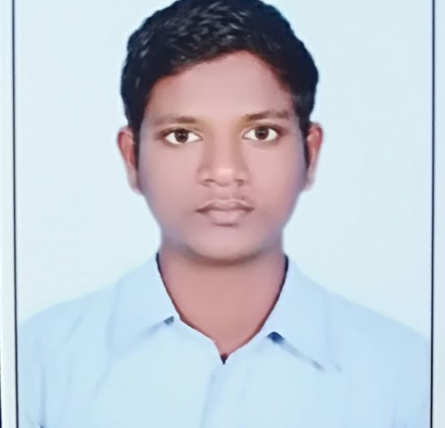
Prasad Jonnalagadda
Bachelor of Technology
: 2018 - 2021
Analyst/Software Engineer
Skills
Java | Java Basics, OOPS, Generics, Collections, java8 features
J2EE | JDBC, Servlets, JPA
Database | PostgreSQL
Web Technology | HTML5 & CSS and JavaScript, Typescript, Bootstrap, Angular.
Tools | Git, Postman, Swagger, Visual Studio Code SonarQube, Jenkins, Spring Tool
Frameworks | Hibernate & spring
Add On skills | Problem Solving, Adaptability, Leadership skills, Communication skill, Team management, work ethic persuasion, Time Management
Bangalore
Prasad.jonnalagadda@capgemini.com
+91 9010070485
A4
Online Advertisement System
Developed Online Advertisement System application to maintain the process of planning and managing the advertisement system.
We Used HTML,CSS, Boostrap and TypeScript for the UI designing and Java & Spring Boot as a middleware and PostgreSQL as backend.
Trained on JEE Full Stack with Angular
Core java, java8 features(stream API , Lambda Expressions, java date time API, Optional class)
J2EE
Git and GitHub
SQL and RDBMS
Hibernate and Spring Frameworks
HTML, CSS , JavaScript , Typescript

