Slide 1
PROJECT PRESENTATION
Design and Simulation of an Automatic Street Light Control System
Team Members
Mokshit: 2620030124
Pardhiv: 2620030132
Bhuvan: 2620030121
Sri Ram: 2620030135

Slide 2

CURRENT INFRASTRUCTURE LIMITATIONS
Why Automate Street Lighting?
Manual Inefficiency
Energy Wastage
High Overhead
Requires daily human intervention.
Lights remain active during daylight hours.
Increased maintenance and labor costs.

Slide 3



Core Objective
SECTION 01
Design a self-regulating illumination system.
Introduction & Objective
Resource Conservation
Minimize municipal electricity consumption.
Replacing manual switches with autonomous digital logic.
Methodology
Implement foundational Boolean AND logic.

Slide 4


HARDWARE ABSTRACTION
Input Parameter Definitions
Parameter 1: Environment
Parameter 2: System Status
Sensor: Light Dependent Resistor (LDR).
Control: Master Switch.
Function: Detects ambient daylight.
Function: Enables global automation.
Logic High (1): Complete darkness.
Logic High (1): System activated.

Slide 5

SECTION 02
Theory and Logic Circuit
Input A (LDR)
Input B (Switch)
AND Logic Gate
High logic during nightfall.
High logic when system armed.
Strict dual-condition requirement.

Slide 6

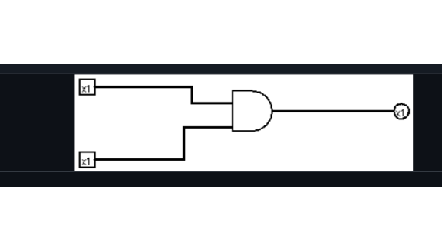
SECTION 03
Circuit Design in Logisim
Diagram Analysis
Direct implementation using standard digital components.
Top Input [x1]
LDR Sensor state.
Bottom Input [x1]
Master Switch state.
AND Gate
Multiplies Boolean inputs.
Output [x1]
Triggers street light relay.

Slide 7
SECTION 04
Simulation Results
Comprehensive truth table verifying the required logic conditions.
Environment (LDR) | System (Switch) | Logic Result | Physical State
0 (Daylight) | 0 (Disabled) | 0 | Lights OFF
0 (Daylight) | 1 (Armed) | 0 | Lights OFF
1 (Night) | 0 (Disabled) | 0 | Maintenance Mode
1 (Night) | 1 (Armed) | 1 | Lights ON

Slide 8



SECTION 05
Practical Applications
Smart Cities
Highway Corridors
Industrial Sectors
Automated municipal grids.
Weather-adaptive tunnel lighting.
Factory perimeter security.
Substantial carbon footprint reduction.
Private campus automation.
Enhanced driver safety at dusk.

Slide 9


SECTION 06
Conclusion and Future Scope
Project Outcome
Hardware Next Steps
Future Upgrades
Successful AND logic implementation.
Remote IoT status monitoring.
Microcontroller integration (Arduino).
Reliable automated switching.
Off-grid solar power integration.
Dynamic LDR sensitivity tuning.

Slide 10
Thank You
Open for Questions and Discussion

