Slide 1
Asp.Net MVC Views

Slide 2
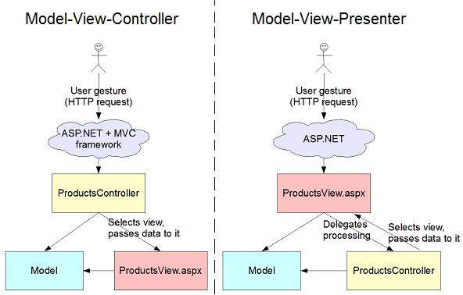
Asp.Net MVC Views
What is a view?
MVC is a pattern that is used when we want to display the same data multiple ways.....views
"Views" are the components responsible for displaying the application's user interface
Common example is having a Domain object called “Product” and displaying a view for all of CRUD

Slide 3
Asp.Net MVC Views
What is a view engine?
MVC is designed to be highly extendable with nearly every component interfaced and swappable.
This means that the entire ViewEngine and be swapped for an entirely new system.
Or you can extend the current web forms implementation to move resources and introduce new templating standards.
Either way the job of a view engine is to decide how to represent the data returned by the controller

Slide 4
Asp.Net MVC Views
Interfaces
IView
Render(ViewContext viewContext, TextWriter writer)
ViewContext : Encapsulates information that is related to rendering a view
IViewEngine
ViewEngineResult FindPartialView( ControllerContext controllerContext, string partialViewName, bool useCache)
ViewEngineResult FindView( ControllerContext controllerContext, string viewName, string masterName, bool useCache )
ReleaseView(ControllerContext controllerContext, IView view)

Slide 5
Asp.Net MVC Views
WebFormViewEngine
Represents a view engine that is used to render a Web Forms page to the response. Return a class called ViewPage that actually inherits from the System.Web.UI.Page class and runs the control template abstraction from the original Asp.Net 2.0. However not the web forms “Post Back” abstraction. This makes it backwards compatible, is this a good thing?
Inherits from: VirtualPathProviderViewEngine
Represents an abstract base-class implementation of the IViewEngine interface.
What the hell is VirtualPathProvider?
The VirtualPathProvider class provides a set of methods for implementing a virtual file
system for a Web application. Lives in System.Web.Hosting

Slide 6
Asp.Net MVC Views
ActionResult and ViewResult
Custom ActionResult’s must inherit and implement from ActionResult. There is one method: ExecuteResult(ControllerContext)
Custom action results make Restful functionality on Asp.Net MVC possible through resource based requests.
Eg. ContentResult, JsonResult, or you could have XmlResult, AtomResult
ViewResult uses view engine functionality, where you want logic to execute around your requested data.
Imagine if a viewengine could choose the document format to return based on the httprequest?

Slide 7
Asp.Net MVC Views
In line with MVC principles. Promotes separation of UI and Business Logic. All data is created ahead of time, and passed down to the template
Alternative view engines: SimpleTemplate
Conditional Statements
ViewData["IsSuperUser"] = true;
<div> Employee Detail: $if(IsSuperUser)$ <a href="/allowEdit">Edit</a> $else Editing not allowed $endif$ </div>
Iteration
var employee1 = new { Id=1, Name="Joe" }; var employee2 = new { Id=2, Name="Sally" }; ViewData["employees"] = new object[] { employee1, employee2 }; <ul> $employees:{ <li>$it.name$ has an ID of $it.id$</li> }$ </ul>

Slide 8
Asp.Net MVC Views
Alternative view engines: Spark
<viewdata products="IEnumerable[[Product]]"/>
<ul if="products.Any()">
<li each="var p in products">${p.Name}</li>
</ul>
<else>
<p>No products available</p>
</else>
Spark is a view engine for Asp.Net Mvc and Castle Project MonoRail frameworks. The idea is to allow the html to dominate the flow and the code to fit seamlessly.

Slide 9
Asp.Net MVC Views
Conclusion:
A controller should return a result of data (Model) that represents a response to a set of arguments. Views exist is to represent the same data in many ways, they’re not there to perform more logic on the data.
Stick to this Separation of Concerns and you will have a much more readable and testable code base.

