Slide 1

Learning Yeoman
Notes:
This book provides you with the opportunity to discover all three core tools that the Yeoman workflow has to offer but also gives you an insight into its advanced features.
The book will focus on what kind of applications can be built using Yeoman and what kind of frameworks that can be used easily with it.
In order to demonstrate how it can speed up development time, we'll build a application from scratch, integrating with the AngularJS framework with as many functionalities as needed by any modern web application.
Given that Yeoman can be used with both JavaScript and CoffeeScript, you'll be introduced to the CoffeScript programming language because most of the examples are in CoffeScript for readability and simplicity.

Slide 2




Design, implement, and deliver a successful modern web application with three powerful tools in the Yeoman workflow.
Notes:
With so many modern tools for web developers to leverage, creating web applications ends up being a never ending struggle on deciding on which tools and workflows to use for that project, meet Yeoman - a workflow composed of three tools that enables developers to save time when creating modern web applications, with a module for just about any task and a code generator for just about any project, getting starting with projects using community best practices has never been easier.

Slide 3

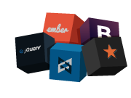

yo - the scaffold tool
Lightening Fast Scaffolding
Create modern web applications with Yeoman, to save time and money by automating a developers workload using yo – the scaffolding tool.
Hundreds of Generators
Just about a generator for everything, generators are installed via Node’s package manager NPM. No matter what project your working on there is most likely a generator for it.
A generator for generators
Use the yo generator to create a custom generator that runs in a Node.js environment. Leverage the yeoman-generator API to add advanced functionality to new or existing generators.

Slide 4



bower - the package tool
Web Package Manager
Bower is a package manager for the web and allows you to easily manage dependencies for your projects.
1000+ Libraries
Bowers repository is packaged full of libraries, no more manually downloading scripts and outdated versions.
Notes:
Bower is a package manager for the web. It offers a generic, unopinionated solution to the problem of front-end package management, while exposing the package dependency model via an API that can be consumed by a more opinionated build stack. There are no system wide dependencies, no dependencies are shared between different apps, and the dependency tree is flat.
Bower runs over Git, and is package-agnostic. A packaged component can be made up of any type of asset, and use any type of transport (e.g., AMD, CommonJS, etc.).

Slide 5


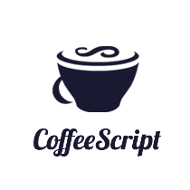





grunt - the build tool
JavaScript Task Runner
Build, test and preview projects to ensure code is always ready for production using Grunt – the task management tool.
Hundreds of Plugins
Most tasks you need are already available as Grunt Plugins, and with new plugins are published every day there is also a solution.
Used by top companies
Grunt is used by some of the top companies of the web which drive the development efforts for years to come.
Notes:
In one word: automation. The less work you have to do when performing repetitive tasks like minification, compilation, unit testing, linting, etc, the easier your job becomes. After you've configured it, a task runner can do most of that mundane work for you—and your team—with basically zero effort.

Slide 6
Why Yo?
$ yo
[?] What would you like to do? (Use arrow keys)
❯ Run the Angular generator (0.8.0)
Run the Angular-component generator (0.2.3)
Run the Angularjs-library generator (1.0.2)
Run the Backbone generator (0.2.8)
Run the Ember generator (0.8.3)
Run the Generator generator (0.4.3)
Run the Gruntfile generator (0.1.0)
(Move up and down to reveal more choices)
[?] What more would you like? Bootstrap, Sass with Compass, Modernizr
create Gruntfile.js
create package.json
create .gitignore
create .gitattributes
create .bowerrc
create bower.json
create .jshintrc
create .editorconfig
create app/favicon.ico
create app/404.html
create app/robots.txt
create app/.htaccess
Notes:
Yo is a scaffolding tool that you can use to create pretty much anything.
Working on a backbone project?
1. want to create a new model - $ yo backbone:model post
2. what about a collection of models - $ yo backbone:collection posts
Working on an angular project?
1. want to create a new directive - $ yo angular:directive cmsMarkdownEditor
2. need a service ? - $ yo angular:service cmsAuthService
You can also create a custom generator to stream line repeated tasks when coding projects at work or home.
Need to add Grunt to a project, easy just use yo grunt file to interactively create a custom grunt file.

Slide 7
Why Bower?
$ bower install [package]
$ bower search [name]
$ bower list
$ bower update
$ bower uninstall [package]
Notes:
TODO

Slide 8

Why Grunt?
$ grunt test
$ grunt build
$ grunt dist
$ grunt docs
$ grunt serve
$ grunt serve:dist
Notes:
Commands for everything. Testing, building, generating docs, starting development server, running preview server. Just about anything you could think of you can do with grunt. Automate everything you do.

Slide 9
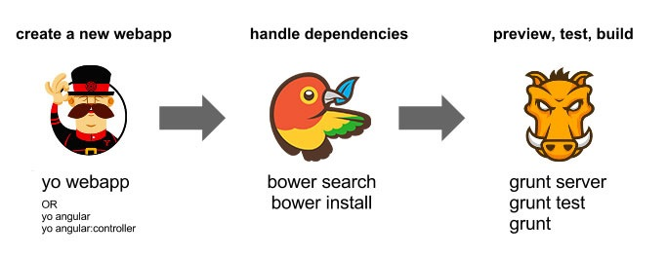
Why Yeoman?
The Yeoman workflow consists of three tools that will streamline development of modern web projects.
What more could you want?
Notes:
TODO

Slide 10

Official Generators
generator-angular
generator-backbone
generator-ember
generator-node
generator-commonjs
generator-polymer
generator-jquery
generator-gruntplugin

Slide 11

Resources
yeoman.io
bower.io
gruntjs.com
github.com/yeoman

Slide 12


Presentation
by
Jonnie Spratley
@jonniespratley
UI Developer @ GE Software
Notes:
My name is Jonnie Spratley and I am on the Predix Platform team at GE Software, building a framework to power the Industrial Internet; I've started creating web applications with HTML, CSS, PHP and JavaScript around 2004 and have been hooked ever since, I've spent the past few years learning JavaScript frameworks and tools such as AngularJS, BackboneJS, Yo, Grunt, CoffeeScript, RequireJS, etc. and a variety of server-side languages. I have a passion for creating and using tools to streamline a developers productivity.

