Slide 1
Jon Nordby
EuroSciPy 2018
Machine Learning for microcontrollers with Python and C
https://github.com/jonnor/emtrees

Slide 2
About Me
Bachelor Electronics Engineering
Software Developer since 2010
Embedded devices, audio & image processing
Freelance consultant since 2015
+ studying Master of Data Science

Slide 3
This presentation
Why Machine Learning on microcontrollers
Practical howto in Python with emtrees

Slide 4
Machine Learning Device Spectrum
 | Server/Workstation | Mobile/Embedded | Sensor/Node | vs Dev Laptop
RAM (MB) | 10 000 ++ | 100 - 1000 | << 1 | 10 000x
Processing perf (peak GFLOPS) | 100 ++ | 1 - 10 | < 0.1 | 1 000x[1]
Power budget [Watt] | 100 ++ | 1 - 10 | << 0.001 | 10 000x
P.U Cost [USD] | 100 ++ | 10 - 100 | 1 - 10 | 100x[2]
1. Power budget limited
2. Processing unit only
Notes:
Cloud=normal.
As much RAM as want, as much compute as GPU want, incl GPU
Edge. Gateway. Embedded Linux.
Mobile, iOS/Android. 100-1000 MB RAM
FPU no GPU
Micro/node.
1-1000 kB RAM

Slide 5
Microcontroller spectrum
Example Device | RAM | FPU
Minimal Attiny10 | 50 bytes | x
Arduino Uno (AtMega328) | 2 kB | x
General ARM Cortex M0 (STM32f0) | 16 kB | x
Low-power BTLE ARM Cortex M4F (NRF52832) | 64 kB | v
Performance ARM Cortex M7 | 512 kB | v
Preferred:
10 kB RAM+
with FPU

Slide 6
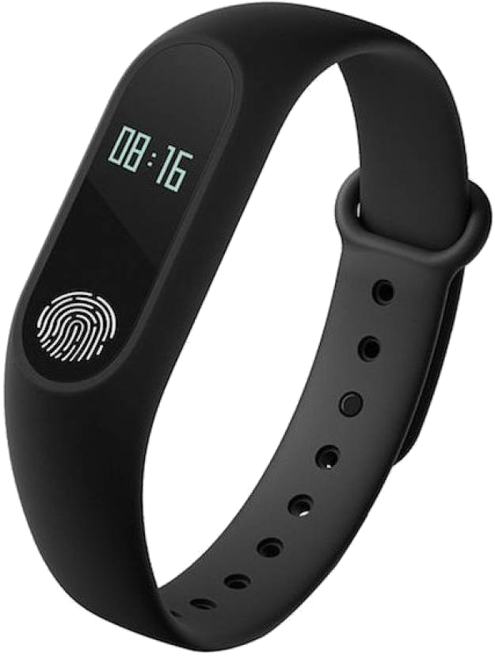
Usecase: Fitness bracelet/smartwatch
Personal and Medical uses
Activity Detection
Gesture Recognition
Wakeword Detection

Slide 7
Usecase: Industry Machine Monitoring
Anomaly Detection
User feedback/warning
Predictive Maintenance

Slide 8
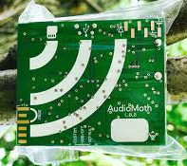
Usecase: Monitoring of animals
Wildlife or domestic
Recording Trigger
Health Warnings
Presence Estimation

Slide 9
Usecase commonalities
High-bandwidth input data, low-bitrate information
Limited sensing area → need many, cheap
Placement important → portable,small
24/7 availability
Wireless connectivity
Battery||Energy-Harvesting

Slide 10
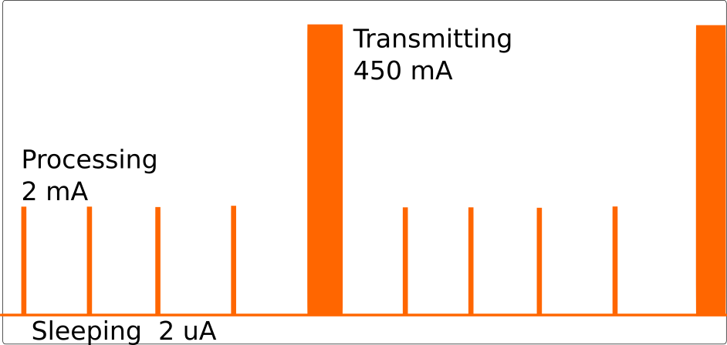
All about (low) power
Sleep as much as possible
Transmit as seldom as possible

Slide 11
Opportunities
Compared to cloud-ML or edge-ML only
Lower power consumption
Lower cost, more coverage/deployments
New sensor types

Slide 12
Challenges
Models must be small, efficient. < 32kB RAM
Popular frameworks not suitable
(scikit-learn,Tensorflow)
C (or C++) still king on microcontrollers
! Quality Assurance on edge

Slide 13
OK, lets do it!
…now what?

Slide 14
Relevant methods
Unsupervised
  Anomaly Detection
  Data compression
Supervised (regression, classification)
  Linear models
  Tree-based ensembles
  Deep Learning

Slide 15
Available implementations
EdgeML, ELL (Microsoft Research)
uTensor. TensorFlow for microcontrollers
(maybe) mlpack or dlib. C++ ML frameworks
(maybe) MATLAB with C generation
emtrees: Python to C
Others?

Slide 16
emtrees
Tree-based ML methods for embedded devices
https://github.com/jonnor/emtrees
RandomForests && ExtraTrees
MIT licensed, available on PyPI

Slide 17
emtrees
Train in Python, deploy to C
Microcontroller-friendly for Inference
Python module with scikit-learn integration

Slide 18
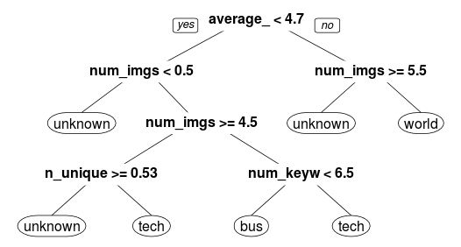
Decision-tree ensembles
Ensemble: (weighted) Majority voting

Slide 19
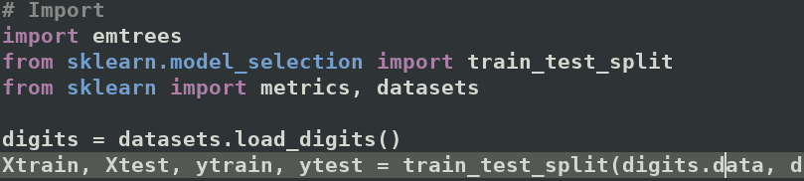
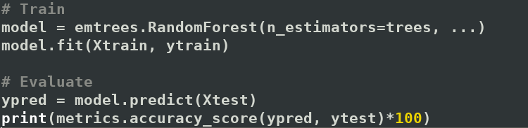
Training & Evaluation
It’s just scikit-learn!

Slide 20


Deploy to microcontroller

Slide 21
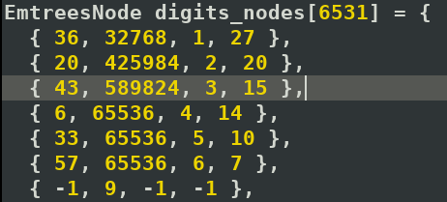
Use loadable model

Slide 22

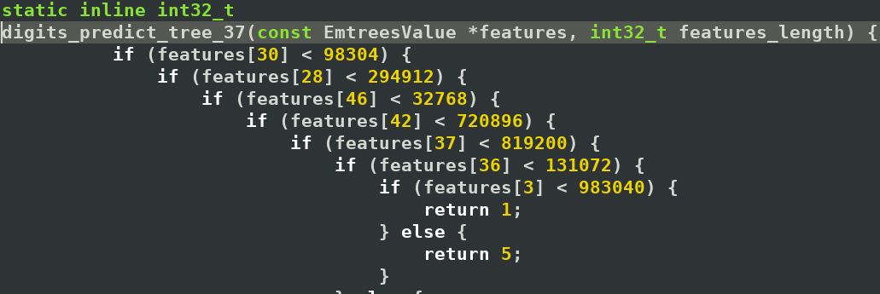
Use generated code

Slide 23
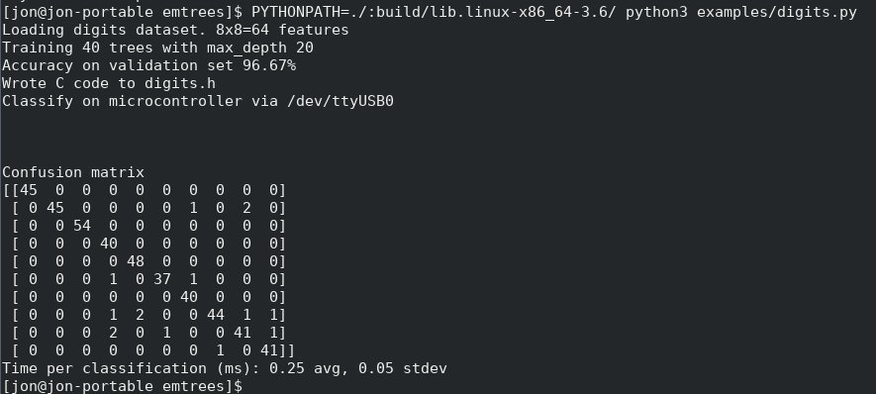
Performance on microcontroller

Slide 24
Related work
https://github.com/jonnor/birddetect
Passive acoustic monitoring
for Wireless Sensor Network
Audio feature extraction (melspectrogram)
emtrees for classification

Slide 25
emtrees: Upcoming
Floating-point over fixed-point/integer
End2end hardware demo
Isolation Forests (anomaly detection)
Regression Trees (continuous output)
Gradient Boosted Trees (boosting classifier)

Slide 26
Thank you!
Interested in Machine Learning for Microcontrollers?
Usecases, Methods, Papers, Tools?
- I want to hear from you!
Catch me @EuroScipy2018 today or tomorrow
Github: https://github.com/jonnor/emtrees
Email: jononor@gmail.com

