Slide 1
Introduction to 3d-modelling with FreeCAD
WIFI:
bitraf
grimbadgerassault
DOWNLOAD: freecadweb.org
Jon Nordby @jononor

Slide 2
> whois jonnor
…
... engineer software electronics bike mechanic maker hacker

Slide 3
Workshop setup
10 minutes talking intro/examples
Hands-on examples ~ 1 hour
Break ~10 min
Hands-on, examples → personal project

Slide 4
3d-model uses
Games/VR
Movies
Concept visualization (arch/design)
Documentation
Manufacturing
  Digital fabrication (3d-print, CNC, lasercut)
  Conventional (technical-drawings, manual labor)

Slide 5
Approaches to 3d-modelling
Examples
Direct modelling
  Mesh / Polygon Blender Sketchup
  Solid / Nurbs Rhino3d
Parametric modelling FreeCAD Solidworks
Mesh sculpting Z-Brush
Algoritmic/code
  Visual GrassHopper
  Textual OpenSCAD
3d-scanning Kinect+Skanect

Slide 6
Solid, Feature-based, Parametric
+ changes updates everything
+ always watertight
+ easy to create families/variations
- order of operations matters
- a bit techical

Slide 7
Examples of FreeCAD work
Things I've done
Mostly from https://github.com/jonnor/projects

Slide 8
Tips
Use mouse/trackball/ instead of trackpad
Have pen & paper available for sketch/dimensions
Use pictures as reference material

Slide 9
LIVE show & tell
Everyone got FreeCAD installed & running?

Slide 10
FreeCAD UI concepts
Workbenches
  Part, Part Design, Draft
Object tree
Object properties (view/data)
Document viewport

Slide 11
Viewport navigation
Note: configurable
right click → nav. Style
  Edit → Preferences → Display zoom-at-cursor
Key numbers 1-9: top, front, side, …
Scroll wheel: Zoom in/out

Slide 12
Part Design basics
New Sketch
Adding geometry: Rect
Adding constraints: Distances
Pad
Map Sketch to Face
Pocket

Slide 13
Finishing: Fillet & Chamfer
Also used for structural purposes,
ex: compensating for layer bonding in 3d-print
Select object
Select edge(s)
Hit PartDesign:Chamfer or PartDesign:Fillet
Select value, OK
WARN: too large value will not work, fail semi-silently
Part:Fillet/Chamfer has couple of more, advanced options

Slide 14
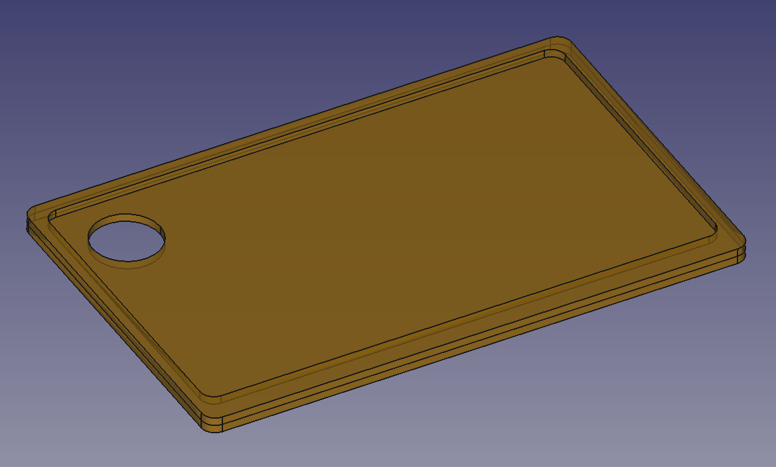
Project: Tray
Simple tray to keep food on FILE: tray2.fcstd
Designed for laser-cutting

Slide 15
Export: 2d for CNC/laser
Part:Cross-Section → 2d object(s)
Select 2d object
File → Export → .DXF
Open in V-Carve / AutoLaser
Note; sometimes need to convert .DXF
Can use QCAD (free)

Slide 16
Intermission
Bitraf tour Donations

Slide 17
Part Design: Revolve
New Sketch
Create a feature: L bracket (using poly-line)
Select sketch
Choose Revolve

Slide 18
Part basics
Adding primitives
Boolean operations
  Union “Fusion”
  Subtraction “Cut”
  Intersection “Common”

Slide 19
Part: Mirror

Slide 20
Draft: Move & Rotate

Slide 21
Draft: Array
Rectangular, polar

Slide 22
Draft: Copy along Path

Slide 23
Part: Sweep

Slide 24
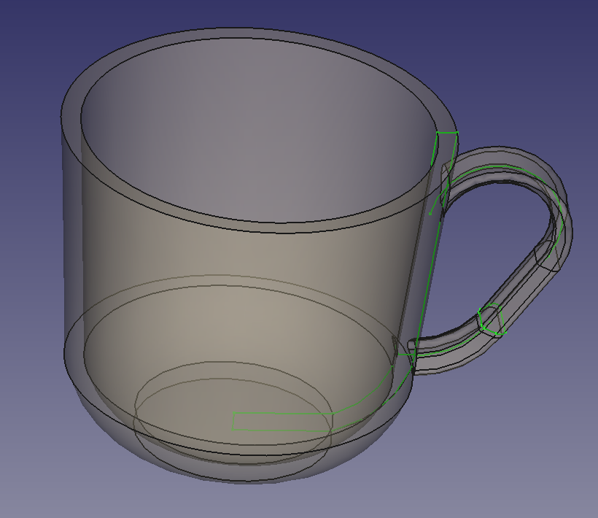
Project: Cup
Designed for 3d-printing
Revolve,
Sweep,
Union
FILE: cup2.fcstd

Slide 25
Export: 3d-printing
Select object
File → Export → Mesh
.STL output by default
Import into Cura/Slic3r
Also used for 3d-milling on Roland Modela

Slide 26
Part: Loft

Slide 27
Finishing: Coloring
Select object
Right click → Apperance (Ctrl + D)
Change material, colors, transparency

Slide 28
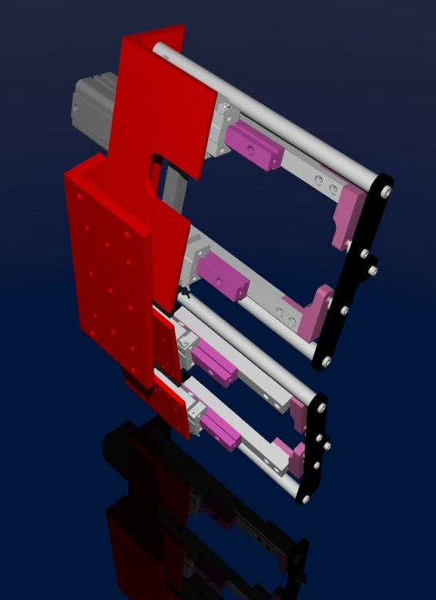
Finishing: Raytracing
Uses LuxRender / POVRay
http://www.freecadweb.org/wiki/index.php?title=Raytracing_Module

Slide 29
Best Practices
Bolts/holes, booleans instead of sketch
Selecting good origin position
Feature type with most information
Jakob

Slide 30
Python scripting
Everything can be done with Python
Recorded macros are Python

Slide 31
Part libraries
BOLTS: standardized fasteners/bearings...
github.com/yorikvanhavre/FreeCAD-library
Anything which has .STEP

Slide 32
Animation
Using Python scripting:
https://www.youtube.com/watch?v=KynMmsLJXV0
Altenative:
Export files, do animation in Blender etc

Slide 33
Functionality not covered
Workbenches
  Architecture
  Drawing
  Mesh
  Ship
  FEM
  Robot

Slide 34
In Development
3D-printer workbench, using CuraEngine
https://github.com/cblt2l/FreeCAD-CuraEngine-Plugin
Path/CAM module, for CNC/laser
http://forum.freecadweb.org/viewtopic.php?f=10&t=8622
Assembly workbench
http://forum.freecadweb.org/viewforum.php?f=20

Slide 35
More resources
YouTube tutorials (NB: FreeCAD 0.14)
http://forum.freecadweb.org/
FreeCAD docs/wiki
http://www.freecadweb.org/wiki/
Visit at Bitraf anytime!

Slide 36
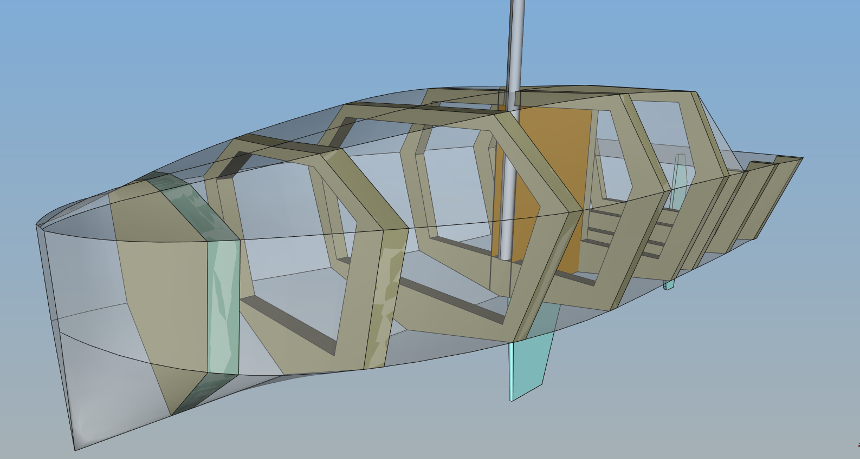
Workbench: Ship Design
http://www.freecadweb.org/wiki/index.php?title=FreeCAD-Ship_s60_tutorial

