Slide 1
Patents & Open Hardware
Jon Nordby, The Grid @jononor

Slide 2
Open Hardware & Patents = incompatible
Patents not for small inventors
Open Hardware = excellent innovation form
NOT attempting to reform patent system

Slide 3
> whois jonnor
…
... engineer software electronics maker hacker

Slide 4
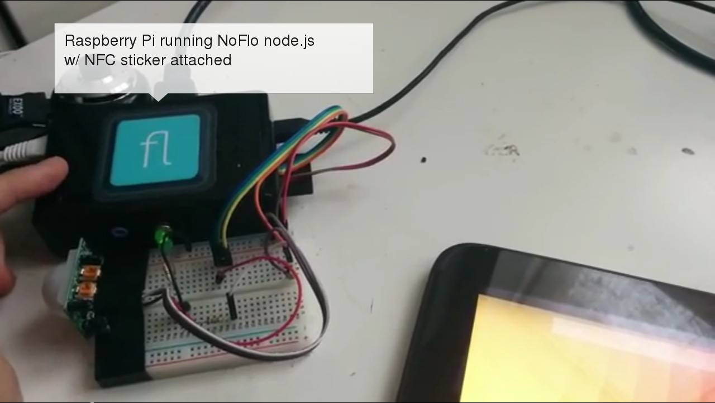

Slide 5
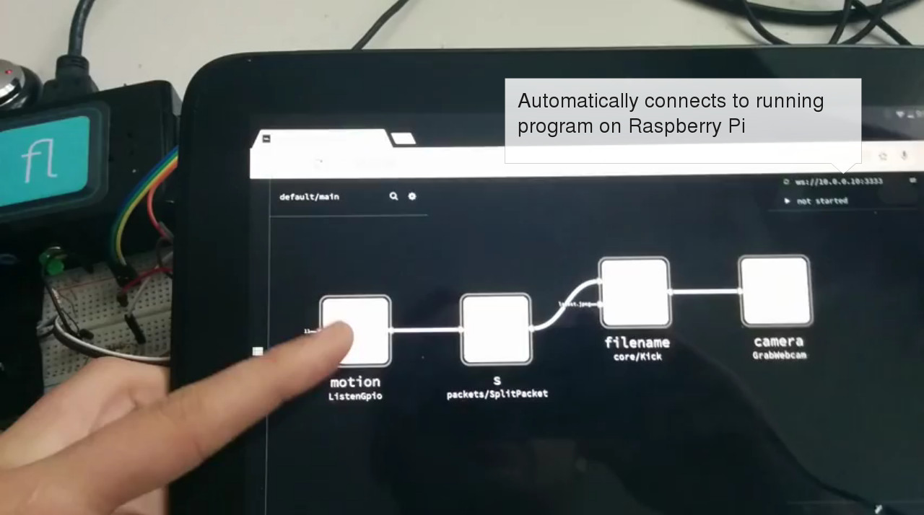

Slide 6
What are patents?
definition
right to time-limited monopoly on use of invention
purpose
ensure inventions available to public
encourage innovation

Slide 7
Patentability
Novel
Inventive
Useful

Slide 8
OSHW definition
"Open source hardware is hardware whose design is made publicly available so that anyone can study, modify, distribute, make, and sell the design or hardware based on that design"
http://freedomdefined.org/OSHW

Slide 9

Open source != non-commercial

Slide 10
Patents are broken the system is rigged

Slide 11
License to sue not money in the bank

Slide 12

Using patent optional

Slide 13
Not enough time to check
Bad patents get through

Slide 14

Litigation insanely expensive

Slide 15
First to file when invented not important

Slide 16
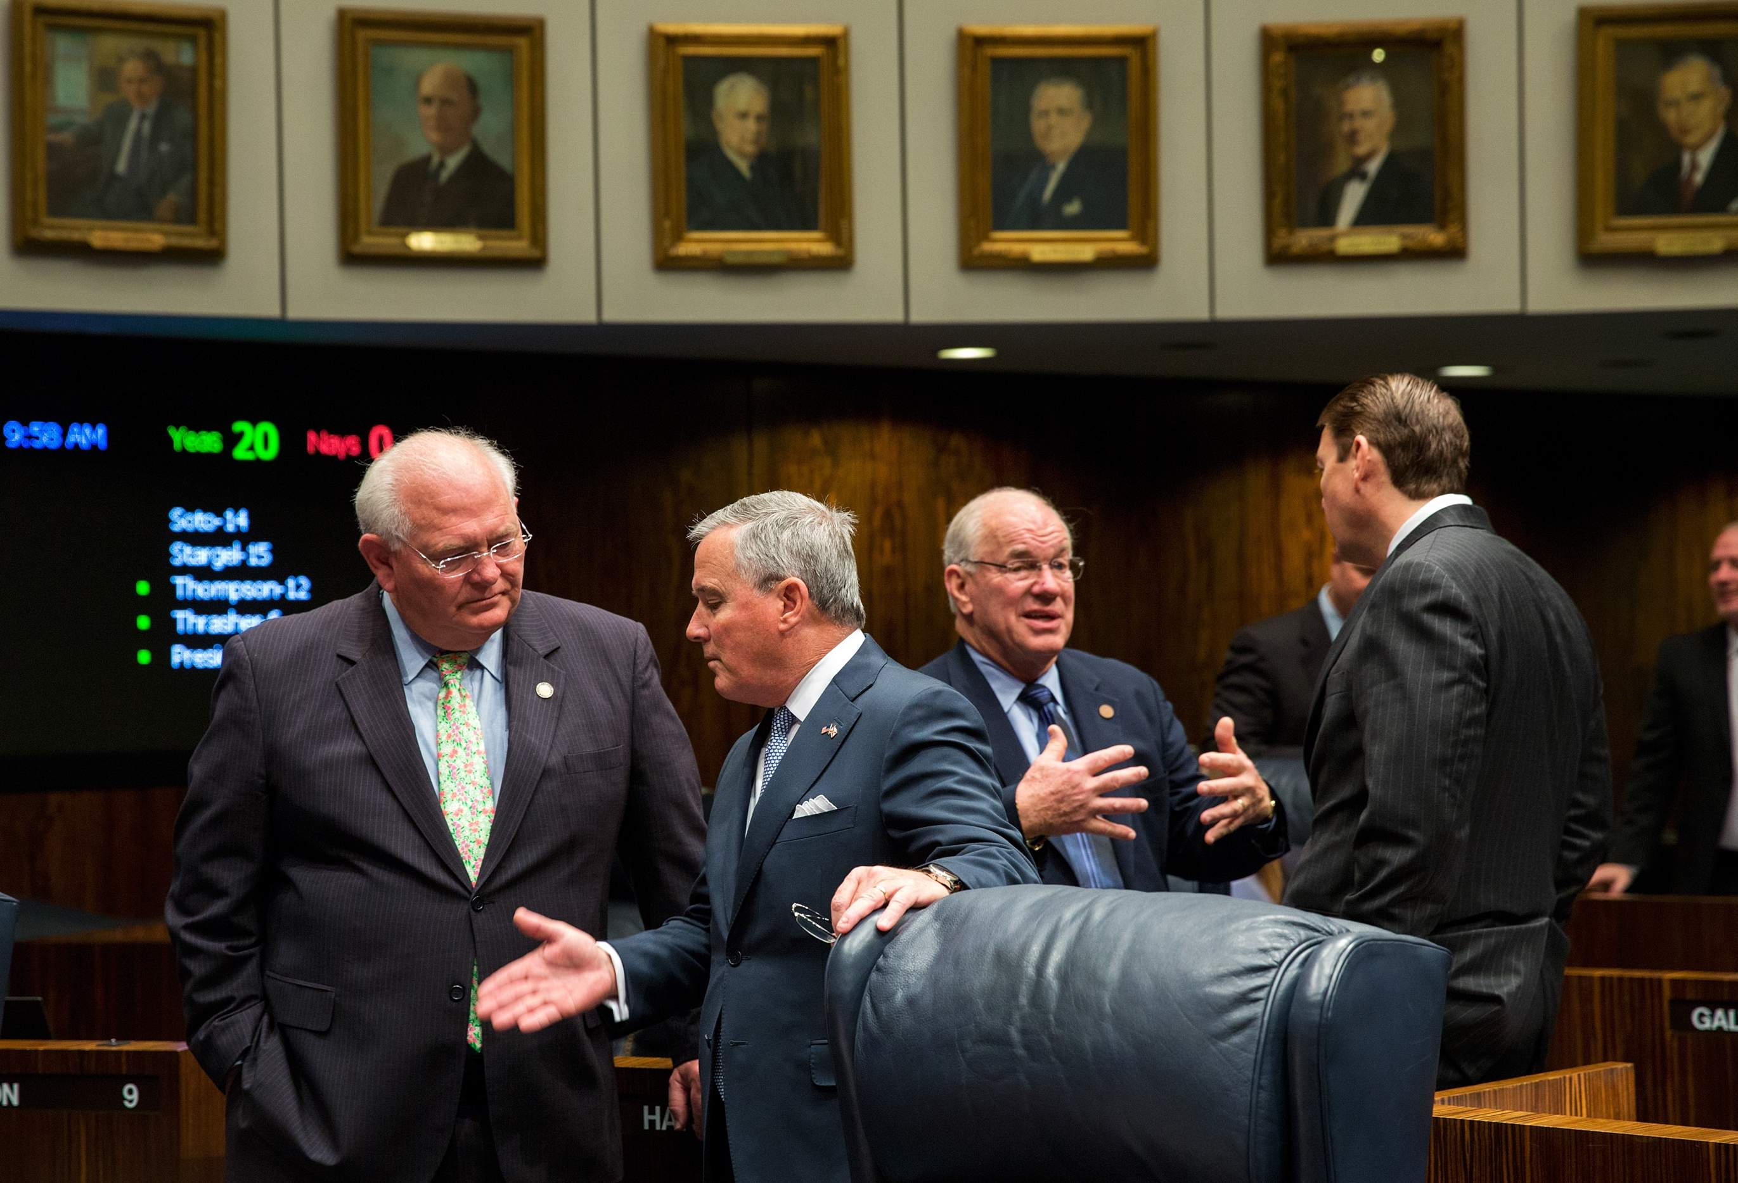
No transparency

Slide 17
Competing in court instead of market
http://www.forbes.com/sites/timworstall/2013/11/07/interesting-number-microsoft-makes-five-times-more-out-of-android-than-it-does-windows-phone/

Slide 18
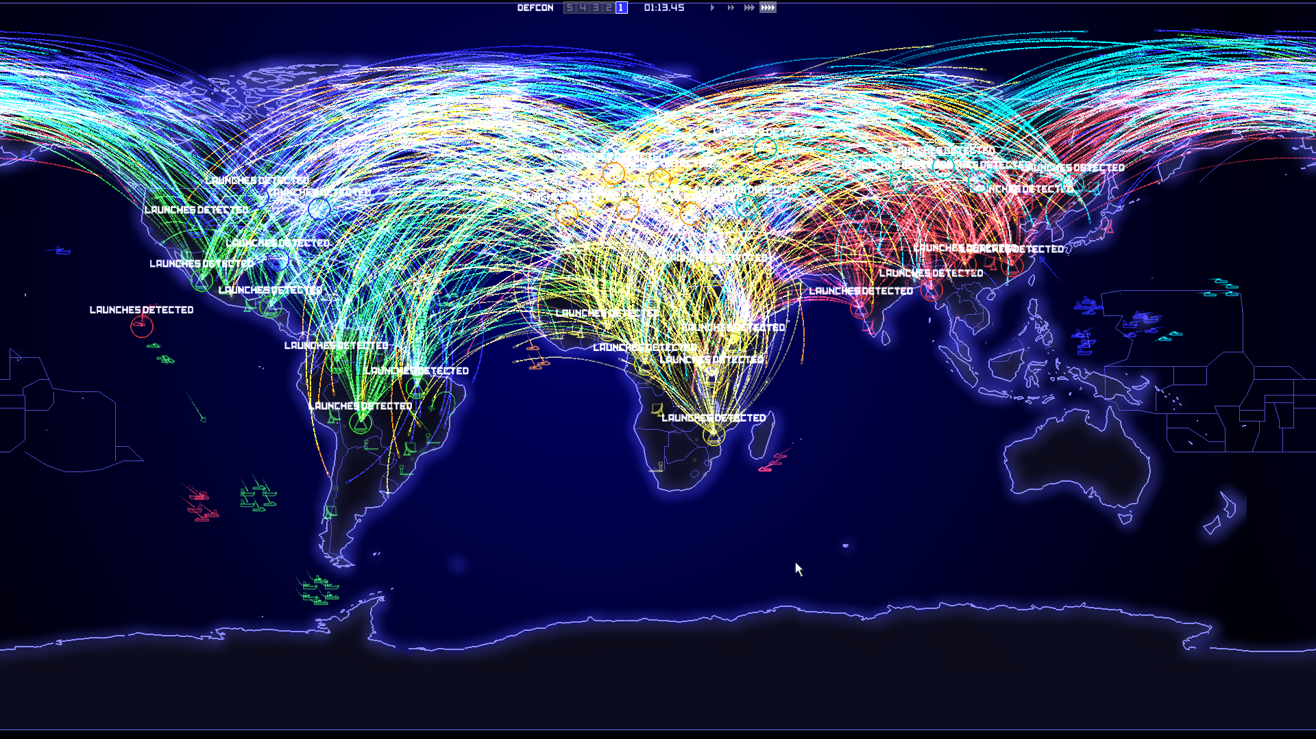
Mutually Assured Destruction

Slide 19
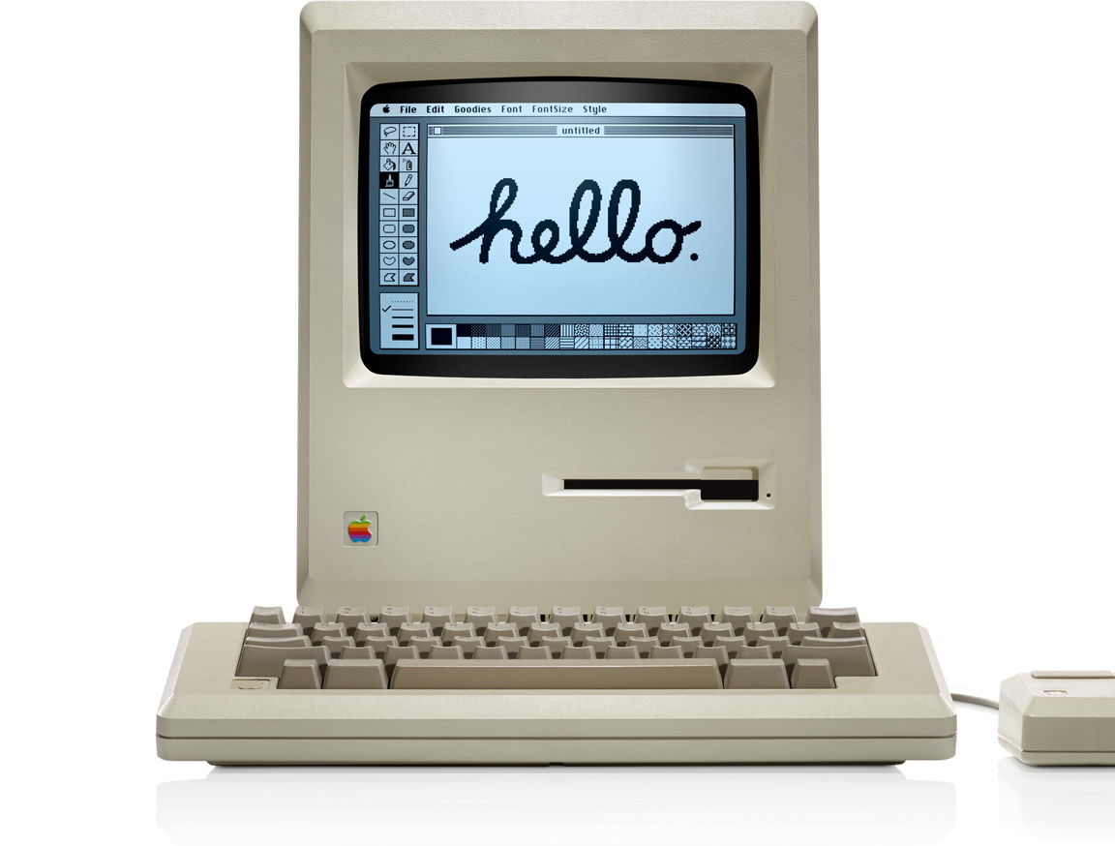
15-30 years

Slide 20
Defend

Slide 21

Defensive Publication
http://www.linuxdefenders.org/

Slide 22
Patent pool
http://www.openinventionnetwork.com

Slide 23


Patent promise
https://github.com/twitter/innovators-patent-agreement
http://www.redhat.com/legal/patent_policy.html

Slide 24

Support reform
https://eff.org/join

Slide 25
Open Hardware
Open Innovation

Slide 26

Open Source as prior art

Slide 27
Openness → visibility → leadership

Slide 28
Recruit contributors

Slide 29
Frictionless cross-company collaboration

Slide 30
Company fail != idea fail

Slide 31
Open Hardware & Patents = incompatible
Patents not for small inventors
Open Hardware = excellent innovation form
NOT attempting to reform patent system

