Slide 1
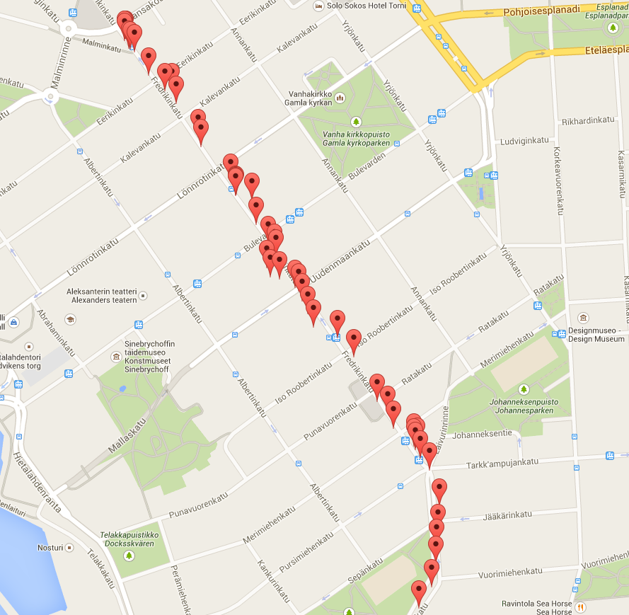
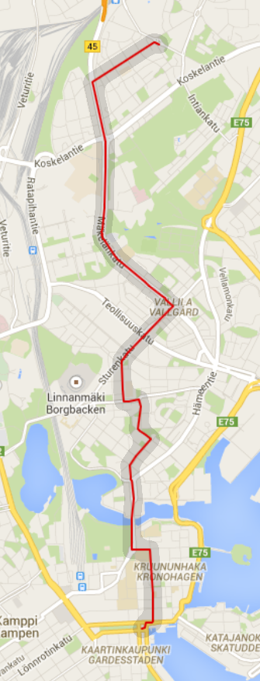
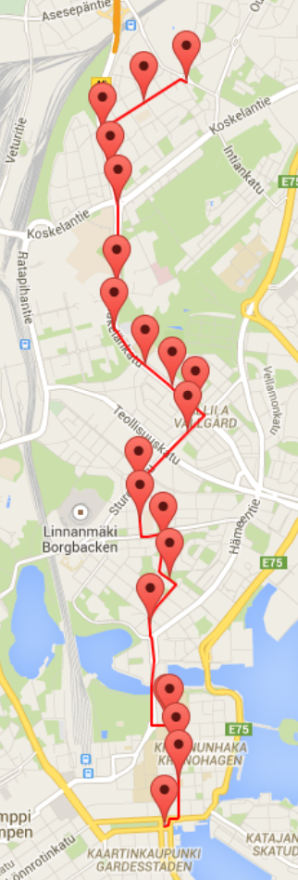
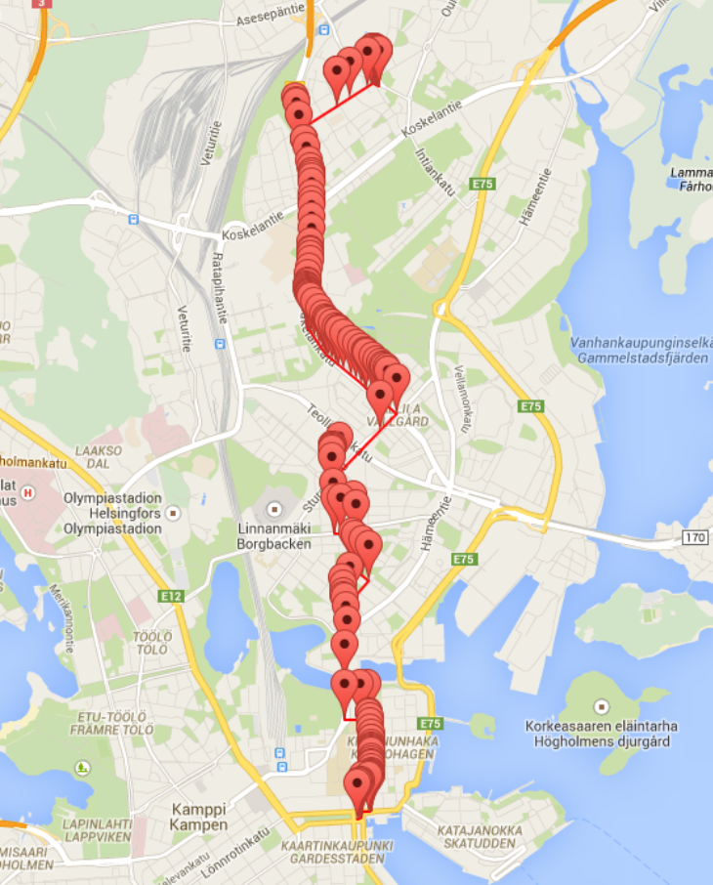
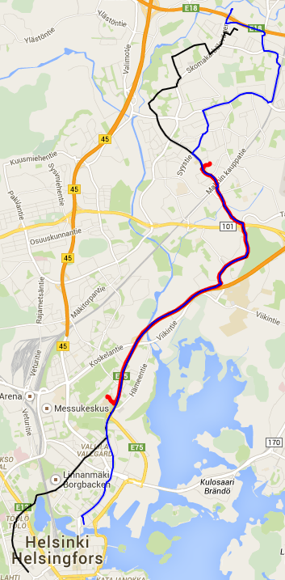
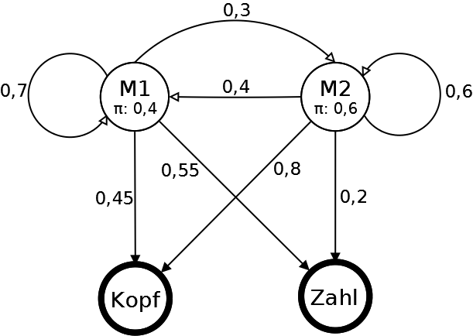
Buslinien-Erkennung
Mit Hidden-Markov-Modellen
1
2
3
4
5
Summary
You should use a sans-serif font to be con-sistent with the template of the WeST-slides. Normal tex
Normal Text
Institute for Web Science and Technologies
apeldoorn@uni-koblenz.de

Slide 2

Some more Template
Elements...
You can access the WeST colors through the predefined color palette in the color menus (seems to not work properly in MS Office/OO):
1
WeST Blue
2
WeST Orange
3
WeST Red
Elements can be emphasized using an outline:
Red arrow without outline
Orange arrow with outline
Daan Apeldoorn
Institute for Web Science and Technologies
apeldoorn@uni-koblenz.de

