Slide 1
AWS an Introduction
By: Jonathon Graf

Slide 2
Why should I care about AWS?
Java Archetypes exist
Help desk creates servers
Security Handled
Apps low volume - little need to scale
US clients - few concerns about down time
Deploy changes - every few weeks or months

Slide 3
Why should I care about AWS?
Vanguard outsourcing Pension Plans
Promised 0 down time
Promised 0 freeze dates
Wells Fargo Retirement Acquisition
Expected down time
Planned freeze dates
Amazon selling insurance policies
Tesla selling automotive insurance
Mass Mutual selling retirement business
Lemonade – App driven insurance - in 5 years achieved 1/3 PFG market cap

Slide 4
Resource Types
Storage Resources
Compute Resources
Notification Resources
Permission Resources

Slide 5
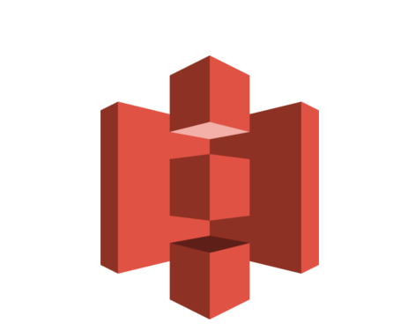


Storage Resources
Simple Storage Solution (S3)
DynamoDb
Relational Db Service (RDS)

Slide 6

S3
File Storage
Keep private
Expose publicly
Can create folders to organize
Store static content websites

Slide 7

DynamoDb
NoSQL database
Key-Value storage
Document storage
Unstructured data
Simplify database schemas
Multi regional support

Slide 8

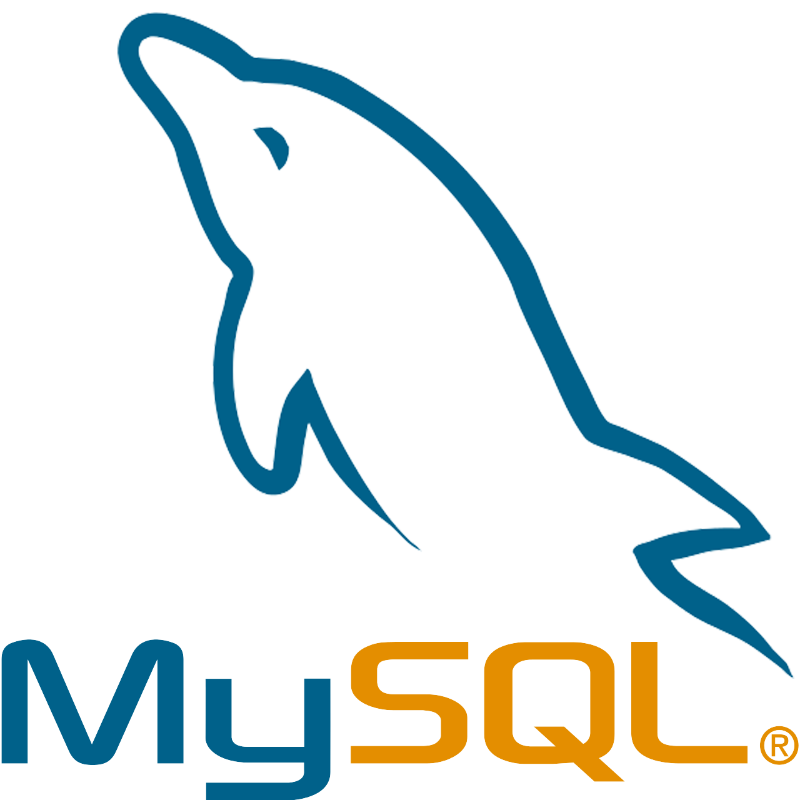

RDS
Relational Database
Support for multiple servers
Familiar SQL syntax
Tighter control of Db Schemas

Slide 9

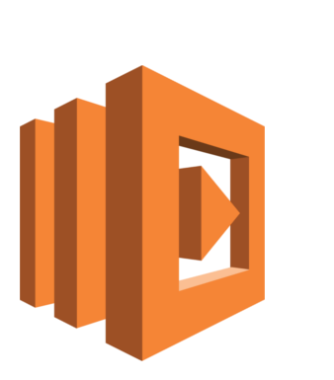
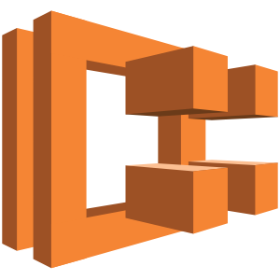
Compute Resources
Elastic Compute Cloud (EC2)
Elastic Container Service (ECS)
Lambda

Slide 10
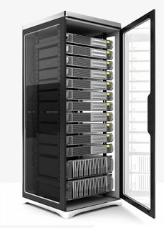
EC2
Standard Servers
Manually configurable or Scriptable
Base or custom images
Single instance or scalable
Low or high processing power
Host API Webservers
Host Batch applications

Slide 11
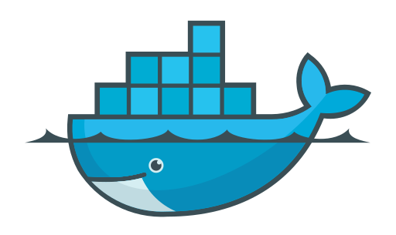
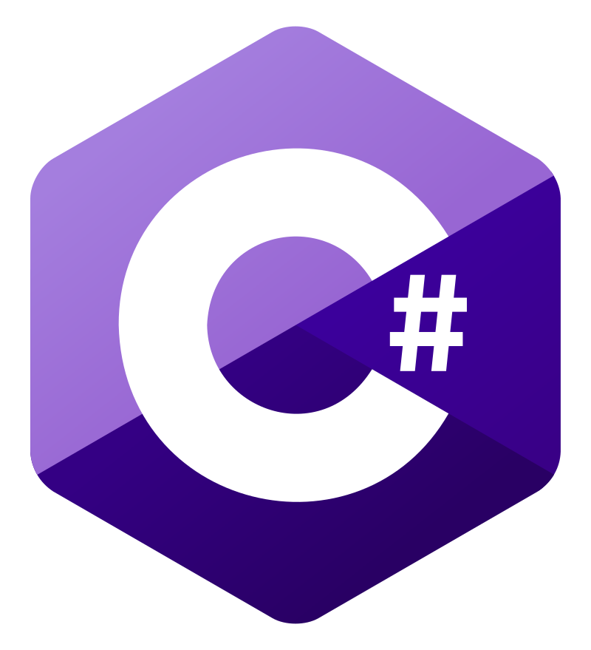

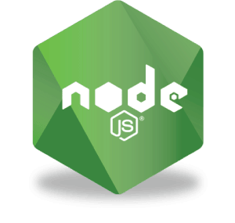

ECS
Containerized Servers
Standard Base Images
Customize and store New Images
Lower operating cost
Scalable instances
Host API Webservers
Host Batch applications

Slide 12
Lambda
Serverless functions
Applications that execute on triggers
Supports multiple languages
Reduced configuration and setup over Server
Often used as APIs
Simple event driven workers

Slide 13



Notification Resources
Simple Notification Service (SNS)
Simple Queue Service (SQS)
Cloud Watch

Slide 14

SNS
Coordinate messages
APIs
Queues
Create topics
Applications can subscribe
Actions can be triggered

Slide 15

SQS
Store Actions to be completed
Keep track of work
Store different work types
Track work that is failing
Workers can subscribe or publish to queues

Slide 16


Cloud Watch
Track logs
Structured
Unstructured
Create Alerts
Configurable by events

Slide 17
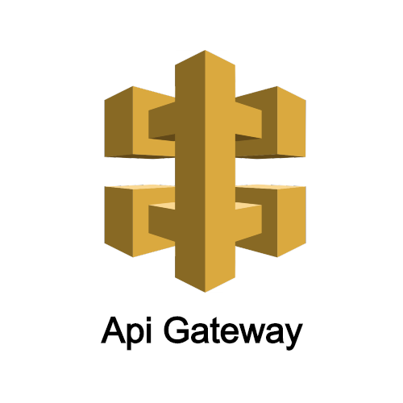

Publicly Expose Resources
API Gateway
CloudFront
* Should I add VPCs?

Slide 18

API Gateway
Exposes APIs publicly
EC2 instances
Lambdas
Can use Security Authorization
SAML
OIDC
Custom solutions using Lambda

Slide 19

CloudFront
Content Delivery Network (CDN)
Distributed system for Html/CSS/JS
Expose Webservers Publicly
EC2 Instances
S3 Static Content

Slide 20

Permissions Resources
IAM

Slide 21
IAM
User
Policies
Granular access to one or many resources
Can define Get/Put/Update/Delete
Roles
Container for multiple policies
Groups
Similar to AD Groups
Allow control to users through group permission
User
Can have permission via roles directly or groups
Resource
Groups
Roles
Policy
Policy
Policy

Slide 22
Architecting Resources

Slide 23
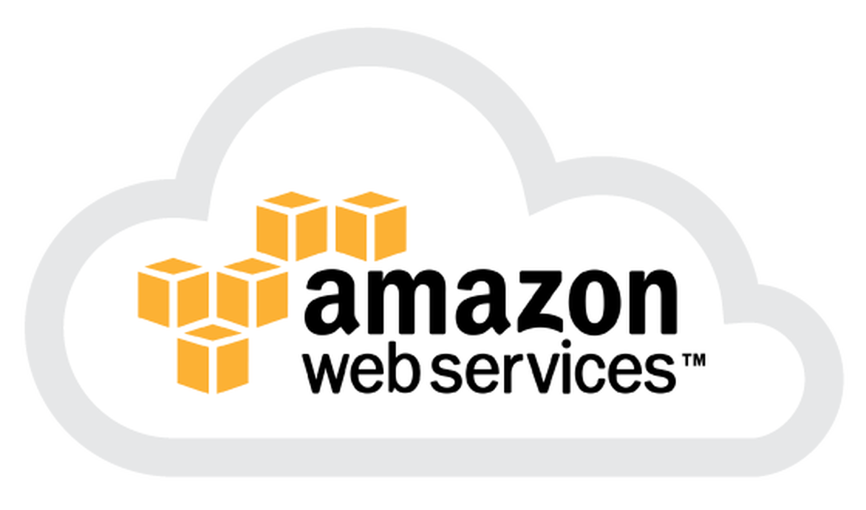
Standard App
EC2
RDS

Slide 24
Container App
ECS
Dynamo

Slide 25
Webpage App
CloudFront
S3
Html/CSS/JS

Slide 26

Event Driven
SES
SNS
SQS
Dynamo
Lambdas

