Slide 1
OPRF construction-2
Analysis of Timing

Slide 2
Components in OPRF construction-2
R0: matrix multiplication
R1, R2 : matrix vector multiplication + vector addition
Here, R0 is the Key update phase.
R1, R2 and computation of y=Mz is the evaluation phase.

Slide 3
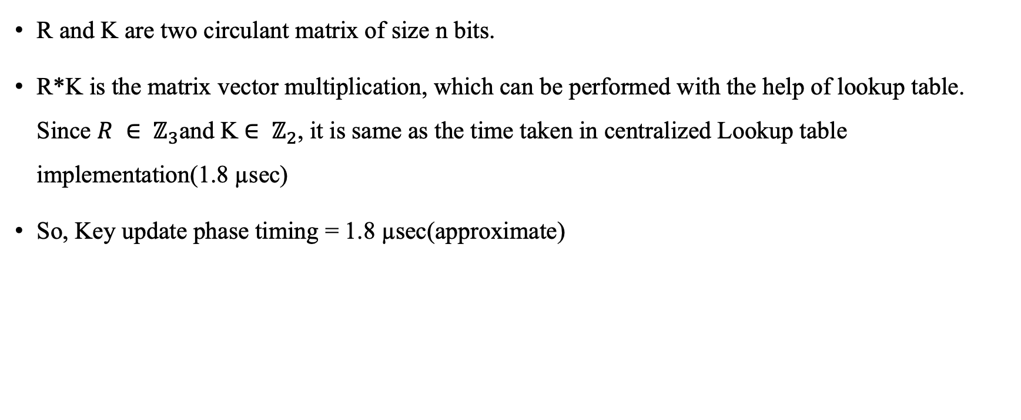
Key Update phase timing
R and K are two circulant matrix of size n bits.
R*K is the matrix vector multiplication, which can be performed with the help of lookup table. Since $R ∈ ℤ_{3}$and K$∈ ℤ_{2}$, it is same as the time taken in centralized Lookup table implementation(1.8 µsec)
So, Key update phase timing = 1.8 µsec(approximate)

Slide 4
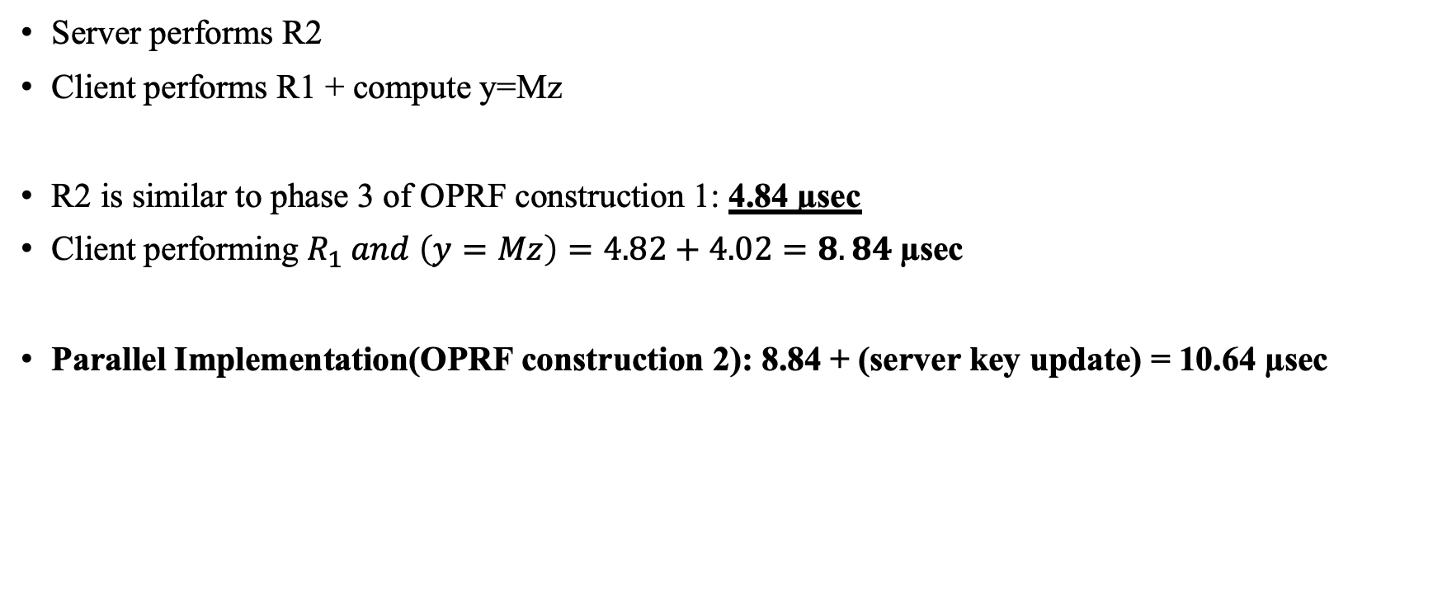
Evaluation phase timing
Server performs R2
Client performs R1 + compute y=Mz
R2 is similar to phase 3 of OPRF construction 1: 4.84 µsec
Client performing $R_{1} and \left(y=Mz\right)=4.82+4.02=8.84$µsec
Parallel Implementation(OPRF construction 2): 8.84 + (server key update) = 10.64 µsec

