Slide 1
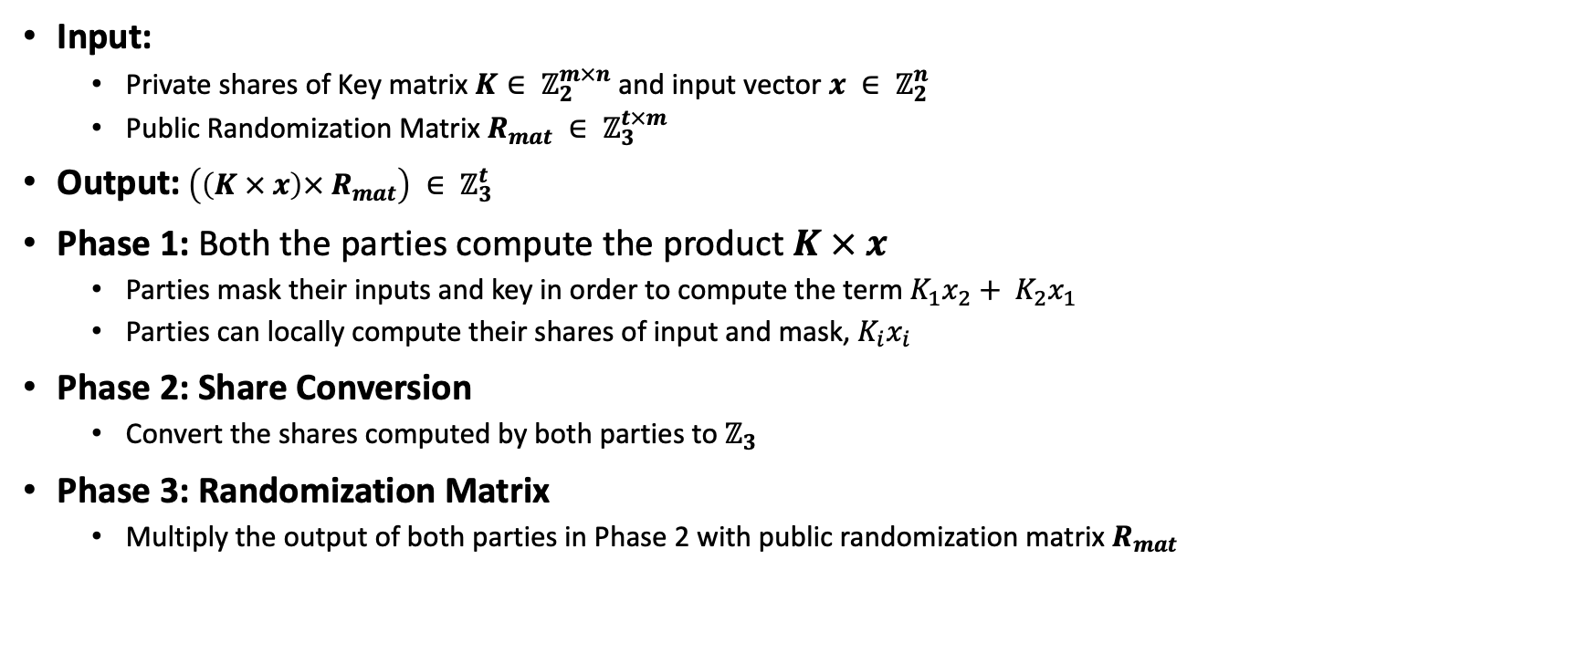
wPRF(Old Protocol)
Input:
Private shares of Key matrix $K∈ ℤ_{2}^{m×n}$ and input vector $x ∈ ℤ_{2}^{n}$
Public Randomization Matrix $R_{mat} ∈ ℤ_{3}^{t×m}$
Output: $\left(\left(K × x\right)× R_{mat}\right) ∈ ℤ_{3}^{t}$
Phase 1: Both the parties compute the product $K × x$
Parties mask their inputs and key in order to compute the term $K_{1}x_{2}+ K_{2}x_{1}$
Parties can locally compute their shares of input and mask, $K_{i}x_{i}$
Phase 2: Share Conversion
Convert the shares computed by both parties to $ℤ_{3}$
Phase 3: Randomization Matrix
Multiply the output of both parties in Phase 2 with public randomization matrix $R_{mat}$

Slide 2
Shared Input and Shared Key

Slide 3
oPRF

