Slide 1
Timing

Slide 2
Dark Matter wPRF (TCC ‘18)
Phase 1
Computation of K1x2
topelitz_Party2_1
topelitz_Party1
topelitz_Party2_2
Computation of K2x1
topelitz_Party2_1
topelitz_Party1
topelitz_Party2_2
Phase 2
SC_Party2_1()
SC_Party1()
SC_Party2_2()
Phase 3
usedLookuptable

Slide 3
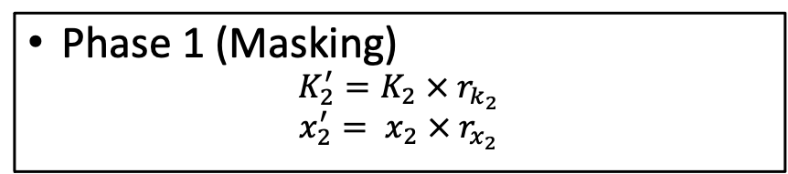
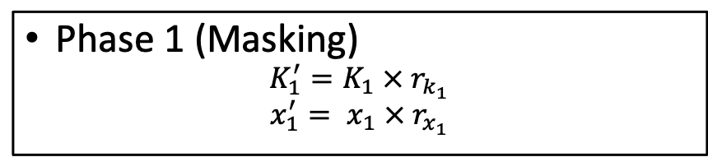
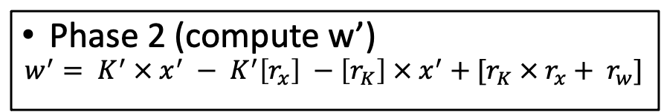
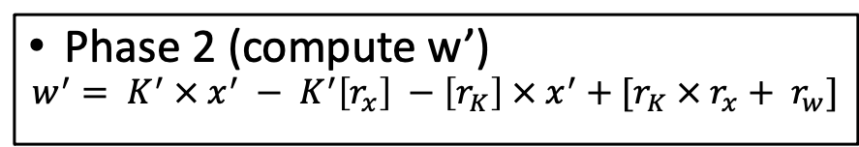
Fully Distributed (New protocol)
Party 1
Party 2
Phase 1 (Masking)
$$K_{1}^{′}=K_{1} × r_{k_{1}}$$
$$x_{1}^{′}= x_{1} × r_{x_{1}}$$
Phase 1 (Masking)
$$K_{2}^{′}=K_{2} × r_{k_{2}}$$
$$x_{2}^{′}= x_{2} × r_{x_{2}}$$
compute_input_mask()
Phase 2 (compute w’)
$$w^{′}= K^{′} × x^{′} − K^{′}\left[r_{x}\right] −\left[r_{K}\right] × x^{′}+[r_{K} × r_{x}+ r_{w}]$$
Phase 2 (compute w’)
$$w^{′}= K^{′} × x^{′} − K^{′}\left[r_{x}\right] −\left[r_{K}\right] × x^{′}+[r_{K} × r_{x}+ r_{w}]$$
compute_wmask()
Phase 3 (Compute output share)
mux
usedLookupTable()
Phase 3 (Compute output share)
mux
usedLookupTable()

Slide 4
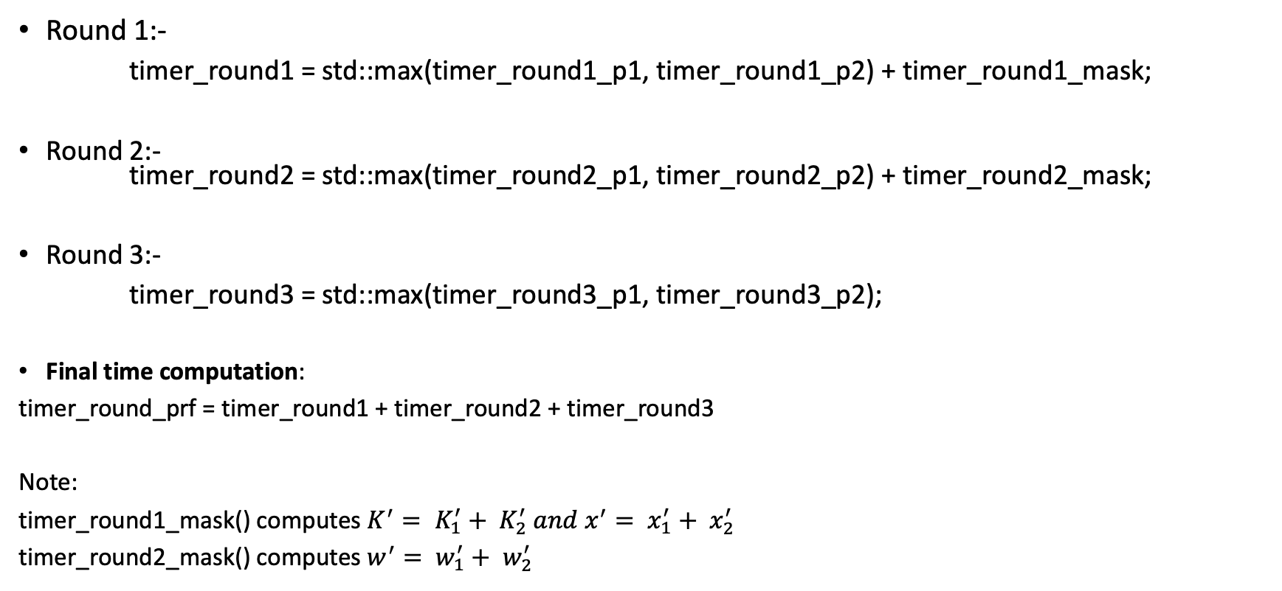
Fully Distributed (New protocol) – Implementation
Round 1:-
timer_round1 = std::max(timer_round1_p1, timer_round1_p2) + timer_round1_mask;
Round 2:- timer_round2 = std::max(timer_round2_p1, timer_round2_p2) + timer_round2_mask;
Round 3:-
timer_round3 = std::max(timer_round3_p1, timer_round3_p2);
Final time computation:
timer_round_prf = timer_round1 + timer_round2 + timer_round3
Note:
timer_round1_mask() computes $K^{′}= K_{1}^{′}+ K_{2}^{′} and x^{′}= x_{1}^{′}+ x_{2}^{′}$
timer_round2_mask() computes $w^{′}= w_{1}^{′}+ w_{2}^{′}$

Slide 5
OPRF – Current Implementation
Client
Server
Mask the input x’
Mask the Key K’
Phase 1
Share K’ and x’
Compute wc_mask(wc’)
Compute ws_mask(ws’)
Phase 2
Reconstruct w_mask = wc’ + ws’
Compute y = Mz
Compute y = Mz
Phase 3
Server sends its output
Client reconstructs the final output.

