Slide 1
Project Buggy Snail

Slide 2
Problem
Phase 3(using lookup) took 4.6 µsec in new protocol and OPRF but it takes 13 µsec in Dark matter PRF.
The following was microbenchmark on dark matter PRF.
Phase 1
Toeplitz_by_x()
20.9 µsec
Phase 2
SC_party1/2()
6.4 µsec
Phase 3
usedLookupTable()
13.5 µsec

Slide 3
Possible Problems
Something from previous phase/round takes more time and the timing is leaked.
Phase 1 and Phase 2 runs nRuns(1000) number of times internally* instead of nTimes(=1) times.
* = This internal run is different from 1000 runs used in timing.

Slide 4
Analysis: Project Buggy Snail
Replicate PRF.cpp
Make code modular
Disable full-length running of each phase and time the protocol.
Aim: To find if running of any phase/round affects the timing for phase3(lookup table)
Removal of phase* | Change in timing of phase 3
Removed phase 1 | 13.5 → 10.5
Removed phase 1 and phase 2 | 13.5 → 3.89
Removed phase 2 | 13.5 → 3.67

Slide 5
Some solutions tried
Time phase 2 on outer level, earlier it was inside OT.cpp – FAILED!
OT.cpp
PRF.cpp
OT_Party[1/2]()
SC_Party[1/2]()
buggy_snail.cpp

Slide 6
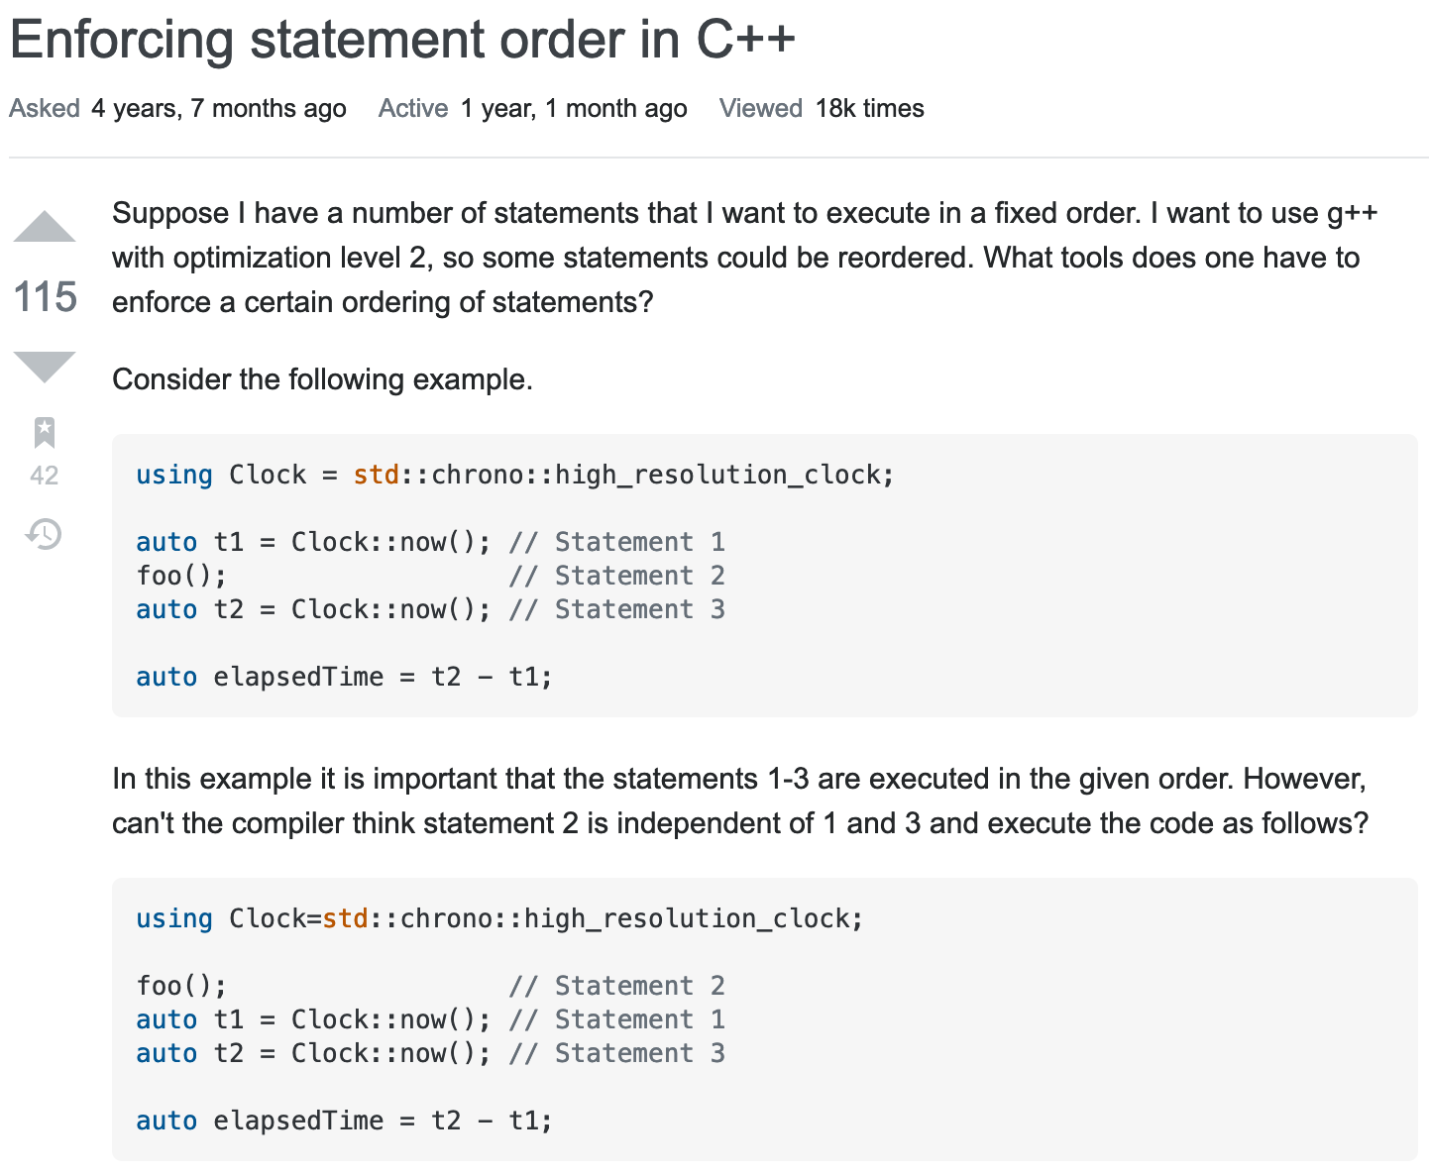
The Culprit
-O3 flag was optimizing the code to a point where reordering was done.
Wouldn’t show up in debugging.
This was the order(suspected)
Start phase3 time
|
Complete phase 2
|
Complete phase 3
|
Stop phase 3 timer
https://stackoverflow.com/questions/37786547/enforcing-statement-order-in-c/37789799

Slide 7
Solution(s)
Being in LLVM committee Chandler Carruth acknowledges this problem and suggest microbenchmarking.
Microbenchmarking is similar to method suggested by Tzipora on 1/22/21 of benchmarking each section separately.
Apart from that another benchmarking method is used where optimization is –O2 flag.

Slide 8
Micro benchmarking technique
Phase 3
Phase 1
Phase 2
Run round 1 and store result in global variable
Run round 1 and store result in global variable
Run round 2 and store result in global variable
Round 1
Fetch output of round 1 from global variable
Fetch output of round 1 from global variable
Round 2
Round 2
Fetch output of round 2 from global variable
Round 3
Round 3
Round 3
Green box indicates a loop that runs for 1000 times, rest of the blocks runs just once.

Slide 9
Micro benchmarking result
-O2 flag optimization result
Phases | Time
Phase 1 | 21.31
Phase 2 | 3.17
Phase 3 | 3.54
Total PRF | 28.02
Phases | Time
Phase 1 | 23.17
Phase 2 | 3.31
Phase 3 | 9.9
Total PRF | 36.48

