Slide 1
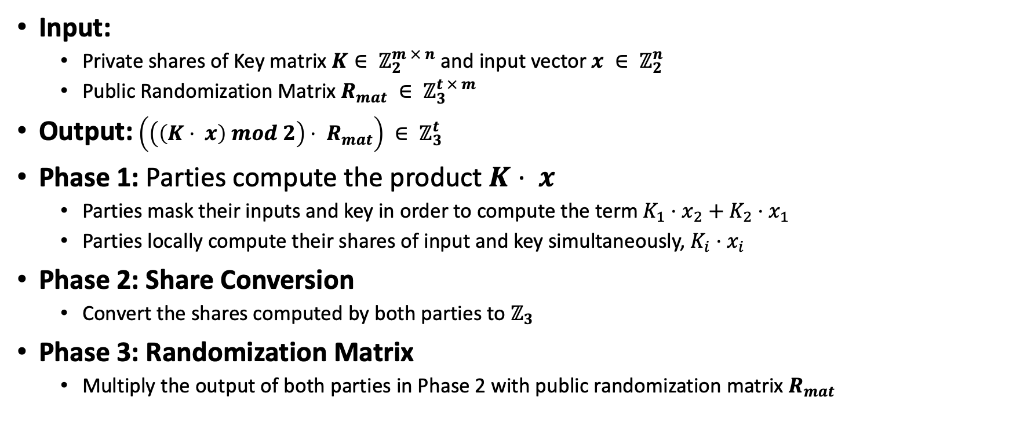
wPRF(TCC’18)
Input:
Private shares of Key matrix $K∈ ℤ_{2}^{m × n}$ and input vector $x ∈ ℤ_{2}^{n}$
Public Randomization Matrix $R_{mat} ∈ ℤ_{3}^{t × m}$
Output: $\left(\left(\left(K⋅ x\right) mod 2\right)⋅ R_{mat}\right) ∈ ℤ_{3}^{t}$
Phase 1: Parties compute the product $K⋅ x$
Parties mask their inputs and key in order to compute the term $K_{1}{⋅x}_{2}+ K_{2}⋅x_{1}$
Parties locally compute their shares of input and key simultaneously, $K_{i}{⋅x}_{i}$
Phase 2: Share Conversion
Convert the shares computed by both parties to $ℤ_{3}$
Phase 3: Randomization Matrix
Multiply the output of both parties in Phase 2 with public randomization matrix $R_{mat}$

Slide 2
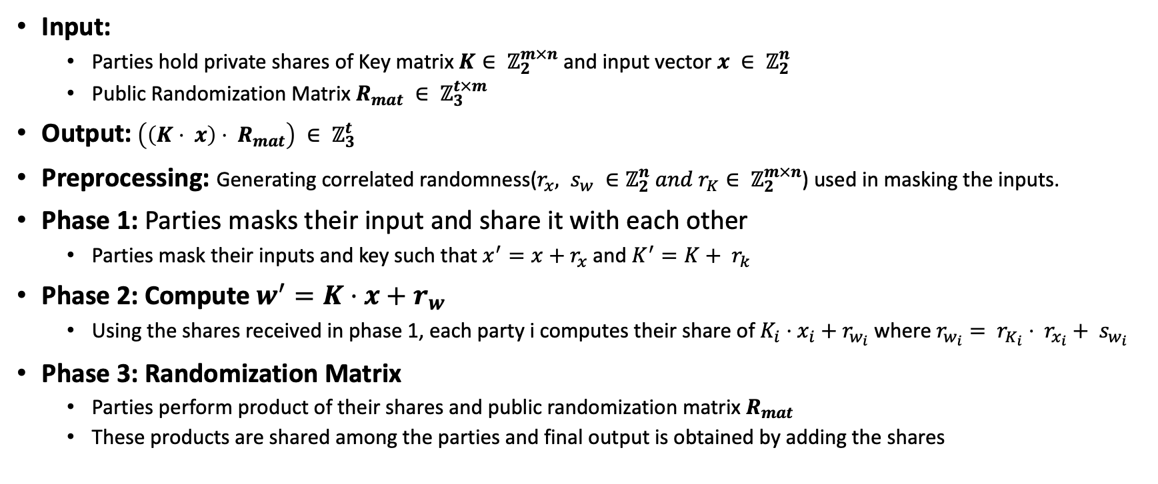
wPRF (Shared Input and Shared Key)
Input:
Parties hold private shares of Key matrix $K∈ ℤ_{2}^{m×n}$ and input vector $x ∈ ℤ_{2}^{n}$
Public Randomization Matrix $R_{mat} ∈ ℤ_{3}^{t×m}$
Output: $\left(\left(K⋅ x\right)⋅ R_{mat}\right) ∈ ℤ_{3}^{t}$
Preprocessing: Generating correlated randomness(${r_{x}, s}_{w} ∈ℤ_{2}^{n} and r_{K}∈ ℤ_{2}^{m×n}$) used in masking the inputs.
Phase 1: Parties masks their input and share it with each other
Parties mask their inputs and key such that $x^{′}=x+r_{x}$and $K^{′}=K+ r_{k}$
Phase 2: Compute $w^{′}=K⋅x+r_{w}$
Using the shares received in phase 1, each party i computes their share of $K_{i}{⋅x}_{i}+ r_{w_{i}}$ where $r_{w_{i}}= r_{K_{i}}⋅ r_{x_{i}}+ s_{w_{i}}$
Phase 3: Randomization Matrix
Parties perform product of their shares and public randomization matrix $R_{mat}$
These products are shared among the parties and final output is obtained by adding the shares

Slide 3
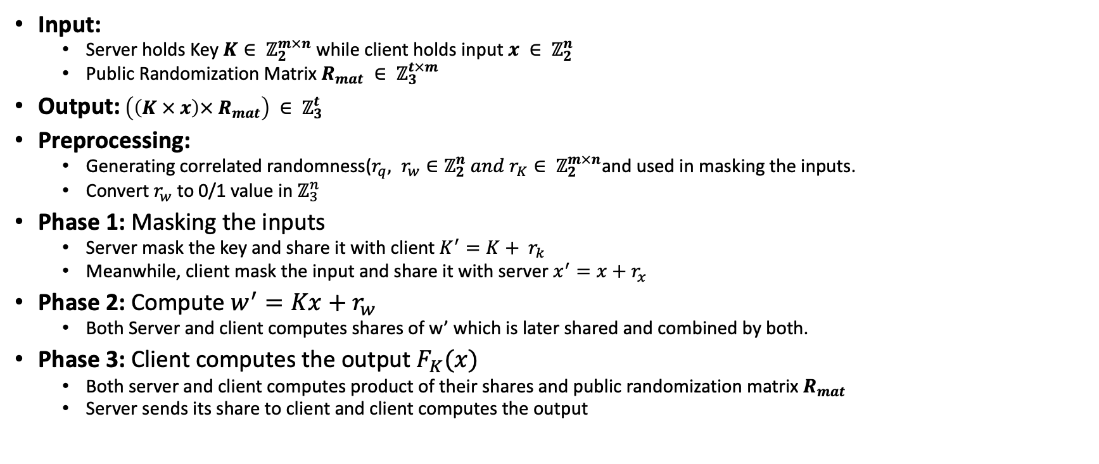
oPRF
Input:
Server holds Key $K∈ ℤ_{2}^{m×n}$ while client holds input $x ∈ ℤ_{2}^{n}$
Public Randomization Matrix $R_{mat} ∈ ℤ_{3}^{t×m}$
Output: $\left(\left(K × x\right)× R_{mat}\right) ∈ ℤ_{3}^{t}$
Preprocessing:
Generating correlated randomness($r_{q}, r_{w}∈ℤ_{2}^{n} and r_{K}∈ ℤ_{2}^{m×n}$and used in masking the inputs.
Convert $r_{w}$ to 0/1 value in $ℤ_{3}^{n}$
Phase 1: Masking the inputs
Server mask the key and share it with client $K^{′}=K+ r_{k}$
Meanwhile, client mask the input and share it with server $x^{′}=x+r_{x}$
Phase 2: Compute $w^{′}=Kx+r_{w}$
Both Server and client computes shares of w’ which is later shared and combined by both.
Phase 3: Client computes the output $F_{K}(x)$
Both server and client computes product of their shares and public randomization matrix $R_{mat}$
Server sends its share to client and client computes the output

Slide 4

$\sim A$

Slide 5

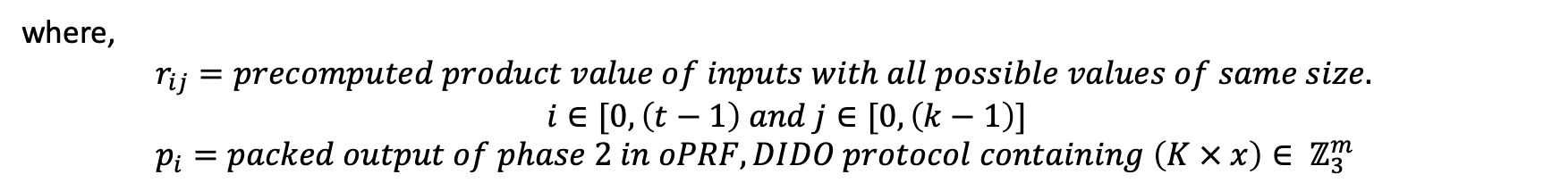
Lookup table
$${\left[\begin{matrix}r_{00} & ⋯ & r_{0(k−1)} \\ ⋮ & ⋱ & ⋮ \\ r_{\left(t−1\right)0} & ⋯ & r_{(t−1)(k−1)}\end{matrix}\right]}_{t ×k}{\left[\begin{matrix}p_{0} \\ ⋮ \\ p_{15}\end{matrix}\right]}_{k}= {\left[\begin{matrix}z_{0} & … & z_{(m−1)}\end{matrix}\right]}_{m}$$
where,
$r_{ij}=precomputed product value of inputs with all possible values of same size.$
$$i∈[0,\left(t−1\right) and j∈[0, \left(k−1\right)]$$
$p_{i}=packed output of phase 2 in oPRF, DIDO protocol containing \left(K × x\right)∈ ℤ_{3}^{m}$

