Slide 1
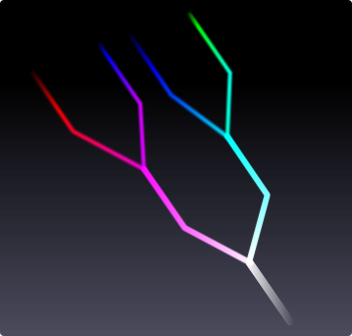
Running Coupling in the Standard Model and Beyond
Jonathan Arnold
Department of Physics
Durham University

Slide 2
Project Aims
“The three coupling constants of the Standard Model vary (run) with energy, admitting the possibility of unifying at a single point (a Grand Unified Theory, or GUT).
Determine – by analysing these running couplings – whether models admit a Grand Unified Theory, and if so at what scale this unification occurs.”
Notes:
GUT: A theory where the electroweak, and strong interactions are manifestations of the same, high-energy force, which appears at low energies as a low-energy force.

Slide 3
Outline of this Presentation
Why Do They Run?
  Ultraviolet Divergences and Renormalisation
How Do We Quantify Unification?
How Do They Run?
  Standard Model
  Minimal Supersymmetric Standard Model
    Fixing Unification in the MSSM
  (Compactified) Extra Dimensions

Slide 4
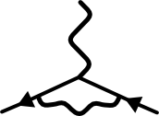
Ultraviolet Divergences
QED (and other quantum field theories) admit amplitude integrals that diverge at high energies/short distances:
To avoid this, we introduce:
  An ultraviolet cutoff (regularisation)
  Bare and physical mass/coupling (renormalisation)
Divergences are 'absorbed' into these terms
as
Notes:
We introduce the physical mass as the mass we measure in experiment, and the bare mass as a mathematical concept used in equations

Slide 5
Renormalisation
The process of renormalisation makes parameters of the theory scale-dependent
This scale-dependence is characterised by the beta-function:
The coupling 'constant' therefore varies (runs) with energy: 'running coupling'
Notes:
TODO: ~all~ parameters?
g: Coupling constant
Mu: Energy scale – typically s, the centre of mass squared
We obviously integrate to get g at any energy scale mu

Slide 6
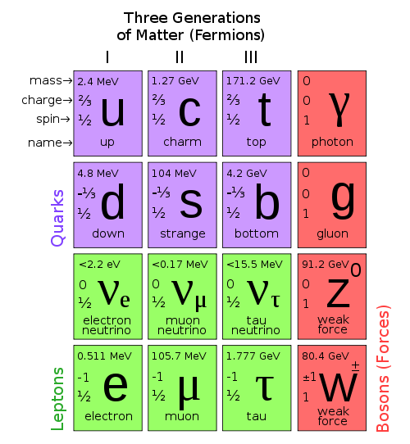
The Standard Model
Image Source: wikipedia.org, 'Standard Model'
Notes:
Shouldn't be new to you!
3 sectors of matter: quarks, leptons, gauge bosons.
3 interactions, known as an SU(3) x SU(2) x U(1) gauge symmetry
Each interaction has an associated coupling constant

Slide 7
Beta-Functions of the Standard Model
Considering one- and two-loop corrections,
where gives the coupling strength at an energy scale , and denote the U(1), SU(2) and SU(3) sectors of the Standard Model.
Alternatively,
Notes:
Calculations of the beta-function are non-trivial and rely on what level of perturbation theory you go to.
All sectors of SM behave in the same way, apart from a different constant – hence, we can condense three equations down to one, and encode the constants into b_i, b_ij
Equation from Amaldi et al, uses Big O notation
One loop corrections in first term, two-loop corrections in second term
Solvable using a fixed point (M_Z)

Slide 8
Quantifying Unification
We can quantify unification:
where is the mean of at , and denotes the error in
The value of for which is a minimum is the unification energy , with associated unification coupling

Slide 9
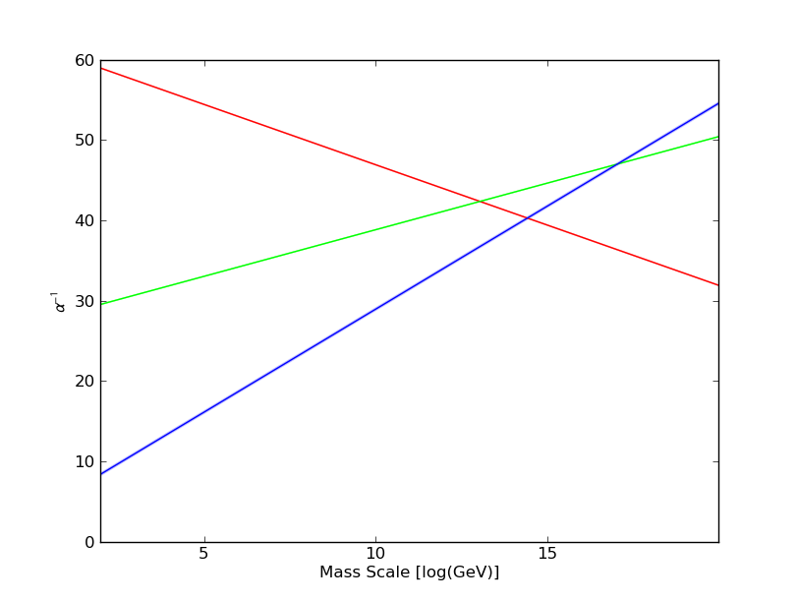
Running Coupling in the Standard Model (1-loop Corrections)
Notes:
Red: U(1)
Green: SU(2)
Blue: SU(3)
Obviously, no unification!

Slide 10
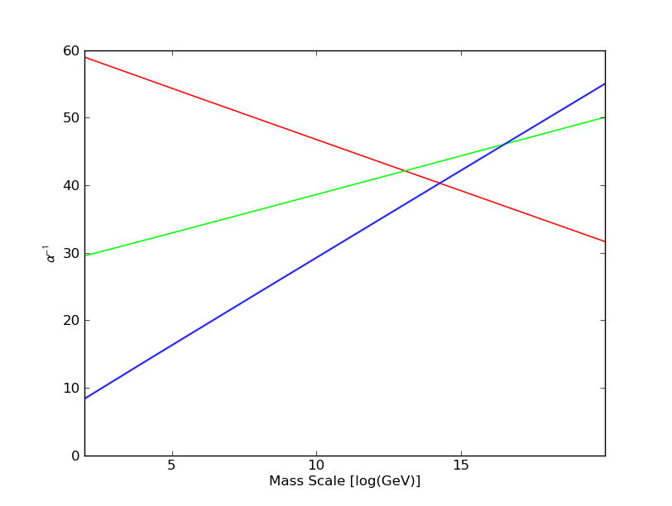
Running Coupling in the Standard Model (2-loop Corrections)
Notes:
No running up to two loops for SM
We could go to higher order, but the change as you go higher in order gets lower.

Slide 11
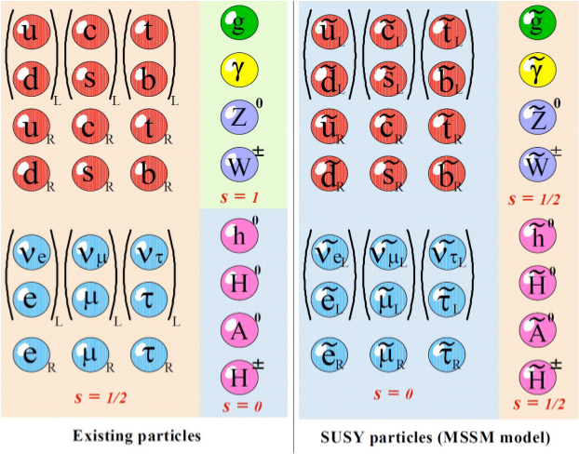
The Minimal Supersymmetric Standard Model (MSSM)
Image Source: “Looking for SUSY at the LHC”, KEK, April 2010
Notes:
TODO: Read up on changes from SM to MSSM
Used to explain the hierarchy problem of fermions.
MSSM suggests a boson-fermion symmetry exists. This creates a superpartner for each SM particle, and also introduces an extra Higgs superdoublet.
Same interactions => same form for the beta-function, just with different constants

Slide 12
Beta-Functions of the MSSM
The form of the beta-function remains the same:
We introduce the SUSY breaking scale
At energies , we use SM values for and
When , we use MSSM values
is a free parameter!
Notes:
M_SUSY: Scale at which supersymmetry is broken and we get the Standard Model

Slide 13
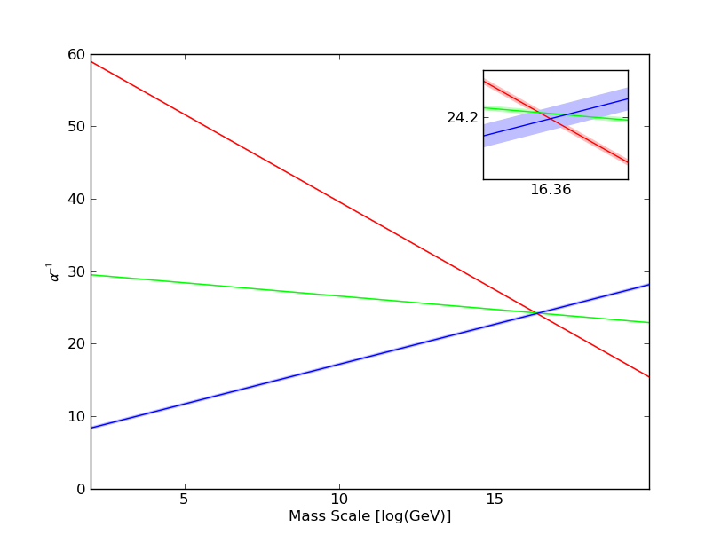
Running Coupling in the MSSM
(1-loop Corrections)
Notes:
Error bars are shown around the average value
Unification! BUT at 1 loop,minimisation of M_SUSY pushes it towards 0 – obviously unfeasible, otherwise we'd see SUSY!
Here, Chi^2 = 2.88

Slide 14
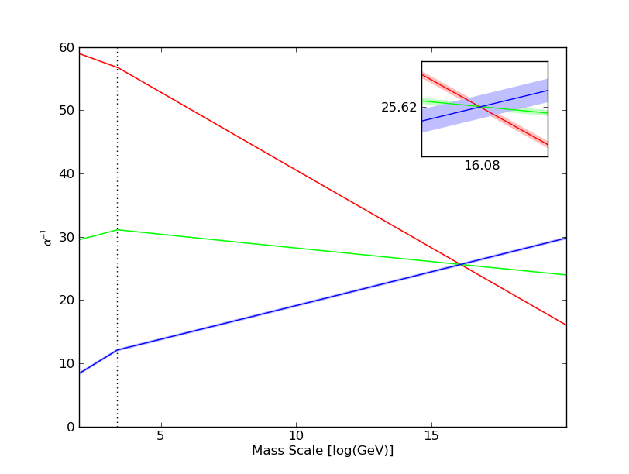
Running Coupling in the MSSM
(2-loop Corrections)
Notes:
At two-loops, a value M_SUSY comes into play: this is the value at which supersymmetry becomes significant.
This graph has been made by fitting M_SUSY so the value of Chi^2 at the unification point is minimised.
Here, M_SUSY = 10^3.37 GeV, Chi^2 = 0.0194 – hence, we should see supersymmetry signals at the LHC if the theory is correct

Slide 15
Fixing Unification
Idea: Instead of measuring unification based on experimental parameters, we do the reverse: fix unification ( , ) and extrapolate backwards, then determine how close we are to experimental values
  No need to propagate errors
We define a new measure of 'goodness of fit':
3 free parameters in MSSM: , ,

Slide 16
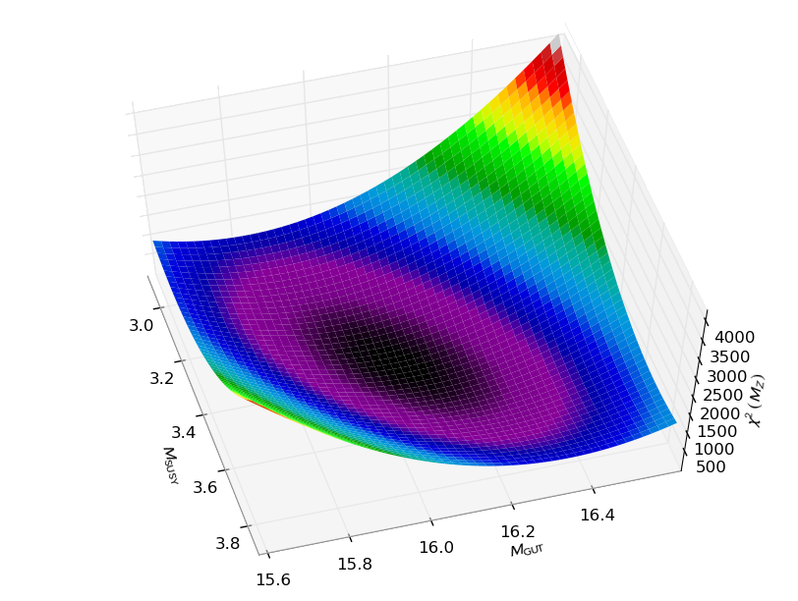
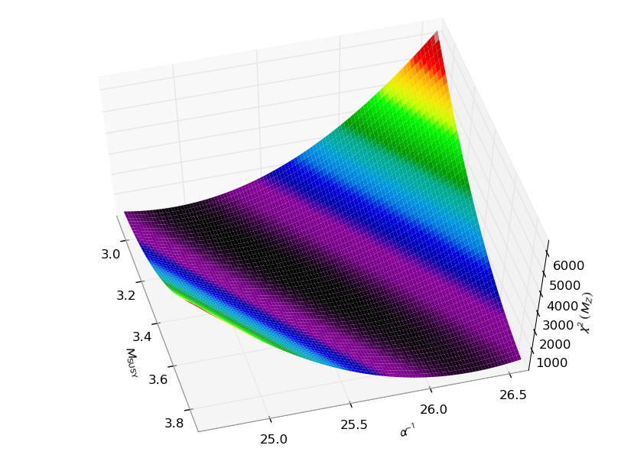
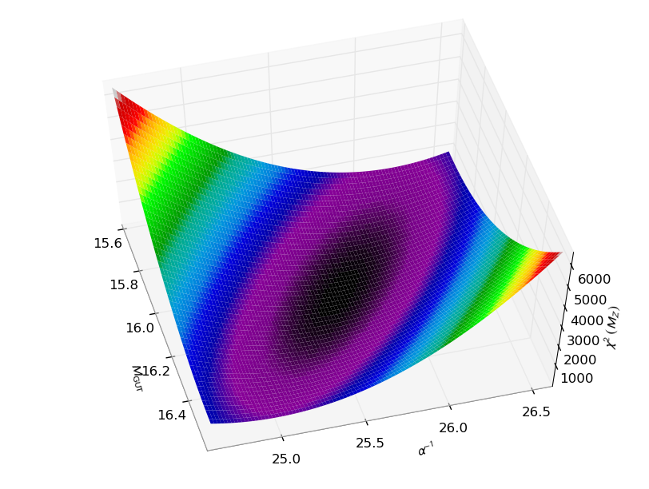
Fixing Unification in the MSSM
Notes:
Amount of unification not surprising – we have an underconstrained system of equations!

Slide 17
(Compactified) Extra Dimensions
Extra dimensions have not yet been observed – if they exist, they must be currently out of observational bounds
Idea: extra dimensions are small and 'curled up' (compactified) into circles of radius
  Implies that we expect effects of extra dimensions at an energy
Notes:
Originally proposed by Kaluza and Klein, who showed that a 5D theory can be turned into a 4D theory with general relativity included

Slide 18
Running Coupling in the MSSM with Extra Dimensions (EDMSSM)
If we add extra dimensions, compactified on a radius , the coupling constants run as
when ,where and is the Euler gamma function
and are free parameters
Notes:
Equation from Dienes, Dudas and Gherghetta

Slide 19
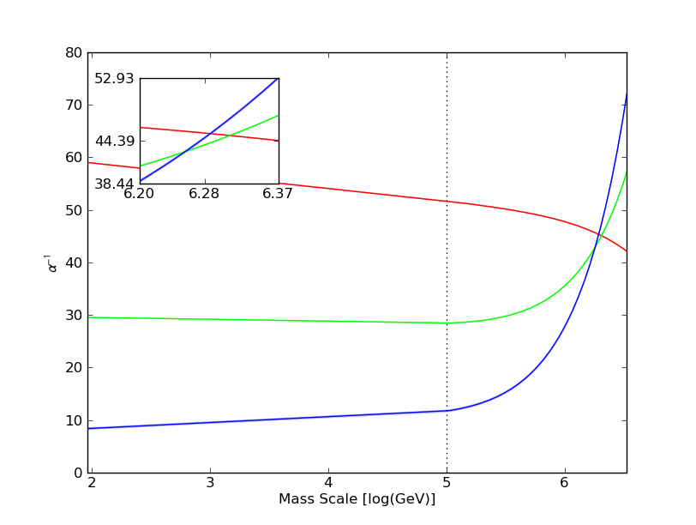
Running Coupling in the MSSM with 1 Extra Dimension

Slide 20
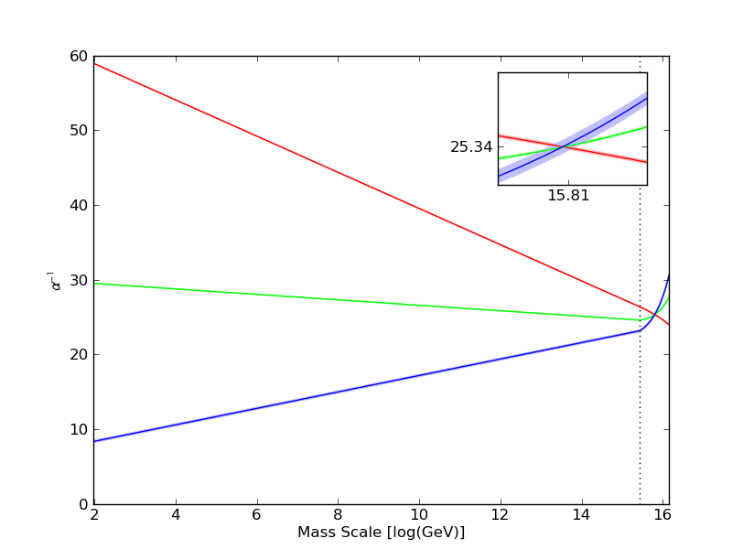
Running Coupling in the MSSM with 1 Extra Dimension

Slide 21
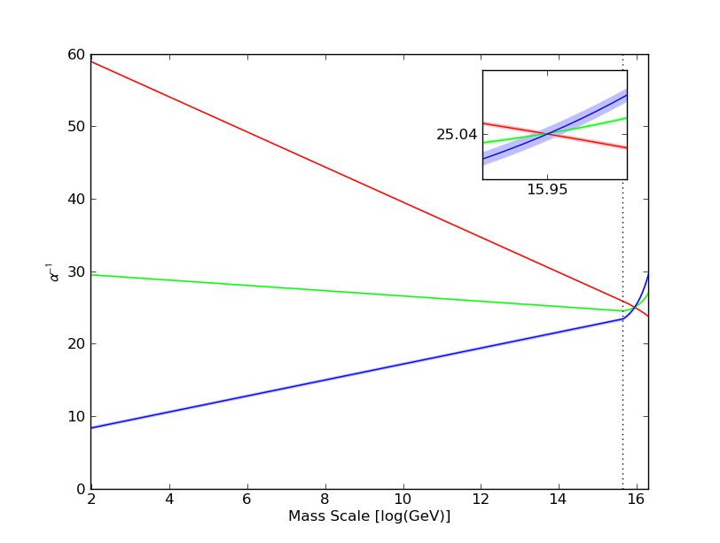
Running Coupling in the MSSM with 2 Extra Dimensions

Slide 22
Conclusions
Coupling constants vary ('run') due to renormalisation, allowing the possibility for the couplings to unify
The Standard Model does not admit unification
The Minimal Supersymmetric Standard Model (MSSM) admits unification best at
Admitting extra dimensions to the MSSM lowers the unification scale (but not by much!)
Notes:
Further work may involve adding the SM to the Extra Dimension model, or doing the back-propagation method as done in the MSSM

Slide 23
Thanks for Listening!
References and Further Reading
M. E. Peskin and D. V. Schroeder, An Introduction to Quantum Field Theory, Perseus Books (1995)
Amaldi et al, Consistency Checks of Grand Unified Theories, Phys. Lett. B 281 (1992), pp. 374-382
Dienes, Dudas and Gherghetta, Extra Spacetime Dimensions and Unification, Phys. Lett. B 436, 55 (1998)

