Slide 1
RED EMPIRE
C2 Framework / Agent Management System

Slide 2
Background / Inspiration
Began initial development in mid April
Worked during after hours / free time
Wanted to become more familiar with the languages I learned in TDQC.
Wanted to the experience building an agent / C2 framework before returning to work.

Slide 3
Project Summary
Consists of two programs: Mastermind and Initiate
Mastermind
C2 Server
Written in Python
Initiate
Linux Agent
Written in C

Slide 4
Mastermind
Agent Management System / C2 Server
Provides command and control for all agents
Webserver using Python http.server module
Capabilities:
Create multiple listeners
Manage multiple agents
Text driven user intferace

Slide 5
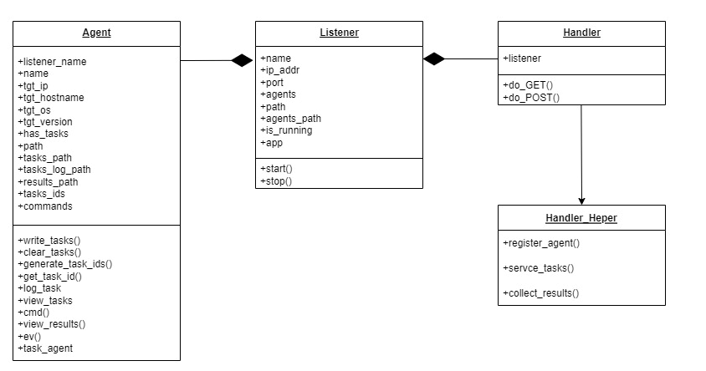
Mastermind UML (Partial)

Slide 6
Mastermind API
Reg
Responsible for registering new agents.
Only accepts GET requests.
Parameters: hostname, OS_type, OS_version
Hostname: target host name
OS_type: target host operating system
OS_version: target host OS version
Tasks/UUID
Endpoint for serving tasks file to agents.
URL is dynamically generated using agents UUID
Results/UUID
Endpoint for agents to send their results.
URL is dynamically generated using agents UUID
Parameters: task id, task cmd, task results
Task id: Unique ID for a given task
Task cmd: Task command and arguments
Task results: Results of a given task

Slide 7
Initiate
Beaconing Linux Agent
Capabilities:
Shell command execution

Slide 8
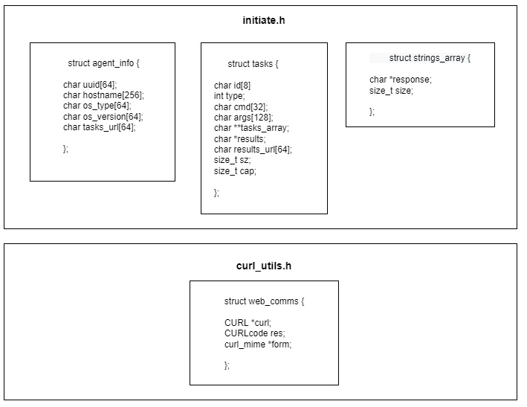
Initiate stRucts
Struct agent_info:
Holds info associated with target host.
Struct tasks:
Holds information associated with tasks retrieved from Mastermind
Struct strings array:
Used to store HTTP response data retrieved from C2 server.
Struct web_comms:
Contains commonly used curl structs used throughout program.

Slide 9
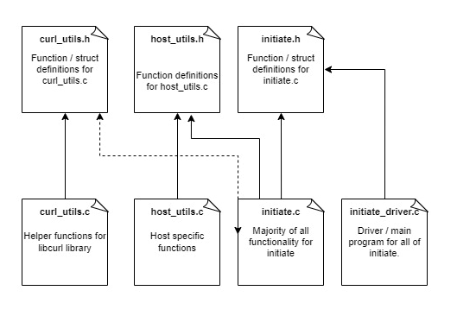
Initiate program Organization

Slide 10
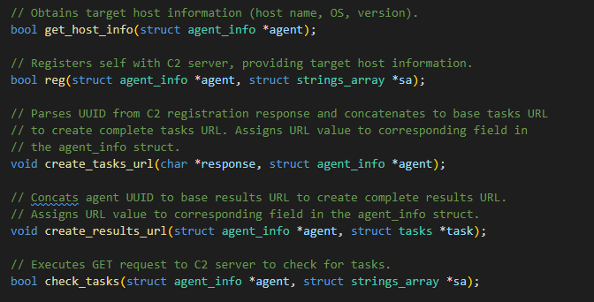
Initiate Significant functions

Slide 11
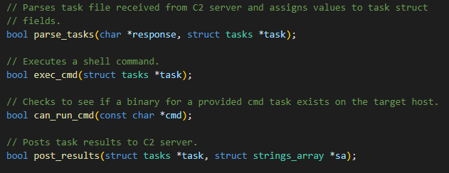
Initiate Significant functions (Cont.)

Slide 12



C2 Server / Agent Workflow
1. Initiate installed on target host.
2. Gathers target host information.
3. Registers with C2 server.
4. Creates tasks results / URL.
5. Enters forever loop, checking for tasks.
6. Parses / executes tasks.
8. Posts task results to c2 server.
User creates listener
User creates tasks
Inventories agent / returns agent UUID
Returns tasks file.
Register w/ c2 sending host info
Return agent UUID
Listening on 127.0.0.1:9000…
Checks for tasks (127.0.0.1:9000/tasks/UUID)
Returns tasks file
Returns task results (127.0.0.1:9000/results/UUID)
Target Host
Mastermind

Slide 13
Future Development
Mastermind:
Complete re-build / overhaul
Migrate from http.server module to Django
Provide GUI capability (DearPyGui)
Create agents from server
Initiate:
Add sleep command
Add kill command
Develop Additional Agents
Android (written in Kotlin)
Windows (written in C#)

Slide 14
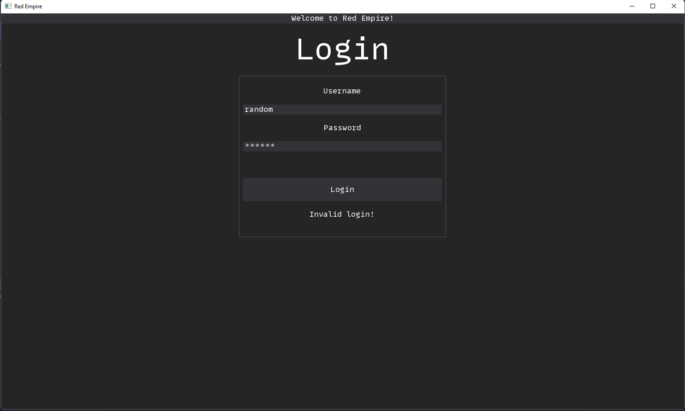
Mastermind GUI Prototype

Slide 15
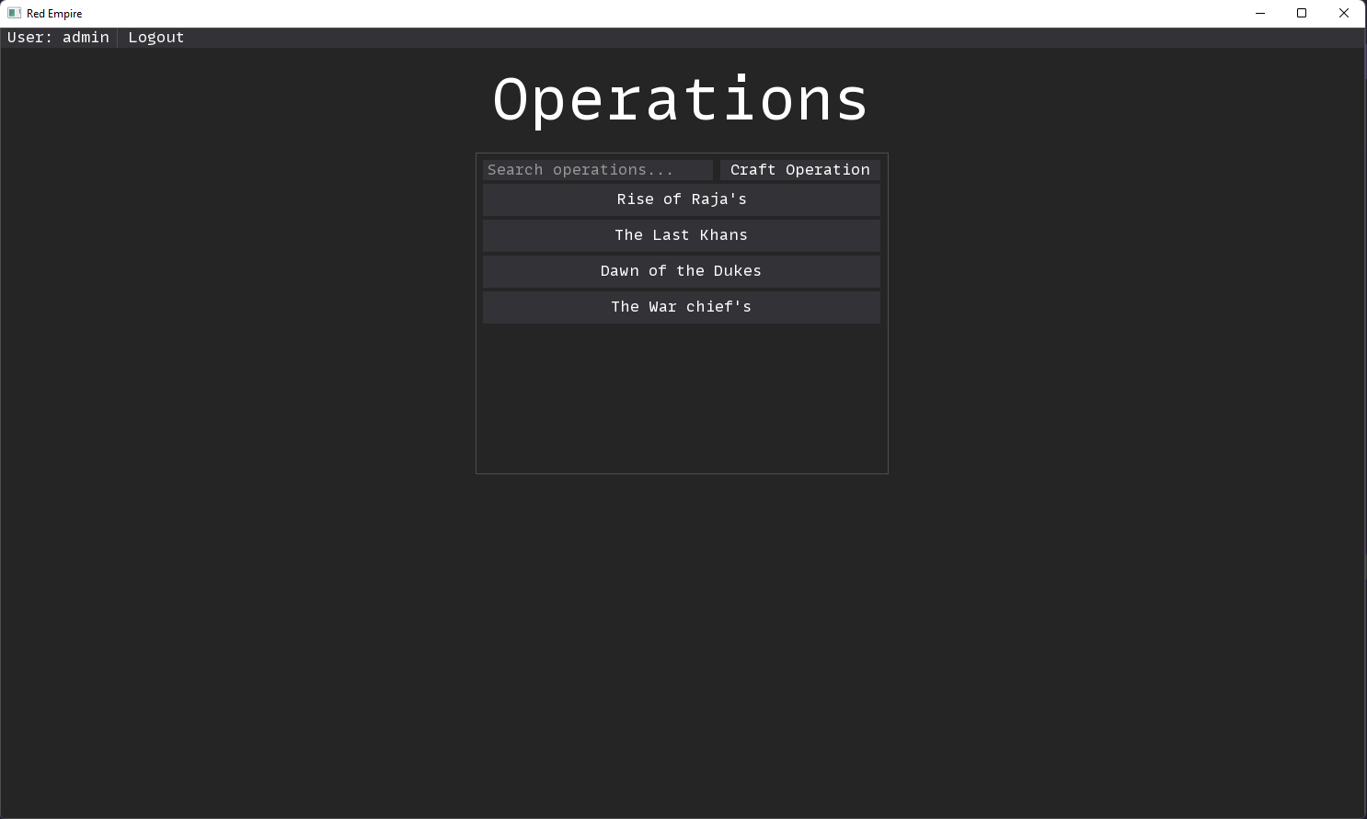
Mastermind GUI Prototype (Cont.)

Slide 16
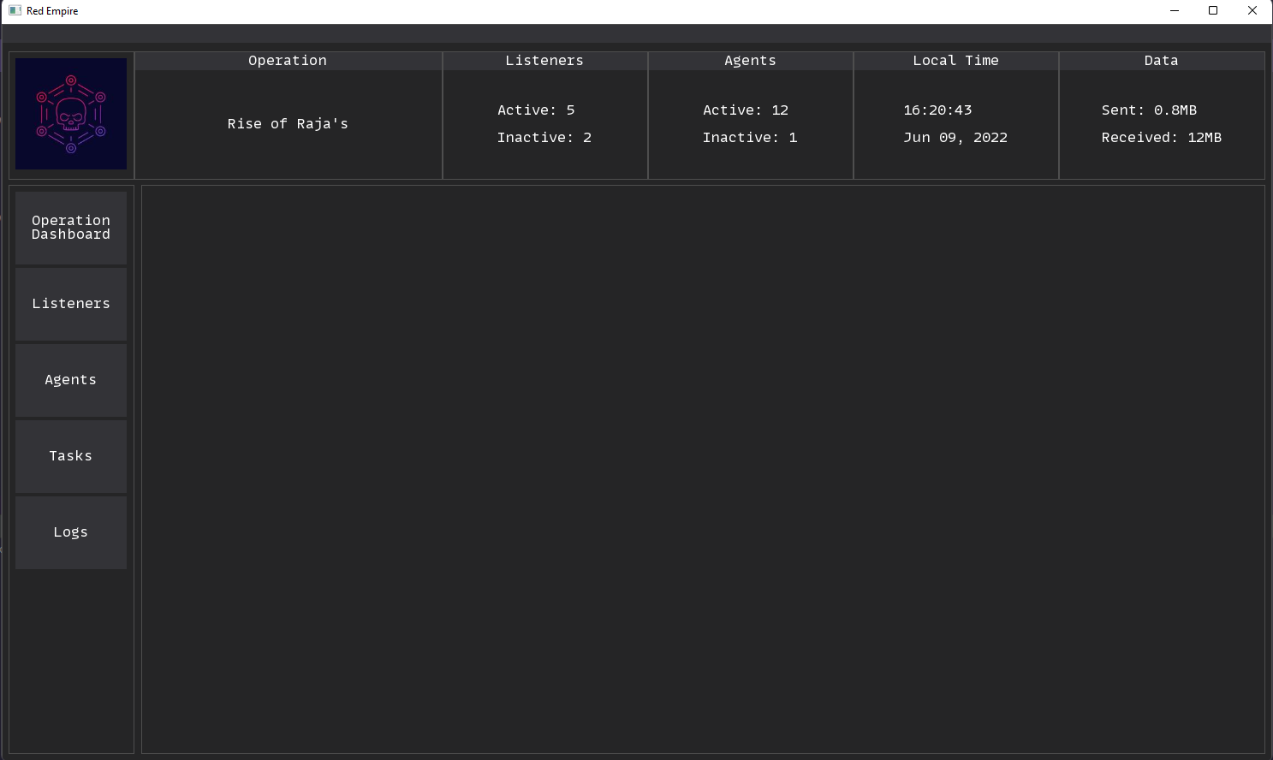
Mastermind GUI Prototype (Cont).

Slide 17
References
https://stackoverflow.com/questions/41230547/check-if-program-is-installed-in-c
https://stackoverflow.com/questions/35101996/sscanf-get-the-value-of-the-remaining-string
https://curl.se/libcurl/c/postit2.html
https://everything.curl.dev/libcurl/callbacks/write
https://www.linuxquestions.org/questions/linux-newbie-8/help-in-getting-return-status-of-popen-sys-call-870219/
https://stackoverflow.com/questions/52974572/cast-char-to-file-without-saving-the-file
https://curl.se/libcurl/c/postit2.html
https://www.youtube.com/watch?v=kogOfxg1c_g
https://www.youtube.com/watch?v=dgvLegLW6ek
https://0xrick.github.io/misc/c2/

Slide 18
Questions ?

