Slide 1
Immersive Mobile
Examinator
Notes:
Hello everybody, my name is Jonny i’m a audio visual engineer with some experience in software development and product design. i’m glad to be here and i would like to thank the organization for this oppertunity to take you through the possibilities of applying immersive media technology to increase reliabilty and trust during online exam taking.

Slide 2
Trust
Notes:
Hello everybody, my name is Jonny i’m a audio visual engineer with some experience in software development and product design. i’m glad to be here and i would like to thank the organization for this oppertunity to take you through the possibilities of applying immersive media technology to increase reliabilty and trust during online exam taking.
Trust is the most important issue to guarantee your accreditations keep their value howeve online exams have a stigma of being worth less than a exam taken in person at a dedicated facility.

Slide 3

Trust
Notes:
This make me sad, because there are is a lot of unused potential in consumer technology, that with a bit of love might become the future of online education.
I hope to make you all aware of some possibilities that seem unused and to lay out some milestones of things that need tackling before we get there.

Slide 4
Recording
Notes:
There is a great advantage of having a 3th party record everything you do during a exam. You have more to go by to prove what you did to earn your certification when you are faced with liabilities.

Slide 5
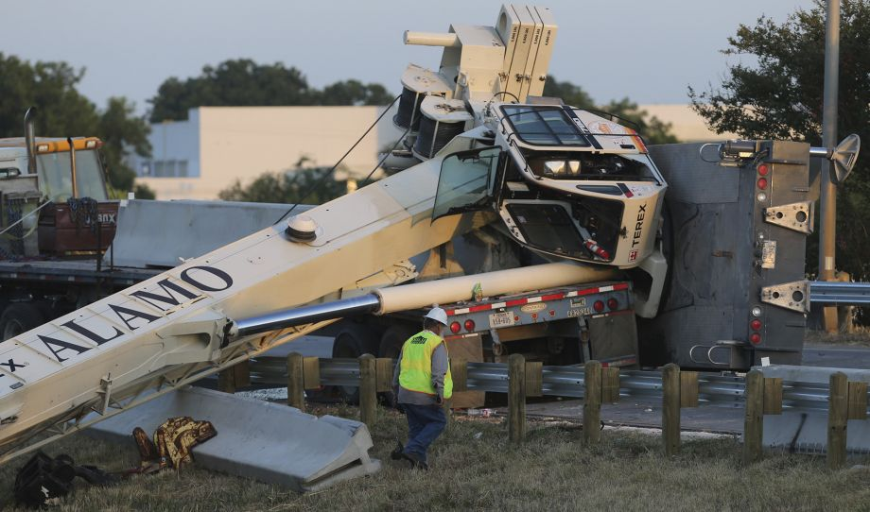
Recording
Notes:
It’s not only just more tangible evidence, some future employer might also be more impressed by the speed and quality of your awnsers or just the way you smile when faced with tough questions.
Recording more ,equals more trust. For example recording biometrics such as fingerprints, infared facial heatmaps, the nfc data from id card or even bank card for the account numbres are just more data wich can only correspond to one person. After encrypting the data and storing the public keys in a encrypted RSA keychain much like bitcoins the encrypted data can be returned to the user, removing a lot of privacy concerns.
After a 3th party adds you to the chain you can use it to underscore the data’s validity to any future employee by pointing to the your decryption key in the chain.

Slide 6
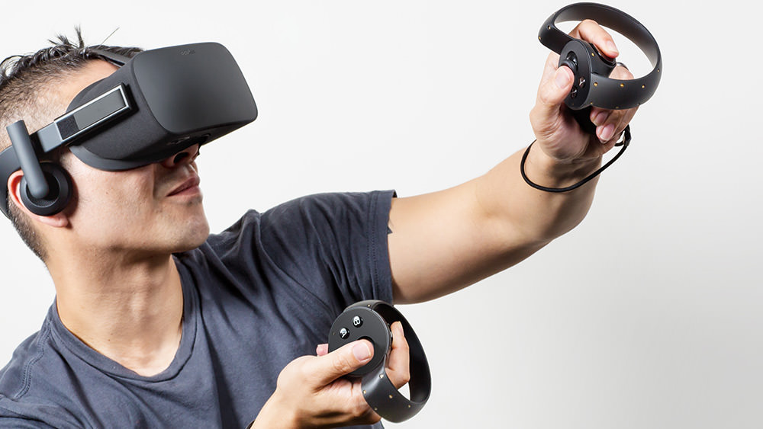
Invisible blindfold
Notes:
Using immersive technology to generate a controlled enviroment is ideal for online education and taking examinations however the technology is expensive and does not offer any method of identification.
Luckely almost everyone here has a device in their pocket or hand. That does the very thing we are looking for.

Slide 7
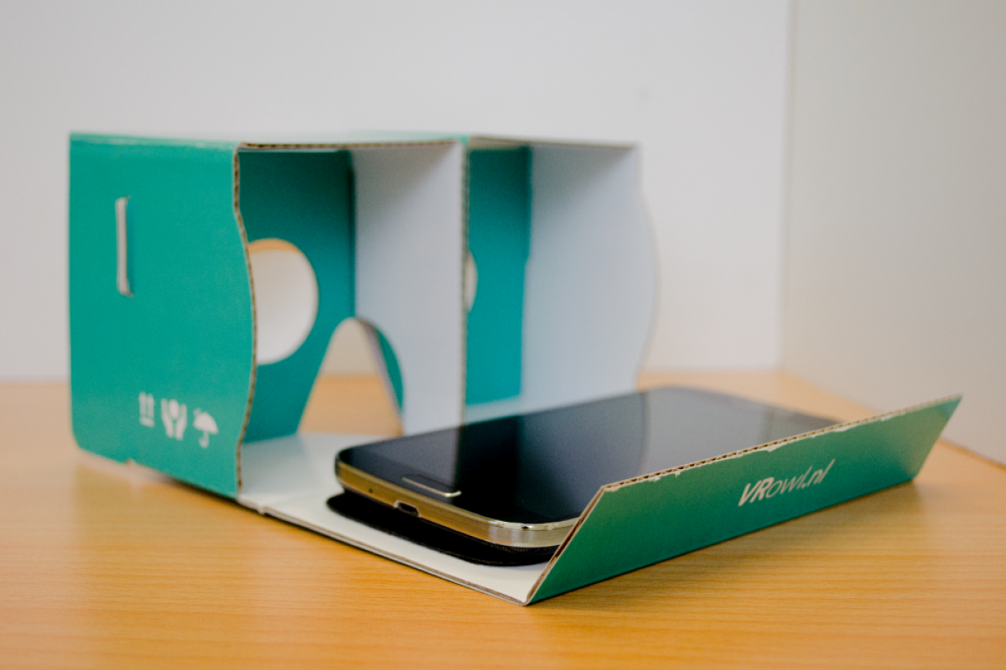
Invisible blindfold
Notes:
In combination with the vr owl most phones can be used to provide a immersive enviroment, connect to a third party in a secure way, record audio / video with the front and back camera and read id card nfc data. With slight modifications like making it head mounted, providing the front facing camera to see the eyes and blocking light from entering from below the nose it’s pretty easy to determine if the devices is removed during the examination or someone poked some extra viewing holes in the device.
Not all phones are identical, a unrooted or jailed device would provide a bit more security than a normal computer.
Technicly Some phones do not provide biometrics, and others do not function as immersive interface without a compass on board.
Also most devices cannot use the front and back camera on the ic2 bus at the same time, but this can be solved by peeking through the rear camera at a random interval to check if the room is still lit.

Slide 8

Invisible blindfold
Notes:
Fove is a kickstarter from Yuka Kojima wich is getting a lot of backing that incoperates eye tracking to reduce unneeded rendering cycles for the aeras in your perhiperal vision.
So it only renders stuff your looking at with higher clarity and reduces the overall hardware load on the device. This kind of emerging technology would be ideal to use for online examinations.
The eyetracking can be used not only for interfacing but can in some case be very valuable when assesing someones situational awareness. Best of all, statistical analisys of eye movement patterns can afterwards be analysed to improve the exam. But most notably on a psychological level some eye movement patterns correlate certain feelings or thoughtpatterns this information can be very valuable if it is presented to a educator in a relatable manner.

Slide 9
Roadmap
Phones
Dedicated device
Feature lock
Extend
Extends within
Development of Mobile Examinator
User Interface testing
Introduce
Development of dedicated device

