Slide 1
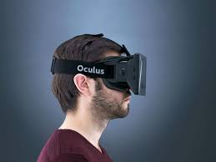

Exploration of direct immersive examination methods
Jonny van der Hoeven
Using technology to fight cheating in online education
Finding ways to thwart the ingenuity of computer-savvy students is crucial to proving Internet courses and diplomas are valid.

Slide 2
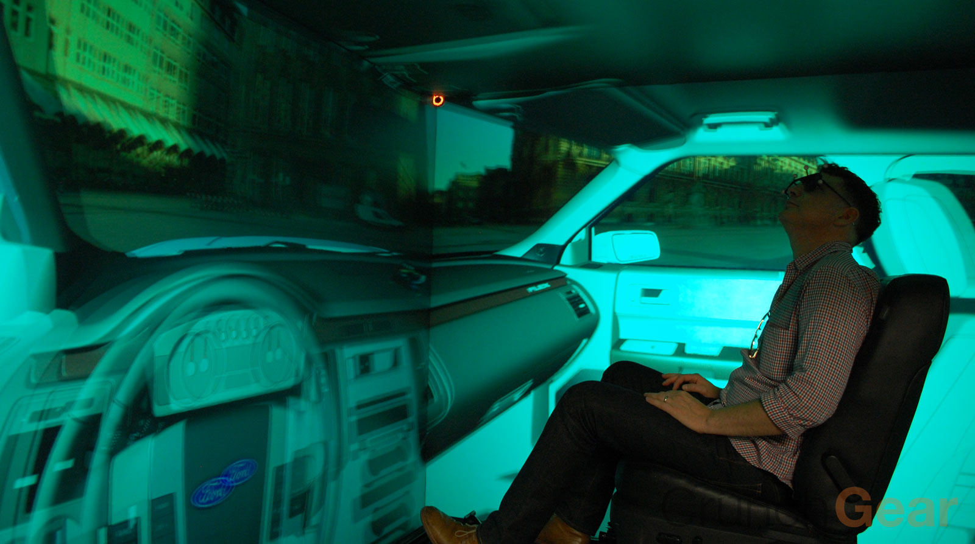
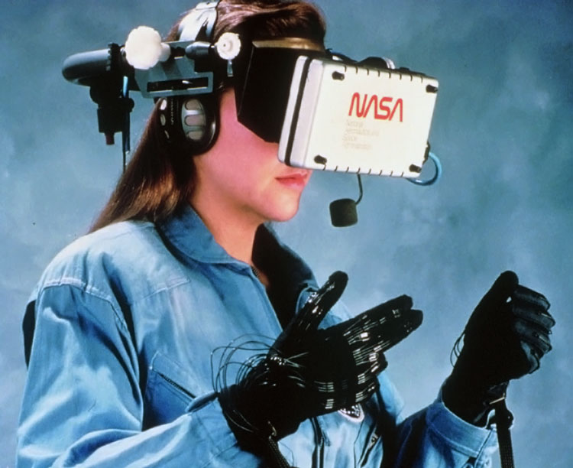
Immersive technology is being used a lot
Testing methods
Testing designs

Slide 3
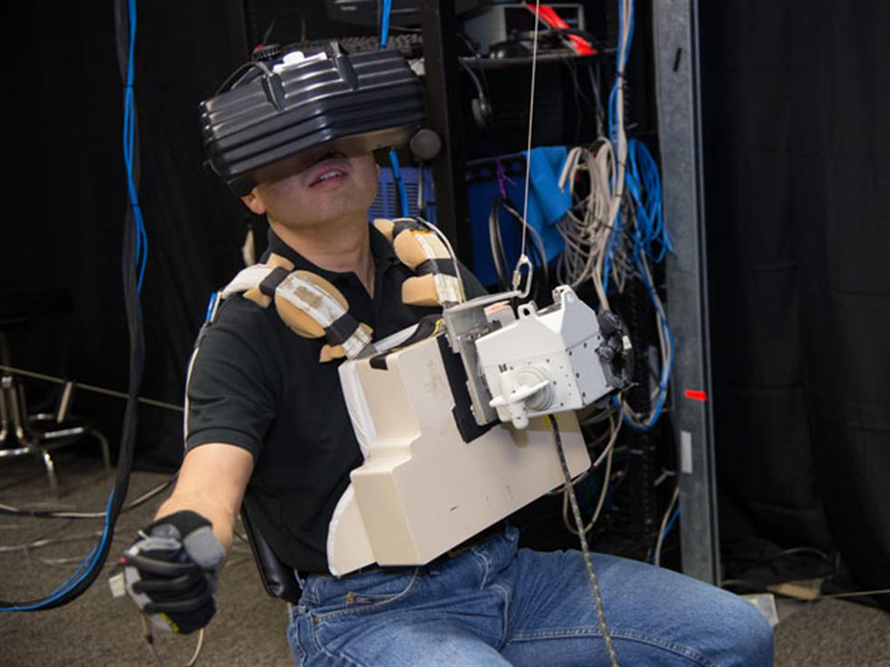
Training
Astronaut Koichi Wakata during SAFER training in the VR Lab.

Slide 4
Online Training but no reliable online examination
Student have full control of the device and his/her enviroment before any test. Alltough
Video and Audio Recordings are made during the examination, it does little to detect
fake video/audio stream or anything out of the camera's point of view.
Many Educational institutions arent willing to certify a users with a online examination
alone.
Our mission is to develop a more reliable method for testing individual skills, and minimize
attack vectors from fraudulent students during their examinations.
By leverage readilly available immersive technology in a home study setting, we aim to
positively influence the reliabilty of online examinations.
In a future where you can certify your preferred education wherever you are!
Examinations, without the hassle of travel or adhering to schedules.

Slide 5
Whats currently happening in online edu
There is a great need to reliably asses a persons skills.
Some company's are stepping into this market and offer methods to test users while filming them. And some provide
methods to include more camera's during the examination.
But sadly this is not reliable enough for higher certifications.
Problems involving online examination.
Notes on the ceiling, the floor.
Person helping outside camera P.O.V.
Streaming out pre recorded data.
Other person taking the exam

Slide 6
Online lesson will need to include online certification.
What can we do with technology?
Replace the user environment by a controlled immersive media
Use front facing camera to determine continous user presence
Rear/extra camera for recording enviroment
Microphone recording
Because the end user is not able to see it's enviroment, the microphone is suddenly pretty usefull.
Also nobody except the student knows the current question there is no way to help the student while standing outside the camera's p.o.v.

Slide 7
How it works
When a examination is needed, the users puts on their immersive headset. Awnsers multiple choice questions by head movement. When the test is completed the user can take off the headset.
The headset can be anything from the users own phone with cardboard or a dedicated highly secure device owned by the certifier containing a single examination for one person.

Slide 8
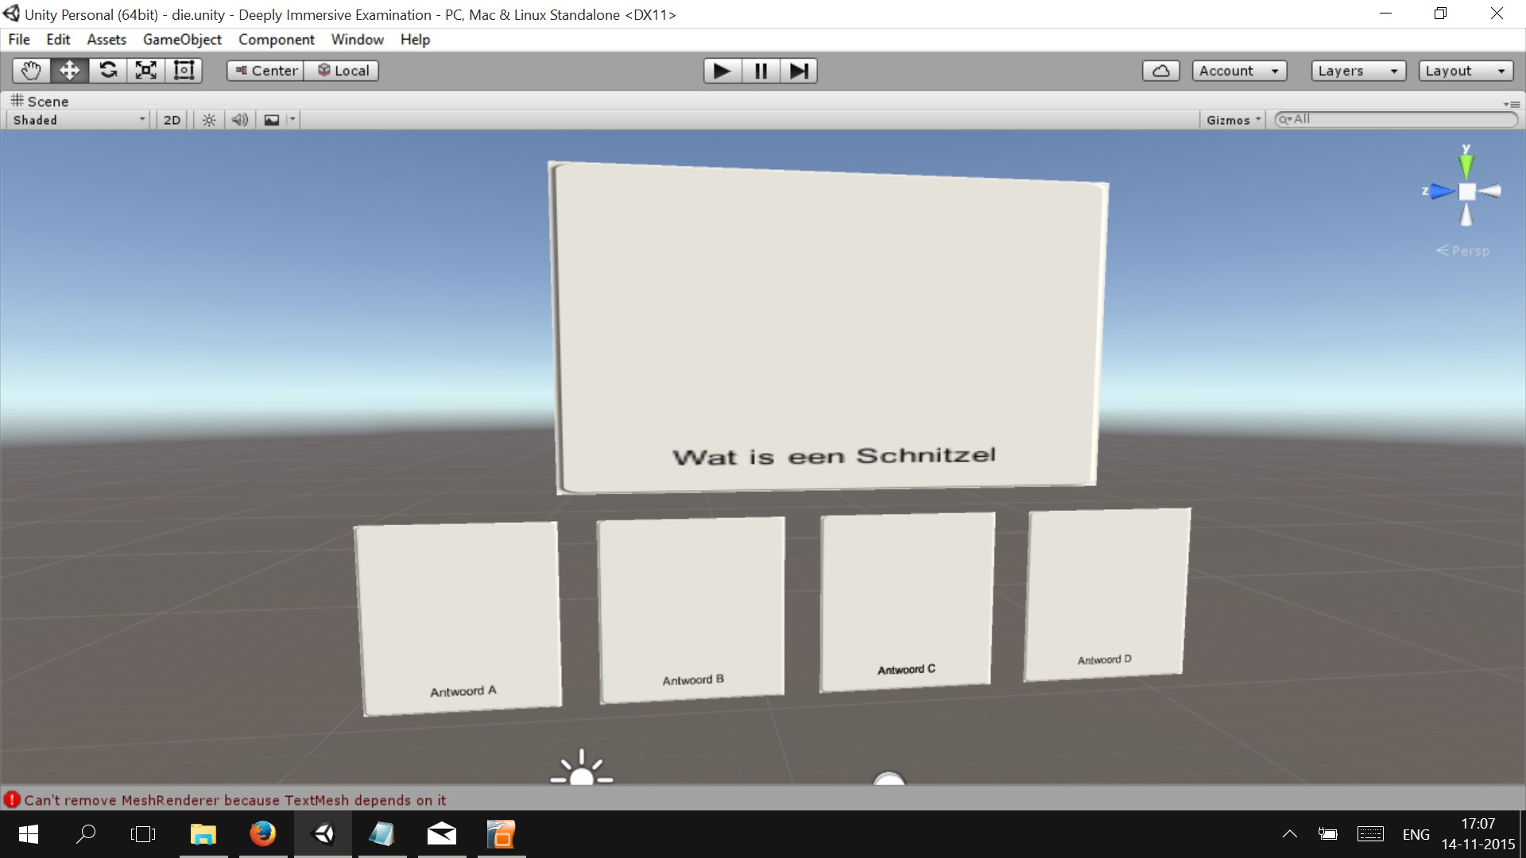
The interface

