Slide 1
Rethinking CPAP
Expiratory Pressure Relief for the CPAP Exhalation Path
A biofluid-mechanics redesign that makes exhaling easier and the vent quieter, from one valve.
Group 10 · BME 3261C Biofluid Mechanics · Respiratory Flow Device Design Challenge
Notes:
Title. We redesigned the CPAP exhalation path. One design change, the expiratory pressure relief valve, gives two measurable wins: easier exhalation and a quieter vent.

Slide 2
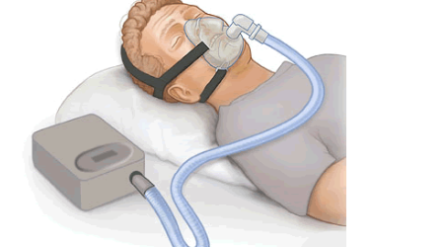
The Problem: Obstructive Sleep Apnea
OSA is a disorder where the upper airway repeatedly collapses during sleep, so breathing stops and starts. CPAP is the standard treatment: it delivers pressurized air to splint the airway open.
Repeated breathing pauses, gasping, and daytime fatigue
Driven by airway anatomy, not body weight
Not limited to high BMI
Standard CPAP setup: blower, tube, and mask.
Obesity raises risk, but OSA also affects lean, athletic people. Airway anatomy and muscle control matter too.
Notes:
OSA is anatomical, not a weight problem. CPAP is the standard fix but it has real comfort limitations, which is where we focus. Note: obesity is a major risk factor, but OSA is not limited to high BMI.

Slide 3
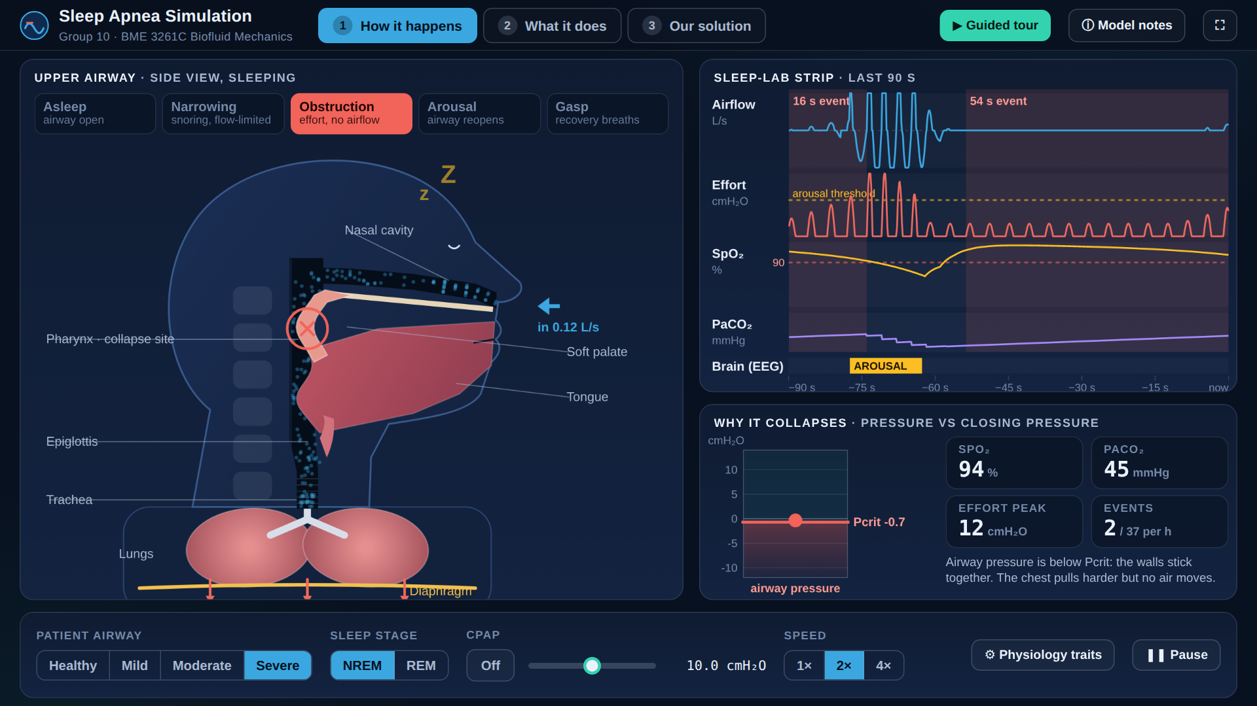
How the Airway Collapses
What you are seeing
Sleep relaxes the airway muscles, so the closing pressure (Pcrit) rises
Each breath pulls airway pressure below Pcrit: the walls collapse and the chest works harder with no airflow
Oxygen falls, effort climbs, the brain arouses, the patient gasps, and it repeats
CPAP raises airway pressure above Pcrit, a pneumatic splint
Live physiology model, severe OSA, then CPAP on. Interactive version: sleep-apnea-simulation.html
Notes:
Play the clip. Point out the red ring where the airway closes, the effort crescendo on the strip, then the arousal. Around the halfway mark CPAP turns on and the airway stays open. Model: Starling-resistor airway plus RC lung, four OSA traits after Eckert 2013. Teaching model, not clinical.

Slide 4
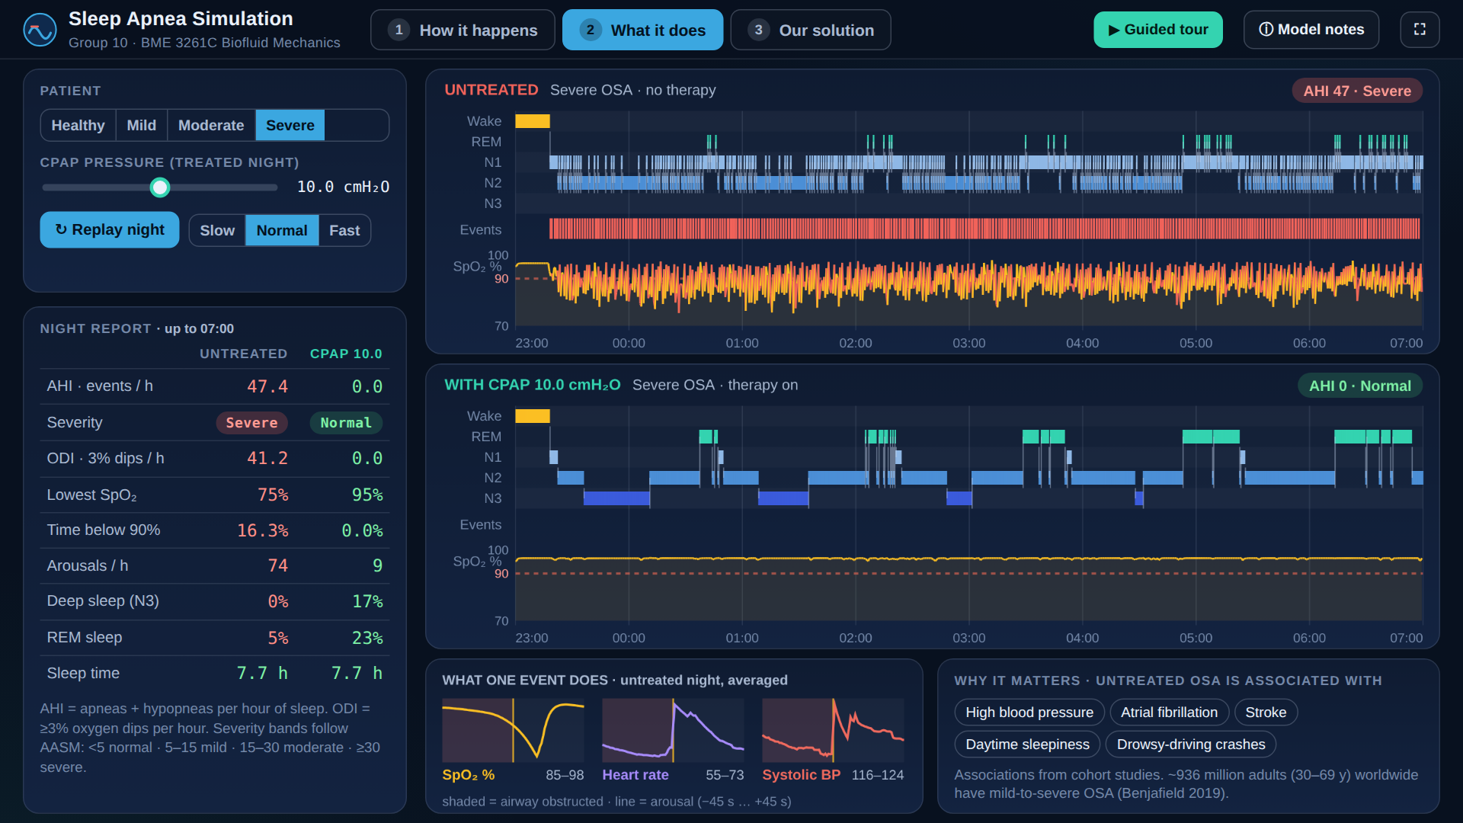
What a Night of OSA Does
What you are seeing
Untreated severe OSA in our model: about 50 breathing events per hour
Oxygen dips to the mid-70s; sleep is fragmented and deep sleep almost disappears
On CPAP the events stop and deep sleep and REM return
Untreated OSA is associated with high blood pressure, atrial fibrillation, stroke, daytime sleepiness and drowsy-driving crashes
Same simulated patient, 8 hours, untreated (top) vs CPAP at 10 cmH2O (bottom). Heart-rate and BP traces are illustrative.
Notes:
Top strip is untreated, bottom is CPAP. AHI bands (AASM): under 5 normal, 5-15 mild, 15-30 moderate, 30 or more severe. About 936 million adults aged 30-69 have mild-to-severe OSA worldwide (Benjafield 2019, Lancet Respir Med).

Slide 5
Where Current CPAP Falls Short
Discomfort
Air leaks
Dryness
Masks and straps irritate
Poor seal cuts effectiveness
Constant flow dries airways
Portability
Cost
Adjustment
Bulky to travel with
Machine + upkeep add up
Takes time to tolerate
We target: Exhalation difficulty
We target: Noise
Patients must breathe out against constant pressure: often described as "fighting the machine."
The mask vent jet can disturb sleep, especially for a bed partner and at higher pressures.
Notes:
Seven known limitations. We chose two that share one root cause in the exhalation pressure, so one fix addresses both.

Slide 6
Primary Source: A CPAP User
We interviewed a daily user of the ResMed AirSense 11. Three findings shaped our scope:
"It takes time to adjust to the pressure."
Supports our concept: relief eases the exhalation that users struggle with.
"Noise isn't too bad, like a white noise machine."
Honest counter-point: on a premium unit noise is mild, so we target bed-partner and high-pressure cases.
"I wish it were more compact to travel with."
Real pain, but out of scope for an airflow model, logged as future work.
His machine already includes EPR (0–3 cmH₂O): the exact mechanism our model builds on and quantifies.
Notes:
Real user of the exact device. His words justify our target and keep us honest on noise. His machine has EPR, so we are quantifying and improving a real feature, not inventing one.

Slide 7
Our Concept: Flow-Triggered Relief Valve
Standard CPAP holds one pressure across the whole breath, so you always exhale against it.
Our valve senses the start of exhalation, drops mask pressure by up to 3 cmH₂O, then restores full pressure for the next inhalation.
One change, two wins
Easier exhalation: less pressure to push against
Quieter vent: lower expiratory pressure means a slower, calmer vent jet
Concept fits standard nasal-pillow hardware.
Notes:
The valve only acts on exhalation. Inhalation pressure is unchanged, so the airway is still splinted open and therapy still works.

Slide 8
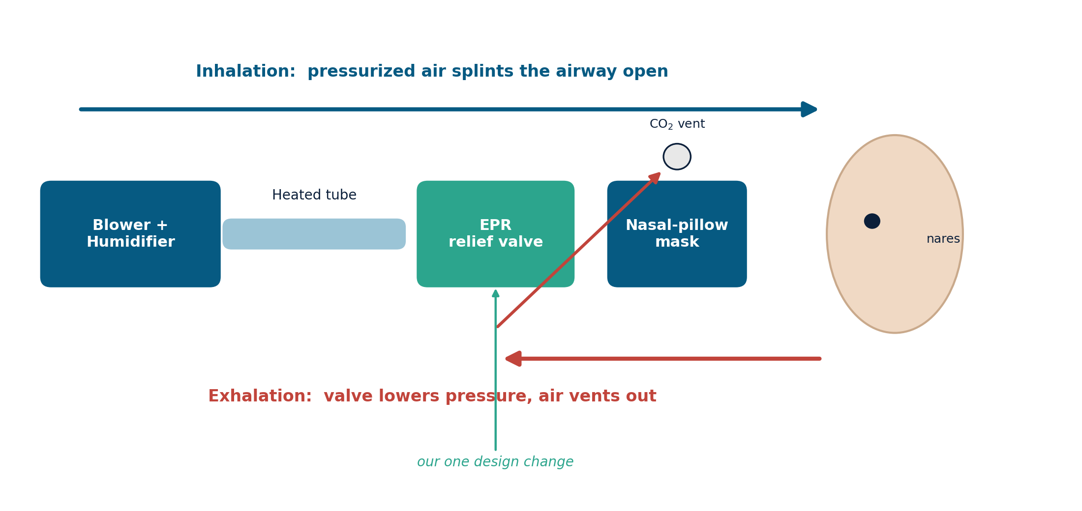
How It Works: The Airflow Path
Notes:
Blue is inhalation, full pressure to splint the airway. Red is exhalation: the relief valve lowers pressure and air leaves through the CO2 vent more gently.

Slide 9
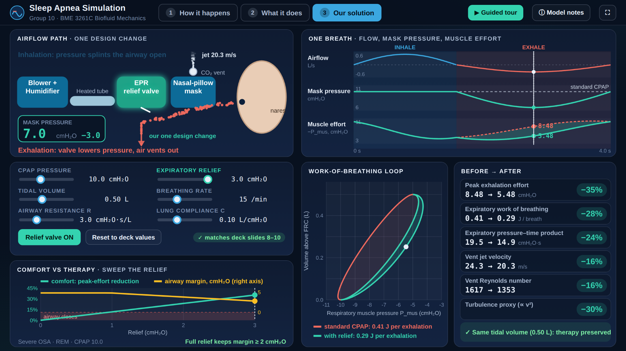
The Relief Valve in Action
What you are seeing
Standard CPAP holds one pressure all breath long
Our valve drops mask pressure by up to 3 cmH2O during exhalation, then restores it
Peak exhalation effort -35%, expiratory work -28%
Vent jet 24.3 to 20.3 m/s; tidal volume unchanged, so therapy is preserved
Live reproduction of the group model (slides 7-10). Every number matches the results slides.
Notes:
The clip reproduces slides 8-10 exactly. At the end the relief is swept 0 to 3 cmH2O: comfort rises while the airway safety margin above Pcrit shrinks, which is the trade-off named in Limitations. Caveat: the effort percentages depend on the constant-CPAP-offset convention of the model; the absolute 3 cmH2O drop at peak flow does not.

Slide 10
Simulation: Modeling the Breath
We model the patient and device as a single-compartment resistance–compliance (RC) lung, the standard biofluid model of breathing.
P_mus + P_dev = R · V̇ + V / C
Parameters (AirSense 11 spec)
muscle + device pressure = resistive + elastic load
Airway resistance R: 3 cmH₂O·s/L
Lung compliance C: 0.1 L/cmH₂O
Tidal volume: 0.5 L
Breathing rate: 15 / min
CPAP pressure: 10 cmH₂O
Expiratory relief: 3 cmH₂O
Key idea: the prescribed breath (tidal volume, rate) is identical before and after, so every improvement comes from the device, not from changing the breathing.
Notes:
Standard RC respiratory model. Parameters match a real AirSense 11 so a reviewer can trace every number. Same breath both runs isolates the device effect.

Slide 11
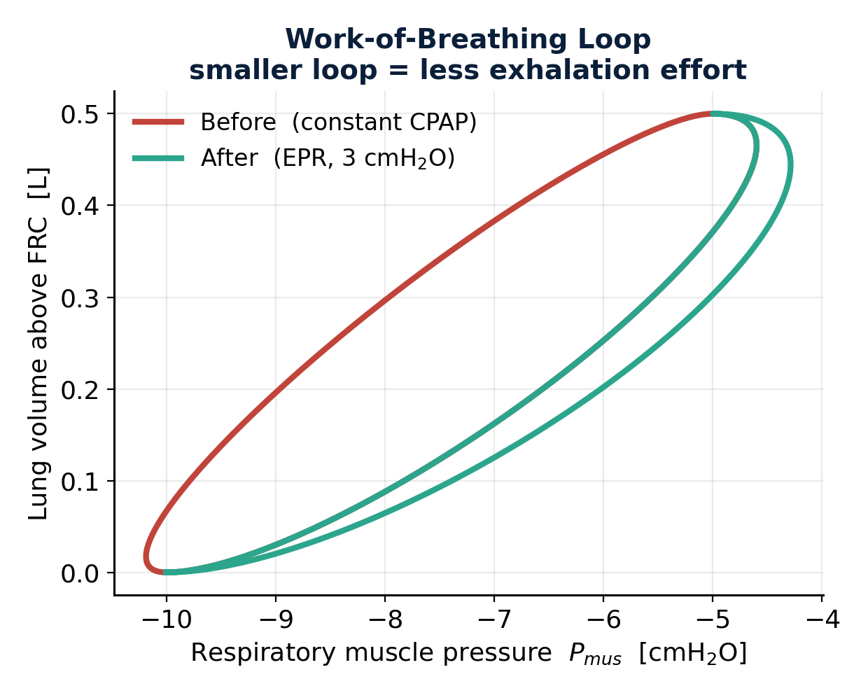
Result 1: Easier Exhalation
−35%
peak exhalation effort
−28%
expiratory work of breathing
−24%
expiratory pressure–time product
Tidal volume is unchanged, so therapy is preserved.
Notes:
The work-of-breathing loop shrinks. Peak effort down 35 percent, total expiratory work down 28 percent. Ventilation unchanged, so the patient does the same breathing with less effort.

Slide 12
Result 2: A Quieter Vent
The same pressure drop slows the vent jet, the source of vent noise.
24.3
20.3
−30%
m/s vent jet (before)
m/s vent jet (after)
turbulence proxy (∝ V²)
Vent Reynolds number falls 1617 → 1353, so the jet is slower and less turbulent.
Honest scope: noise is acoustic, so we report it as a velocity / turbulence proxy, not decibels. Even our interviewee finds his premium unit quiet, so the real target is bed-partner disturbance and higher-pressure users.
Notes:
Vent velocity down 16 percent, turbulence proxy down 30 percent. We are explicit that this is a velocity proxy, not a decibel measurement, and that premium machines are already fairly quiet.

Slide 13
Before vs After: One Design Change
Metric | Before | After | Change
Peak exhalation effort (cmH₂O) | 8.48 | 5.48 | −35%
Expiratory work (J/breath) | 0.41 | 0.29 | −28%
Vent jet velocity (m/s) | 24.3 | 20.3 | −16%
Vent Reynolds number | 1617 | 1353 | −16%
Every gain above comes from a single change: the flow-triggered expiratory relief valve.
Notes:
One valve moves all four numbers the right way. That is the whole argument: a single, buildable change with a measurable, defensible payoff. Note: effort is -P_mus at peak expiratory flow; the percentages depend on the constant-CPAP-offset convention (the absolute 3 cmH2O drop does not).

Slide 14
Limitations & Future Work
Model limitations
Design tradeoffs & next steps
Single-compartment, linear R and C
Fixed resistance and compliance
Noise treated as a velocity proxy, not dB
Idealized, flow-proportional relief profile
EPR exists on premium units: our contribution is quantifying it and pairing it with vent-noise reduction
Too much relief may trigger central apneas in some patients
Mouth-breathers can leak more at higher relief
Future: compact, travel-friendly form factor
Future: lower-maintenance humidifier / water handling
Next: sweep relief 0–3 cmH₂O to find the comfort-vs-therapy sweet spot
Adherence benefit of expiratory relief is unproven (Killick & Marshall 2020): we show reduced effort, not better adherence
Notes:
We name the model limits and the clinical tradeoffs from the literature. The relief sweep is the obvious next experiment.

Slide 15
Takeaways
One buildable valve delivers two measured wins: easier exhalation and a quieter vent.
Grounded in a real device (AirSense 11) and a real user, so every number is defensible.
Same breathing, less effort, so therapy is preserved, comfort improved.
Audience vote
How much do you think expiratory relief cuts breathing effort: 10%, 25%, or 40%?
(Our simulation: 35%.)
Notes:
Close with the vote before revealing 35 percent. It makes our headline result the payoff and gets the room involved.

Slide 16
Try It Live: Interactive Simulation
Open the simulation
Runs in any modern browser, no install, works offline as a single HTML file.
Three scenes: how it happens, what it does, our solution. Sliders for patient, CPAP and relief.
Live link (after the repo is merged and GitHub Pages is on):
jonnyterrero.github.io/BME-Visualizations/biofluid-mechanics/sleep-apnea-simulation.html
Full guided tour (2:38), captioned
Notes:
Backup slide. If asked, open the live page and use the Model notes button for equations, references and limits.

