Slide 1
✦ Antigravity
Intro
ANTIGRAVITY · CLAUDE CODE
Building with Claude Code
From zero to your first prompt — in four slides.
01
02
What is Antigravity?
Claude Code as a Plugin
An agentic dev environment built around Claude.
Not a separate app — a plugin, wired in.
03
04
Adding a Project Folder
Sending a Prompt
Drop in a folder. Claude Code indexes it.
Type what you want. Claude Code acts.
Use ← → arrow keys to navigate

Slide 2
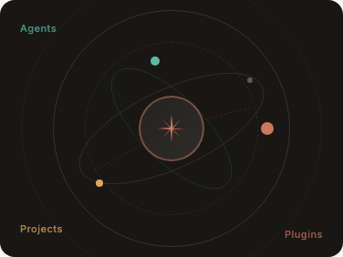
✦ Antigravity
1 / 4
01 — ANTIGRAVITY
Agents
Meet Antigravity.
An agentic dev environment built around Claude — AI and code in the same place.
Projects
Plugins
Plugin-first
Project-aware
One-prompt flows
Every capability is a plugin. Add, remove, compose.
Drop in a folder. Your whole codebase becomes live context.
One prompt. Agents, tools, and code edits — handled.

Slide 3
✦ Antigravity
2 / 4
02 — PLUGIN
Antigravity — Plugins
Claude Code lives inside Antigravity.
✦ Claude Code
AI pair programmer & agent
⌥ Git & Branches
Inline diff, blame, history
Not a separate app. A plugin — toggled on, wired into your project.
✓ Test Runner
Instant context.
Reads your codebase the moment it's enabled.
Jest, Vitest, pytest
Side-by-side.
Terminal panel in the same window — no switching.
◇ Deploy
Vercel, Railway, Fly.io
Composable.
Mix with other plugins in one flow.
≡ Linter & Formatter
ESLint, Prettier, Ruff
Claude Code is on by default. Everything else is optional.

Slide 4
✦ Antigravity
3 / 4
03 — SETUP
Antigravity — Open Project
Add your project folder.
📁 my-project
📂 src
index.ts
Three steps. Drop in a folder, Claude Code indexes it, you're ready.
app.ts
Drop a folder here
📂 tests
or click to browse
✓
Open Antigravity
package.json
Open folder…
Land on the Projects screen.
2
Drop in your folder
RECENT
Drag a folder into the drop zone, or click Open folder.
my-project
~/Documents/my-project
Open
api-service
Open
~/Work/api-service
3
Claude Code indexes it
Files scanned. Prompt bar unlocks. You're ready.

Slide 5
✦ Antigravity
4 / 4
04 — PROMPT
Add a rate-limit middleware to src/app.ts, using the pattern in src/auth.ts, without breaking existing tests
Apples an bananas.
⌘ K Commands @ Files
Send →
Type what you want. Claude Code reads your codebase and acts.
Claude Code — Terminal
> claude "Add rate-limit middleware…"
verb
Start with an action.
Add, Fix, Refactor, Write tests for.
Reading src/app.ts, src/auth.ts, tests/ (14 files)
scope
Name the thing.
A file, a function, a feature.
1. Install express-rate-limit
2. Create src/middleware/rateLimiter.ts
context
Add constraints.
"without breaking tests", "using the pattern in auth.ts".
3. Mount after authMiddleware in app.ts
✓ package.json updated
✓ rateLimiter.ts created
✓ app.ts patched
✓ All 14 tests passing
Done. ▌
Reads & reasons
Writes & runs
Iterates
Full codebase before writing a line.
Files edited. Tests run automatically.
Self-corrects if tests fail.
You're ready to build.
Open Antigravity. Drop in a project. Send your first prompt.
Back to overview →

