Slide 1
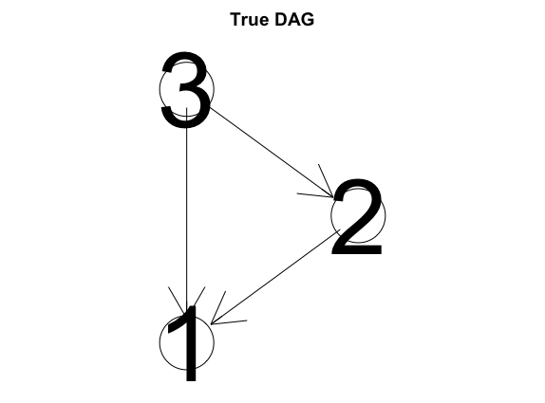
Example 1

Slide 2
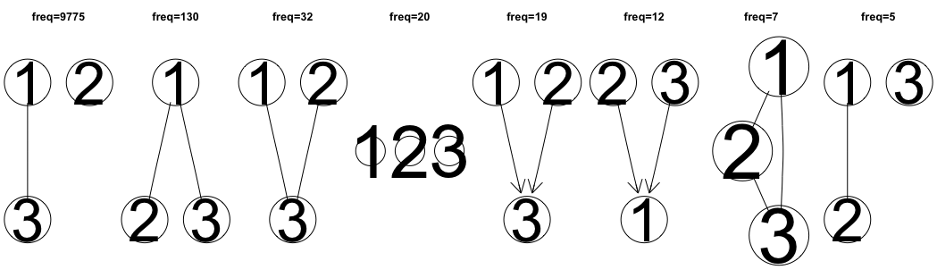
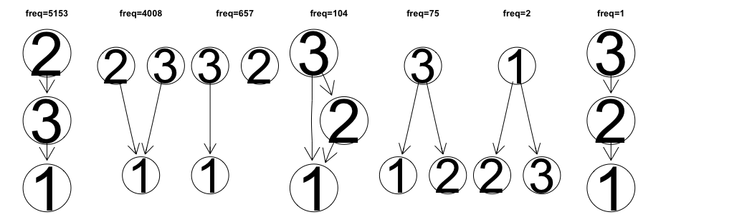
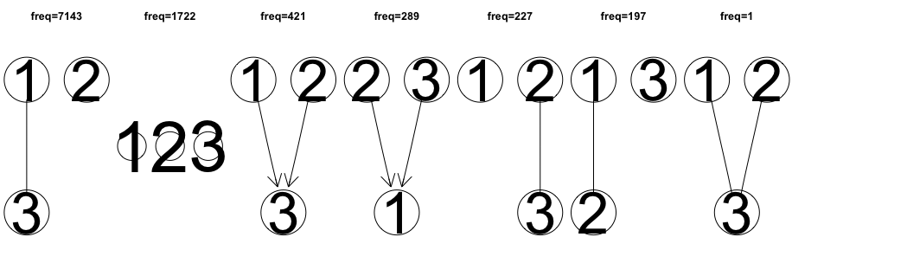
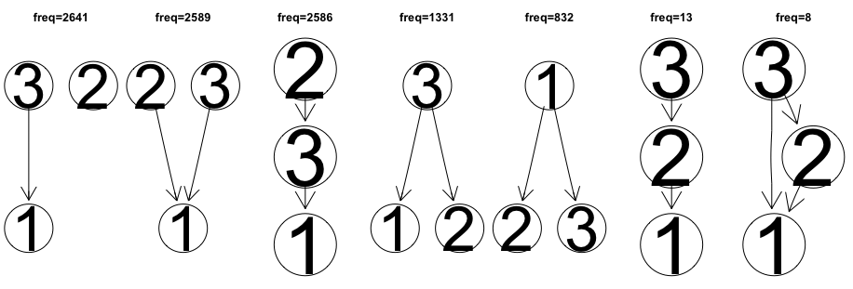
Data size n: 20
Number of iterations: 10000
PC (alpha = 0.01)
BOSS (discount = 1)
BOOTSTRAP
MCMC (95% CI)

Slide 3
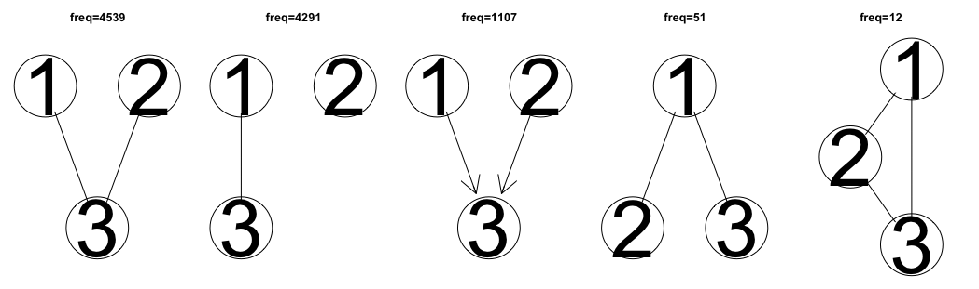
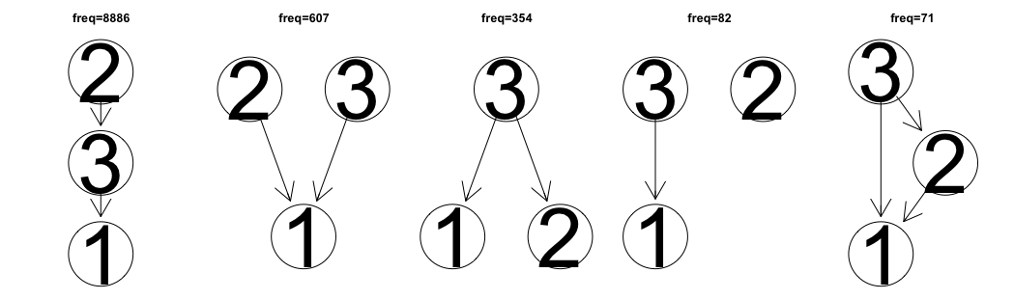
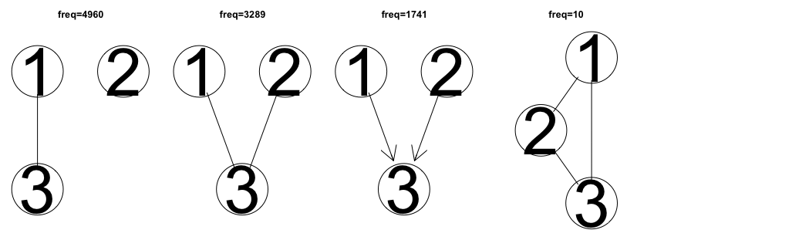
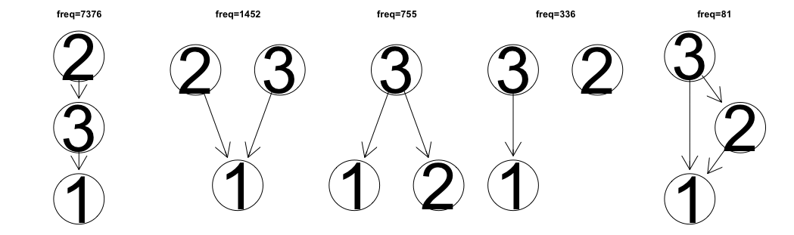
Data size n: 200
Number of iterations: 10000
PC (alpha = 0.01)
BOSS (discount = 1)
BOOTSTRAP
MCMC (95% CI)

Slide 4
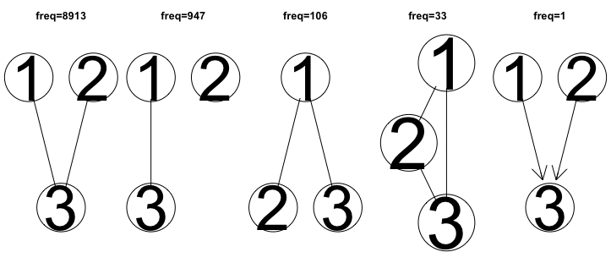
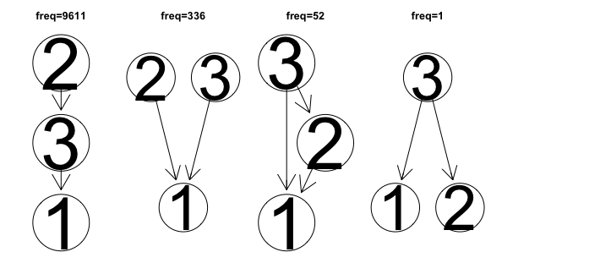
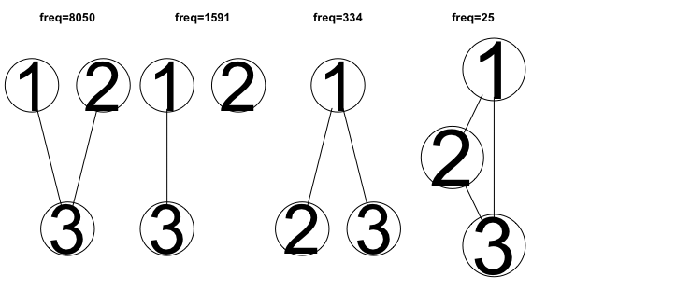
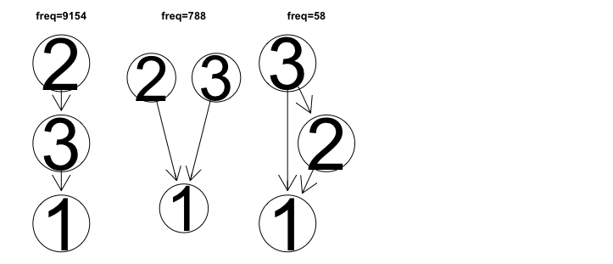
Data size n: 500
Number of iterations: 10000
PC (alpha = 0.01)
BOSS (discount = 1)
BOOTSTRAP
MCMC (95% CI)

Slide 5
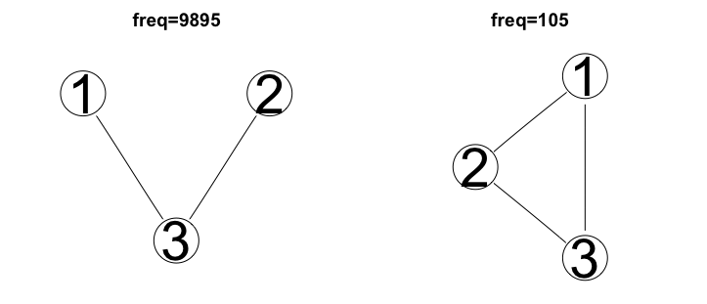
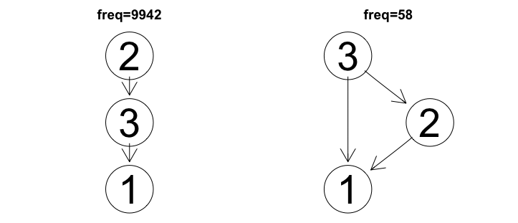

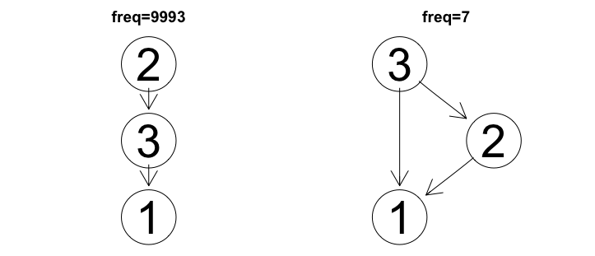
Data size n: 2000
Number of iterations: 10000
PC (alpha = 0.01)
BOSS (discount = 1)
BOOTSTRAP
MCMC (95% CI)

Slide 6
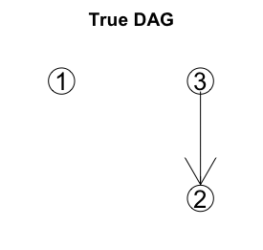
Example 2

Slide 7
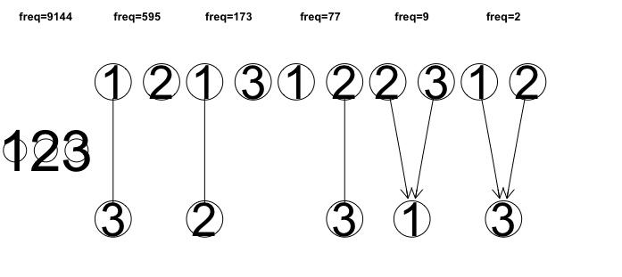
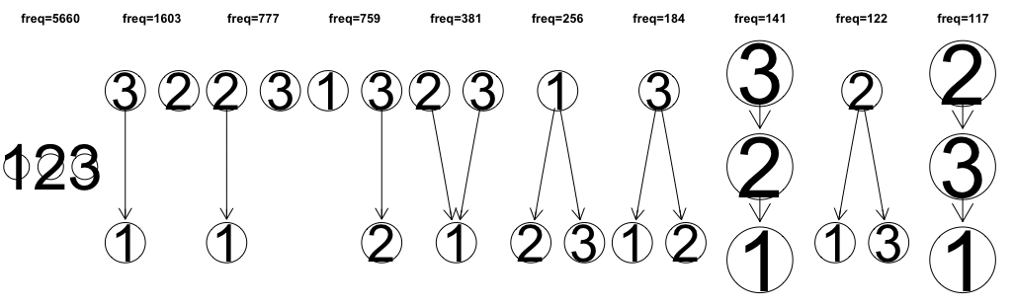
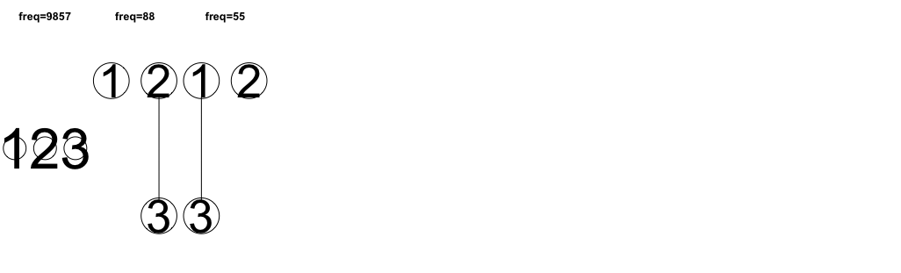
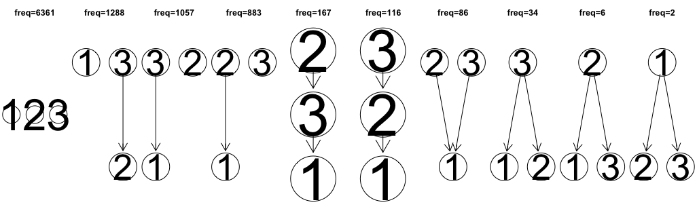
Data size n: 20
Number of iterations: 10000
PC (alpha = 0.01)
BOSS (discount = 1)
BOOTSTRAP
MCMC (95% CI)

Slide 8
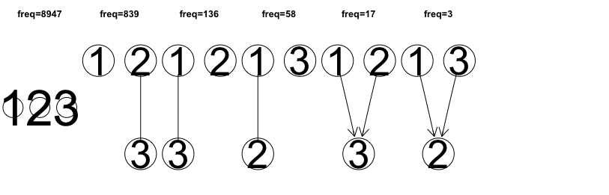
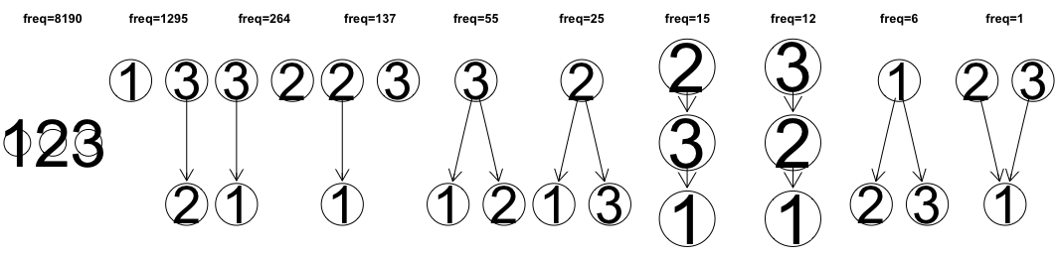
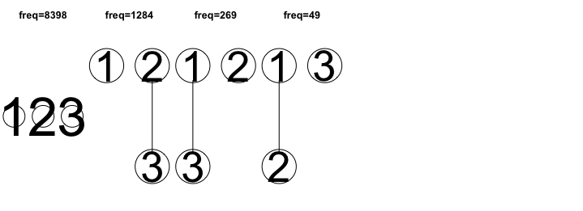
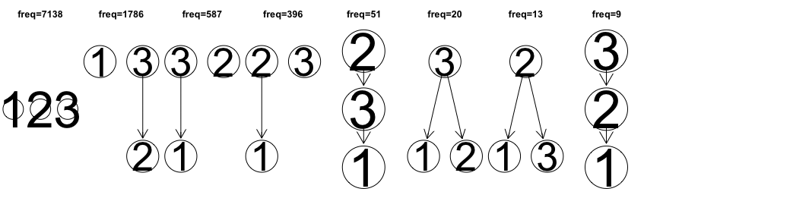
Data size n: 200
Number of iterations: 10000
PC (alpha = 0.01)
BOSS (discount = 1)
BOOTSTRAP
MCMC (95% CI)

Slide 9
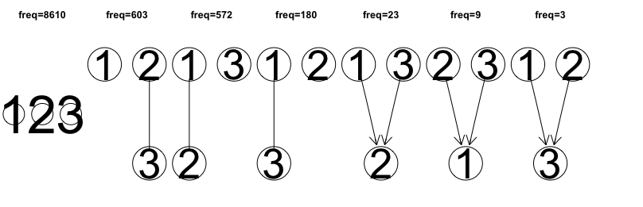
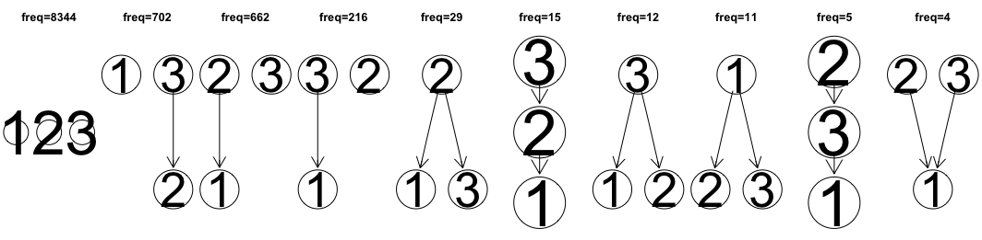
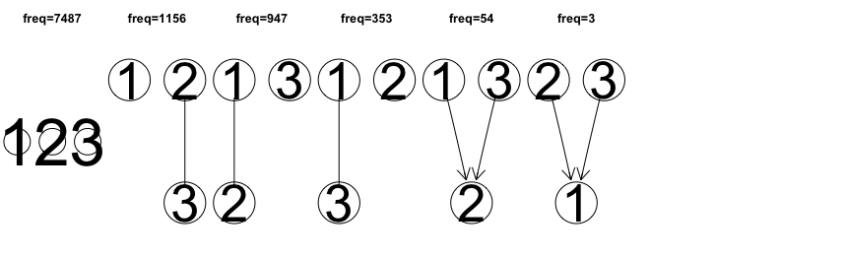
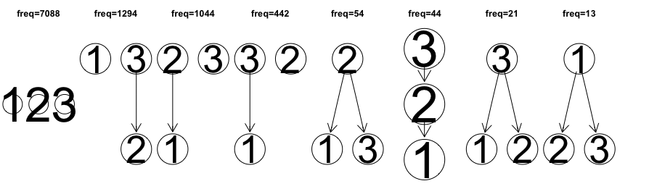
Data size n: 500
Number of iterations: 10000
PC (alpha = 0.01)
BOSS (discount = 1)
BOOTSTRAP
MCMC (95% CI)

Slide 10
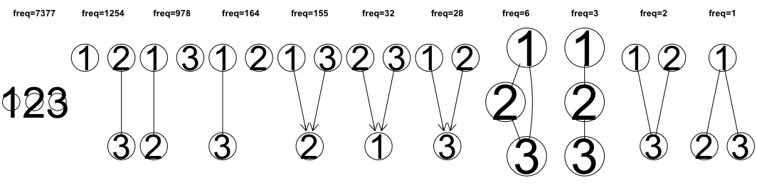
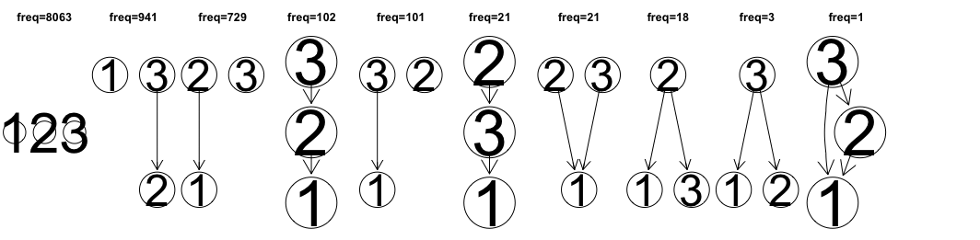
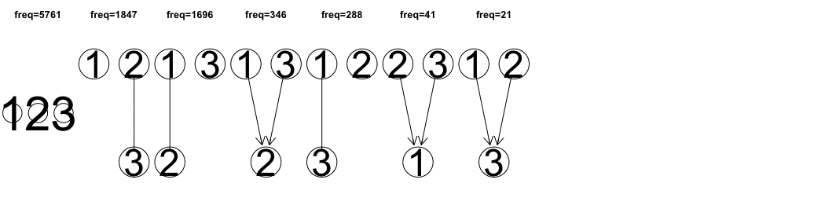
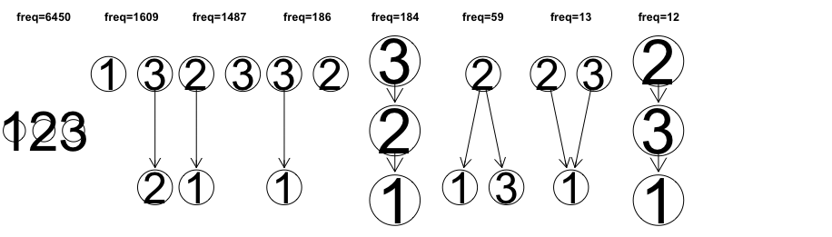
Data size n: 2000
Number of iterations: 10000
PC (alpha = 0.01)
BOSS (discount = 1)
BOOTSTRAP
MCMC (95% CI)

