Slide 1
Single-Stage Analysis of Variance Under Heteroscedasticity
文獻研讀---
授課老師：溫敏杰 老師
報告者：沈銘玉
Chen S.Y. and Chen H.J. (1998), Single-stage analysis of variance underheteroscedasticity, Communications in Statistics: Simulation & Computation (SCI), 27 (3), 641-666.

Slide 2
Outline
Two-stage for ANOVA
Single-stage for ANOVA
Numerical Studies--Power
Example
Conclusion

Slide 3
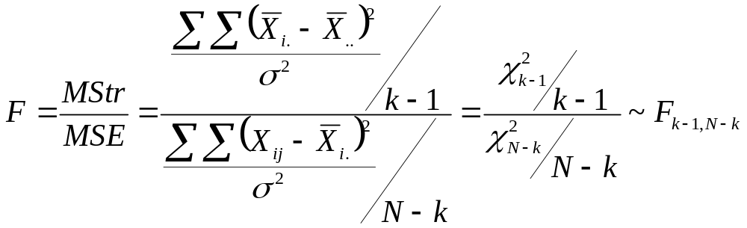
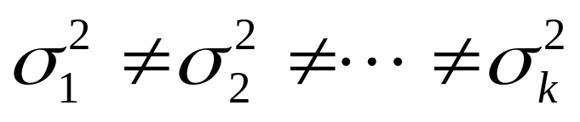
Assumption of ANOVA
Normal
Independent
Equality of the error variances
How
Unequal & Unknown
Notes:
若變異數不等但已知會如何?

Slide 4
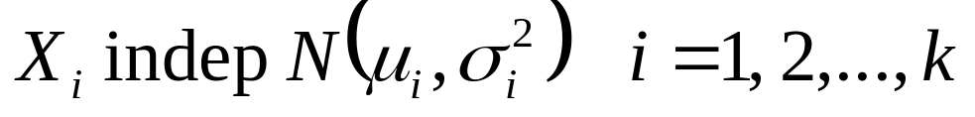
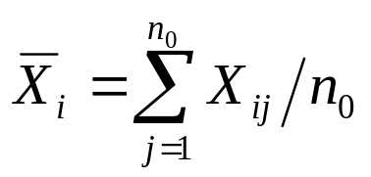
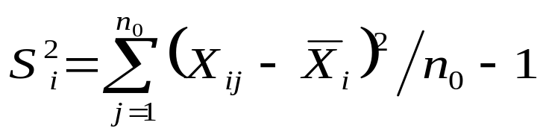
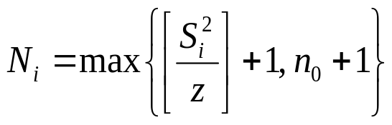
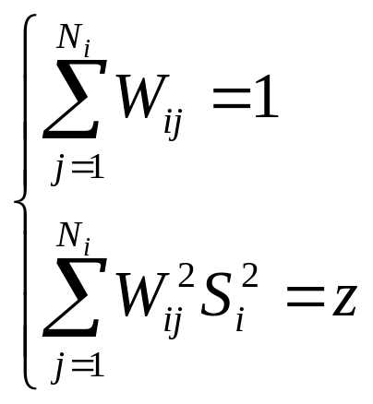
Two-stage
Bishop & Dudewicz(1978)
1 | 2 | 3 | … | k
X₁₁ | X₂₁ | X₃₁ | … | X_{k1}
X₁₂ | X₂₂ | X₃₂ | … | X_{k2}
… | … | … |  | …
X_{1n0} | X_{2n0} | X_{3n0} | … | X_{kn0}
A_{i}
A_{i}
…
A_{i}
B_{i}
…
B_{i}
X_{1n0+1} | X_{2n0+1} | X_{3n0+1} | … | X_{kn0+1}
… | … | … |  | …
X_{1N1} | X_{2N2} | X_{3N3} | … | X_{kNk}

Slide 5
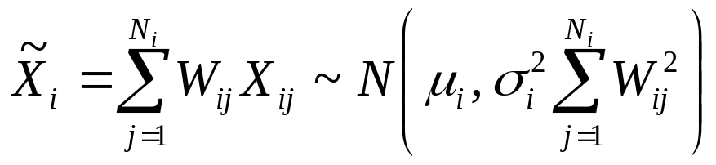

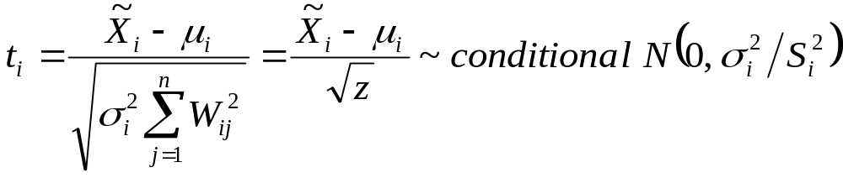
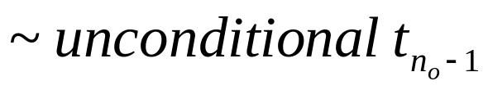
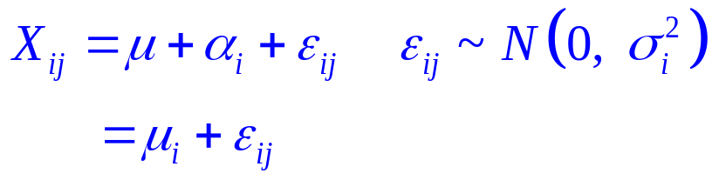
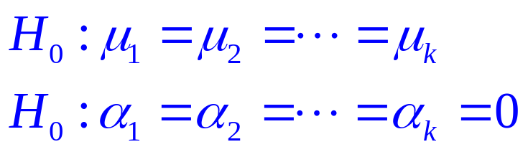
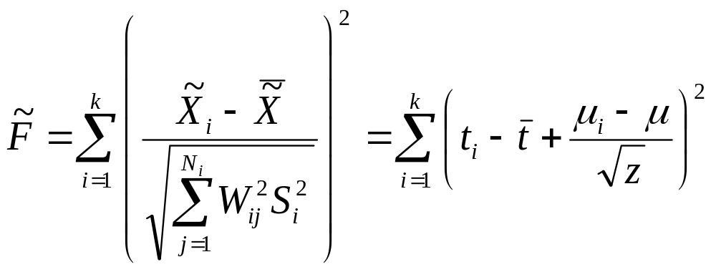
Two-stage
given

Slide 6
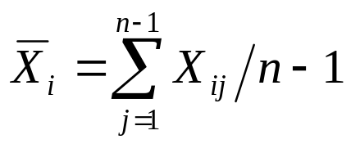
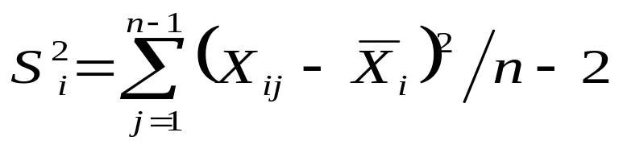
Single-stage
1 | 2 | 3 | … | k
X₁₁ | X₂₁ | X₃₁ | … | X_{k1}
X₁₂ | X₂₂ | X₃₂ | … | X_{k2}
… | … | … |  | …
X_{1n-1} | X_{2n-1} | X_{3n-1} | … | X_{kn-1}
X_{1n} | X_{2n} | X_{3n} | … | X_{kn}
U_{i}
U_{i}
…
U_{i}
V_{i}
Notes:
為什麼選n-1和1

Slide 7
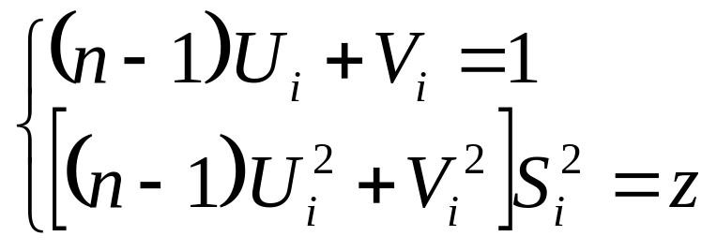
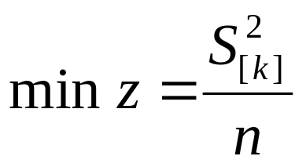
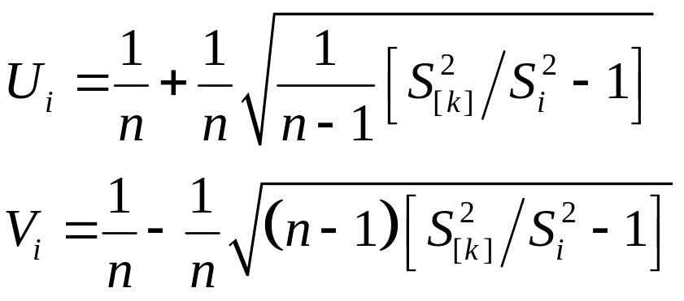
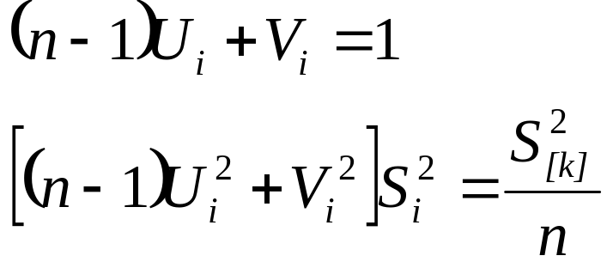
Single-stage

Slide 8
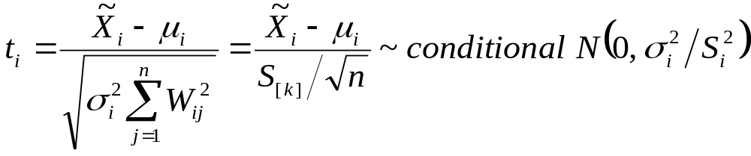
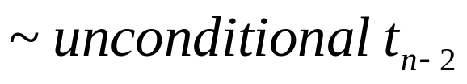
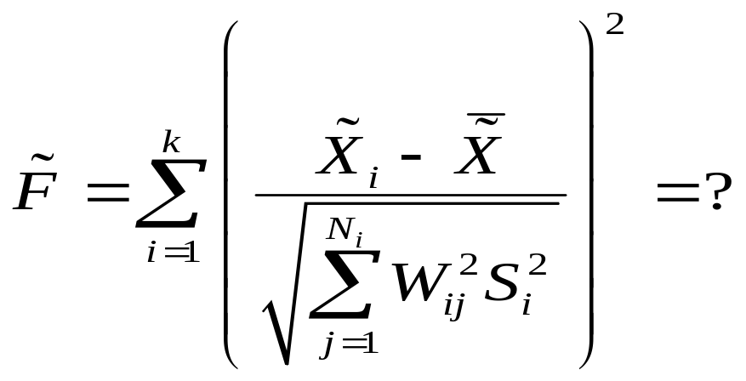
Single-stage
given

Slide 9
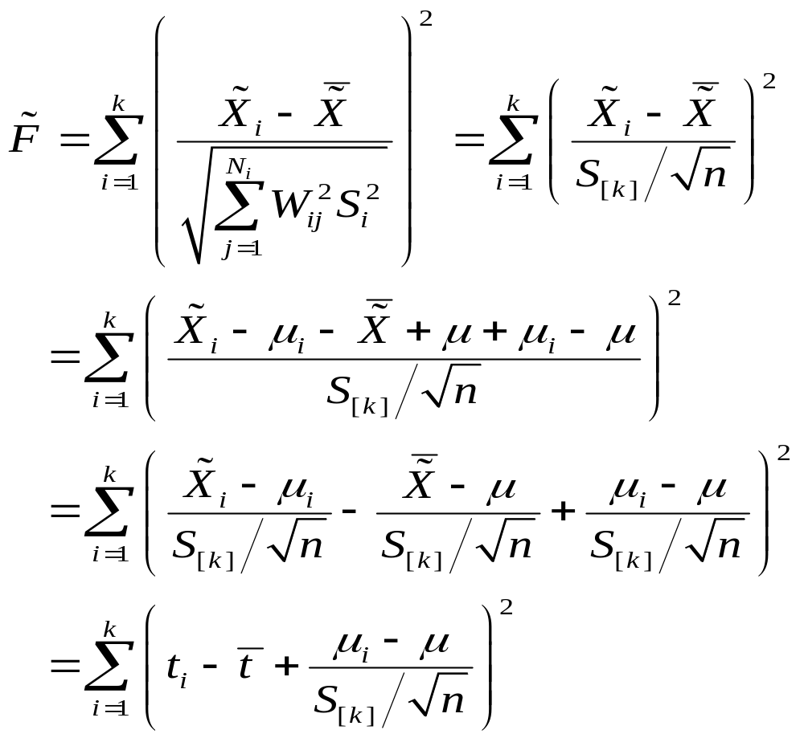

One-way ANOVA

Slide 10
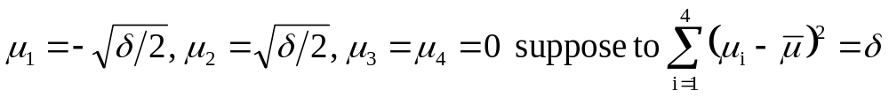
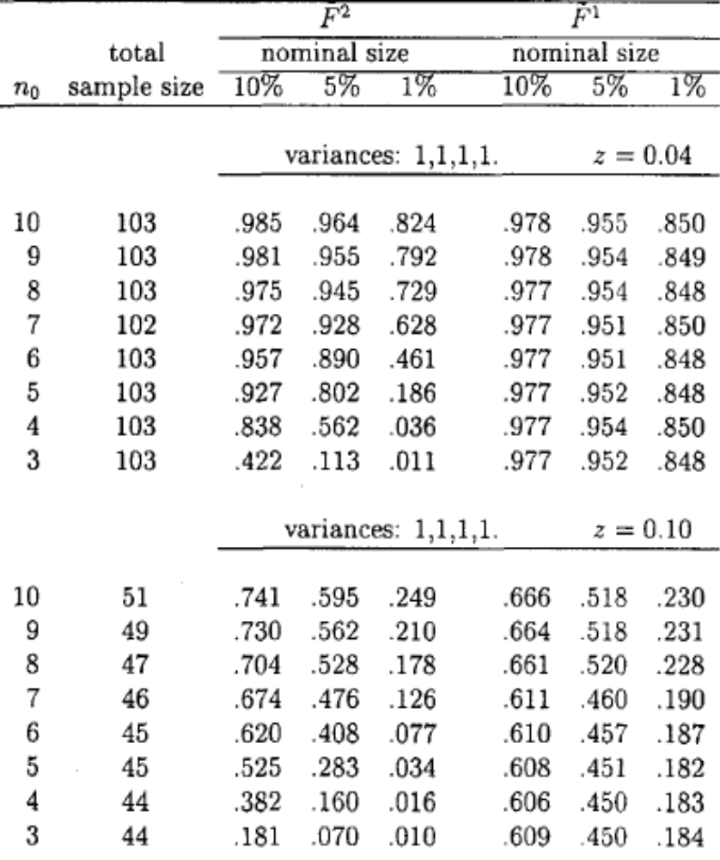
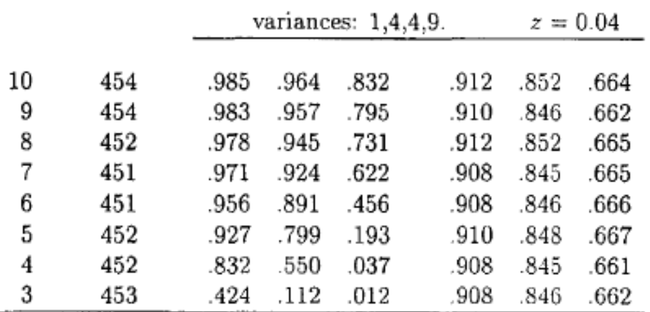

Slide 11
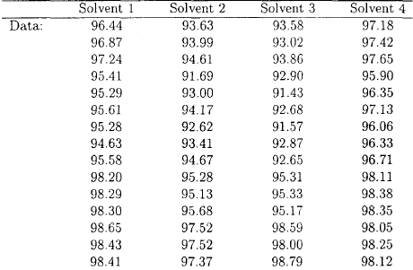
Example

Slide 12
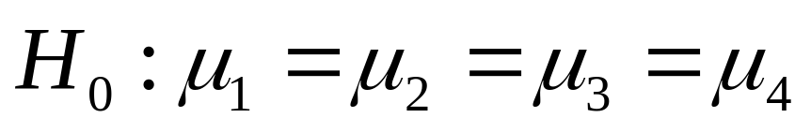
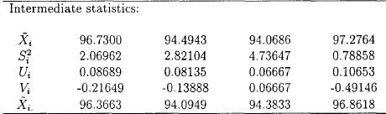
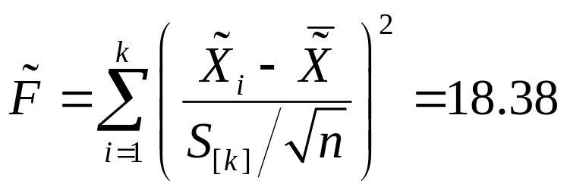

Slide 13
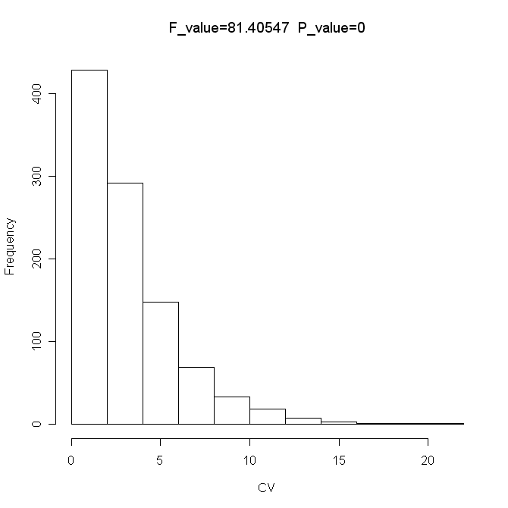
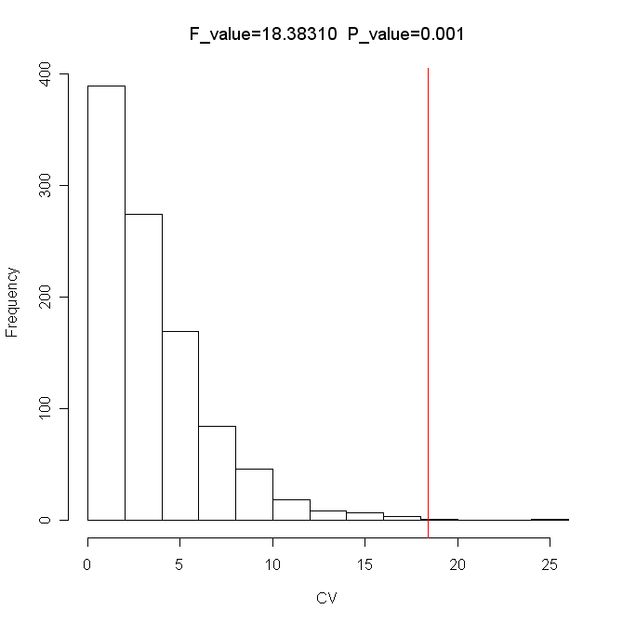
Result of single and two stage
Two-stage | Solvent 1 | Solvent 2 | Solvent 3 | Solvent 4
additional samples | 12 | 25 | 59 | 1
Single-stage
Two-stage

Slide 14
Conclusion
Exact distribution
Not require additional samples
Power of Single stage is better when n₀ is less than 6

Slide 15
Thanks for your attention

