Slide 1

Multiple comparisons in the ANOVA model under heteroscedasticity
Gerhard Hommel
7th Int. Conf. on Multiple Comparison Procedures
Washington D.C., August 29 – September 1, 2011

Slide 2
Outline
1. Introductory example
2. The classical two sample t test for unequal variances
3. Multiple comparison procedures for k=3 groups
3.1 Description of procedures
3.2 Simulation study
3.3 Results
4. Multiple comparisons for k≥4 groups
4.1 The Welch F test
4.2 Type I errors for completely pooled variance
5. Discussion
6. References

Slide 3
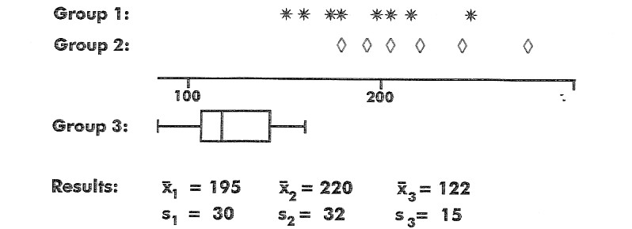

Introductory example
Group 1: 8 diabetic pregnant women, not insulin-dependent
Group 2: 6 diabetic pregnant women, insulin-dependent
Group 3: 130 pregnant women, no diabetes
Glucose tolerance test: i.v. injection of 0.33g glucose/kg body weight
Variable of interest: blood glucose conc. [mg/100ml] 1h after injection
Comparison of groups 1 and 2: t=1.51, 12 d.f., p=0.16

Slide 4
Introductory example (contd.)
Fisher‘s LSD test:
Global F = 172.6, (2;141) d.f., p << .0001
Pairwise comparisons:
t₁₂ = 2.86, 141 d.f., p = .0049
t₁₃ = 12.36, 141 d.f., p << .0001
t₂₃ = 14.48, 141 d.f., p << .0001

Slide 5
The classical two sample t-test for unequal variances – equal sample sizes
α* = actual type I error („size“)
slightly anticonservative
for increasing n₁=n₂: α* → α
Example: σ₁²=1, σ₂²=4, α=.05
n₁=n₂ | 5 | 20 | 100
α* | .0616 | .0546 | .0535

Slide 6
The classical two sample t-test
– unequal sample sizes (n₁ < n₂)
σ₁² < σ₂²: conservative
σ₁² > σ₂²: anticonservative
Example: n₁ = 5, n₂ = 100, α = .05
σ₁²=1, σ₂²=4 ⇒ α* = .0003
σ₁²=4, σ₂²=1 ⇒ α* = .2917
Boneau (1960), Coombs et al. (1996)

Slide 7
Multiple comparisons for k=3 groups
A: Start with global level α F test; after rejection:
A1: 3 classical t tests with (n₁+n₂+n₃–3) d.f.
(completely pooled variance → LSD test)
A2: 3 classical t tests with (n_{i}+n_{j}–2) d.f.
(separately pooled variances)
A3: 3 Welch t tests (Welch, 1938)
A4: Global Welch F test (Welch, 1947); then
3 Welch t tests

Slide 8
Multiple comparisons for k=3 groups (contd.)
B: Start with global Tukey test; after rejection:
B1: t tests with (n₁+n₂+n₃–3) d.f.
B2: t tests with (n_{i}+n_{j}–2) d.f.
B3: Welch t tests
C: Shaffer‘s (1986) procedure with sequential bounds 1–(1–α)^{1/3}; α; α
C1: t tests with (n₁+n₂+n₃–3) d.f.
C2: t tests with (n_{i}+n_{j}–2) d.f.
C3: Welch t tests

Slide 9
Simulation study
n₁, n₂, n₃ ∈ {5, 20, 100}
μ₁ = μ₂ = μ₃ = 0
σ₁², σ₂², σ₃² ∈ {1, 4}
⇒ 108 parameter constellations
normally distributed data
determination of α* for α=.05 and α=.01
(Hommel / Bernhard, 1994)

Slide 10
Results of the simulation study
sample sizes procedure results
_____________________________________________________________________________________________________________________________
equal classical t tests slightly anticonservative
Welch t tests slightly conservative
_____________________________________________________________________________________________________________________________
unequal classical t tests extremely conservative
and anticonservative
combinations very conservative
classical / Welch and anticonservative
only Welch α* ≈ α
_____________________________________________________________________________________________________________________________

Slide 11
Results: an example
n₁=100, n₂=n₃=5, σ₁=1, α=.05
σ₂=σ₃ A A3 A4 B B3 C3
____________________________________________________________________________________________________________
0.5 .0001 .0001 .059 .0001 .0001 .057
0.8 .012 .011 .063 .013 .012 .061
1.0 .048 .032 .060 .045 .031 .054
1.2 .118 .060 .060 .104 .057 .052
1.5 .232 .090 .056 .231 .090 .048
2.0 .385 .106 .059 .367 .104 .044
____________________________________________________________________________________________________________

Slide 12
Comparison of k=3 groups when the global hypothesis is not true
1. Balanced case
Example:
n₁=n₂=n₃=20, μ₁=0, μ₂=μ₃=5, σ₁²=1, σ₂²=σ₃²=4
Rejection rates α* for H₂₃: μ₂=μ₃
A1 (pooled over 3 groups) .089
A2 (separately pooled) .049
A3/A4 (Welch tests) .048
For A1 and σ₁² → 0: α* → .113
2. Unbalanced case: similar arguments as for 2 ggroups (under separate pooling)

Slide 13
Global F tests for k≥4 groups
Unbalanced case, n_{i} ∈ {5,100}, σ_{i}² ∈ {1,4}, H₀ true
Rejection rates of H₀ for α = .05:
k | classical F test | Welch F test
3 4 5 6 10 | 0 - 0.385 0 – 0.433 0 – 0.465 0 – 0.490 0 – 0.534 | 0.054 – 0.063 0.058 – 0.067 0.060 – 0.073 0.064 – 0.086 0.060 – 0.104

Slide 14
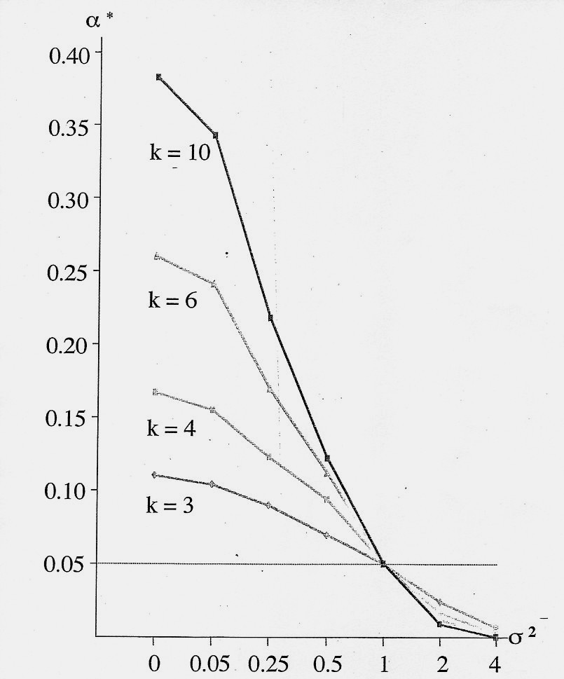
Completely pooled variance for k≥4 groups (balanced case)
Let n₁ = … = n_{k} = n
μ₁ = μ₂ << μ₃, … , μ_{k}
σ₁² = σ₂² = 1,
σ₃² = … = σ_{k}² = σ²
Closure test
α* = rejection rate for H₁₂: μ₁ = μ₂

Slide 15
Discussion I
Strongly different sample sizes:
Classical procedures under- or overestimate type I error rates, even for moderately different variances
Closure test with Welch F tests: can be recommended for k ≤ 4; otherwise too anticonservative
Shaffer procedure with Welch t tests can be recommended (slightly conservative, in general)

Slide 16
Discussion II
Equal or similar sample sizes (but heterogeneous variances):
H₀ true: classical procedures can be applied
H₀ not true: Use pooled variance only for two-sample tests!
Robustness for non-normal data?
Power of procedures?
Extensive survey by Coombs et al. (1996)

Slide 17
Some references
Boneau, C.A. (1960). The effect of violations of assumptions underlying the t test. Psych. Bull. 57, 49-64.
Coombs, W.T., Algina, J., Oltman, D.O. (1996). Univariate and multivariate omnibus hypotheses tests selected to control type I error rates when population variances are not necessarily equal. Rev. Ed. Res. 66, 137-179.
Julious, S.A. (2005). Why do we use pooled analysis of variance? Pharm.Stat. 4, 3-5.
Welch, B.L. (1938). The significance of the difference between two means when the population variances are unequal. Biometrika 29, 350-362.
Welch, B.L. (1947). The generalization of ‚Students‘ problem when several different population variances are involved. Biometrika 34, 23-35.
Westfall P.H. (1999). Multiple comparisons and multiple tests: using the SAS system, Chapter 10.2. SAS Publishing, Cary, NC.

