Slide 1
Euro Area Bond Yield Spillovers
A Diebold-Yilmaz Analysis of Cross-Market Transmission
January 2025

Slide 2
Executive Summary
• METHODOLOGY: Generalized FEVD spillovers (order-invariant) using VAR(4) on daily yield changes
• SAMPLE: 7 countries (US, JP, UK, DE, FR, IT, ES), 1995-2025, 200-day rolling windows
• KEY FINDING: Within-EA spillovers (~14%) consistently exceed external spillovers (~8%)
• SURPRISE #1: France has overtaken Germany as the dominant EA transmitter since 2015
• SURPRISE #2: Spain is the most vulnerable market - largest net receiver in the system
• SURPRISE #3: Japan became MORE isolated after normalizing yields (YCC exit paradox)
• CURRENT STATE: Spillover intensity at 30-year highs during the tightening cycle

Slide 3
Methodology

Slide 4
Diebold-Yilmaz Spillover Framework
THE MODEL
• VAR(4) estimated on daily yield changes
• 200-day rolling windows (~10 months)
• 10-day forecast horizon for FEVD
WHY GENERALIZED FEVD?
• Order-invariant (no arbitrary ordering)
• Based on Pesaran & Shin (1998)
• Uses historical error correlations
• Rows normalized to sum to 100%
SPILLOVER MEASURES
• Total spillover: % variance from others
• Directional TO: how much i affects others
• Directional FROM: how much i is affected
• Net: TO minus FROM (+ = transmitter)
• Bilateral: i to j pairwise flows
INTERPRETATION
• High spillover = tight market integration
• Net transmitter = 'price setter'
• Net receiver = 'price taker'

Slide 5
Key Results

Slide 6
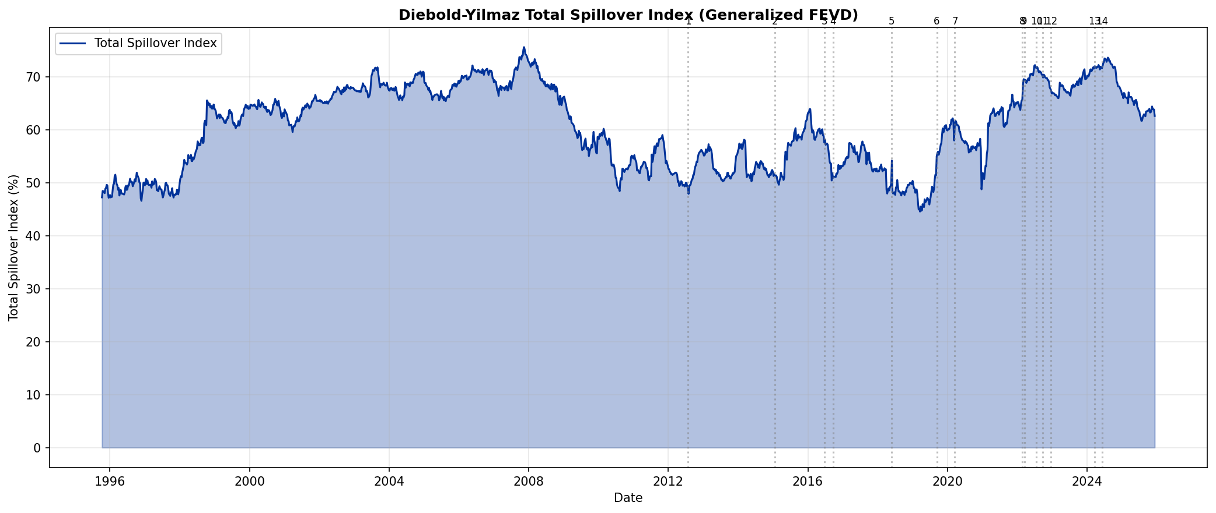
Total Spillover Index: 30 Years of Market Integration
Note: Total spillover = % of yield variance explained by shocks from other countries. Higher = more integrated.

Slide 7
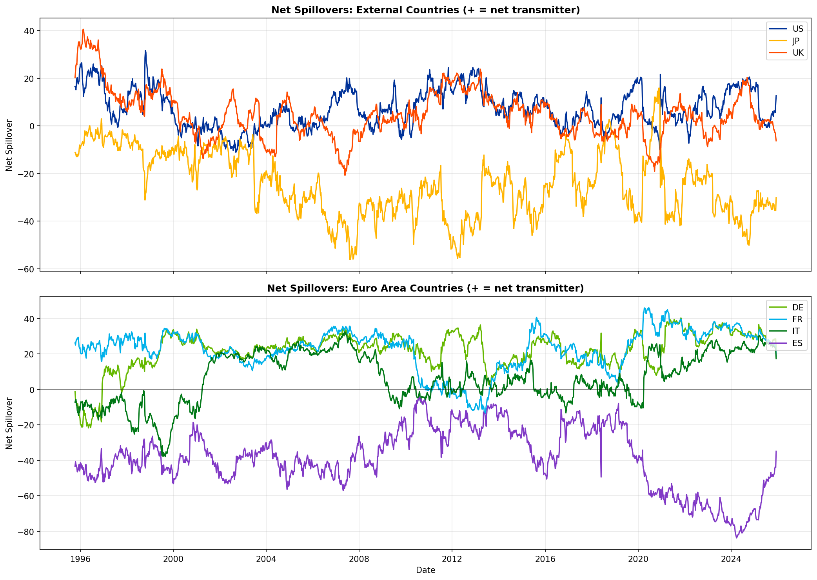
Who Transmits, Who Receives?
Positive = net transmitter (price setter), Negative = net receiver (price taker). France and Germany dominate transmission.

Slide 8
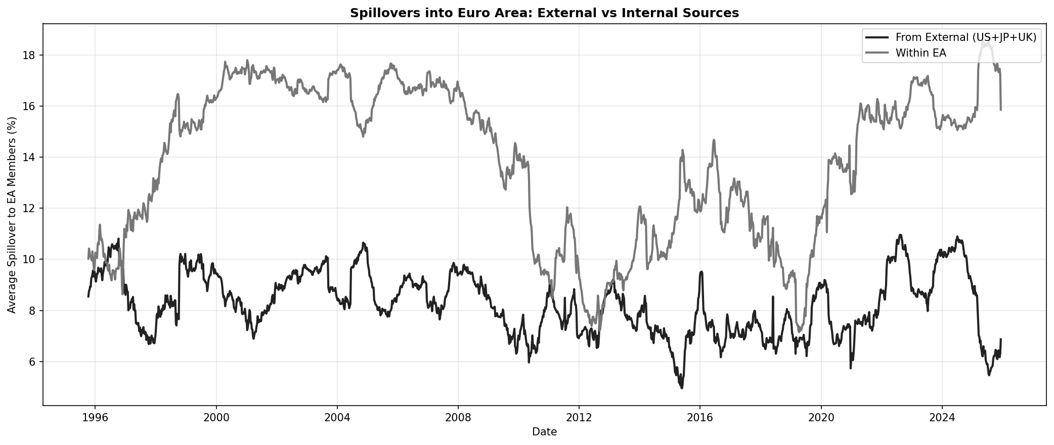
External vs Internal: Where Do EA Shocks Come From?
Within-EA spillovers consistently exceed external (US+JP+UK) spillovers by 40-90%.

Slide 9
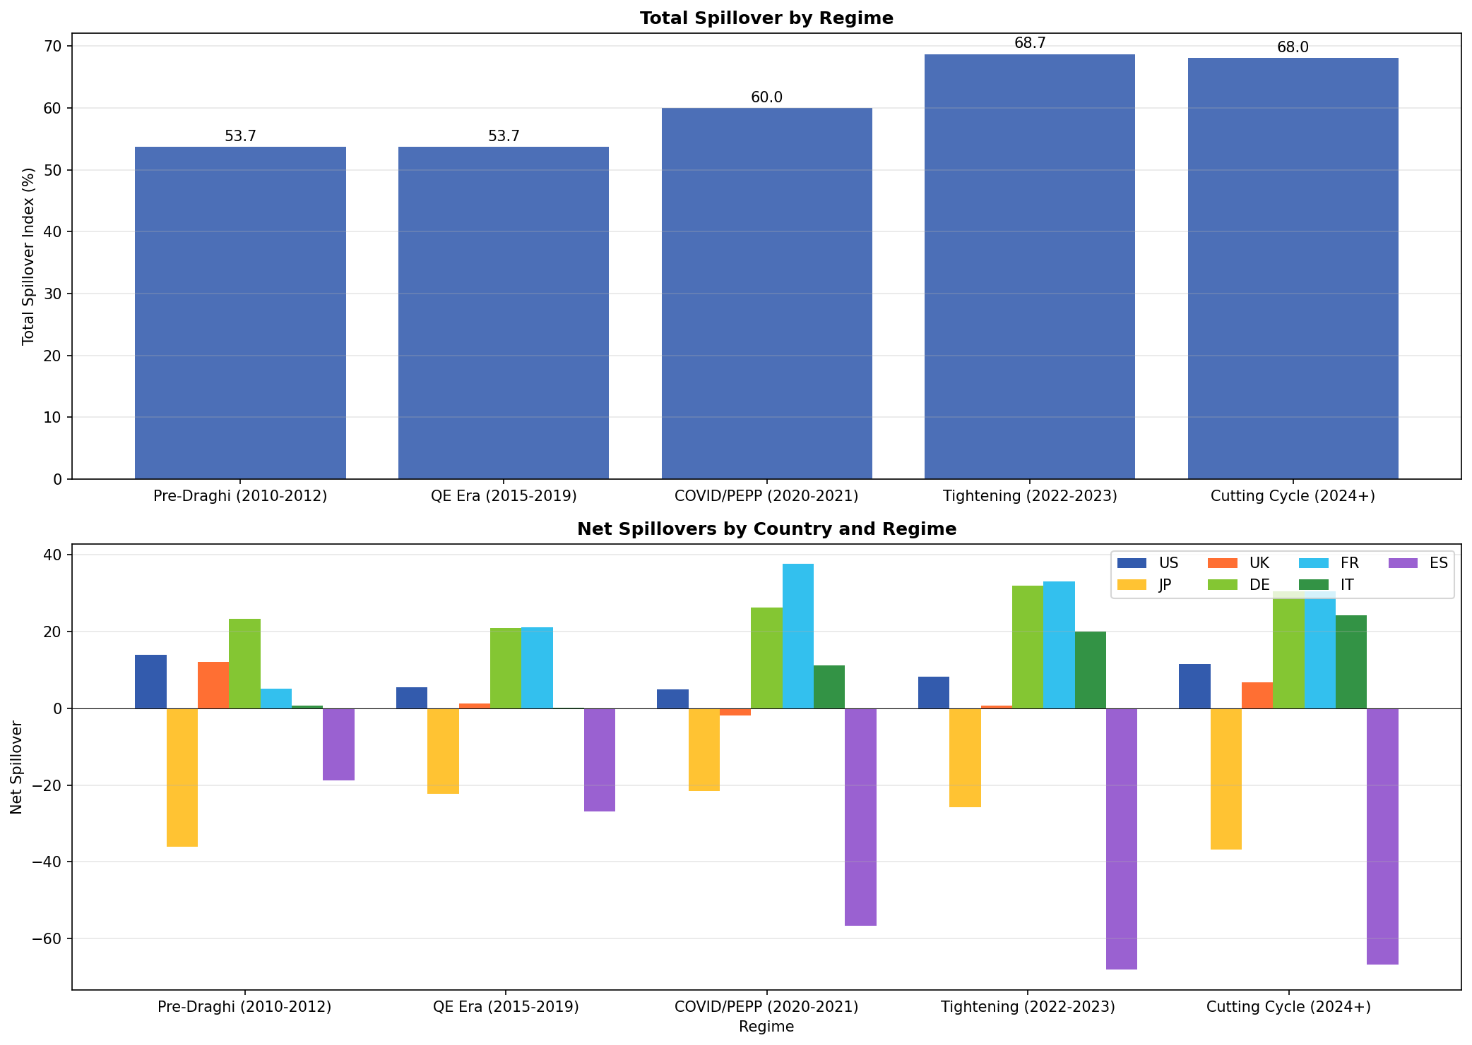
Finding #1: France as the 'Hidden Anchor'
• France has overtaken Germany as the largest net transmitter since 2015
• Average FR_net = +22.6 vs DE_net = +21.5 over full sample
• During COVID/PEPP: FR_net = +37.6 vs DE_net = +26.2
• France transmits ~17-22% to each EA country, receives ~13-15%
• Interpretation: OAT market is the 'swing' market bridging core and periphery
• The 2024 political turmoil tested this anchor role...

Slide 10
Case Study: French Political Turmoil 2024

Slide 11
French Political Crisis: Timeline & Impact
KEY EVENTS
• June 9, 2024: Macron calls snap elections
• June 30: First round - RN leads
• July 7: Second round - Left bloc wins
• Sept 5: Barnier appointed PM
• Dec 4: Barnier government falls (no confidence)
FR-DE SPREAD EVOLUTION
• Pre-crisis (Jan-Jun 9): 49.5 bp
• Election period: 70.3 bp (+42%)
• Post-election: 72.5 bp
• Barnier fall: 77.7 bp
• Peak: 87 bp (Dec 2, 2024)
SPILLOVER DYNAMICS
• France REMAINED a net transmitter
• Pre-crisis FR_net: +35.9
• During elections: +32.2
• Post-election: +28.7
CONTAGION TO PERIPHERY?
• FR→IT spillover: 21.9% → 22.1% (stable)
• FR→ES spillover: 19.4% → 18.5% (stable)
KEY INSIGHT:
Despite 87bp spread blow-out, France did
NOT become a shock receiver. ECB credibility
(TPI backstop) contained contagion.

Slide 12
Case Study: Japanese Yield Steepening

Slide 13
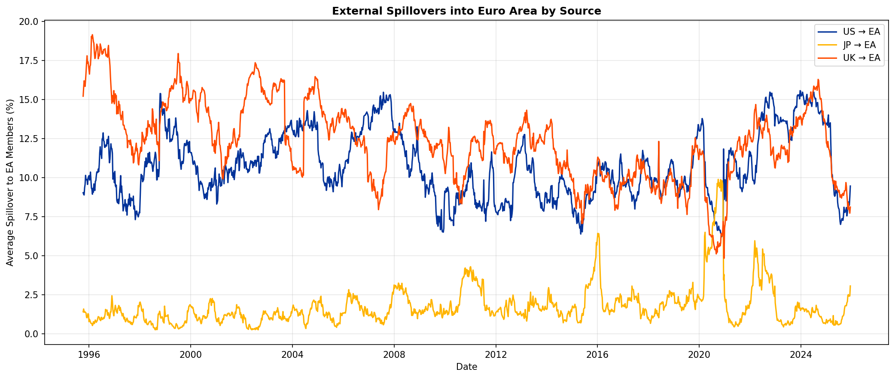
Japan: The Yield Curve Normalization Paradox
• YCC tight (2020-2022): JP 10Y averaged 0.10%, max 0.45%
• YCC widened (Dec 2022-Mar 2024): JP 10Y averaged 0.57%, max 0.97%
• Post-NIRP exit (Mar 2024+): JP 10Y averaged 1.25%, max 1.98%
• PARADOX: Higher JP yields = LESS spillover to EA, not more
• JP→EA spillover fell from 3.7% (YCC) to 1.2% (post-NIRP)
• Japan became MORE isolated as yields normalized
• Interpretation: YCC forced JP yields to track global moves; freed, they decoupled

Slide 14
Japan: From Follower to Island
YIELD TRANSFORMATION
• YCC tight (2020-22): 0.10% average
• Dec 2022: BoJ widens YCC band
• Mar 2024: BoJ ends NIRP + YCC
• Current: ~1.0-1.2%, 30Y at ~2.4%
This is the first real Japanese
yield steepening in 30 years.
Global investors are watching:
Will JP re-engage with global rates?
SPILLOVER PARADOX
JP→EA spillover:
• YCC tight: 3.68%
• YCC widened: 1.14%
• Post-NIRP: 1.17%
JP net position:
• YCC tight: -21.3 (moderate receiver)
• Post-NIRP: -36.9 (very isolated)
Japanese bonds now move independently
of global factors - a structural shift.

Slide 15
Core-Periphery Dynamics

Slide 16
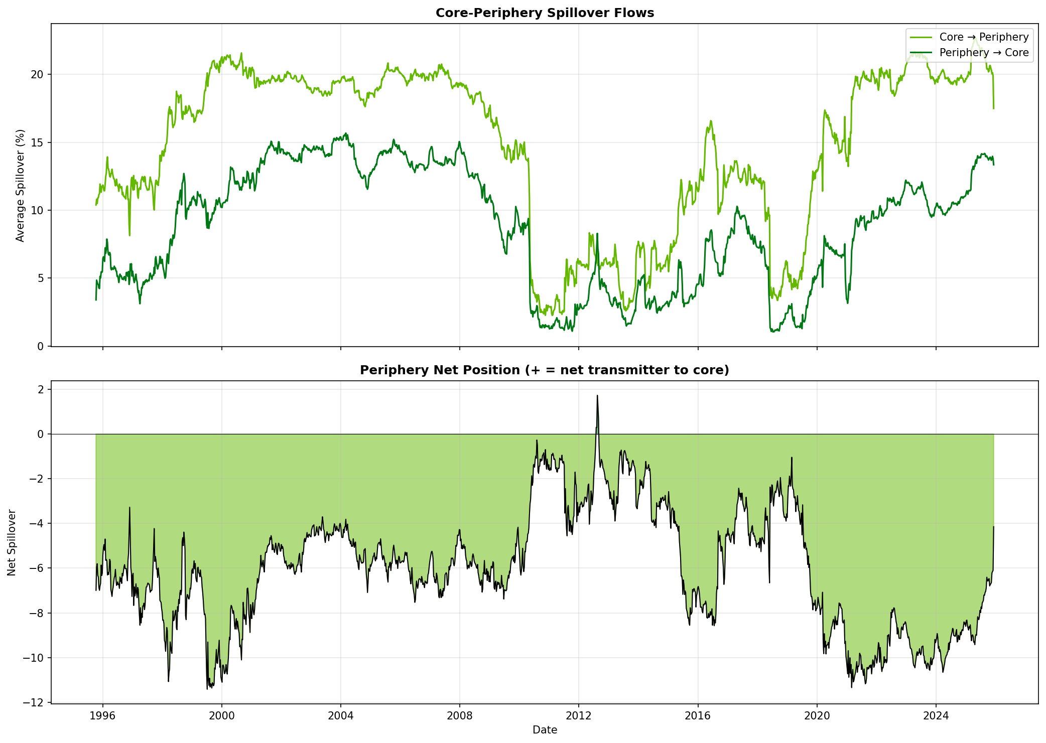
Core-Periphery: The Persistent Asymmetry
Periphery (IT+ES) is ALWAYS a net receiver from Core (DE+FR). Gap narrowed only during 2010-12 when all links weakened.

Slide 17
Spain: The Most Vulnerable Market
• Spain is the largest net receiver in the 7-country system (ES_net = -39.0)
• During tightening cycle (2022-25): ES receives 83.5% of variance from others
• Spain receives more spillovers than Italy (ES_from = 67.3% vs IT_from = 60.6%)
• ES-DE spread dynamics are more reactive than IT-DE
• Implication: Spanish yields are 'price takers' in the EA system
• But this doesn't mean Spain is fragile - just highly integrated with EA dynamics

Slide 18
Risk Regimes & Global Factors

Slide 19
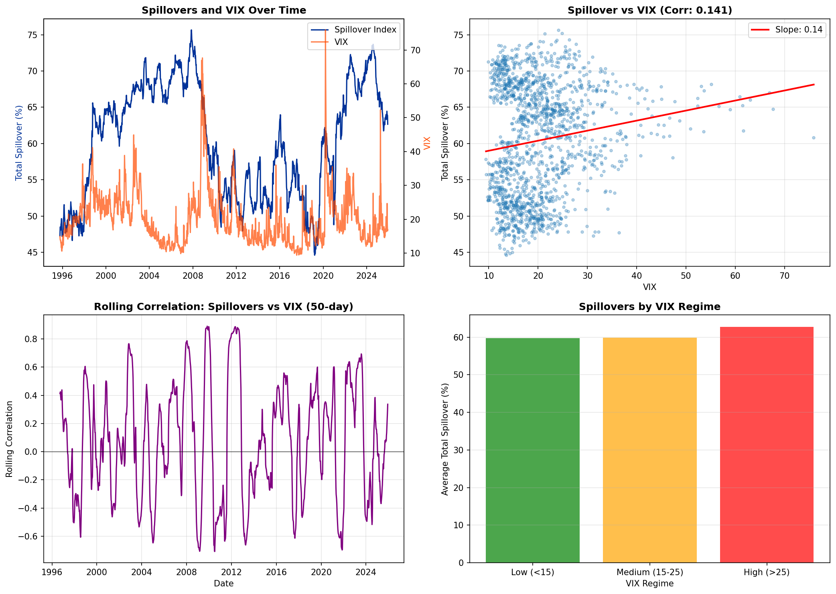
Spillovers and Risk: The VIX Connection
Weak overall correlation (r=0.14), but HIGH VIX regimes (>25) have 3% higher spillovers. Relationship is regime-dependent.

Slide 20
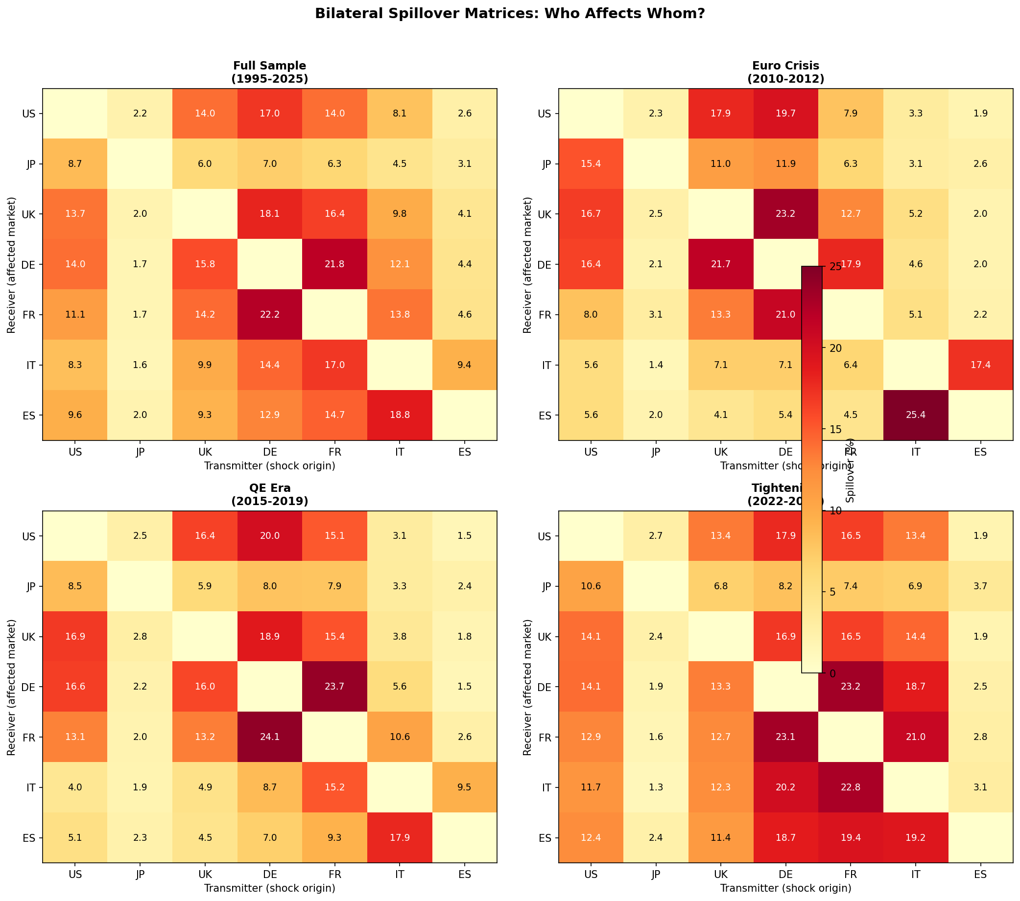
Who Affects Whom: Bilateral Spillover Matrices
Rows = receivers, Columns = transmitters. Note IT-ES contagion during Euro Crisis, uniformity during Tightening.

Slide 21
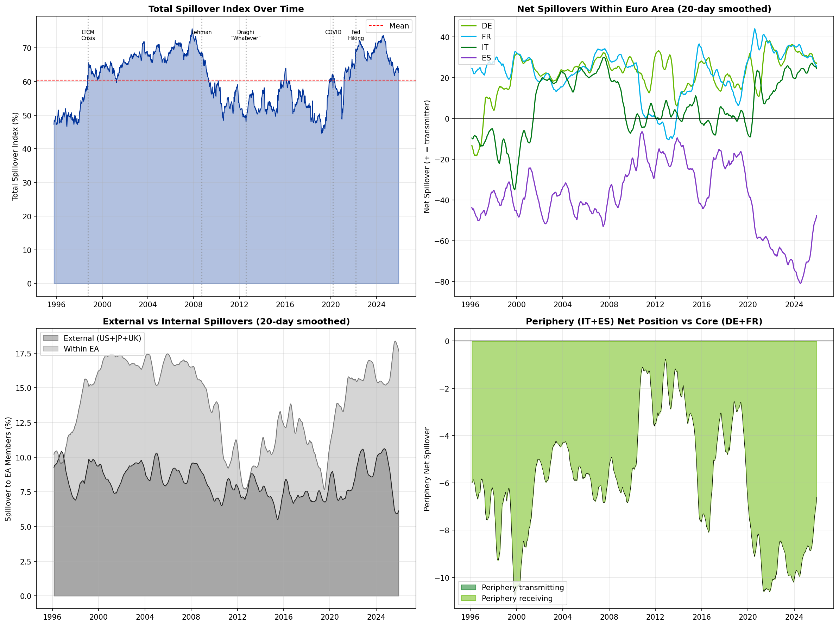
Summary Dashboard
Four-panel view: Total spillover, Net transmitters, External vs Internal, Core-Periphery dynamics.

Slide 22
Implications & Conclusions

Slide 23
Key Takeaways
FOR INVESTORS
• EA yields driven more by internal than external
• Watch France - it's the swing market
• Spain is most sensitive to EA-wide shocks
• Japan is now largely disconnected
• US influence peaks during Fed pivots
FOR POLICYMAKERS
• ECB credibility (TPI) contained French contagion
• Periphery remains structurally vulnerable
• Integration paradoxically FALLS during crises
REGIME PATTERNS
• Pre-2010: 65-70% spillover, high integration
• 2010-12: 50-55%, fragmentation
• 2015-19: 53-57%, QE suppression
• 2020-21: 60%, COVID spike
• 2022+: 68-70%, highest on record
STRUCTURAL FINDINGS
• France > Germany as transmitter (since 2015)
• Core→Periphery > Periphery→Core (always)
• External ~55% of internal spillovers

Slide 24
Questions for Further Research
• Will France remain the anchor despite political fragmentation?
• How will Japanese normalization affect global bond correlations over time?
• Does TPI fundamentally change spillover dynamics during future stress?
• What happens to spillovers when ECB cuts more aggressively?
• Is Spain's vulnerability structural or cyclical?
• Should we expand to 30-year yields, credit spreads, and more EA countries?

Slide 25
Thank You
Data and analysis available in the repository
Methodology: Diebold-Yilmaz (2012) Generalized FEVD

