Slide 1
Euro Area Bond Yield Spillovers
From Convergence to Fragmentation and Back:
Lessons from 30 Years of Market Integration
January 2025

Slide 2
The Story in Numbers
• 1995: IT-DE spread = 446bp, ES-DE = 384bp (pre-EMU divergence)
• 1999: IT-DE spread = 17bp, ES-DE = 13bp (EMU convergence complete)
• 2011: IT-DE spread = 553bp, ES-DE = 626bp (crisis fragmentation)
• 2012: Draghi "whatever it takes" → spreads compressed to 150bp
• 2024: FR-DE spread hits 87bp (French political crisis)
• Today: Spillover intensity at 30-year highs (68-70%)

Slide 3
I
The Historical Arc

Slide 4
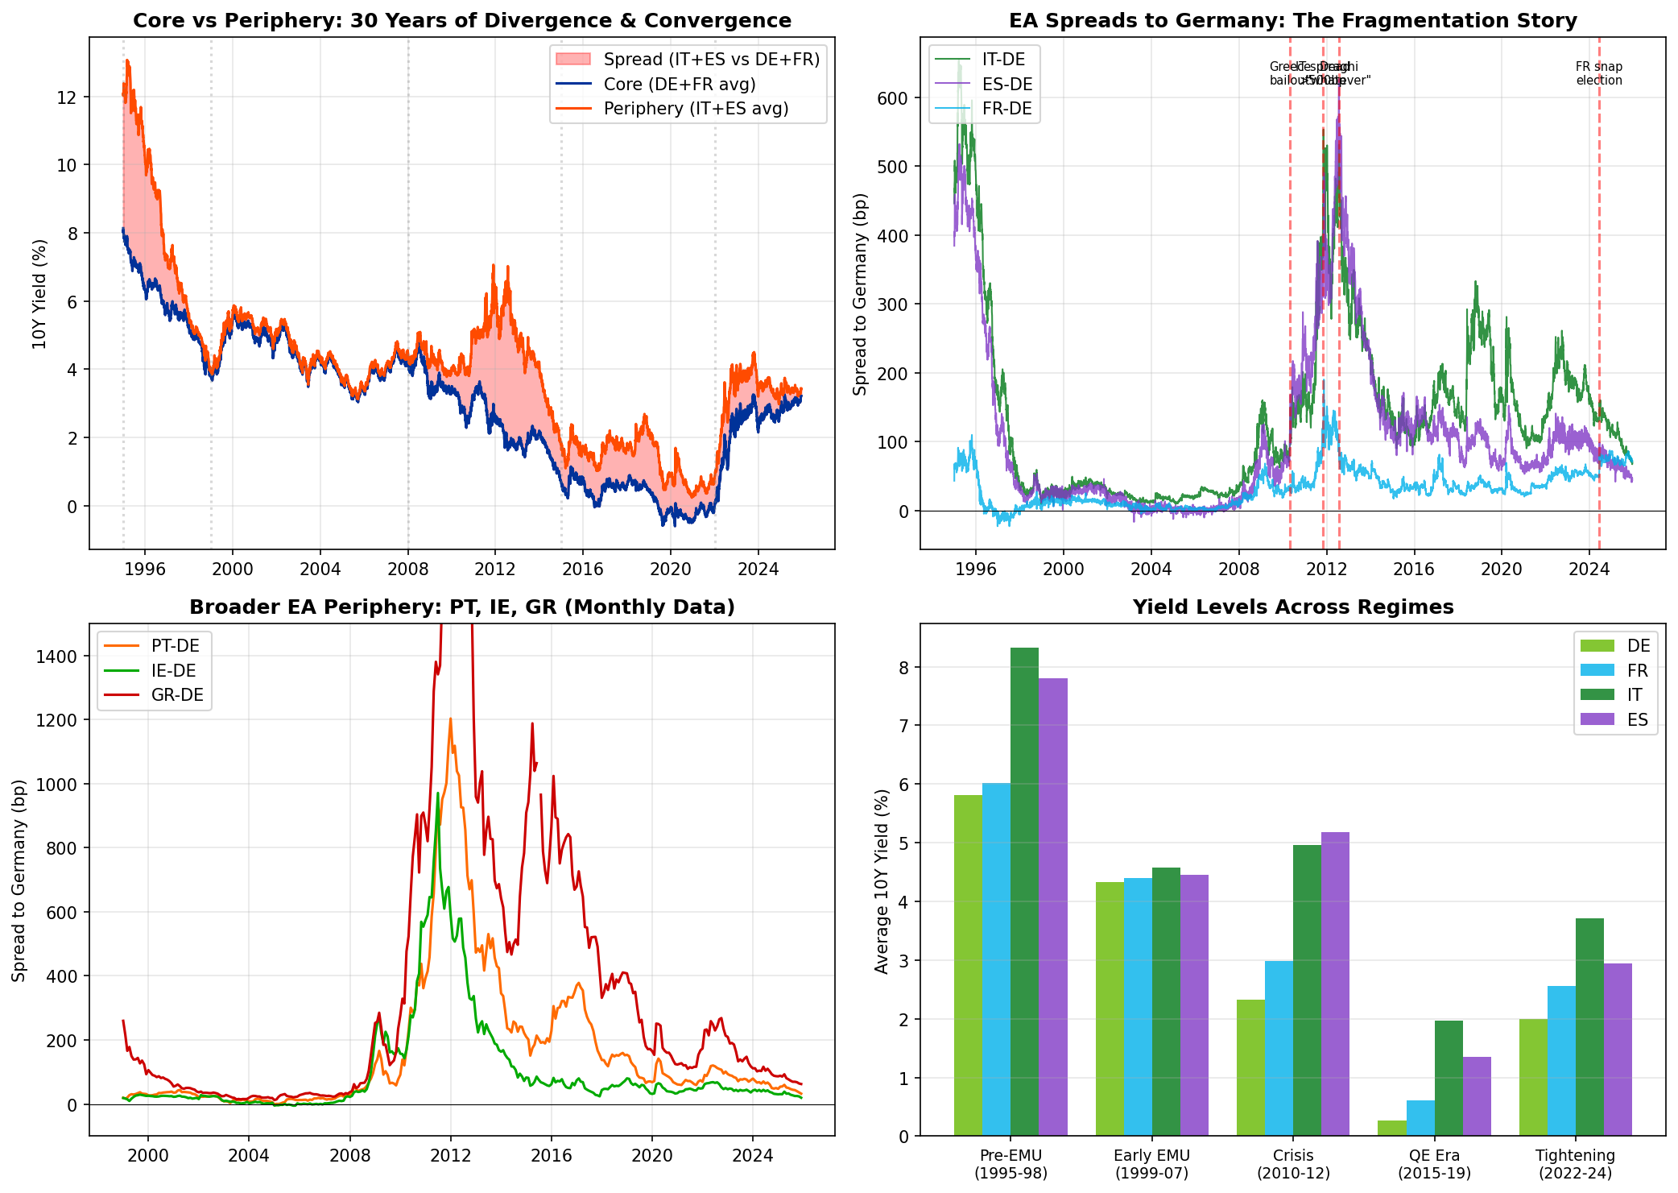
30 Years of Convergence and Fragmentation
Pre-EMU convergence (1995-98) → EMU harmony (1999-07) → Crisis fragmentation (2010-12) → QE compression → Current tightening

Slide 5
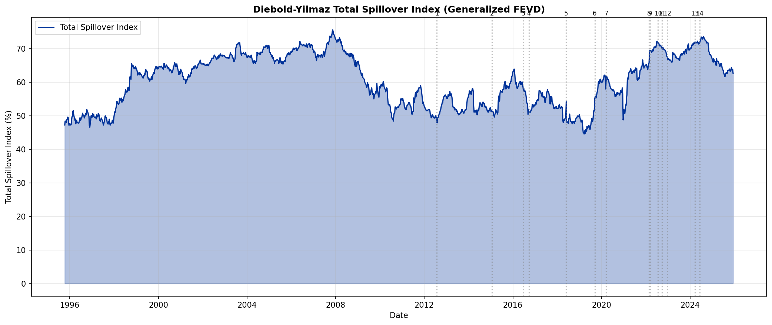
Market Integration: The Spillover Index
Higher spillover = tighter integration. Note: Integration FALLS during crises (2010-12) and RISES during tightening (2022+)

Slide 6
II
Five Key Findings

Slide 7
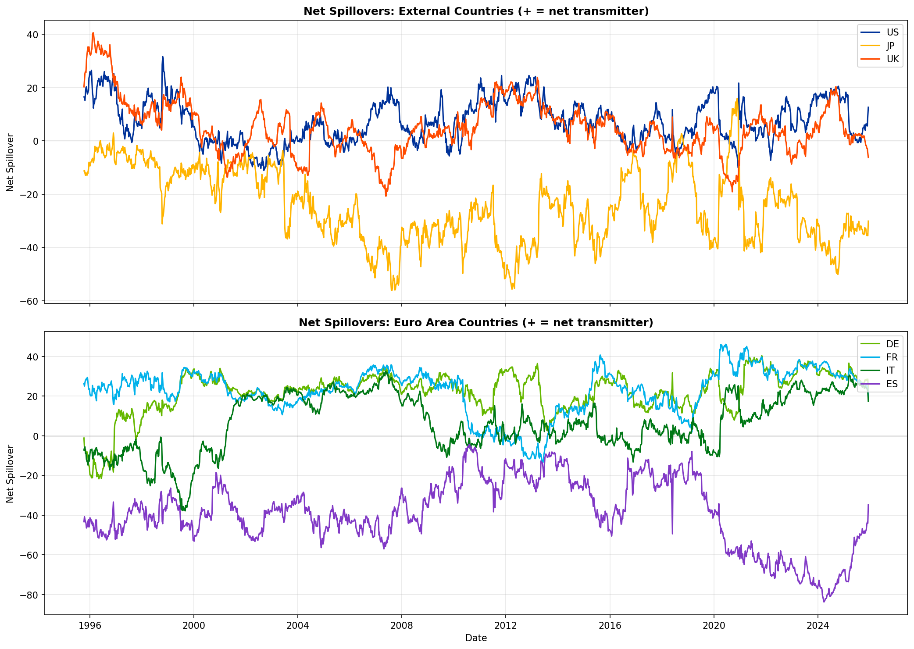
#1
France is the Hidden Anchor
• France has overtaken Germany as the largest net transmitter since 2015
• FR_net = +22.6 vs DE_net = +21.5 (full sample average)
• The OAT market is the 'swing' market bridging core and periphery
• Despite 2024 political turmoil, France REMAINED a net transmitter
• FR-DE spread hit 87bp but contagion to periphery was contained
• Implication: ECB credibility (TPI) provides effective backstop

Slide 8
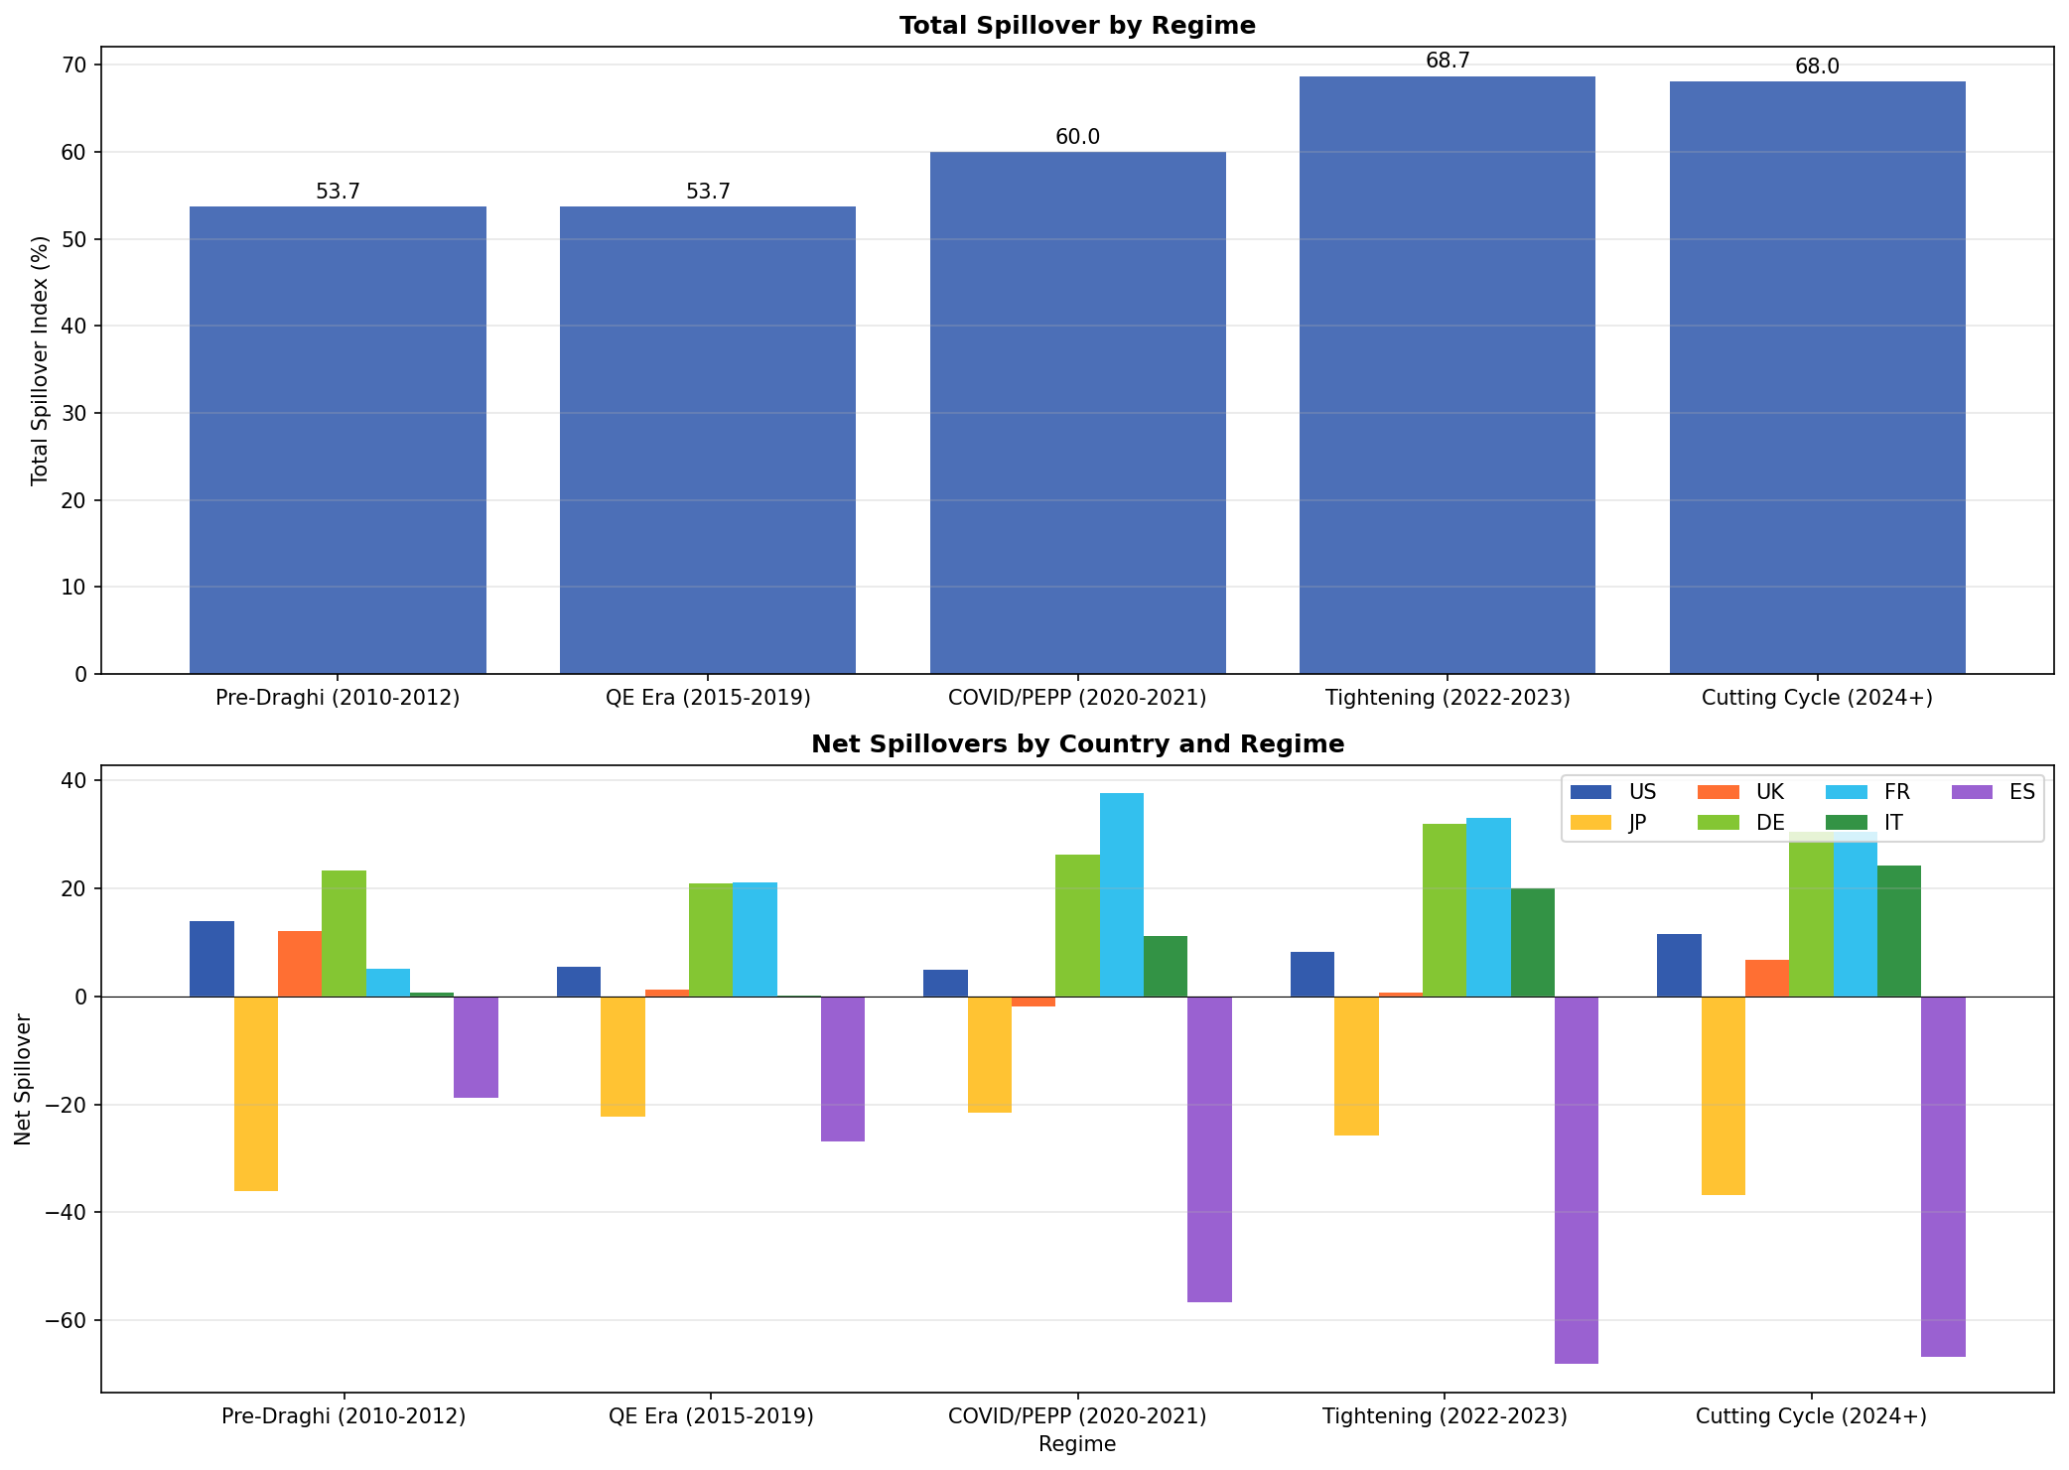
#2
Spain is the Most Vulnerable Market
• Spain is the largest net receiver in the 7-country system
• ES_net = -39.0 (receives far more spillovers than it transmits)
• During tightening (2022+): Spain receives 83.5% of variance from others
• More vulnerable than Italy (ES_from = 67% vs IT_from = 61%)
• Spanish yields are 'price takers' - driven by EA-wide shocks
• Policy implication: Spanish fiscal credibility matters less for EA dynamics

Slide 9
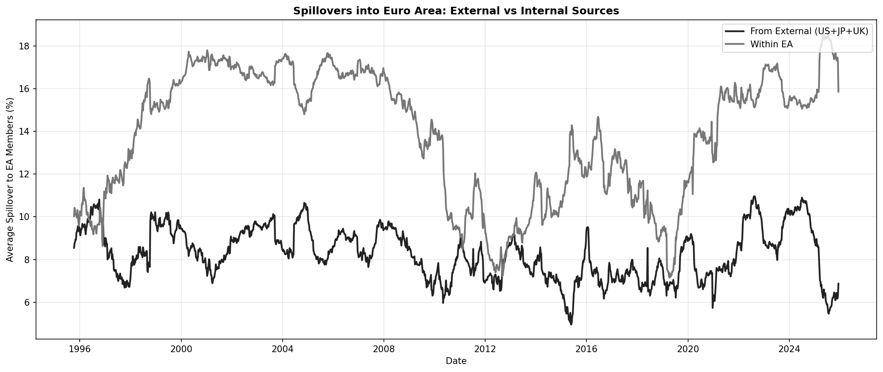
#3
EA Dynamics are Mostly Internal
• Within-EA spillovers (~14%) consistently exceed external (~8%)
• Ratio: Internal ≈ 1.7x External on average
• US influence peaks during Fed pivots (15% during 2022-23 hiking)
• But even at peak, US < intra-EA transmission
• UK influence declined post-Brexit (-12%)
• Implication: ECB policy is the primary driver of EA yield dynamics

Slide 10
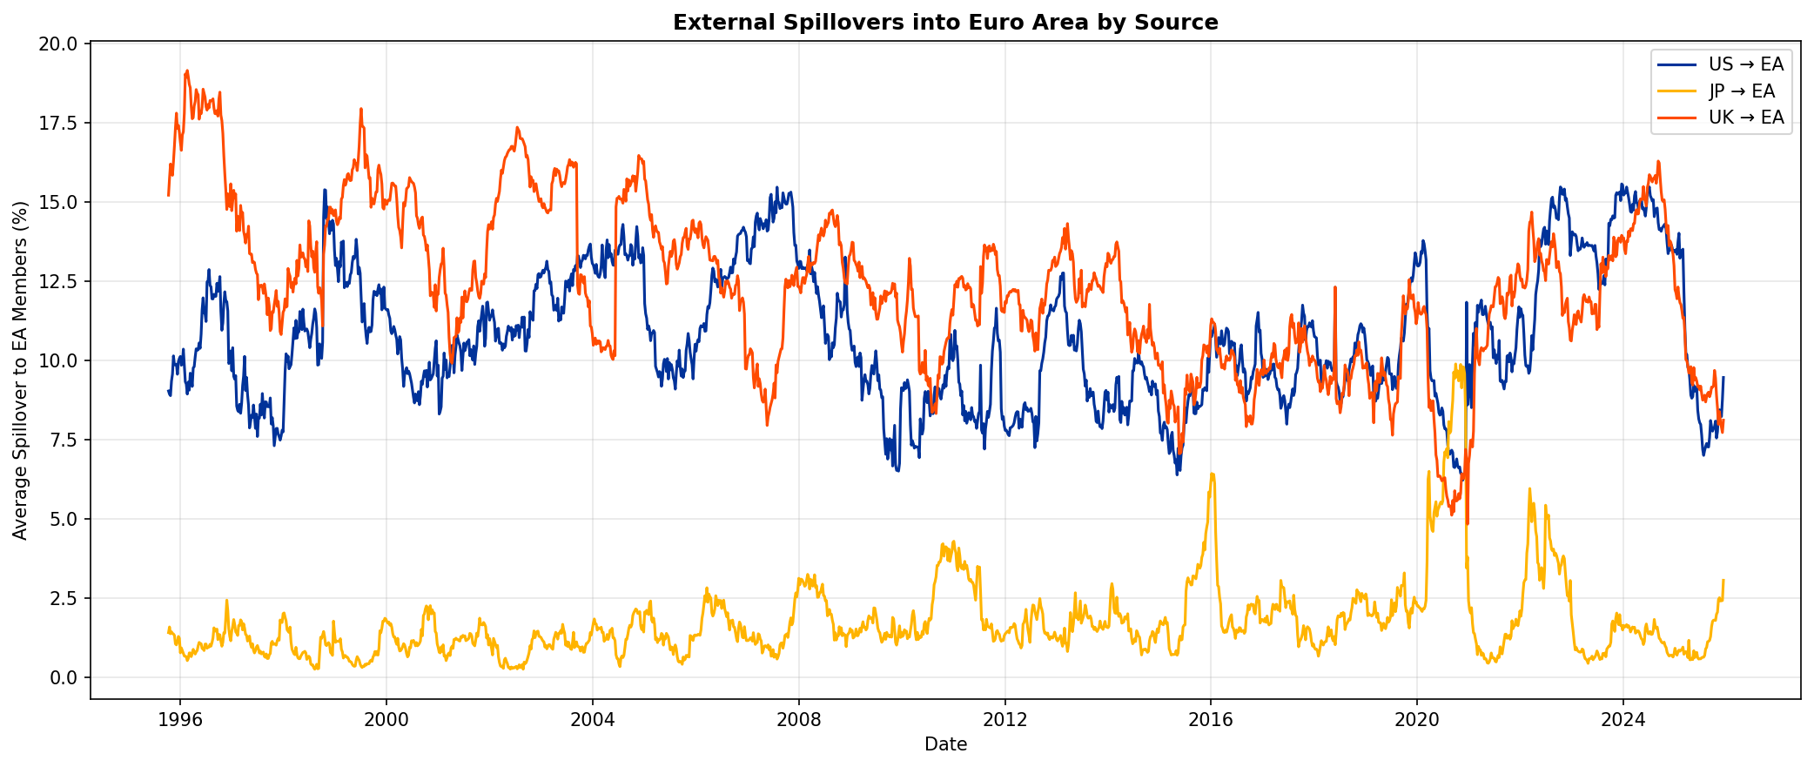
#4
Japan: The Decoupling Paradox
• Japanese yields: 0.10% (YCC) → 1.25% (post-NIRP exit)
• First real yield steepening in 30 years
• PARADOX: Higher yields = LESS spillover to EA
• JP→EA fell from 3.7% (YCC era) to 1.2% (post-NIRP)
• Interpretation: YCC forced JP to track global rates
• Freed from YCC, Japanese bonds now move independently

Slide 11
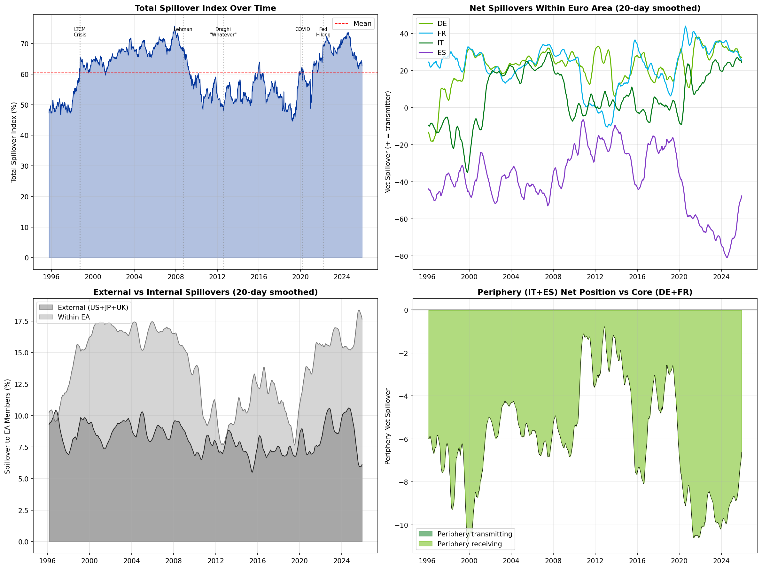
#5
The Integration Paradox
• Spillovers are LOWEST during crises: 50-54% (2010-12)
• Spillovers are HIGHEST during tightening: 68-70% (2022+)
• Markets fragment when stress is idiosyncratic (sovereign risk)
• Markets integrate when facing common shocks (global rates)
• Current high spillovers reflect synchronized tightening
• Implication: Crisis management requires different tools than normal times

Slide 12
III
Current Risk Assessment

Slide 13
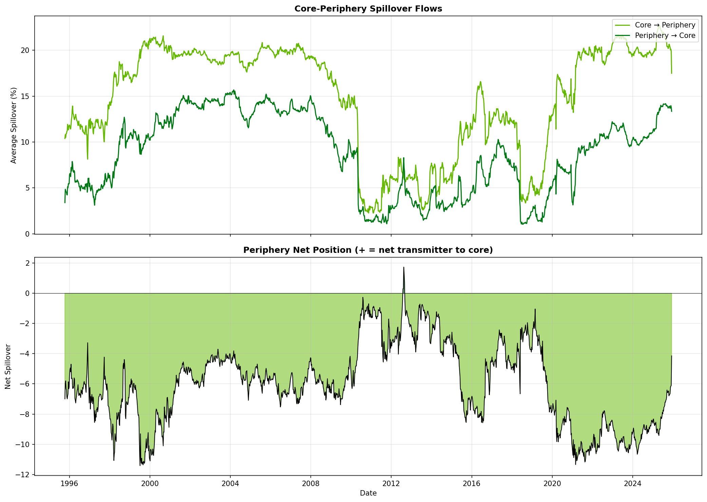
French Political Risk: Contained but Elevated
• FR-DE spread widened from 50bp to 87bp during 2024 turmoil
• Peak spread on Dec 2, 2024 after Barnier government fell
• France remained a net transmitter throughout (FR_net: +36 → +29)
• Contagion to periphery was LIMITED:
• - FR→IT spillover: stable at 21-22%
• - FR→ES spillover: stable at 18-19%
• Key insight: ECB/TPI credibility contained widening
• But: Elevated spreads suggest fragility remains

Slide 14
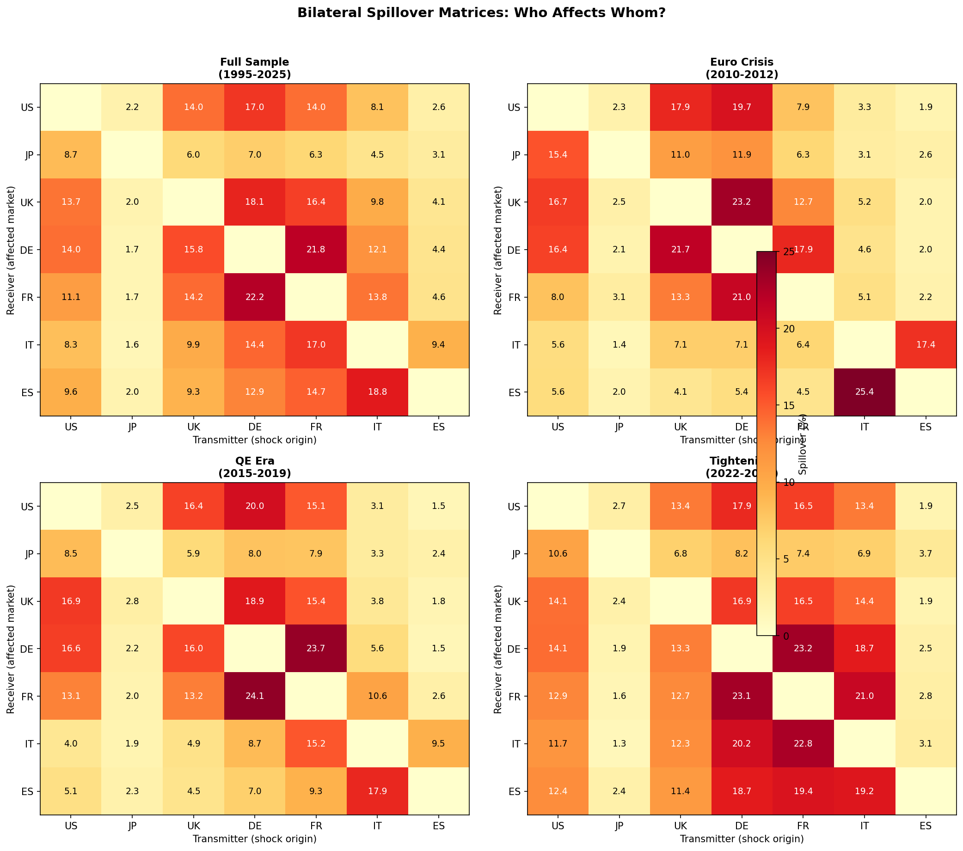
Who Affects Whom: The Bilateral Picture
Note regime shifts: IT-ES contagion in Euro Crisis (25%), uniform flows in Tightening (15-23%)

Slide 15
IV
Policy Implications

Slide 16
Implications for Policymakers
• MONETARY POLICY
• - EA yields driven more by internal than external factors
• - ECB is the primary driver of EA-wide yield dynamics
• - TPI appears effective in containing contagion (French test case)
•
• FISCAL COORDINATION
• - Periphery remains structurally vulnerable (price takers)
• - Spain most sensitive to EA-wide shocks
• - French fiscal credibility now a systemic concern
•
• CRISIS PREPAREDNESS
• - Integration falls during idiosyncratic crises
• - Current high spillovers = vulnerability to common shocks
• - Japan decoupling reduces one external risk channel

Slide 17
Open Questions for 2025 and Beyond
• Will France remain the anchor despite political fragmentation?
• How will ECB rate cuts affect the spillover structure?
• Is Spain's vulnerability structural or cyclical?
• Will Japanese normalization eventually re-engage global correlations?
• What happens when the next idiosyncratic shock hits?
• Is TPI enough, or does the EA need deeper fiscal integration?

Slide 18
Thank You
Methodology: Diebold-Yilmaz Generalized FEVD (order-invariant)
Data: Daily 10Y yields, 1995-2025
Countries: US, JP, UK, DE, FR, IT, ES

