Slide 1
Capstone Project 2: Chest X-Ray Image Classification Using Deep Learning
Jonathon Poage
Springboard Data Science Career Track
06/09/2019

Slide 2
Outline
Introduction
Data
Raw Data
Processed Data
Analysis
General Image Properties
Model Building
Model Evaluation
Binary Classification
Conclusion

Slide 3
Introduction

Slide 4
Background
Pneumonia is the leading infectious cause of death for children worldwide.¹
Fatalities are most common in developing areas of the world.
Low cost treatments are available. Fatalities could potentially be reduced if patients are efficiently diagnosed and referred for treatment.
The issue is that fast and accurate diagnosis of pneumonia can be challenging in facilities that have limited resources.

Slide 5
Pneumonia Diagnosis
Two leading causes of pneumonia:
Bacteria
Viruses
Accurate diagnosis is essential to refer patients for proper treatment. Bacterial pneumonia requires more intensive treatment than viral pneumonia.
Diagnosis commonly involves inspecting chest radiograph (X-ray) images for signs of inflammation in the lungs.²
Interpretation of chest X-ray images requires time and expertise, which may not be abundant in facilities with limited resources.

Slide 6
Goals of Analysis
The overall goal is to facilitate diagnosis of pediatric pneumonia.
The immediate goal is to provide a fast, automated, and accurate method for interpreting chest X-ray images.
These goals will be accomplished by developing a classification model that predicts the presence or absence of pneumonia in patients, based on chest X-ray images. The model will distinguish between bacterial and viral pneumonia.

Slide 7
Benefits of Results
Clinicians could save time by automatically interpreting chest X-ray images when diagnosing patients.
Facilities with limited resources could gain the means to quickly and accurately diagnose bacterial and viral pneumonia, which would facilitate rapid referral for treatment.
Clinical outcomes could potentially improve worldwide for pediatric patients with pneumonia.

Slide 8
Data

Slide 9
Raw Data Set
The raw data was downloaded from the following website: https://data.mendeley.com/datasets/rscbjbr9sj/3.³
The raw data was prepared and labeled by Kermany et al.⁴
The raw data set contains thousands of anterior-posterior chest radiograph images of pediatric patients aged 1-5 from Guangzhou Women and Children’s Medical Center.
The image filenames contain the following information:
Image class (Bacterial Pneumonia, Viral Pneumonia, or Normal)
Patient ID
Image number by patient

Slide 10
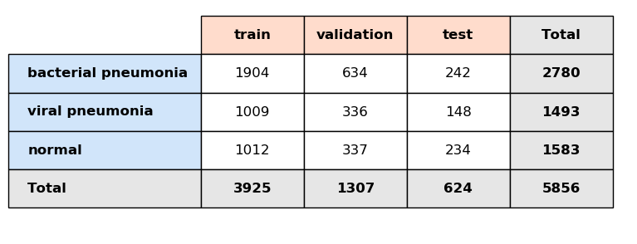
Processed Data
The image files were sorted into train, validation, and test sets.
Feature and target arrays were prepared for each data set.
The feature and target arrays were used as input for the deep learning models during the analysis.
File Counts for the Image Classes and Data Sets

Slide 11
Feature and Target Arrays
Feature Arrays
Target Arrays
Each feature array contained the pixel intensity values for all images in the designated data set.
Dimensions: N x 224 x 224 x 3
N - Number of files in the data set
Pixel dimensions 224 x 224
3 color space dimensions (RGB mode)
Each target array contained the one-hot encoded class labels for all images in the designated data set.
Dimensions: N x 3
N - Number of files in the data set
3 classes

Slide 12
Analysis Part 1
General Image Properties

Slide 13
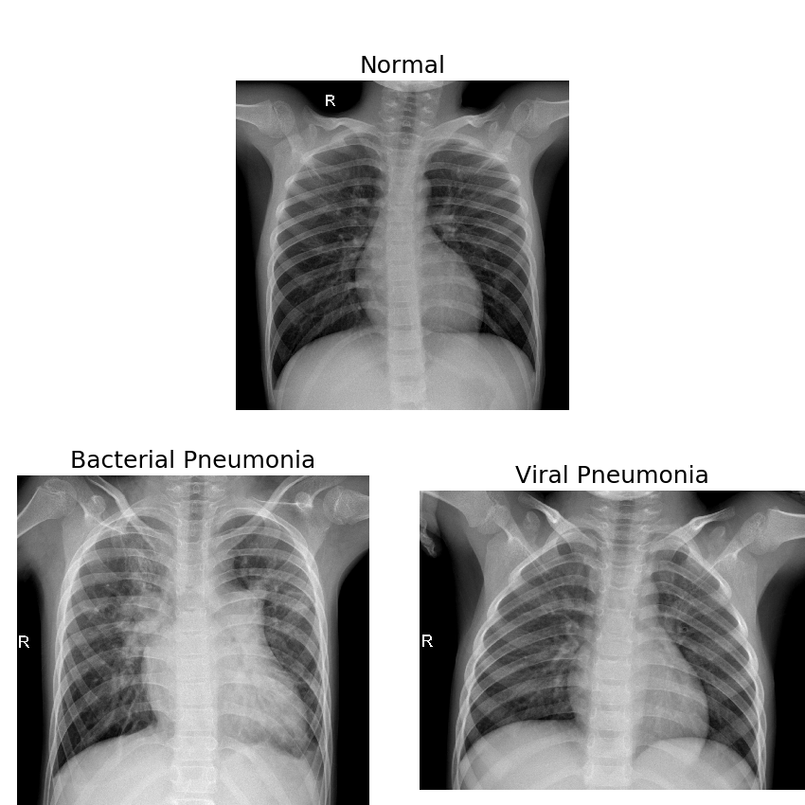
Sample Images
The normal image depicts clear lungs.
Bacterial pneumonia chest X-rays typically have concentrated opaque areas.
Viral pneumonia chest X-rays typically display more diffuse patterns of opacity.

Slide 14
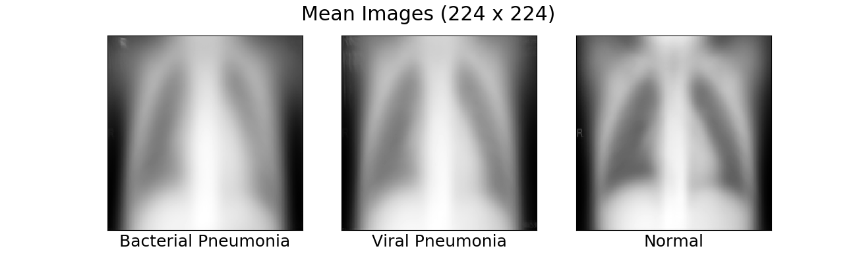
Mean Images
Average pixel intensities for each image class.
The areas in the rib cage are darker in the normal mean image than the corresponding areas in each of the pneumonia mean images.

Slide 15
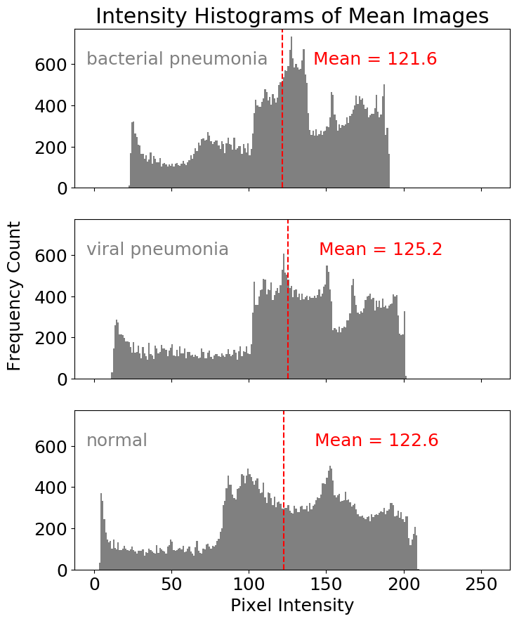
Mean Image Intensity Histograms
Pixel intensity values range from 0 (black) to 255 (white).
The distributions show peaks at different locations. Overall, the predominant pixel intensities vary by image class.
The viral and bacterial mean images have larger proportions of grey and light grey pixels compared to the normal mean image.

Slide 16
Analysis Part 2
Model Building

Slide 17
Models
Three multi-class classification models were developed using deep learning.
Model Input
Array of image pixel values (N x 224 x 224 x 3)
Model Output
Class probability distributions (N x 3)
Class predictions (N)
N - Number of files in the data set

Slide 18
Model Architectures
Each model had a convolutional base followed by a Neural Network (NN) classifier.
Model 1 used a custom built Convolutional Neural Network (CNN) as its base.
Models 2 and 3 utilized transfer learning by adapting VGG16’s base with weights pre-trained on ImageNet.^{5,6}
Model 2 applied VGG16’s base with fixed weights as a feature extractor.
Model 3 fine-tuned the upper convolutional layers of VGG16’s base.
Model | Convolutional Base | Classifier
Model 1 | CNN | NN Classifier
Model 2 | VGG16 with Fixed Weights | NN Classifier
Model 3 | VGG16 with Fine-Tuning | NN Classifier

Slide 19
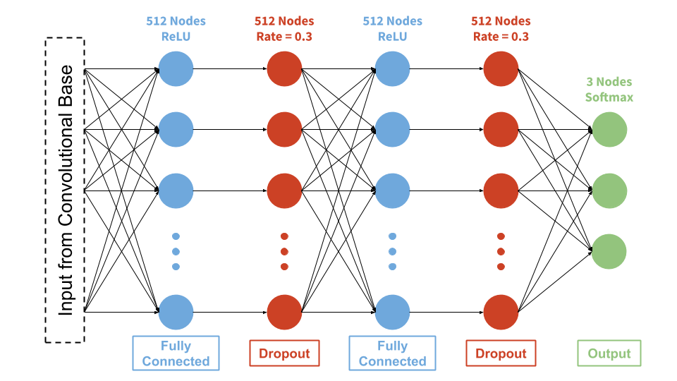
Classifier
Classifier Architecture
The same NN classifier was used for all three models.

Slide 20
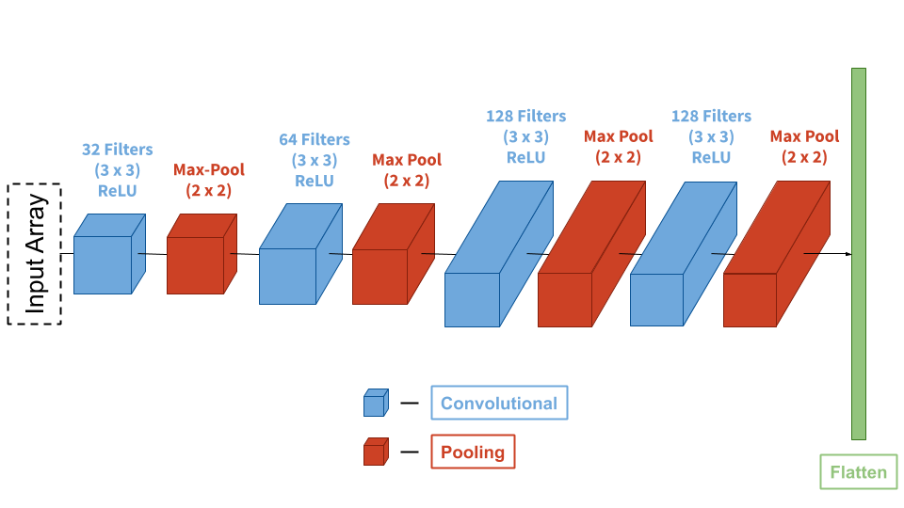
Base 1: Convolutional Neural Network
Convolutional Base 1 Architecture

Slide 21
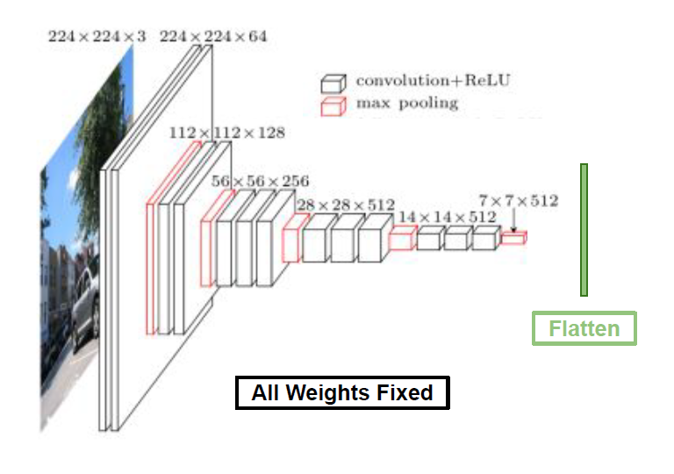
Base 2: VGG16 with Fixed Weights
Convolutional Base 2 Architecture. Source image was obtained from heuritech and modified.⁷

Slide 22
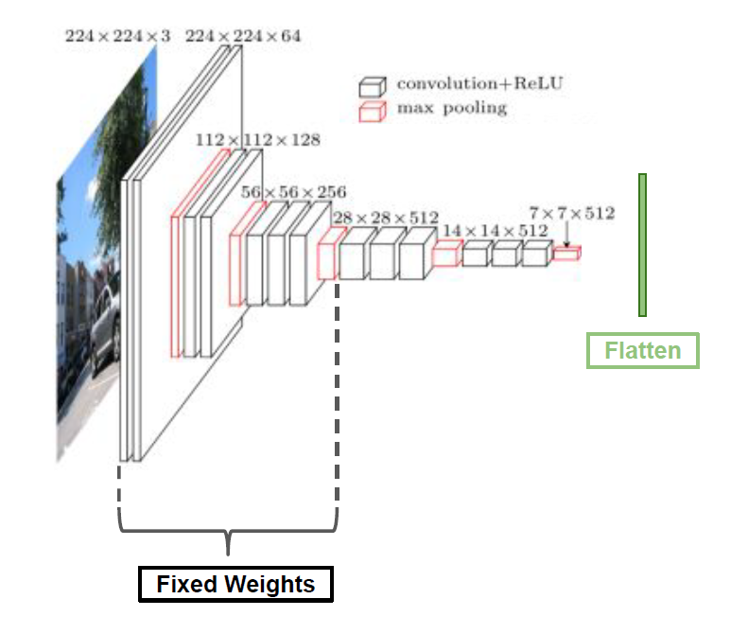
Base 3: VGG16 with Fine-Tuning
Convolutional Base 3 Architecture.
Source image was obtained from heuritech and modified.⁷

Slide 23
Model Fitting
The models were fit using Keras with a Tensorflow Backend:
Adam optimization
Loss: Categorical Cross-Entropy
100 Epochs
Training data were generated in batches with image augmentation.
Validation data were generated in batches without image augmentation.

Slide 24
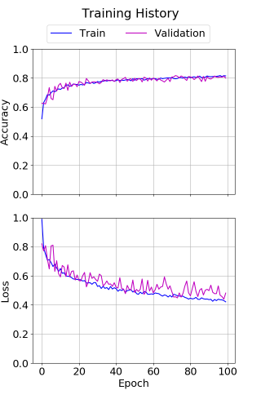
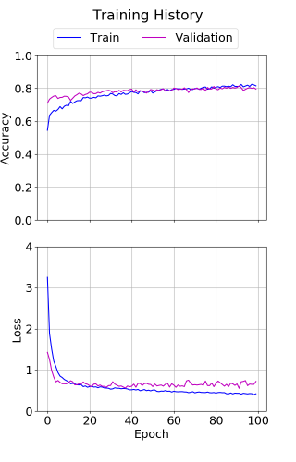
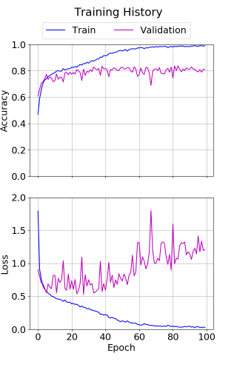
Training Histories
Model 1
Model 2
Model 3
Model 3 shows signs of overfitting.

Slide 25
Analysis Part 3
Model Evaluation

Slide 26
Evaluation Criteria
The predictive performances of models 1 and 2 were evaluated using image data from the test set. Model 3 was not evaluated because its training history showed signs of overfitting.
Evaluation metrics:
Bacterial pneumonia recall.
Proportion of viral pneumonia images misclassified as normal.
Weighted average F₁ score.
Metrics 1 and 2 were selected to minimize undertreatment of patients.
Metric 3 was included to favor well-rounded performance. This prevents excessive overtreatment of patients.

Slide 27
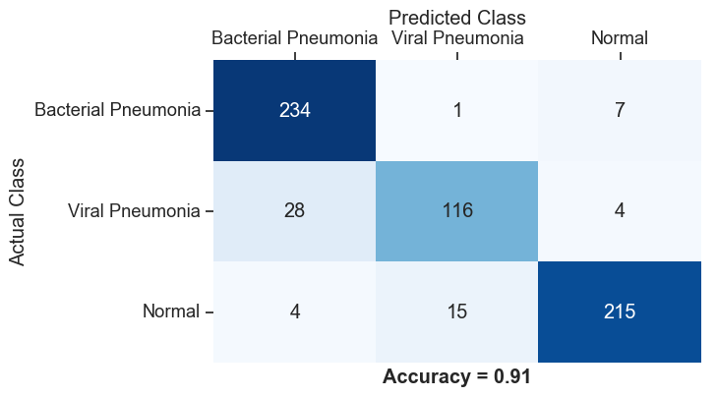
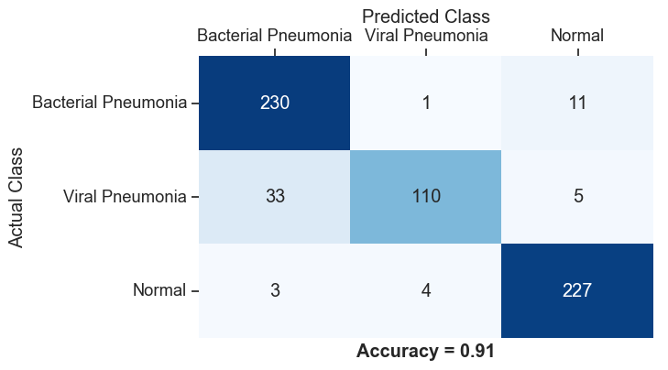
Confusion Matrices
Model 1
Model 2
Both models correctly classified 91 % of the images.
Model 1 misclassified fewer viral pneumonia images as normal than model 2.
Both models showed a tendency to misclassify viral pneumonia images as bacterial pneumonia.

Slide 28
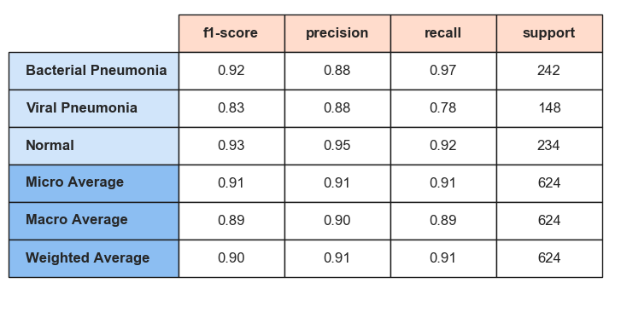

Classification Reports
Model 1
Model 2
Model 1 had a higher score for bacterial pneumonia recall.
Model 2 had a higher weighted average F₁ score.
Both models showed relatively low scores for bacterial pneumonia precision and viral pneumonia recall.

Slide 29
Model Comparison
Evaluation metrics:
Bacterial pneumonia recall.
Proportion of viral pneumonia images misclassified as normal.
Weighted average F₁ score.
Models 1 and 2 each showed advantages and disadvantages with respect to the evaluation criteria.
Evaluation metrics 1 and 2 were prioritized in order to minimize undertreatment of patients.
Model 1 was selected as the best performing model.

Slide 30
Analysis Part 4
Binary Classification

Slide 31
Binary Classification Task
The best model (model 1) was applied to a binary classification task in order to assess its predictive performance in more detail.
The task involved predicting the presence or absence of pneumonia from the images in the test set, without specifying the type of pneumonia.

Slide 32
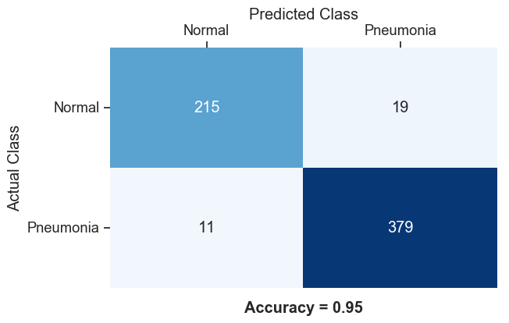
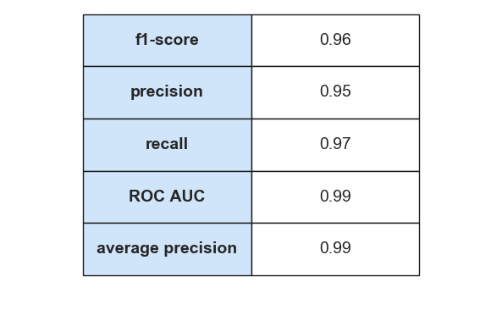
Binary Classification Results 1
95 % of the images were classified correctly.
The confusion matrix indicates the following:
False positive rate of 8.1 %
False negative rate of 2.8 %
The scores indicate strong overall performance.

Slide 33
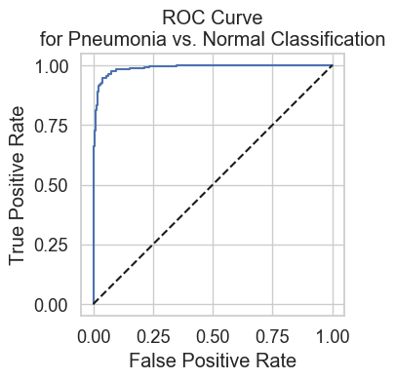
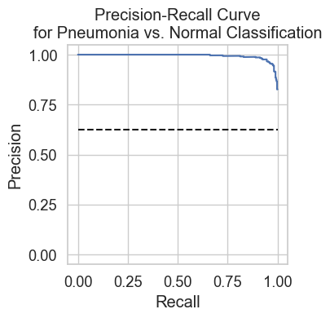
Binary Classification Results 2
Both plots indicate strong performance for a variety of decision thresholds.

Slide 34
Binary Classification Summary
The best model performs well at predicting the presence or absence of pneumonia from a chest X-ray image.
The model’s tendency to misclassify viral pneumonia images as bacterial pneumonia during multi-class classification does not affect its performance for binary classification.

Slide 35
Conclusion

Slide 36
Summary
This project successfully developed a fast, automated, and accurate method for interpreting chest X-ray images.
The results of this project could facilitate diagnosis of pediatric pneumonia, particularly in facilities with limited resources.
The best model from this project performed well for multi-class and binary classification tasks.
The best model showed a tendency to misclassify viral pneumonia images as bacterial pneumonia. This limitation could be circumvented by taking appropriate measures.

Slide 37
Recommendations
Follow up analysis should be performed to evaluate the methods currently used by medical facilities to diagnose pediatric pneumonia.
If the best model from this analysis outperforms the current methods used by a medical facility, then clinicians at that facility could implement this model to facilitate diagnosis of pediatric pneumonia.
Supplemental follow-up testing should be performed if the model predicts the presence of bacterial pneumonia in a patient. This supplemental testing would circumvent the model’s limitations, and confirm the diagnosis before treatment is administered.

Slide 38
Potential Follow-Up Analysis
The results of this analysis could be expanded upon.
Transfer learning might be utilized to develop a new model that outperforms the best model from this analysis.
New models could be explored by:
Creating new convolutional bases.
Creating new classifiers.
Modifying the model fitting procedure.

Slide 39
Thank You!
Any Questions?

Slide 40
Reference List
Pneumonia. World Health Organization Web site. https://www.who.int/news-room/fact-sheets/detail/pneumonia. Published November 7, 2016. Accessed April 30, 2019.
Pneumonia. National Heart, Lung, and Blood Institute Website. https://www.nhlbi.nih.gov/health-topics/pneumonia. Accessed April 30, 2019.
Kermany D, Zhang K, Goldbaum M. Large dataset of labeled optical coherence tomography (OCT) and chest X-ray images. Mendeley Web site. https://data.mendeley.com/datasets/rscbjbr9sj/3. Published June 1, 2018. Accessed April 13, 2019.
Kermany DS, Goldbaum M, Cai W, et al. Identifying medical diagnoses and treatable diseases by image-based deep learning. Cell. 2018;172(5):1122-1131. doi:10.1016/j.cell.2018.02.010.
Karen S, Andrew Z. Very Deep Convolutional Networks for Large-Scale Image Recognition. Paper presented at: 3rd International Conference on Learning Representations; May 7-9, 2015; San Diego, CA. https://arxiv.org/pdf/1409.1556.pdf. Accessed May 30, 2019.
Applications. keras.io. https://keras.io/applications/. Accessed May 1, 2019.
A Brief Report of the Heuritech Deep Learning Meetup #5. heuritech.com. https://blog.heuritech.com/2016/02/29/a-brief-report-of-the-heuritech-deep-learning-meetup-5/. Published February 29, 2016. Accessed May 28, 2019.

