Slide 1
Reports on Goodnotes Subreddit discussion
Jonathan Presto
Dec 2022

Slide 2
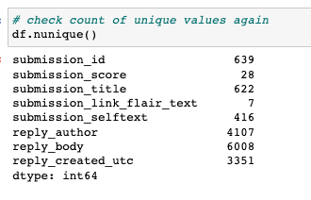
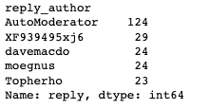
Descriptive Statistics
From Jan 2019 to May 2021, 6008 replies belong to 622 threads in ‘goodnotes’ subreddit.
The top author is a bot named ‘AutoModerator’ that tracks other bots but also promotes the ‘OnlyFans’ subreddit.

Slide 3
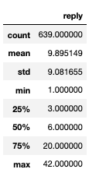
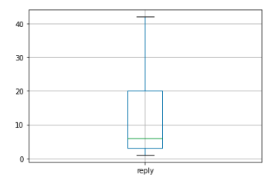
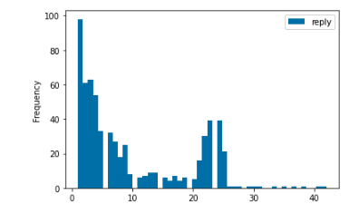
Descriptive Statistics
The median replies per thread is 6 and average is 10.
The top 5 thread with the highest number of replies are typically about errors, tips for using the note-taking app, and sharing resources.

Slide 4
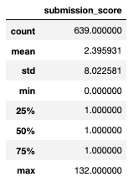
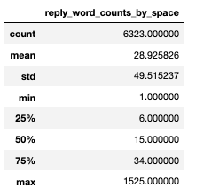
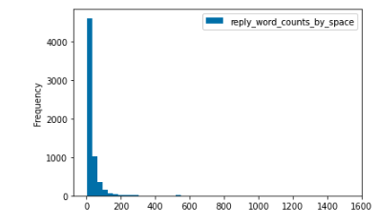
Descriptive Statistics
Median number of upvote for a thread is 1, with the highest thread having 132.
A reply has a median of 15 words, but the distribution appears to be right-skewed.

Slide 5
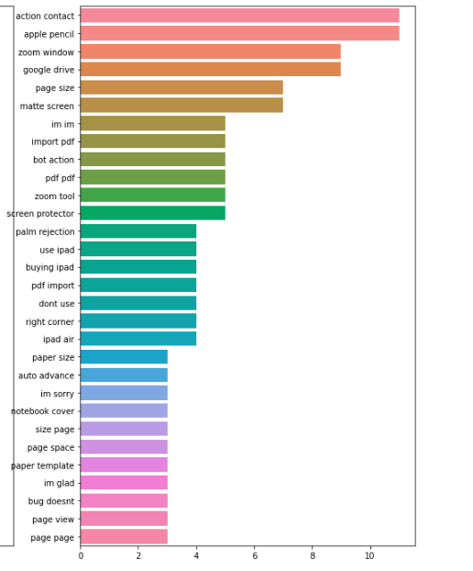
Insights on N-gram and top words
For threads tagged with ‘Question – iPad’, popular topics discussed were about apple pencil, the right page size, and zoom related topics.
There are a lot of auto-replies stating “I am a bot, and this action was performed automatically. Please contact the moderators of this subreddit if you have any questions or concerns.”
A lot of “thank you” and “thanks” in raw text.

Slide 6
LDA Analysis
The topics under tag ‘Question – iPad’ can be grouped into 4 different topics:
Discussions about some bug or problem and users sharing resources to resolve them.
Discussions about the tools (e.g., highlighter, page set-up) for the note-taking app.
Discussions about using the app and how it changed their life and the way they take notes.
Miscellaneous or other topics around pricing, news, etc.

Slide 7
Summary
Users tend to seek other users’ validation or help in the goodnotes subreddit.
Top 5 threads ask for help in resolving errors, tips, and sharing resources.
Top keywords include ”thank you” and “thanks”, indicating replies were helpful in providing some assistance.
Some of the top discussions for ‘Question – iPad’ includes discussing bugs and sharing how they use the app.
The top author is AutoModerator, a self-identified bot that posts things about politics, promote spammy OnlyFan subreddits, and track bugs.

