Slide 1
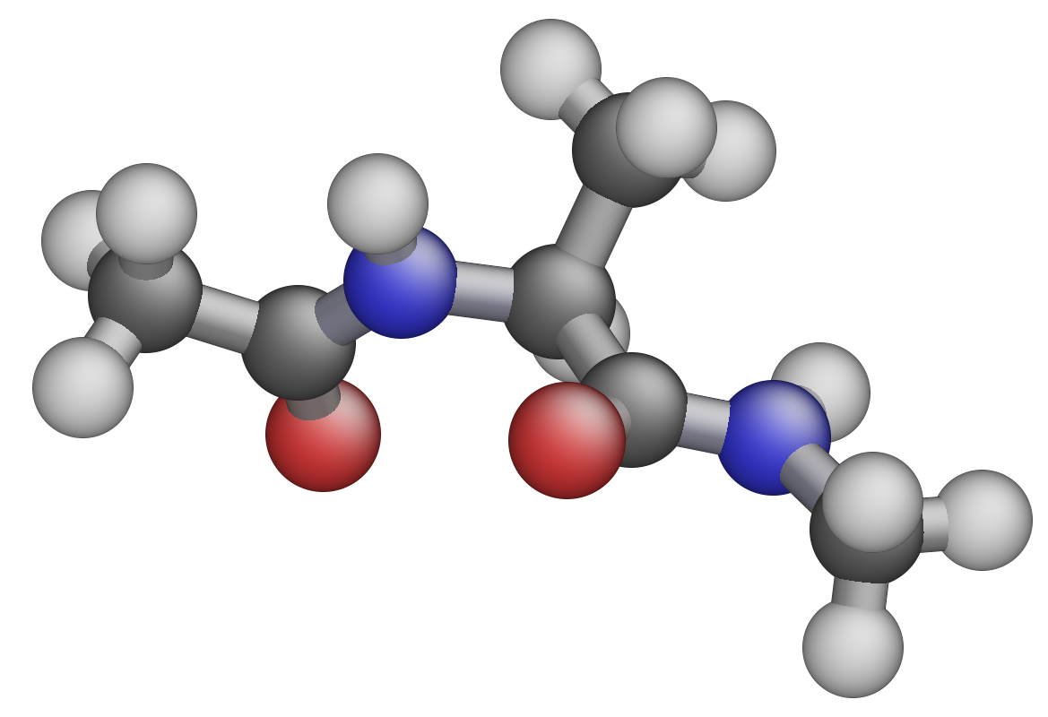
hydrogen
carbon
oxygen
nitrogen

Slide 2
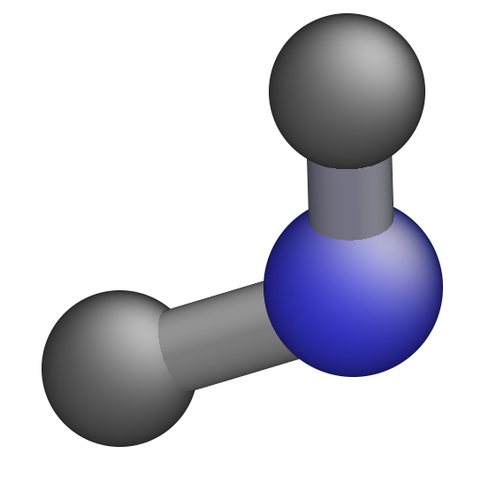
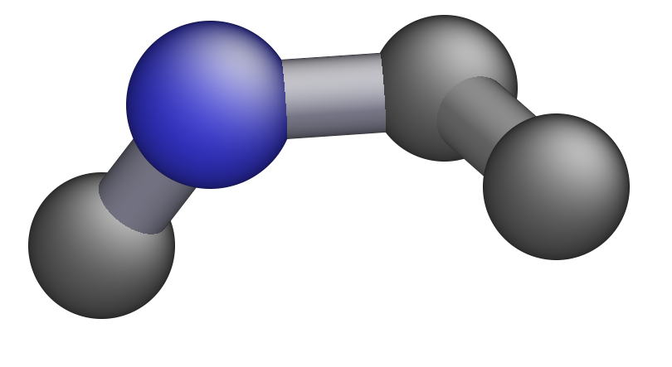
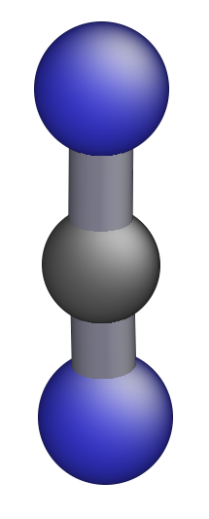
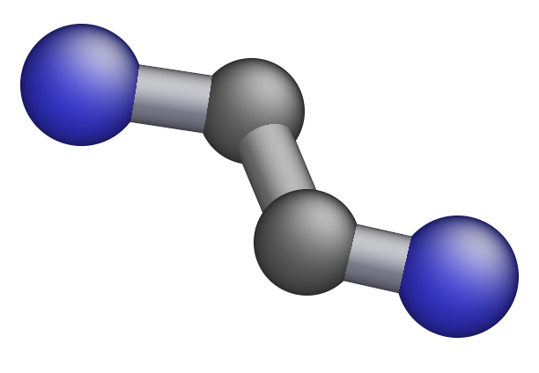
𝜑
𝜓

Slide 3
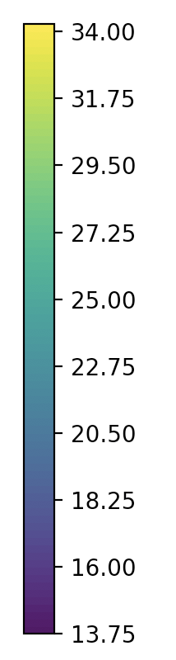

Slide 4
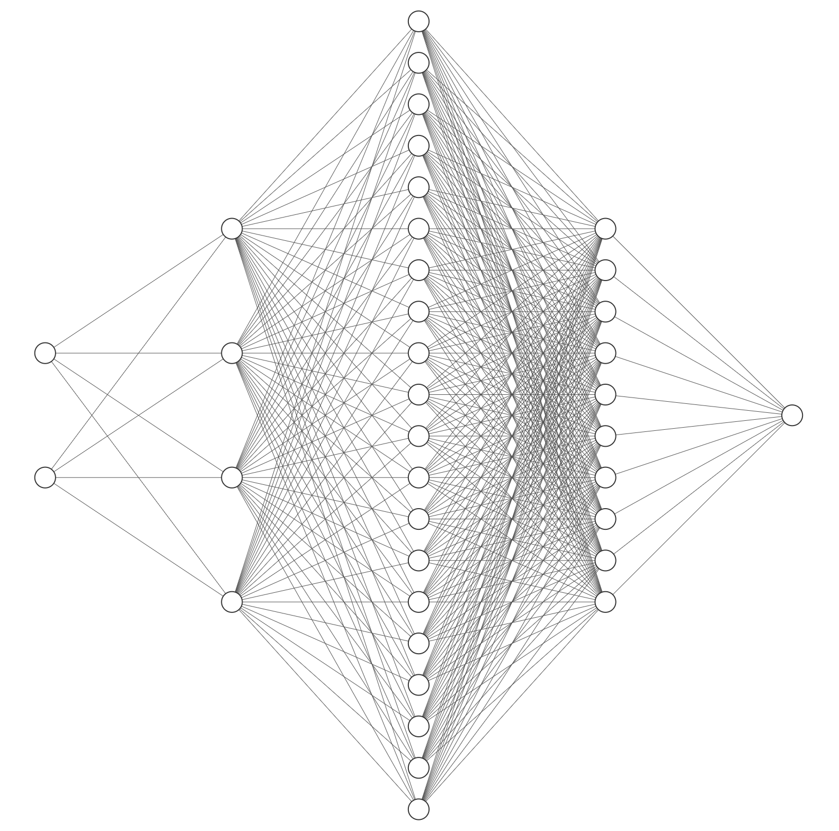
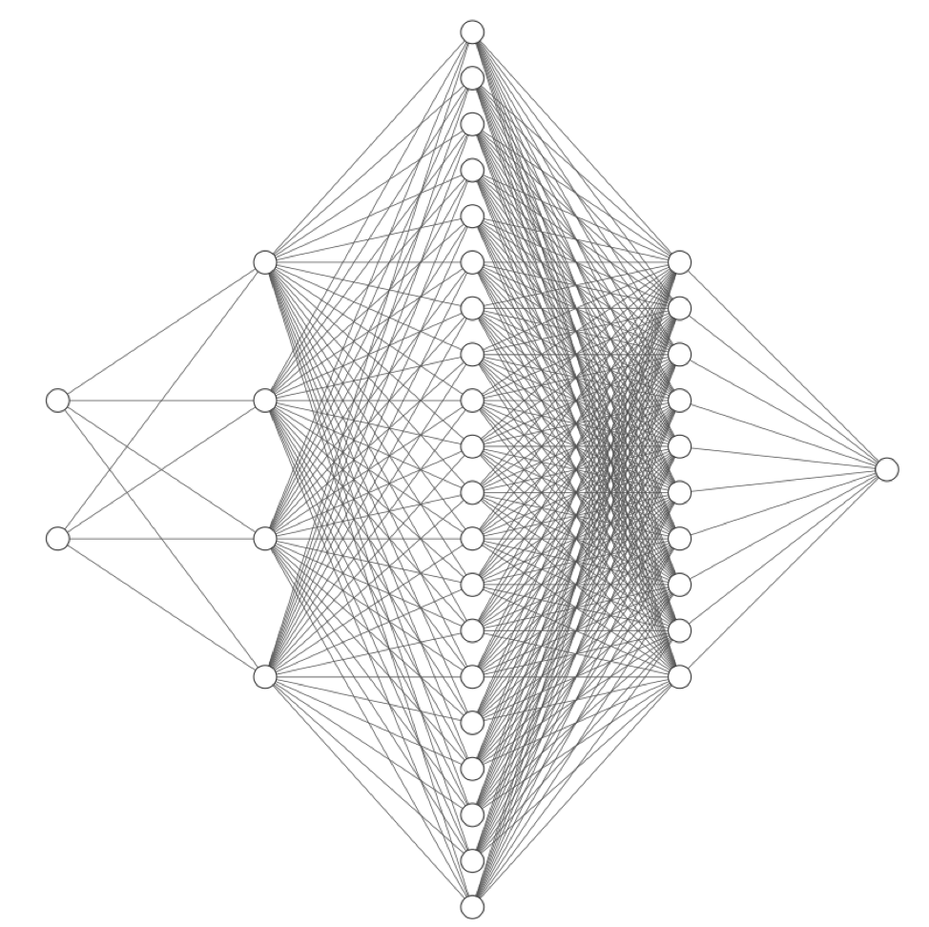
(a)
(b)
sin(𝜓)
cos(𝜓)
𝜓
F
sin(𝜑)
𝜑
cos(𝜑)
Bayesian linear regression

