Slide 1
A* Algorithm
Jonathan Reimels
Notes:
For this assignment, I implemented the A* Algorithm. And found different ways to calculate

Slide 2
Definition
Determines the shortest path between two points
Essentially Dijkstra’s algorithm using a heuristic to more quickly find the shortest path
Notes:
Talk about
A* overall – how it works – compare to others
What it is – algorithm for finding shortest path between two points
Dijkstra’s algorithm – but it uses a heuristic to more quickly find the shortest path

Slide 3
How It Works
Set start node as current node
Loop until end node is set as current node
Open all nodes surrounding current node
Calculate actual distance to each open node from current node
Update actual distance to open node when it is shorter than the current distance
Calculate approximate distance to end node from all open nodes using a heuristic
Close current node and set the open node with the smallest actual distance + approximate distance as current node

Slide 4
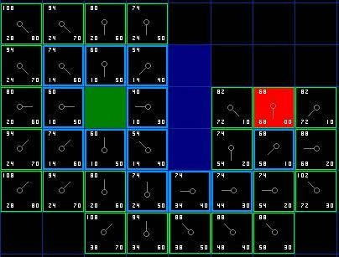
How It Works – Example
Notes:
pictures

Slide 5
A* Algorithm Heuristics
Helps direct toward end node, reducing the number of nodes examined and improving speed of algorithm
Cannot guarantee the shortest path unless an admissible heuristic is used
Admissible heuristics underestimate the distance of a path
Notes:
What makes a heuristic admissible and why there are different heuristics used
A* Star Algorithm
Depending on the heuristic you can improve the speed – in order to guarantee shortest path, need admissible Heuristic
Implemented several heuristics to show how differently A* behaves with different
Show examples of 2 –
dijkstra’s algorithm – no heuristic
Euclidean distance
Diagonal
Manhattan method
Jon’s method – variation of the Manhattan method

Slide 6
Implemented A* Heuristics
Finds the shortest path
Dijkstra’s
Euclidean
Diagonal
May overestimate, thus, not admissible
Manhattan
-
speed +
-
approx +
Notes:
How closely it approximates
Close closer, closest, actual isn’t show, over
Speed of algorithm bar

Slide 7
Observations
The more the heuristic undervalues the distance, the closer A* becomes to Dijkstra’s algorithm
The more the heuristic overvalues the distance, the closer A* becomes to a best search first algorithm
Notes:
What Jon observed using various heuristics – what came up incorrect?

Slide 8
My Heuristic
Goal:
Improve the fastest heuristic by making it admissible
Implementation:
Calculated values for Manhattan Method and halved them to make it admissible
Result:
Runs very slow
May still not be admissible
Notes:
How Jon came up with his own heuristic – why it’s not very good compared to others

Slide 9
Demonstration
Code available on GitHub
https://github.com/jonr22/astar
Notes:
Demo

Slide 10

Questions?
Notes:
Sum up with you learned – hardest part was coming up with my own

