Slide 1
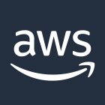
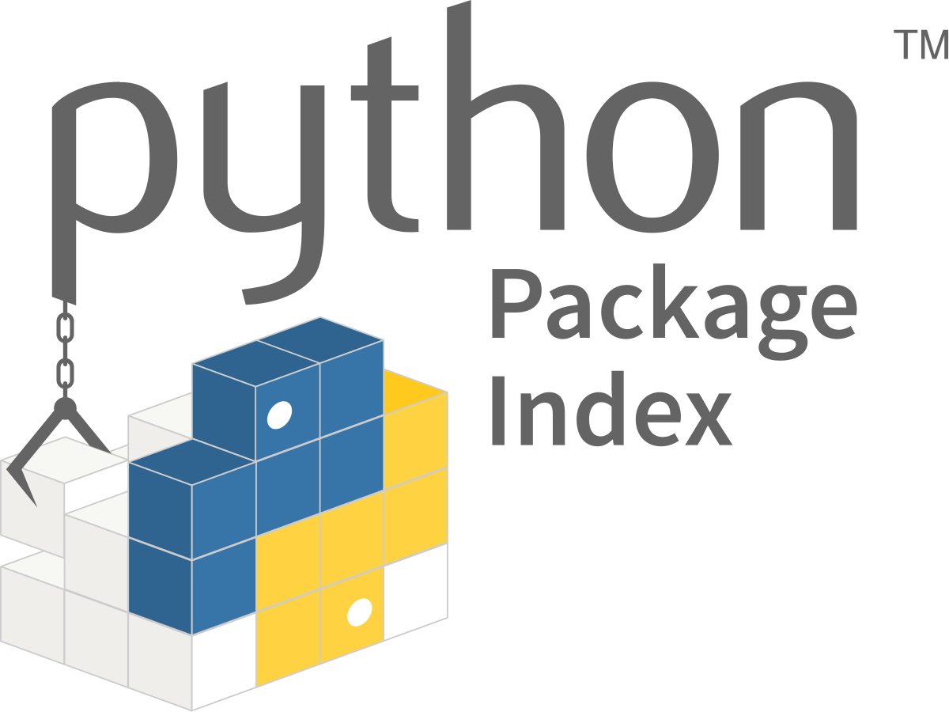
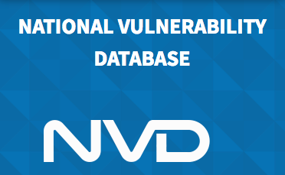
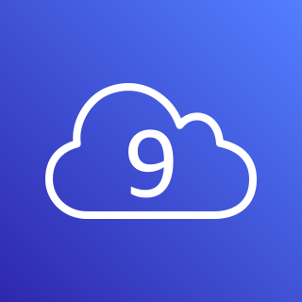
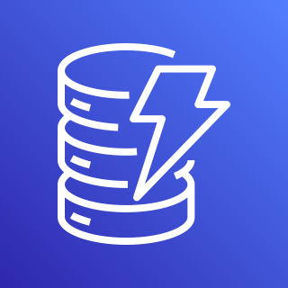
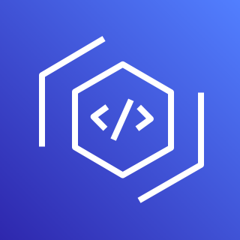
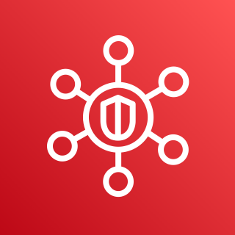
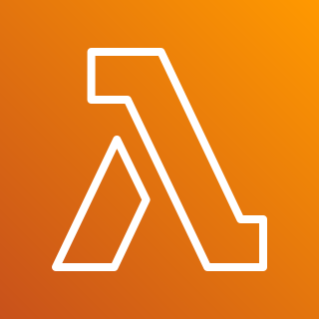
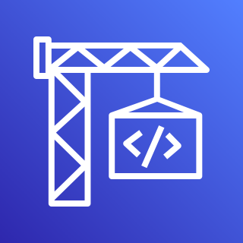
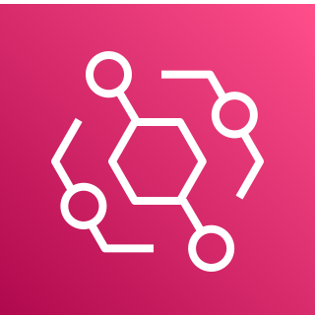
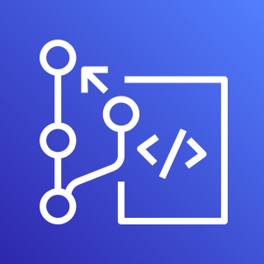

AWS Cloud
1
5
4
NVD JSON Feeds (Yearly)
AWS Cloud9
Amazon DynamoDB
AWS CodeArtifact
AWS Security Hub
6
7
CHANGE THIS FOR EVENT FLOW – ADD EVENT UNDER CODEARTI, AND LAMBDA WHERE CODEBUILD IS
CHANGE TO A MULTI-ACCT/REGION VIEW IN ANOTHER
NVD JSON Feeds (Modified)
AWS Lambda
AWS CodeBuild
2
3
**NIST will update the “Modified” JSON Feed every 2 hours as any downstream CVEs (and their related CPE/CVSS/CWE information changes)
Scheduled Event
(24 Hours)
Amazon EventBridge
AWS CodeCommit

