Slide 1
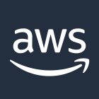
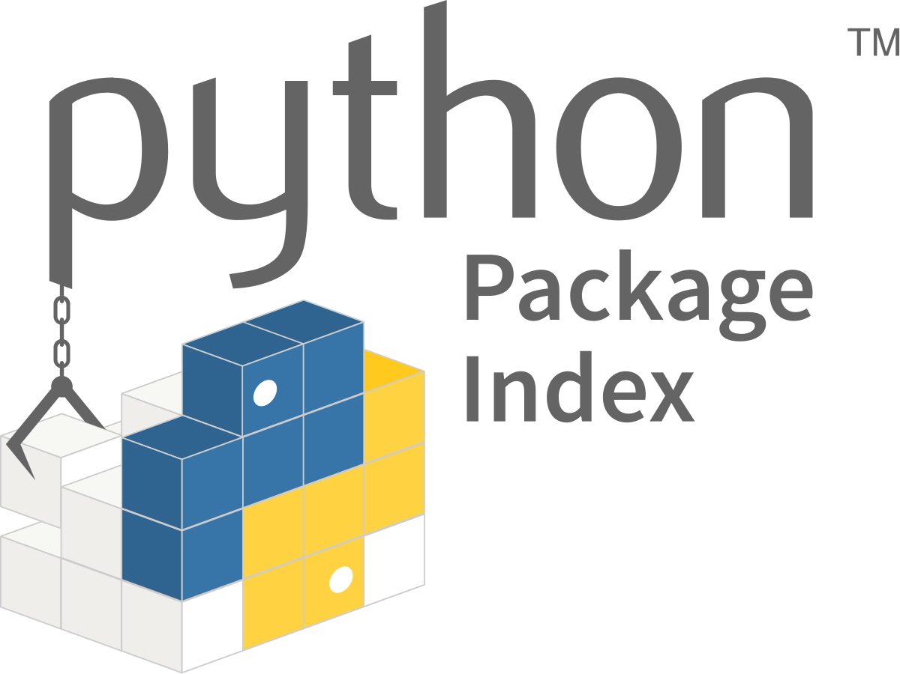
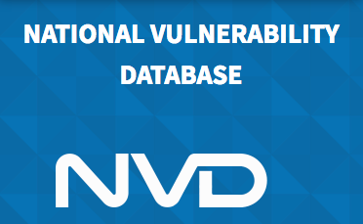
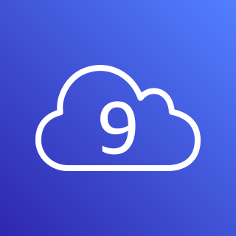
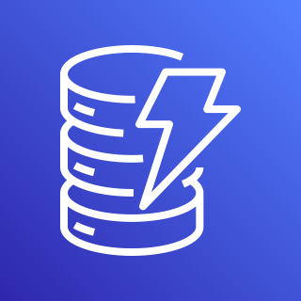
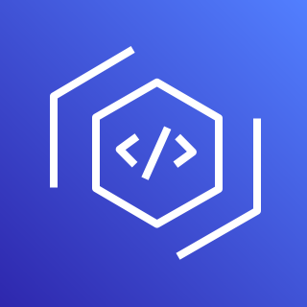
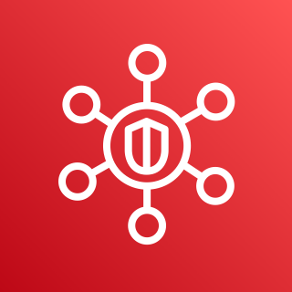
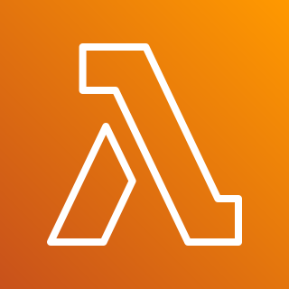
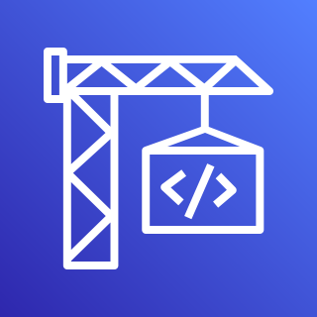
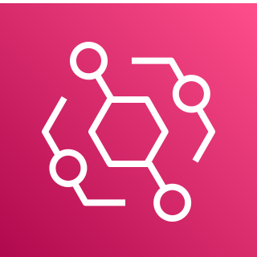
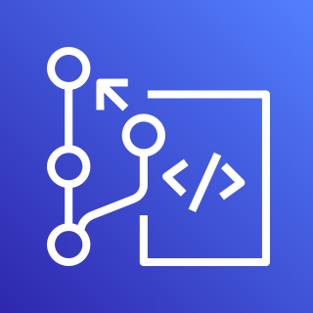

AWS Cloud
1
5
4
NVD JSON Feeds (Yearly)
AWS Cloud9
Amazon DynamoDB
AWS CodeArtifact
AWS Security Hub
6
7
CHANGE THIS FOR EVENT FLOW – ADD EVENT UNDER CODEARTI, AND LAMBDA WHERE CODEBUILD IS
CHANGE TO A MULTI-ACCT/REGION VIEW IN ANOTHER
NVD JSON Feeds (Modified)
AWS Lambda
AWS CodeBuild
2
3
**NIST will update the “Modified” JSON Feed every 2 hours as any downstream CVEs (and their related CPE/CVSS/CWE information changes)
Scheduled Event
(24 Hours)
Amazon EventBridge
AWS CodeCommit

Slide 2
AWS Cloud
1
5
4
NVD JSON Feeds (Yearly)
AWS Cloud9
Amazon DynamoDB
AWS CodeArtifact
AWS Security Hub
6
7
NVD JSON Feeds (Modified)
AWS Lambda
AWS CodeBuild
Event
2
3
**NIST will update the “Modified” JSON Feed every 2 hours as any downstream CVEs (and their related CPE/CVSS/CWE information changes)
Scheduled Event
(24 Hours)
Amazon EventBridge

Slide 3

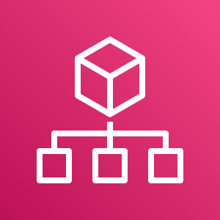

**NIST will update the “Modified” JSON Feed every 2 hours as any downstream CVEs (and their related CPE/CVSS/CWE information changes)
NVD JSON Feeds (Yearly)
NVD JSON Feeds (Modified)
AWS Cloud
AWS Security Account
Member Account n + 1
1
2
6
3
AWS Cloud9
AWS Lambda
Scheduled Event
(24 Hours)
AWS CodeArtifact
Event
4
Amazon DynamoDB
IAM Role
AWS Lambda
**Note: DynamoDB Table containing vulnerable packages and the refresh job needs to only live in a single AWS Region.
IAM Role dependent on AWS Organizations ID condition key for Trust Policy.
7
5
AWS Security Hub
Master
AWS Security Hub

