Slide 1
D3 + Google Maps
Jeff Allen, Jon Roberts

Slide 2
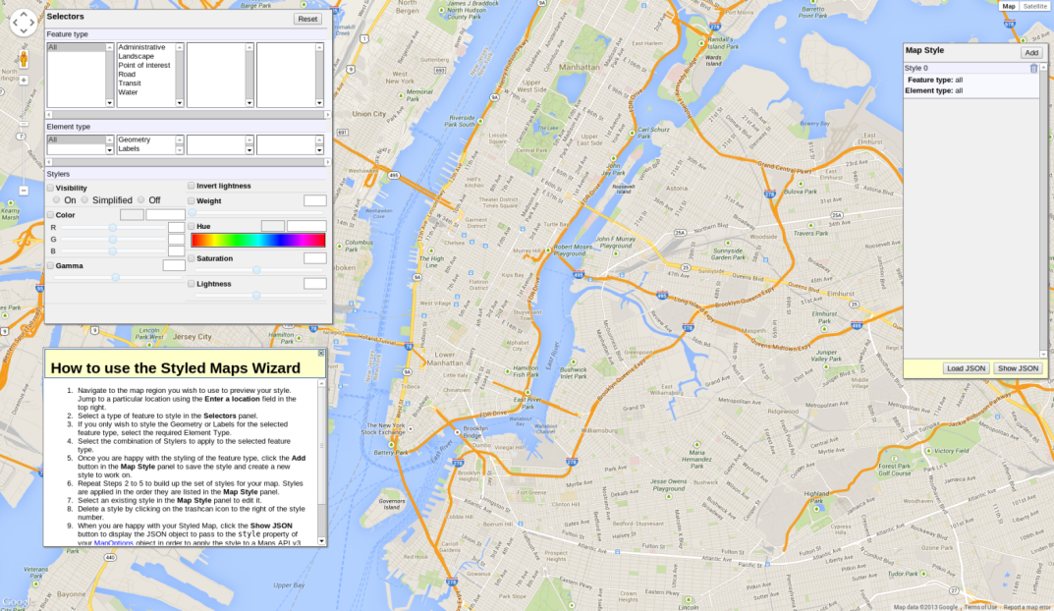
Styling Google Maps
Google maps colors
  Great for readability
  Horrible to plot over

Slide 3
Styling Google Maps
Fortunately, highly customizable!
Style sheet effects
  Remove labels
  Remove icons
  Change colors
http://www.dwzone-it.com/StyledMapWizard/StyledMapWizard.asp
Or “google maps style wizard”

Slide 4
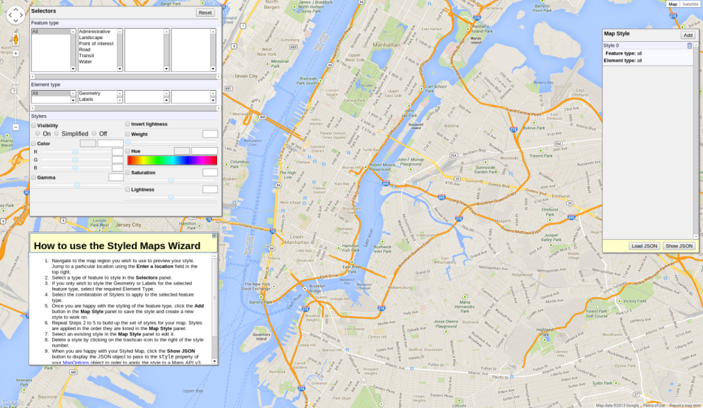
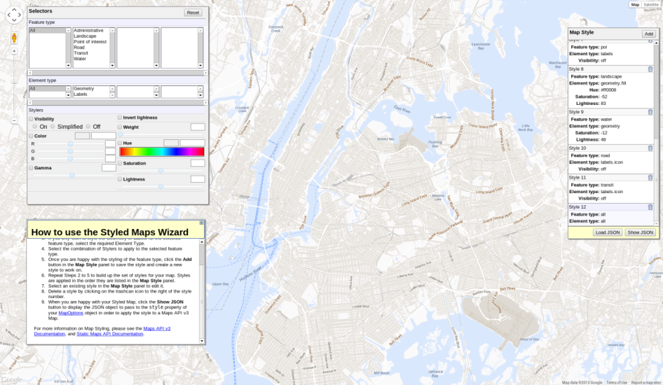
Styling Google Maps

Slide 5
Linking Google Maps and D3
Basic necessities for D3 map
  Div to draw in
  Coordinate transformation/projection
Provided by standard mapping APIs!
Here, Google Maps will give us
  “Overlay” div to draw in
  Lon,Lat -> Div x,y
D3 plays nicely with Google Maps
  Easy to link Google projection to D3 path()
  Standard D3 drawing
  Google Maps automatically pans and zooms map
Useful tutorial: http://bl.ocks.org/mbostock/899711

Slide 6
Plotting Flow with Google Maps
Google D3
Create standard Google Map
Create Google Map overlay
Create D3 SVG elements in overlay
Get Google Map projection
Standard D3 plotting

Slide 7
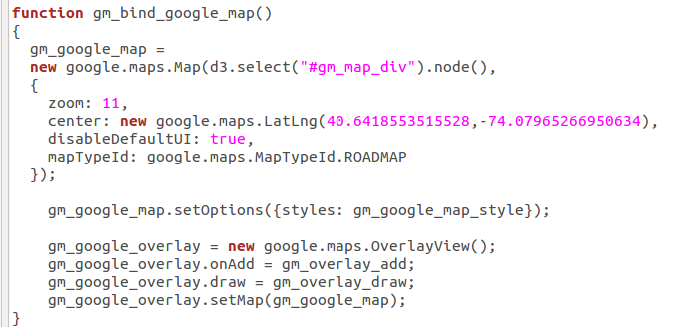
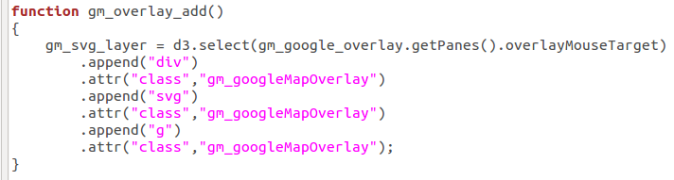
Initialization

Slide 8
Initialization
Create Google map and initialize

Slide 9
Initialization
Create overlay and initialize

Slide 10
Initialization
Create D3 SVG elements

Slide 11
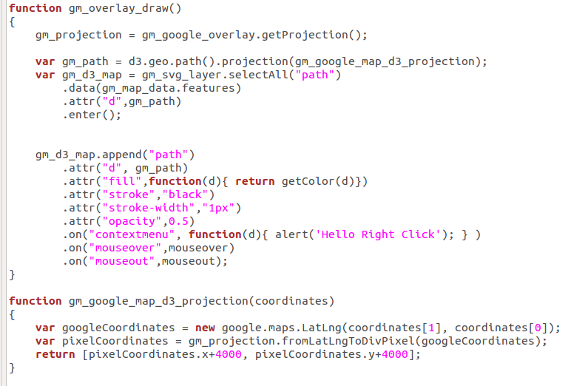
Drawing

Slide 12
Drawing
Get current projection for Google map

Slide 13
Drawing
Simple function to translate Google->D3! ☺

Slide 14
Drawing
Standard D3 plotting!

