Slide 1

Chess Game Analysis

Slide 2
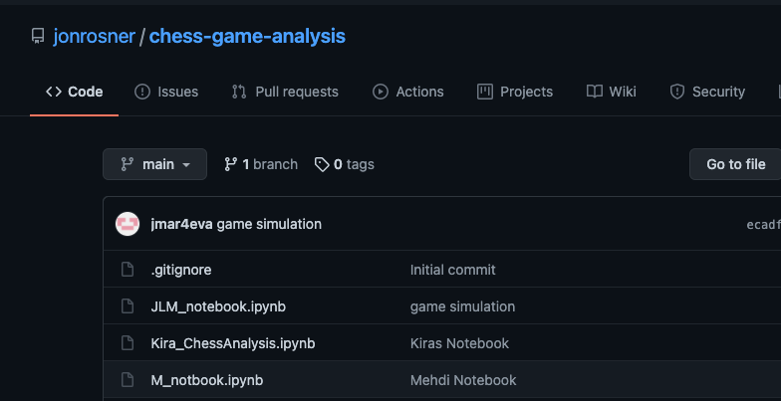
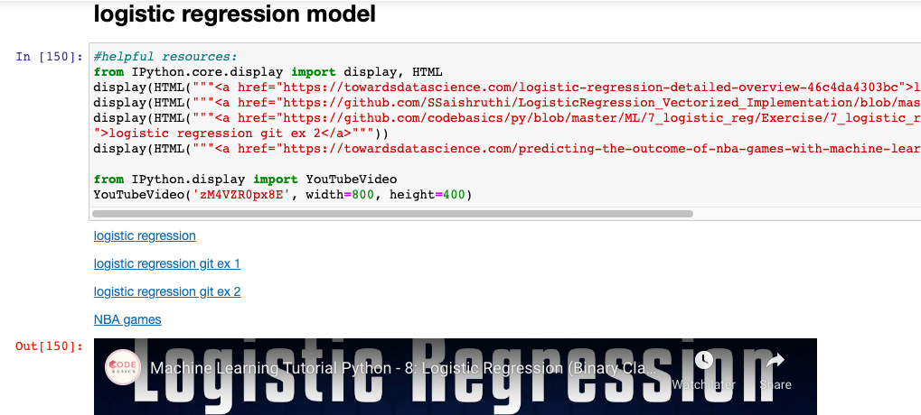
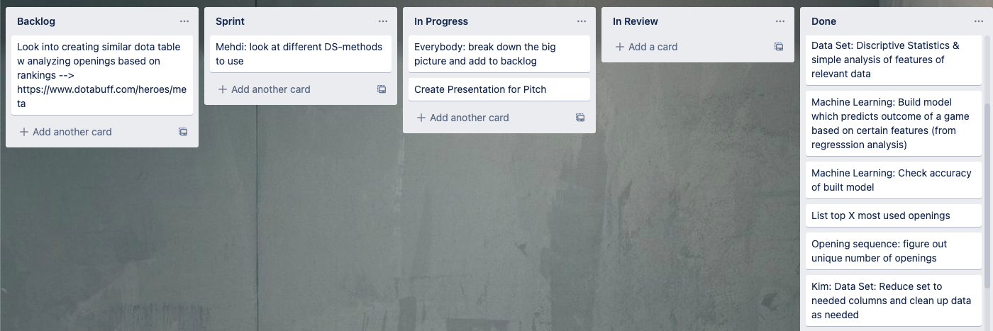
Project Description and Setup
Motivation & goal of the project
Improve understanding of features of a chess game that contribute to a victory
Determine which opening sequences are most closely correlated with winning a game and learn those for casual chess playing
Build model to predict outcome of chess game based on game features
Data & programming languages / utilities used
Kaggle dataset of over 20,000 games with 16 features (player ranking, moves, openings, etc.)
Used Python 3
Pandas, Numpy, Seaborn, and sklearn libraries were used extensively
Used Jupyter Notebooks to write and execute code
Used Github to share code and Trello to help organize work
Data Science | Web Development
✓

Slide 3
Approach and Results
Approach to solve the challenge
Explore dataset and create initial visualizations to help us understand what we were working with better
Consider which types of models would fit best for dataset and what we were trying to predict
Clean and prepare data for models
Do initial attempts at models and examine results
Attempt to tweak models and try variations to see if results could be improved
Final results
Identified most common openings and correlation between different variables in data set
Created a logistic regression model and random forest model
Used logistic regression model to identify 20 most impactful variables and created a reduced model with only these variables that reduced computing time and performed similarly well
Created a model that was trained with each step of a game and that could be given a game and return the expected

Slide 4
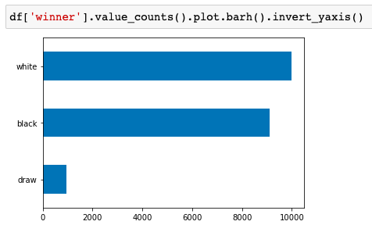
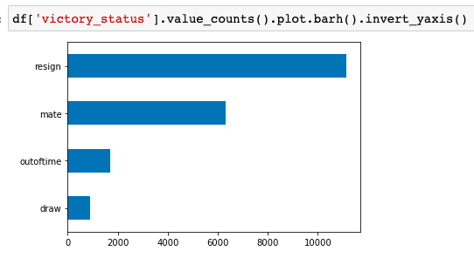
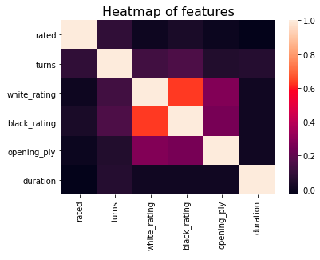
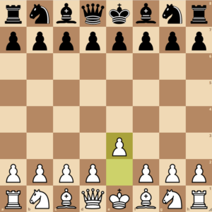
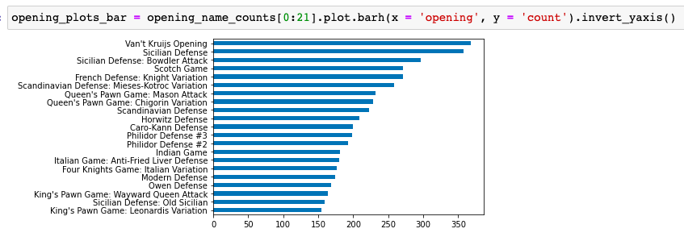
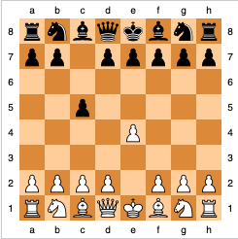
Initial Visualizations and Opening Analysis

Slide 5
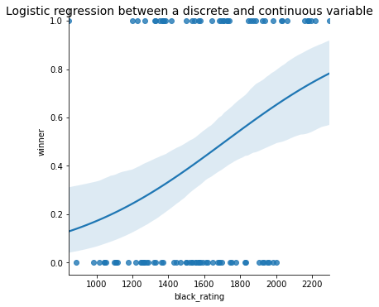
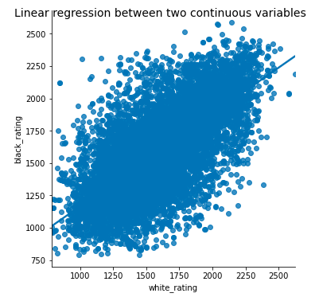
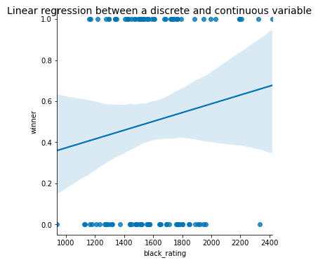
Model Selection

Slide 6
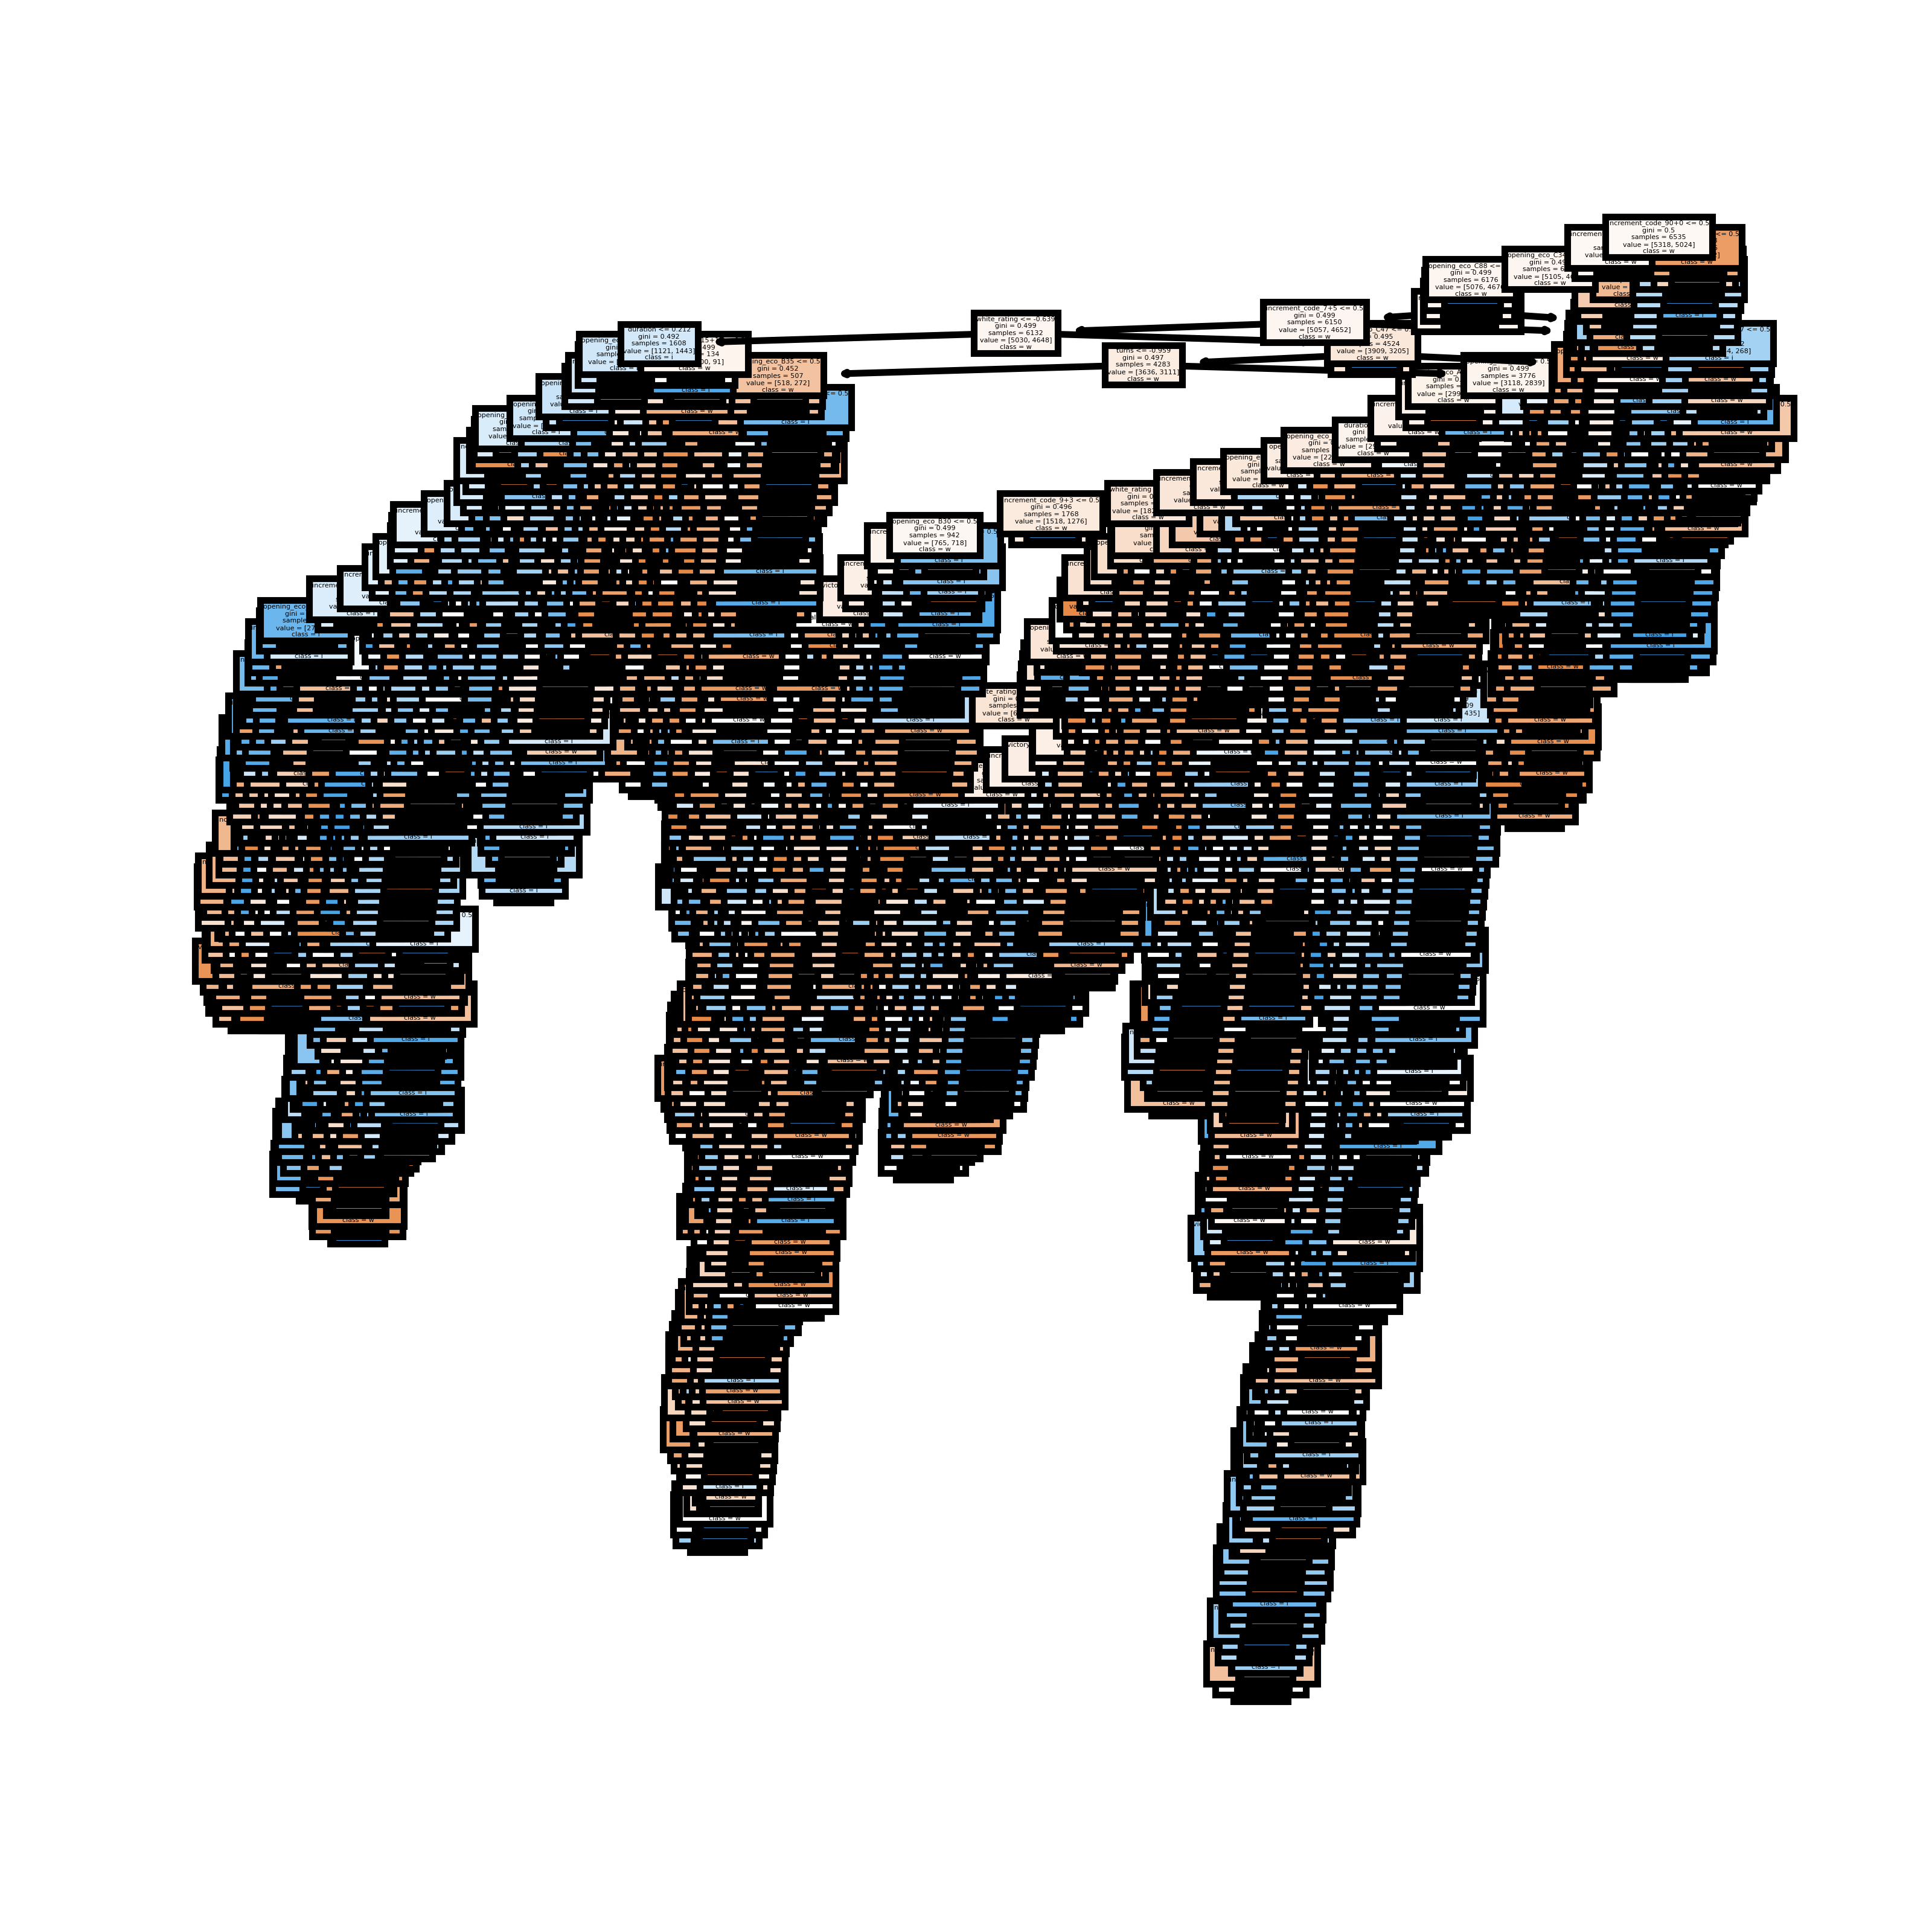
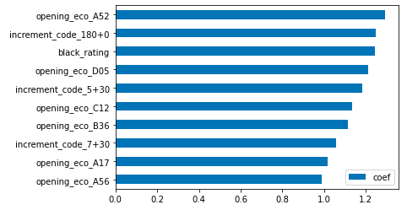
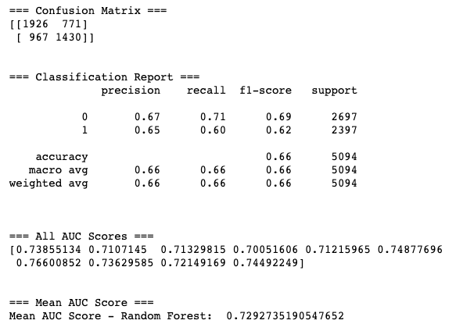
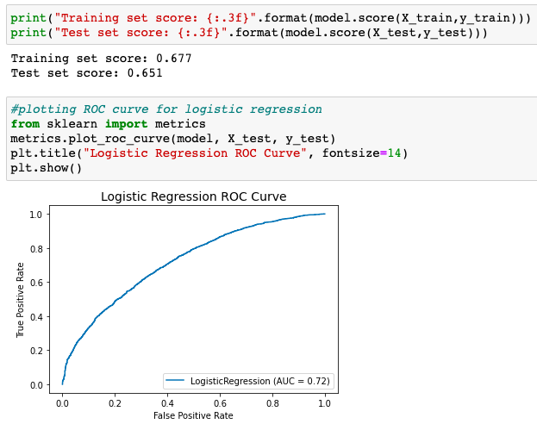
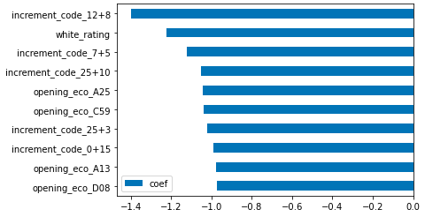
Model Outcome

Slide 7
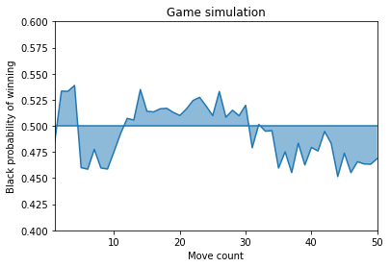
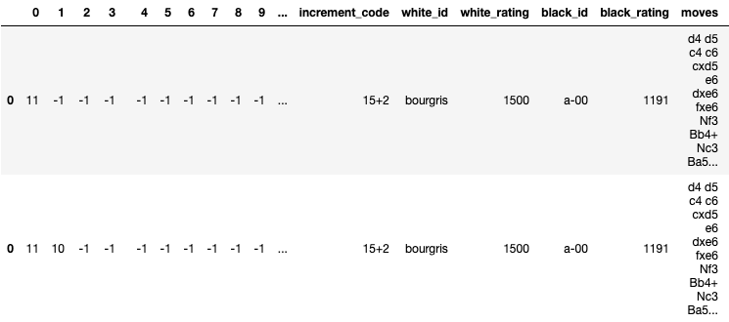
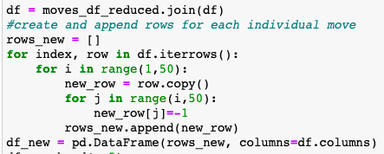

Game Simulation

